Slide 1
An Analysis of Machine Learning and Deep Learning approaches to Sarcasm Detection in Online Text
Student: Molly Hayward
Supervisor: Noura Al-Moubayed
27th January 2020
Level 3 Computer Science (G400)
Notes:
Introduce myself
Level 3 Computer Science student and my project is on machine learning and deep learning approaches to detecting sarcasm in online text
Solving a classification problem of determining whether a snippet of text is sarcastic or non-sarcastic

Slide 2


Presentation Outline
Motivation
Context and Background
Approach
Deliverables and Accomplishments
Summary
Notes:
Why did I choose this project, why is this work necessary?
What has been achieved in this domain already, and what my project aims to achieve
What is my approach to this problem? Discussing the model pipeline
Finally, we will discuss project deliverables and what has been accomplished so far

Slide 3
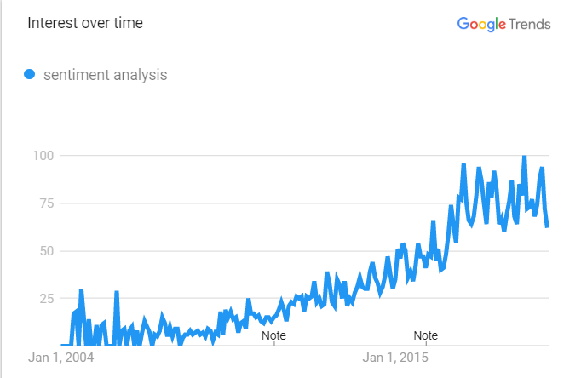
Why is this work necessary?
1. Sentiment analysis is big business
Useful for gauging public opinion on products and services
Notes:
Sentiment Analysis is big business
To better explain why this work is necessary, I will first talk about Sentiment analysis
Sentiment analysis is a task within natural language processing, where snippets of text are assigned a sentiment polarity score, or simply a label of negative, neutral, or positive.
Graph shows that interest in sentiment analysis has been growing steadily since 2004, and its popularity is usually attributed to its applications in opinion mining
This is where companies used automated tools to scrape social media platforms for posts that refer to their products, then score them to determine whether the author likes or dislikes their product
- We have long seen companies sending out surveys and asking for feedback, spending money to gauge public opinion on their products and services
However, on social media, we often publish our opinions online for the world to see, presenting a unique opportunity for organisations to harness this information on a much larger scale, and for a lot less money

Slide 4
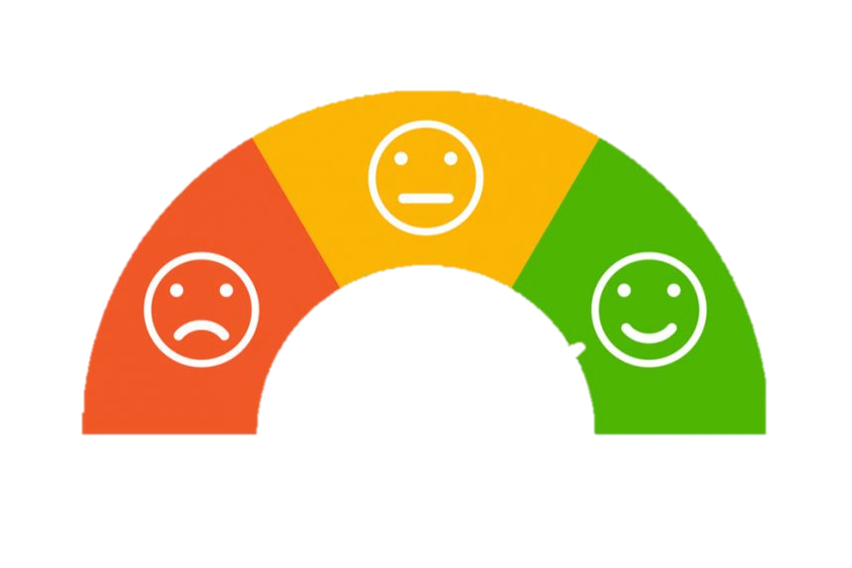
Why is this work necessary?
1. Sentiment analysis is big business
Useful for gauging public opinion on products and services
Sentiment analysers cannot detect sarcasm
Wow! I love when my train is four hours late.
Work in the morning. Yay.
Oh hey it’s raining again what a lovely surprise!
Notes:
The issue here, is that sentiment analysers wrongly classify sarcastic statements, because they often contain words with opposite sentiment
- If we take a look at some real examples of sarcastic tweets
- They often contain words of opposite sentiment polarity
- We observe that people are more inclined to be sarcastic about subjects such as weather and work.

Slide 5
Why is this work necessary?
1. Sentiment analysis is big business
Useful for gauging public opinion on products and services
Sentiment analysers cannot detect sarcasm
2. Sarcasm detection is difficult for humans
Different cultures interpret sarcasm differently
Developmental disorders make detecting sarcasm even harder
Notes:
- If we take a look at some real examples of sarcastic tweets
- They often contain words of opposite sentiment polarity
We observe that people are more inclined to be sarcastic about subjects such as weather and work.
Sarcasm detection is difficult for humans
Human agreement rates are low – 72% in a 2011 study by Gonzalez-Ibanez

Slide 6
Sarcasm Detection Timeline
2010
Semi-Supervised Approach using syntactic and pattern-based features (Tsur et al.)
2011
Support Vector machine (González-Ibánez et al)
2013
Naïve Bayes classifier (Reyes et al)
2014
Random Forest classifier (Barbieri et al)
2015
Recurrent Neural Network (Zhang et al)
2016
Hierarchical Attention Network (Yang et al)
2017
Convolutional Neural Network (Poria et al)
2018
Bidirectional Long Short-Term Memory Model “DeepMoji” (Felbo et al)
Notes:
- If we take a look at some real examples of sarcastic tweets
- They often contain words of opposite sentiment polarity
We observe that people are more inclined to be sarcastic about subjects such as weather and work.
Sarcasm detection is difficult for humans
Human agreement rates are low – 72% in a 2011 study by Gonzalez-Ibanez

Slide 7
Project Aims
Analyse performance of machine learning and deep learning classification models
Develop an interface for the best-performing trained model
Apply sarcasm detection as a pre-filtering step to sentiment analysis
Notes:
Seeing which techniques work, trying to determine why
Include visualisation of attention weights, showing which words and phrases likely lead to the sarcastic or non-sarcastic conclusion
Determine whether it is viable to apply sarcasm detection as a pre-step to sentiment analysis, reversing the polarity of sarcastic phrases

Slide 8






Model Pipeline
Data Pre-processing
Feature Extraction
Classification
Evaluation
Notes:
First, the data is obtained and pre-processed, removing clutter and “bad” data
- Next, the text is transformed into numerical vectors, or features, which are then used to train a classifier
Finally, the performance of the model is evaluated
We will now delve deeper into each of these stages

Slide 9
Model Pipeline
Data Pre-processing
@BAirways my flight is delayyyyyed AGAIN!! always a pleasure travelling with you #neveragain
@BAirways my flight is delayyyyyed AGAIN!! always a pleasure travelling with you
@BAirways my flight is delayyyyyed again always a pleasure travelling with you
@BAirways my flight is delayed again always a pleasure traveling with you
@BAirways my flight is delayed again always a pleasure traveling with you
Notes:
In this domain, datasets are inherently messy because the content is generated by users
Data cleaning helps to reduce sparsity in the dataset
User mentions
Spelling errors
Hashtags
URLs
Punctuation
Stopwords
Remove user mentions, punctuation and hashtags
Convert to lowercase
Remove repeated letters (attempt to correct spelling is never perfect)
Remove stopwords (useless words)
This makes the sentiment incongruity very apparent
Problem: These steps could remove useful features
- Sentiment can be expressed in hashtags
- Context could arise from user mentions
Capitalisation could be used for emphasis
There is a tradeoff to be made between reducing sparsity and removing features
Garbage in = Garbage out
We have to be careful not to remove useful features

Slide 10
Model Pipeline
Data Pre-processing
Feature Extraction
Classification
Evaluation
Cleaned and labelled dataset
Notes:
Once the data has been sufficiently cleaned, we begin extracting features

Slide 11
Model Pipeline
Feature Extraction
KEY POINT
Text must be converted to numerical vectors that can be used to train our classification models
Three main categories:
Traditional Approaches
Word Embeddings
Contextualized Word Embeddings
Notes:
Once the data has been sufficiently cleaned, we begin extracting features
Key thing to note is that in Natural language processing, we need to convert textual represetnations of data into numerical representations

Slide 12

Model Pipeline
Feature Extraction
Traditional Approaches
Bag of Words
Bag of N-grams
e.g. N = 4
the frog sat on log cat mat
the frog sat on the log
the frog sat on the log
[ 2 1 1 1 1 0 0 ]
Vocabulary
the cat sat on the mat
[ 2 0 1 1 0 1 0 ]
thef hefr efro frog rogs ogsa gsat …
Advantages and Disadvantages:
Very easy to implement
Feature set is very sparse for large vocabularies
Notes:
Once the data has been sufficiently cleaned, we begin extracting features
We need to model text as numerical vectors in a process known as vectorization
Bag of Words model
Bag of N-grams (captures a window of context around characters

Slide 13
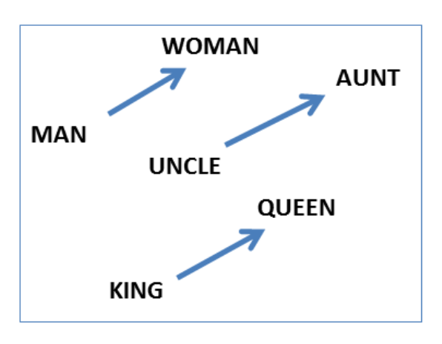
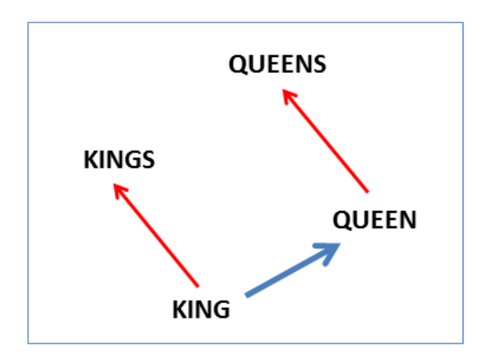
Model Pipeline
Feature Extraction
Word Embeddings
Word2Vec – Shallow neural network
GloVe – Global co-occurrence matrix
(Mikolov et al. 2013)
(Pennington et al. 2014)
Produces vectors for individual words using matrix decomposition
Better at capturing global properties of the corpus
Advantages and Disadvantages:
Successfully models complex properties of language
Does not accommodate polysemy or out-of-vocabulary tokens
Notes:
With Word2Vec, words that share a similar context tend to have colinear vectors (meaning they are clustered together in the feature space)
Preserves the semantic relationships between words
Compose vectors to construct analogies, and capture syntactic regularities
Neither of these approaches capture polysemy → the idea that one word can have two meanings

Slide 14

Model Pipeline
Feature Extraction
Contextualised Embeddings
ELMo – Neural Network
(Peters et al. 2018)
“One of the best state-of-the-art frameworks to extract features from a given text dataset”
Analytics Vidha 2018
Trained neural network
Vectors produced “on the fly”
Character-based
Advantages and Disadvantages:
Constructs robust representations of out-of-vocabulary tokens
Slower in practice (but we can get around this)
Notes:
ELMo (Embeddings from language models)
In ELMo, vectors are produced on the fly
Rather than starting with a database of pre-computed vectors, we begin with a pre-trained ELMo model
We run our data through the model, and vectors are produced
Character-based – therefore robust representations can be constructed for out-of-vocabulary tokens
They are slower in practice, (60 sec glove, 8 hour ELMo). This is a one-time cost if we pre-compute vectors and store them in a database (like in GloVe)

Slide 15
Model Pipeline
Data Pre-processing
Feature Extraction
Classification
Evaluation
Cleaned and labelled dataset
Labelled feature vectors

Slide 16
Model Pipeline
Classification
Training the model
(Feature Vector, label)
(Feature Vector, label)
Training Set
Test Set
Notes:
Two main categories of models:
Machine learning and deep learning models
For both types of model, we have train the model on the training set, so that can learn the underlying patterns in the data

Slide 17
Model Pipeline
Classification
Testing the model
Sarcastic
(Feature Vector)
(Feature Vector)
Non-sarcastic
Training Set
Test Set
Notes:
Finally, we can evaluate the model by running the test set through the model, and comparing the predictions to their ground truth labels
- These predictions are later used for evaluation

Slide 18
Model Pipeline
Classification
Deep Learning Classifiers
Produce state-of-the-art results
Intricate patterns identified
More high-quality data → better results
Training is computationally expensive
Machine Learning Classifiers
Labelled training data is used
High quality data → better predictions
Best performing classifier on my dataset
Structure of a Neural Network
Identify N topics in the dataset
Use each snippet’s share of topics as features
Hidden Layer
Input Layer
Output Layer
e.g. topic #1, topic #2 topic #3, topic #4
Support Vector Machine
Notes:
These classifiers use labelled training data in order to learn patterns that are associated with each category of data
This allows it to classify unseen text into categories without the need for a static linguistic rule set
If the data is high-quality and plentiful, the model can begin to make accurate predictions
Combine with topic modelling (Latent Dirichlet Allocation LDA)
Sci-kit learn has an excellent library of machine learning classifiers, (support vector machines, logistic regression, naïve bayes, random tree classifier)
We can tweak the parameters and see what work best for our model

Slide 19
Model Pipeline
Data Pre-processing
Feature Extraction
Classification
Evaluation
Cleaned and labelled dataset
Labelled feature vectors
Predictions on the training set
Notes:
Finally, one our model has been trained, it must be evaluated

Slide 20
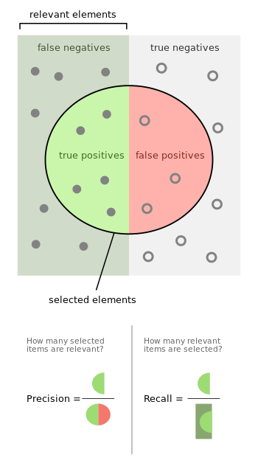
Model Pipeline
Evaluation
Accuracy: What proportion of data is labelled correctly
Precision: What proportion of positives are true positives
Recall: What proportion of true positives are labelled as positive
Notes:
Accuracy
Sarcasm is a minority class
If we train our model on an unbalanced dataset, where we have more negative examples than positive examples
e.g. 90% non-sarcastic and 10% sarcastic, we can achieve 90% accuracy simply by labelling everything as non-sarcastic
Accuracy does not take overfitting into account
Precision: How many items labelled sarcastic, are truly sarcastic
Recall: How many of the sarcastic items are labelled as such

Slide 21
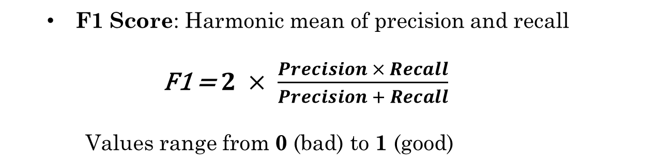
Model Pipeline
Evaluation
F1 Score: Harmonic mean of precision and recall
F1 = $2 × \frac{Precision × Recall}{Precision + Recall}$
Values range from 0 (bad) to 1 (good)
Notes:
F1 Score: Harmonic mean of precision and recall
Considers precision and recall, allowing it to account for overfitting

Slide 22
Model Pipeline
Data Pre-processing
Feature Extraction
Classification
Evaluation
Cleaned and labelled dataset
Labelled feature vectors
Predictions on the training set
Notes:
Once the data has been sufficiently cleaned, we begin extracting features

Slide 23

Project Deliverables
Basic:
Select a high-quality dataset
Implement data-cleaning program
Experiment with machine learning architectures
Evaluate machine-learning classifiers on chosen dataset
= Accomplished
Notes:
Experimented with various combinations of data cleaning techniques
Found that data cleaning is more effective when paired with non-contextualised word vectors
Less cleaning → Contextualized word vectors

Slide 24
Project Deliverables
Intermediate:
Experiment with deep learning architectures
Evaluate deep-learning classifiers on chosen dataset
Identify the best performing model (solution)
Experiment with alternative datasets
= Accomplished

Slide 25
Project Deliverables
Advanced:
Implement an attention-based model
Produce a visualisation of attention words
Explore the impact of using sarcasm detection as a pre-filtering step in sentiment analysis
= Accomplished
The success of the project will be determined by two factors:
Completion of deliverables
Performance of solution
Notes:
The success of the project will be judged on the completion of these deliverables, as well as the

Slide 26





Summary
Data Pre-processing
Feature Extraction
Classification
Evaluation
Sarcasm detection is a difficult problem
Datasets are messy, and cleaning them may remove useful features
We can employ a number of techniques for extracting features
These features are used to train a classification model
We typically use F1 score as a metric for evaluating models

Slide 27

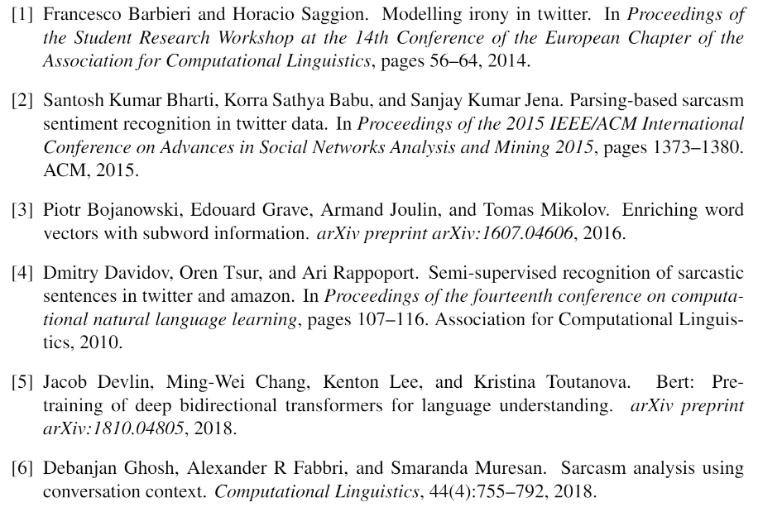
Bibliography – 1/2

Slide 28
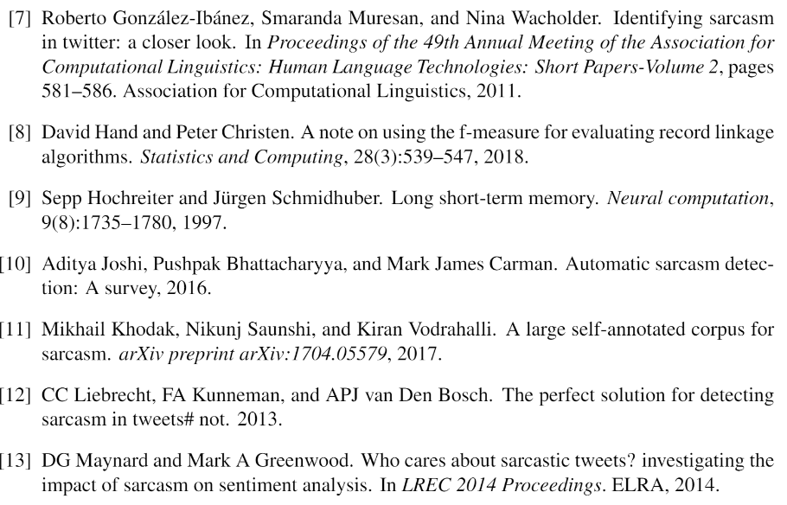
Bibliography – 2/2

