Slide 1
Secure Electronic Voting
By Rob Irwin and Pete Mollica

Slide 2
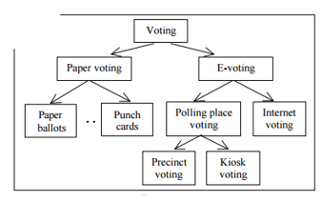
What is Electronic Voting
An electronic voting (e-voting) system is a voting system in which the election data is recorded, stored and processed primarily as digital information.
Network Voting System Standards, VoteHere, Inc., April 2002

Slide 3
Problems

Slide 4
System Security Requirements
Authentication: Only authorized voters should be able to vote.
Uniqueness: No voter should be able to vote more than once.
Accuracy: Voting systems should record the votes correctly
Integrity: Voters should not be able to be modified without detection
Verifiability: Should be possible to verify that votes are correctly counted for the final tally.
Auditability: There should be reliable and demonstrably authentic election results
Secrecy: No one should be able to determine how any individual voted.
*Internet Policy Institute, Report of the National Workshop on Internet Voting: Issues and Research Agenda, USA, March 2001.

Slide 5
System Security Requirements
Non-coercibility: Voters should not be able to prove how they voted.
Flexibility: Equipment should allow for a variety of ballot question formats.
Convenience: Voters should be able to cast votes with minimal equipment and skills.
Certifiability: Systems should be testable against essential criteria.
Transparency: Voters should be able to possess a general understanding of the whole process.
Cost-effectiveness: Systems should be affordable and effient.
*Internet Policy Institute, Report of the National Workshop on Internet Voting: Issues and Research Agenda, USA, March 2001.

Slide 6
Four Stage of Secure Voting
Registration Phase – Prior to election, voters will have to prove that they are eligible to vote and voter credentials are stored in a registration database.
Validation Phase – When the user goes to vote we have to check that their credentials are valid and have not yet voted.
Vote Casting Phase – Voters cast their vote and sent to the tallying database.
Tallying Phase – Votes are tallied quickly and accurately

Slide 7
Registration Phase
Done before the election.
Once a voter is considered eligible to vote their credentials are stored in a registration server database.

Slide 8
Validation Phase
The user will enter their credentials which is checked against the database.

Slide 9
Proposed Method

Slide 10
Current Methods
Homomorphic encryption:
Enc(v1) *...* Enc(vn) = Enc(v1 +...+ vn).

