Slide 1
Secure Electronic Voting
By Rob Irwin and Pete Mollica

Slide 2
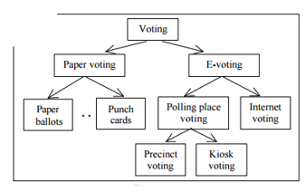
What is Electronic Voting
An electronic voting (e-voting) system is a voting system in which the election data is recorded, stored and processed primarily as digital information.
Network Voting System Standards, VoteHere, Inc., April 2002

Slide 3
Motivation
Eliminate human error in tallying
Cost-effectiveness
Increases voter confidence
Potentially increase voter turnout
Internet-based voting
Immediate Results

Slide 4
Problems
Votes can be altered
Voters may vote more than once
Voter Impersonation
Tallying can be altered
Votes can be tied to voters
Erroneous Communication

Slide 5
System Security Requirements
Authentication: Only authorized voters should be able to vote.
Uniqueness: No voter should be able to vote more than once.
Accuracy: Voting systems should record the votes correctly
Integrity: Votes should not be able to be modified without detection
Verifiability: Should be possible to verify that votes are correctly counted for the final tally.
Auditability: There should be reliable and demonstrably authentic election results
Secrecy: No one should be able to determine how any individual voted.
*Internet Policy Institute, Report of the National Workshop on Internet Voting: Issues and Research Agenda, USA, March 2001.

Slide 6
System Security Requirements
Non-coercibility: Voters should not be able to prove how they voted.
Flexibility: Equipment should allow for a variety of ballot question formats.
Convenience: Voters should be able to cast votes with minimal equipment and skills.
Certifiability: Systems should be testable against essential criteria.
Transparency: Voters should be able to possess a general understanding of the whole process.
Cost-effectiveness: Systems should be affordable and efficient.
*Internet Policy Institute, Report of the National Workshop on Internet Voting: Issues and Research Agenda, USA, March 2001.

Slide 7
Four Stage of Secure Voting
Registration Phase – Prior to election, voters will have to prove that they are eligible to vote and voter credentials are stored in a registration database.
Validation Phase – When the user goes to vote we have to check that their credentials are valid and have not yet voted.
Vote Casting Phase – Voters cast their vote and sent to the tallying database.
Tallying Phase – Votes are tallied quickly and accurately

Slide 8
Registration Phase
Done before the election.
Once a voter is considered eligible to vote their credentials are stored in a registration server database.

Slide 9
Validation Phase
The user will enter their credentials which is checked against the database.
The database is a blockchain.
De-centralized database.
Everyone can read from the blockchain, only authorized users can write
All previous writes are stored in the blockchain

Slide 10
Vote Casting Phase
Votes are sent over an encrypted channel
Encrypted Votes are hashed.

Slide 11
Tallying Phase
Vote is only tallied after the hash is verified

Slide 12
Disassociating Voter/Vote
Once the advisory validates the credentials, the booth initiates communication with the ballot server
Voter can now cast vote, but the ballot server does not know who the vote is coming from.

Slide 13
Proposed Encryption Method
Symmetric Encryption on all channels
AES
Hash encrypted message

Slide 14
Design Topology
1. Send Credentials
Voter Booth:
Enter Credentials
5. Cast Vote
Credential Advisory:
2. Check Registration Status
3. Registration Status
Ballot Server:
7. Tally Vote
8. Close Communication
4. Initiate Communication
6. Send Encrypted Vote

Slide 15
Demo

Slide 16
Problems with Design
Susceptible to man in the middle attacks
If symmetric key is compromised, no mechanism in place to change the key

Slide 17
Proposed Solution
Key Distribution Center
Every time the ballot server opens communication with the booth, both the booth and ballot server request a new symmetric key.
Solves problem of key compromise
Solves man in the middle

Slide 18
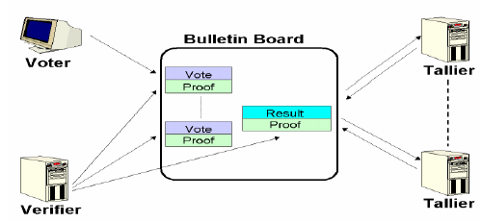
Current Encryption Methods
Homomorphic encryption:
Enc(v1) *...* Enc(vn) = Enc(v1 +...+ vn).

