Slide 1
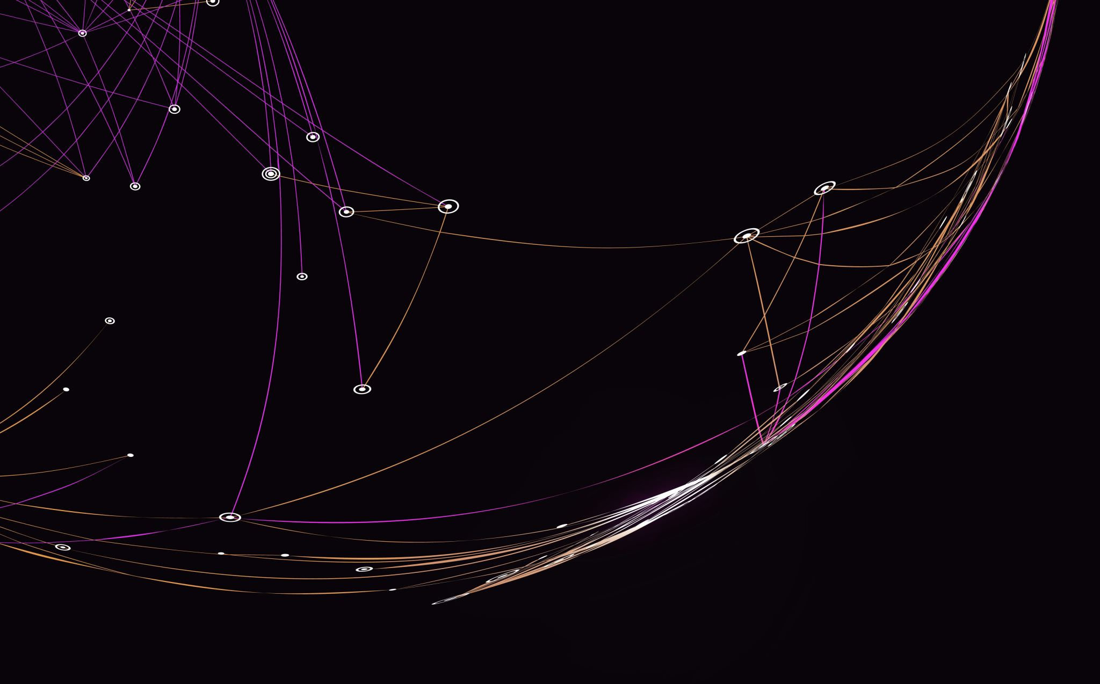
R.A.G.
Retrieval Augmented Generation

Slide 2
Chosen Models - OpenaI - sbert - glove

Slide 3
OpenAI

Slide 4
sbert

Slide 5
glove

Slide 6
Differences

Slide 7
Performance Metrics
 | Relevance | Accuracy | Response Quality
OpenAI
Sbert
Glove

Slide 8
Strengths
OpenAI
SBert
Glove

Slide 9
weaknesses
OpenAI
SBert
Glove

