Slide 1
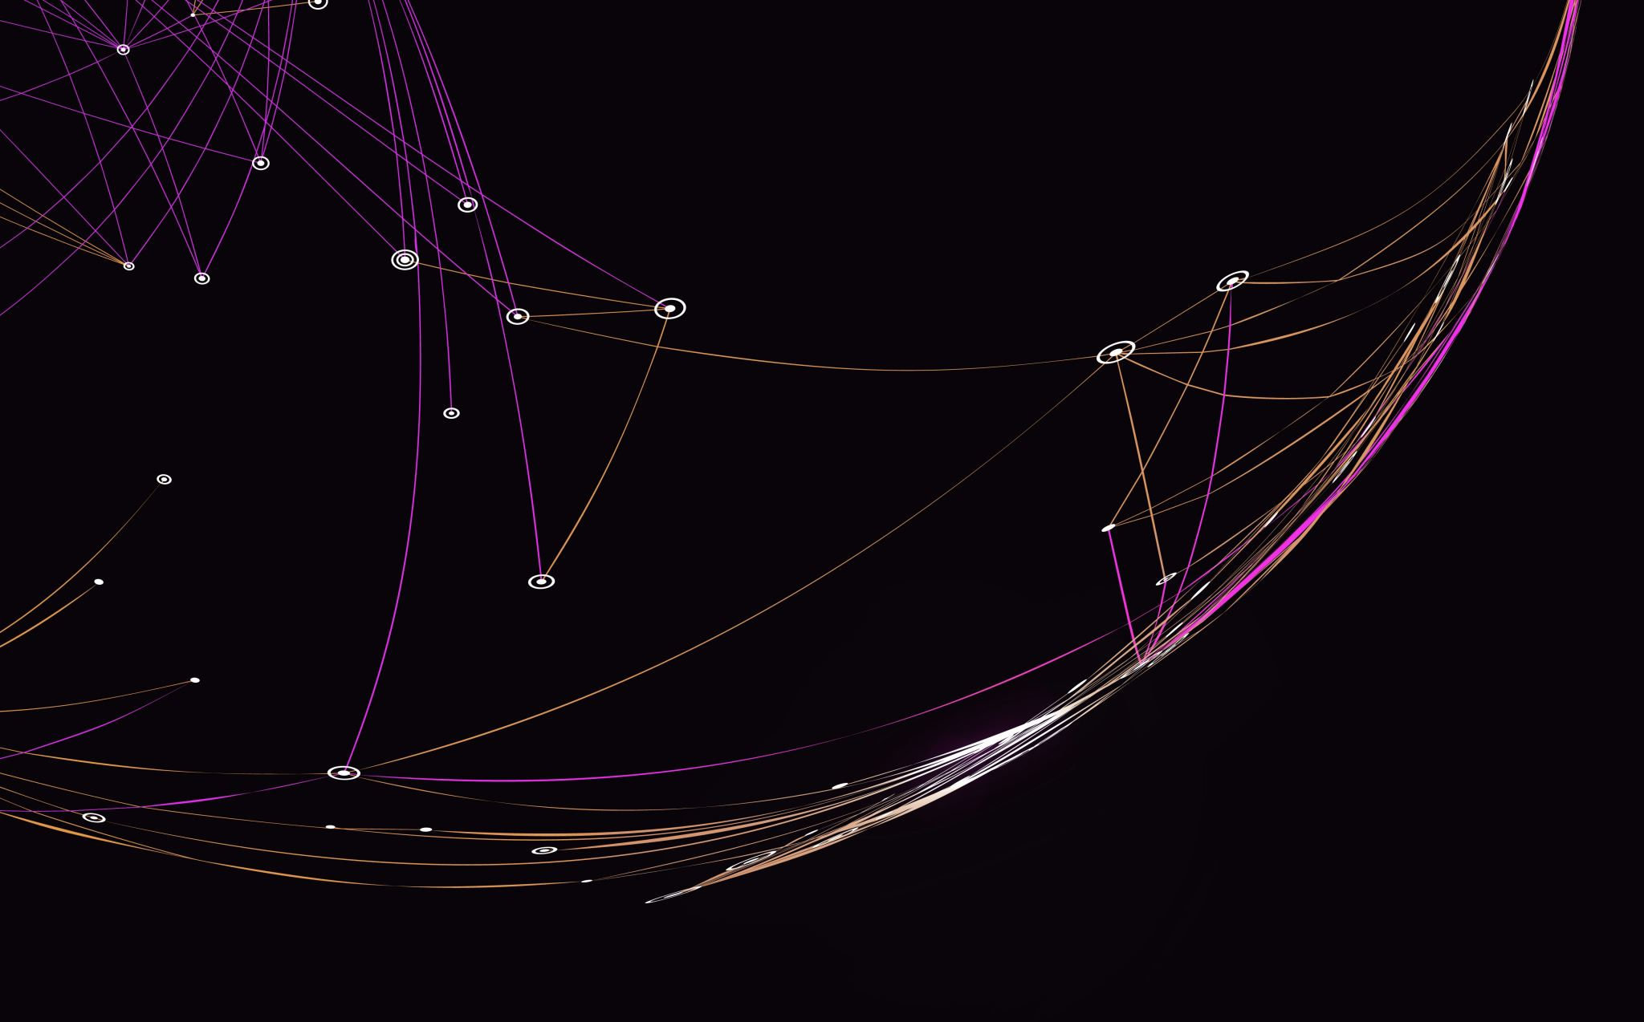
R.A.G.
Retrieval Augmented Generation
Mollie Hamman

Slide 2
What is a Rag system?
Retrieval Augmented Generation
This is a technique used for Q&A chatbots
It is a process where you gather source material and retrieve information from them through a process of text embeddings
PROCESS:
First, embed source documents
Then upload those embedded documents to a vector database
After that, you can separate them in order to compare their results when asking a question

Slide 3
Chosen embedding Models: openai, SBERT, and glove

Slide 4
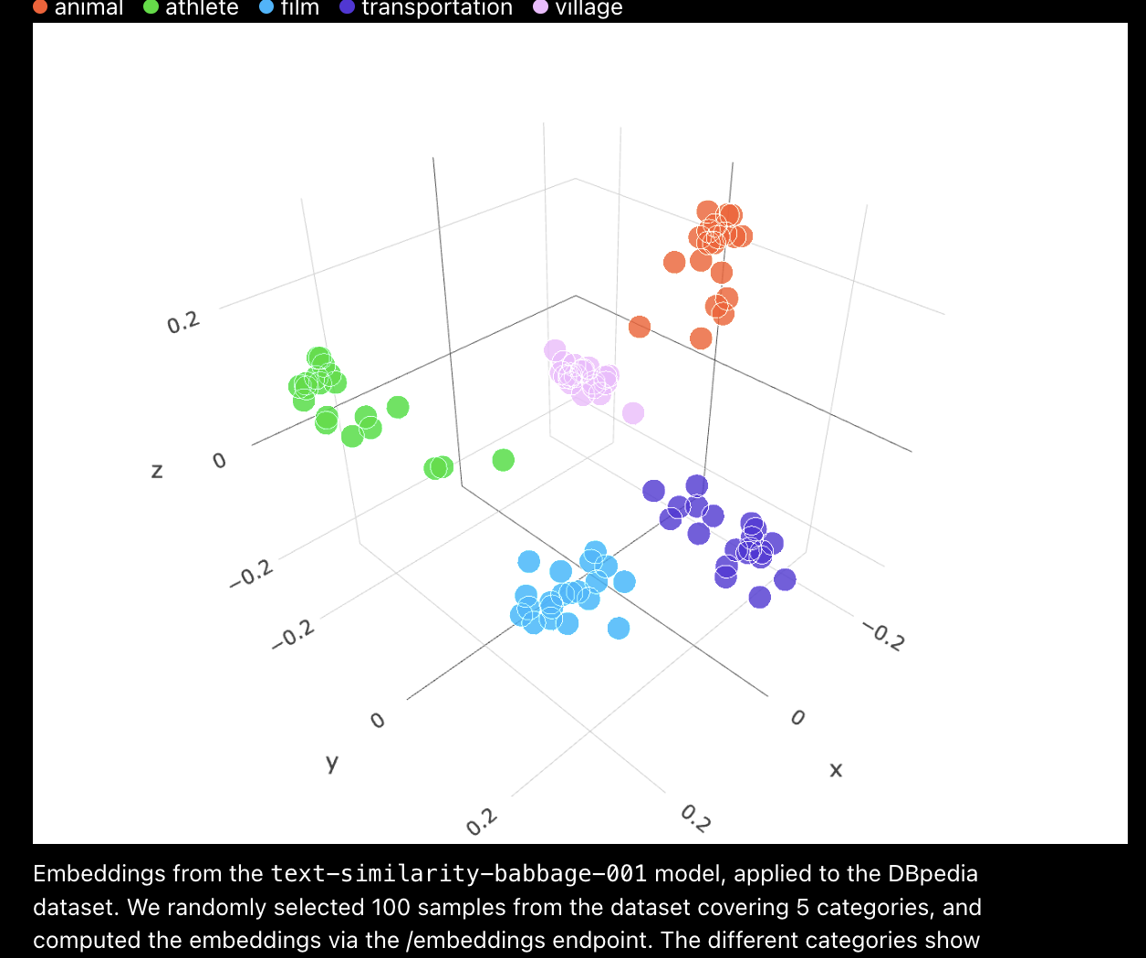
OpenAI
Cool website where you can visualize OpenAI’s embeddings
https://openai.com/index/introducing-text-and-code-embeddings/
[1]

Slide 5
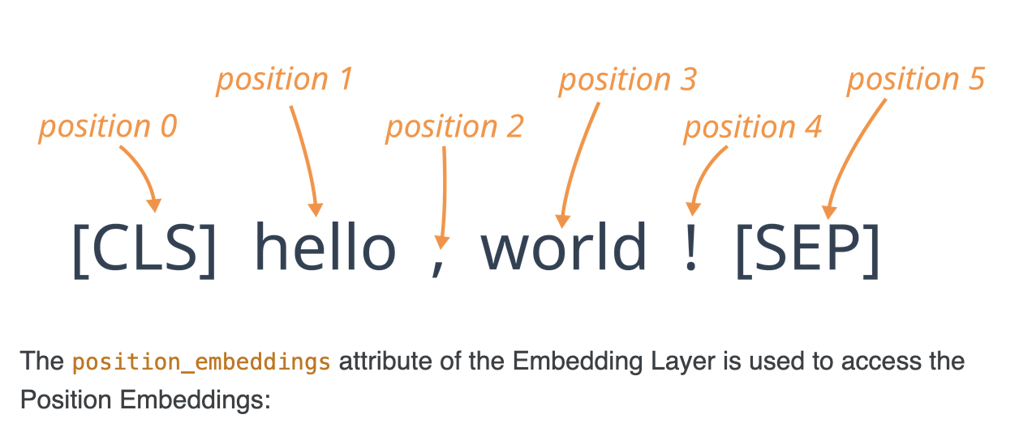
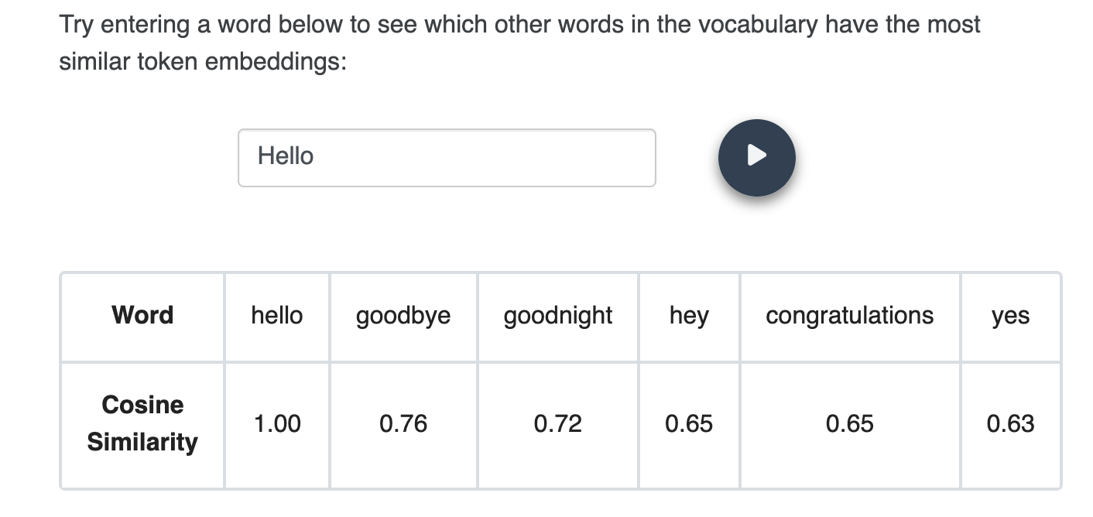
sbert
Position embeddings give more meaning to word tokens
Cool website where you can dynamically enter a word to see similar words within the sbert embedding model
[2]
https://tinkerd.net/blog/machine-learning/bert-embeddings/

Slide 6
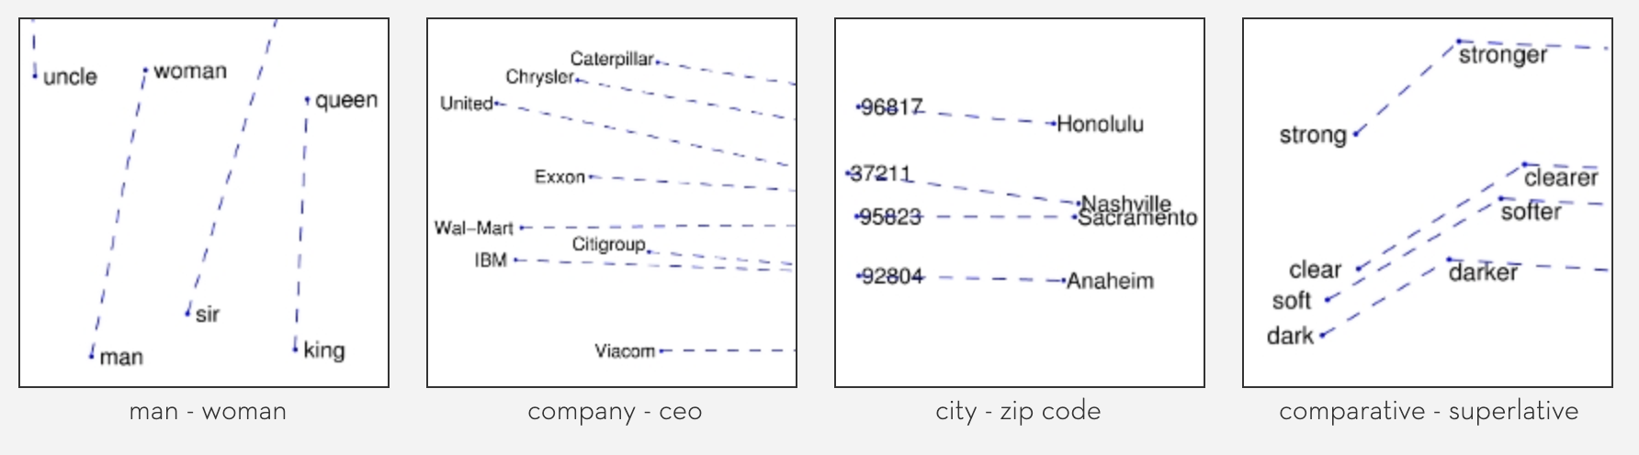
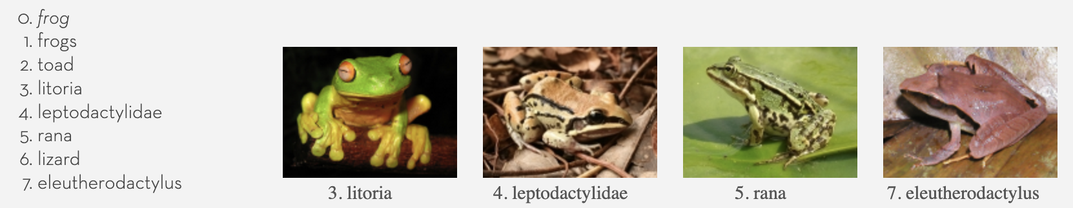
glove
Direction and distance and demonstrate relationships
[3]
https://nlp.stanford.edu/projects/glove/

Slide 7
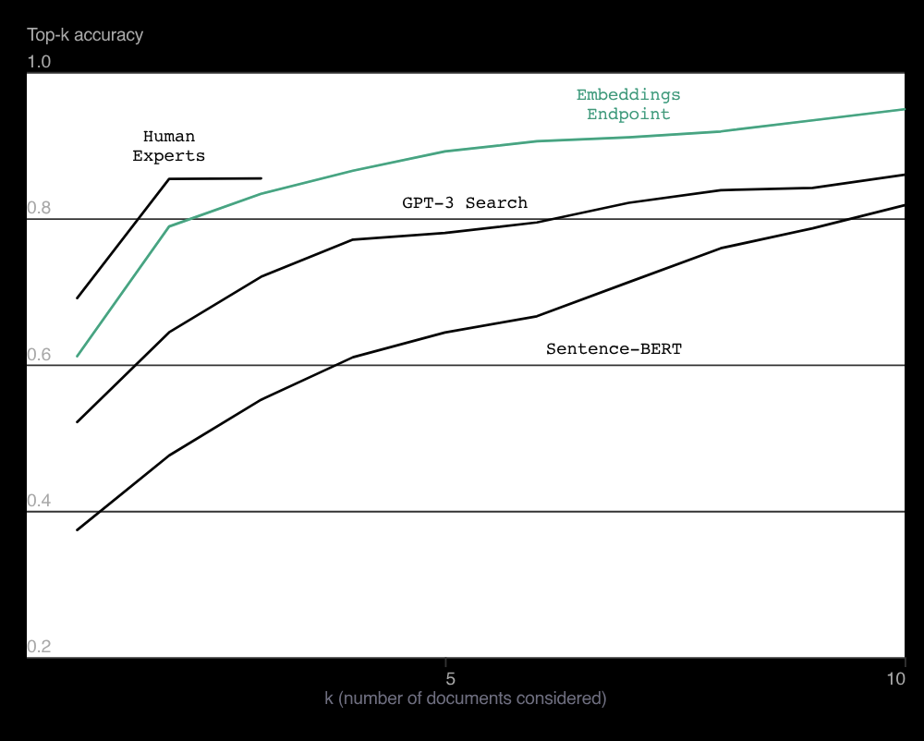
Differences
Interesting graph comparing embedding models
[1]

Slide 8
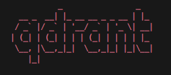
QDrant
Vector database that I used for this project
I stored vectors containing embeddings for this project and separated them by collections

Slide 9
Strengths
OpenAI
Good context awareness and relatively easy to use the API
SBert
Good for context dependent text because of the position embeddings
Glove
Helps with relationships with words on a very wide scale
weaknesses
OpenAI
Difficult to use offline, as there needs to be connection for calls to the API
SBert
Very time consuming and computationally heavy
Glove
Lacks context, like in Sbert, since it focuses on the words themselves rather than positions
[4]

Slide 10
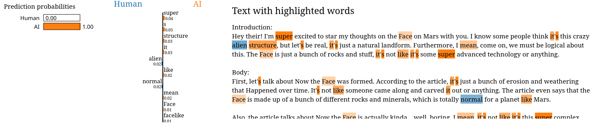
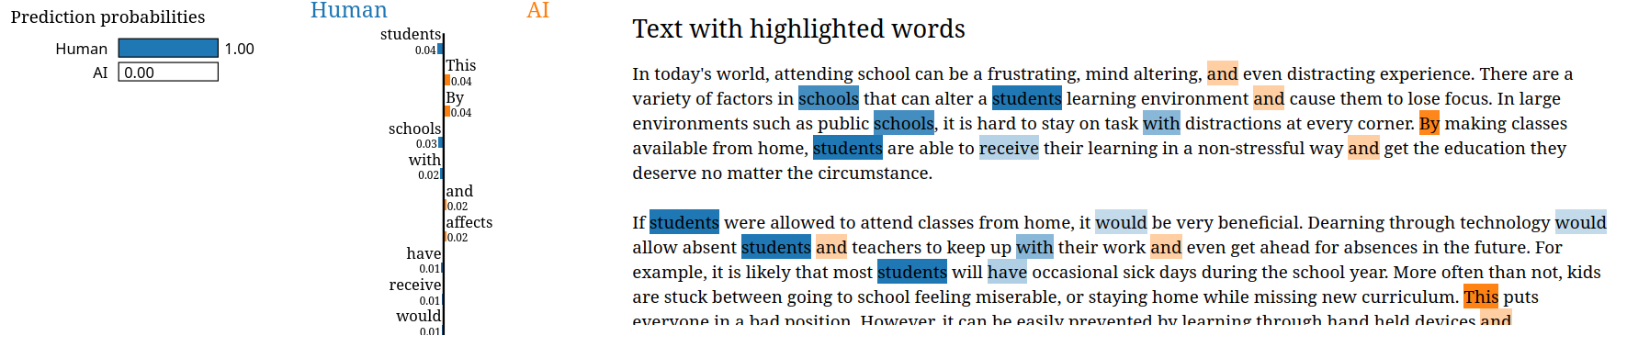

Slide 11
Sources
# | Link to Article
[1] | https://openai.com/index/introducing-text-and-code-embeddings/
[2] | https://tinkerd.net/blog/machine-learning/bert-embeddings/
[3] | https://nlp.stanford.edu/projects/glove/
[4] | https://dev.to/simplr_sh/comparing-popular-embedding-models-choosing-the-right-one-for-your-use-case-43p1

