Slide 1
1) Describe the Markov assumption (1 to 2 sentences) is and why it is important in MDP (1 to 2 sentences).

Slide 2
Dr. Molloy's goldendoodle dog is attending some training. The training consists of calling out a location and having the dog run to that location. The 3 possible locations are the mailbox, the front door, and the garage door. Most of the time the dog listens, but sometimes she goes to the wrong location.
A simple state space consists of:
3 states: {Mailbox, front door, and garage door} and
3 actions {go to mailbox, go to front door, and go to garage door}.
The objective is to have Penny go to the correctly called location (calling the name of the location is an action).
Build a reward function so that the policy obtained from an optimized MDP specifies this objective. You can construct the reward function as a table, such as, given s, a, s' as input: show what the function would return (in a separate column of the table).

Slide 3
Here are the values determined running value iteration k times. The discount factor 𝛾 =0.75.
Here values a few values that show the behavior of the system for the state Mailbox and the action go to garage door.
s | action | s' | T(s, a, s') | R(s, a, s')
Mailbox | "Goto garage door" | Mailbox | 0.1 | -1
Mailbox | "goto garage door" | Garage door | 0.9 | 4
V_{k} (Mailbox) | V_{k} (Front Door) | V_{k} (Garage Door)
2 | 5 | 4
𝜋 (Mailbox) = "Go to Garage door"
= 0.9*[4 + 0.75*4] +0.1*[-1 + 0.75*2]
= 0.9[7] + 0.1[.5] = 6.3 + .05 = 6.35

Slide 4
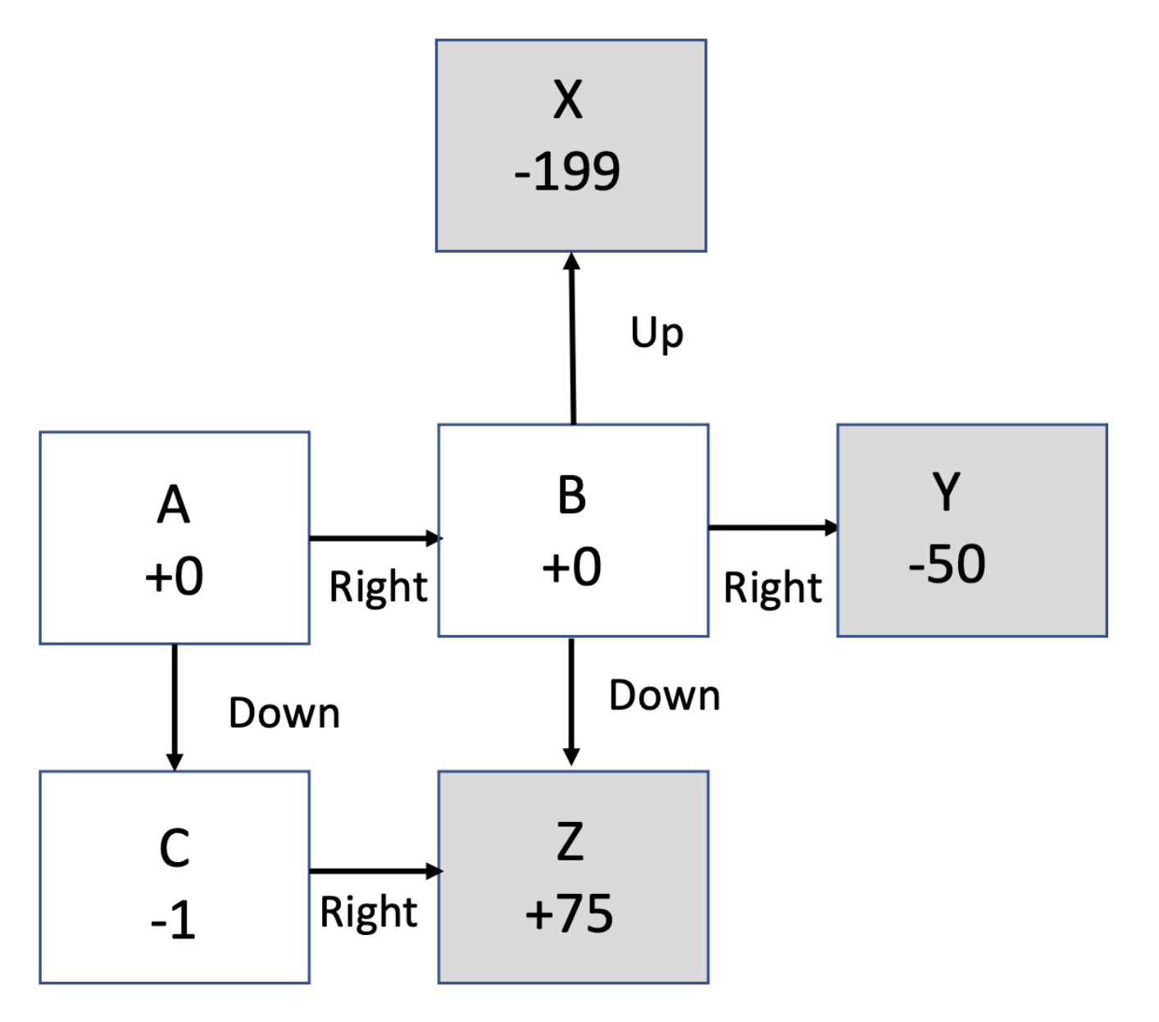
𝜋* (A)
V* (A)
V* (B)
𝜋* (A)

Slide 5
Smaller values of 𝛾 favor short term rewards over longer-term rewards.
When 𝛾 =1, value iteration is guaranteed to converge.
Policy iteration typically converges before value iteration.
Consider 2 MDPs which are identical except for their 𝛾 values.
These two MDPs with have the same 𝜋*.

