Slide 1

Assuming that all actions have the same cost, identify which uninformed search method(s) are guaranteed to find the optimal answer?

Slide 2
Is depth first search complete? Provide a "use-case" (where you would use DFS) to justify your answer. Answers with only yes or no will not receive any credit.
D
E
C
1
G
h = 0
S
A
4

Slide 3
The following heuristic is inadmissible. Briefly state what it means when a heuristic is inadmissible (1, at most 2 sentences) and give a specific example/condition shown in this graph that showcases the fact that the heuristic is inadmissible.
C
h=2
2
2
1
G
h = 0
S
A
h=3
4

Slide 4
C
h=2
2
2
3
D
h = 2
A
h=3
4
3
S
1
G
4
3
B
h = 3
5
E
h = 2
Expand | Fringe | Visited

Slide 5
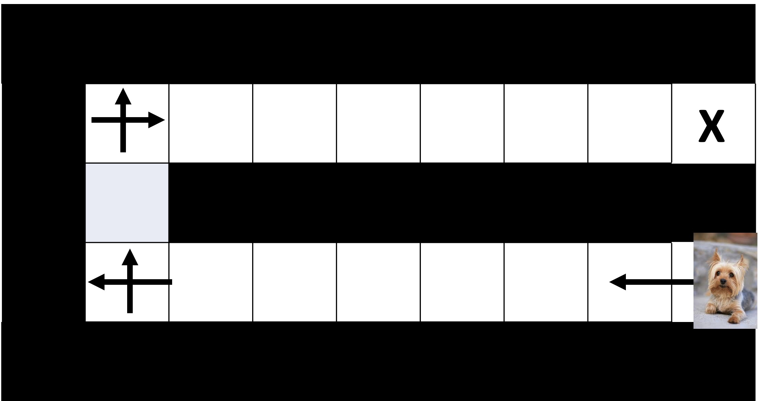
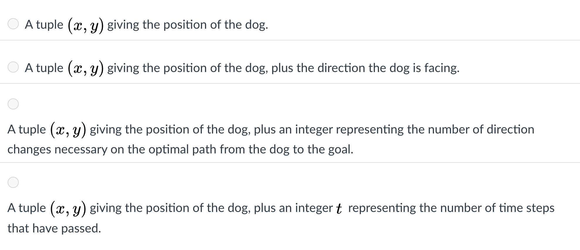
You are working with a dog that has been placed in a vet clinic with the following layout. The dog can run very fast, but only in a straight line. However, when it tries to turn, it is slow. Thus, we have the following conditions:
in a single time step, the dog can run as far as it wants to in a straight line. This "move" has cost 1.
to turn, it takes a single time for the dog to change directions. Changing from one direction to another direction also carries a cost of 1.
Which of the following is a minimal state representation (think about what the state is in PA 1).

Slide 6
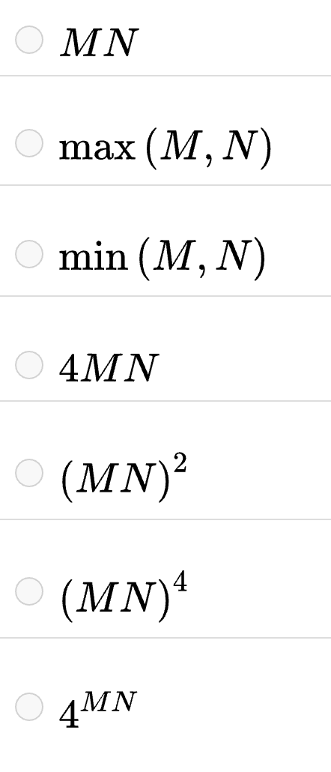
You are working with a dog that has been placed in a vet clinic with the following layout. The dog can run very fast, but only in a straight line. However, when it tries to turn, it is slow. Thus, we have the following conditions:
in a single time step, the dog can run as far as it wants to in a straight line. This "move" has cost 1.
to turn, it takes a single time for the dog to change directions. Changing from one direction to another direction also carries a cost of 1.
What is the size of the state space for this problem?

