Slide 1
PARIS FASHION SHOW INFOGRAPHICS
SLIDESGO 20XX
Here is where this template begins

Slide 2
PARIS FASHION SHOW INFOGRAPHICS
This template contains an assortment of complementary infographic resources for the Paris Fashion Show presentation.
These infographics are adapted to the style of the aforementioned presentation, so you can insert them easily and have them completely integrated at once. You just need to do the following:
Select the element that you want to copy
Right-click and choose “Copy”
Go to the slide where you want the element to appear
Right-click and choose “Paste”

Slide 3
PARIS FASHION SHOW
What is a Paris fashion show
PARADES
FASHION
Venus is the second planet from the Sun
Mars is a cold place, not hot
SALES
MEDIA
Saturn is a gas giant and has several rings
Mercury is the closest
planet to the Sun
SHOWS
EDITORS
Jupiter is a gas giant and the biggest planet
Actually, Neptune is an ice giant

Slide 4
PARIS FASHION SHOW
Who attends Paris fashion shows
20%
35%
Saturn is not the only planet with rings
Jupiter is the biggest planet of them all
A
C
EDITORS
CELEBRITIES
BUYERS
MEDIA
Venus is the second planet from the Sun
B
Mars is actually a very cold place
D
15%
30%

Slide 5
PARIS FASHION SHOW
01
02
03
The Paris fashion shows are organized into 3 groups
ORGANIZATION
HAUTE COUTURE
READY TO WEAR
MENS CLOTHING
Neptune is far away from Earth
Actually, Saturn is the ringed planet
Actually, Jupiter is the biggest planet
January & July
March & September
January & June

Slide 6
PARIS FASHION SHOW
Characteristics of the groups
HAUTE COUTURE | Made completely by hand and on custom measurements | The Spring-Summer collections are presented in January | The Autumn-Winter collections are presented in July
READY TO WEAR | Ready-to-buy collections that one finds in stores | The Autumn-Winter collections are presented in March | The Spring-Summer collections are presented in Sep.
MENS CLOTHING | Menswear collections that one finds in stores | The Autumn-Winter collections are presented in January | The Spring-Summer collections are presented in June

Slide 7
PARIS FASHION SHOW
How to watch Paris fashion shows
INDUSTRY
LIVE STREAMS
Jupiter is the biggest planet
Mercury is a small planet
PUBLIC
VOLUNTEER
Mars is a very cold place
Neptune is an ice giant
LIVE
REPLAY VIDEOS
Saturn is a gas giant
We all live on Earth

Slide 8
PARIS FASHION SHOW
Other Paris fashion show happenings
LAVISH GALAS
Venus has a beautiful name and is the second planet from the Sun. It’s terribly hot
ENTERTAINMENT
Saturn is a gas giant and has several rings. It's composed mostly of hydrogen and helium
CELEBRITIES
Mercury is the closest planet to the Sun and the smallest one in the Solar System
CHARITY EVENTS
Despite being red, Mars is actually a cold place. It's full of iron oxide dust

Slide 9
PARIS FASHION SHOW
Fashion shows around the world
NEW YORK
250
1943 First New York FS
shows
MILAN
158
1953 First Milan FS
shows
PARIS
150
1973 First Paris FS
shows
LONDON
73
1984 First London FS
shows

Slide 10
PARIS FASHION SHOW
Requirements for calls
Jupiter was named after a (Roman) god
Earth is the only planet known to harbor life
MODELS
27/09/2XXX
Neptune is very far away from the Sun
CALLS
Jupiter is the biggest planet of them all
Saturn is not the only planet with rings
Despite being red, Mars is very cold
VOLUNTEERS
13/04/2XXX
Earth is the planet where we all live

Slide 11
PARIS FASHION SHOW
Fashion show vitality index
PARIS FASHION SHOW
FASHION INFLUENCE
FASHION LEADING
DESIGN GROWTH
BUSINESS BENEFIT
PFS scale
PFS exposure
Brand
Media
Business
Product
Industry
Buyers
Venus is the second planet from the Sun
Jupiter is the biggest planet of them all
Actually, Saturn is a gas giant and has several rings
Mercury is the closest planet to the Sun

Slide 12
PARIS FASHION SHOW
Evaluation index system of the Paris fashion show
DOMESTIC BRANDS | 0.01230 | NUMBER OF WORKS | 0.00613
FOREIGN BRANDS | 0.01660 | NUMBER OF FANS | 0.01050
DESIGNERS | 0.02270 | NUMBER OF MEDIA | 0.01640
MODEL | 0.01560 | PARTICIPATION | 0.00843
NUMBER OF SHOW | 0.01550 | MICROBLOGS | 0.00819
MARKETING | 0.01050 | WEB SEARCH | 0.01130
RATING | 0.02590 | AFFILIATION | 0.01230

Slide 13
PARIS FASHION SHOW
GENDER
INTEREST
Fashion
5/5
Design
4/5
25%
50%
25%
Photography
3/5
MALE
FEMALE
OTHER
Shows
4/5
AGE
CATEGORY
20 - 25
30%
BUYERS
60%
26 - 50
30%
EDITORS
30%
50 +
40%
MEDIA
10%

Slide 14
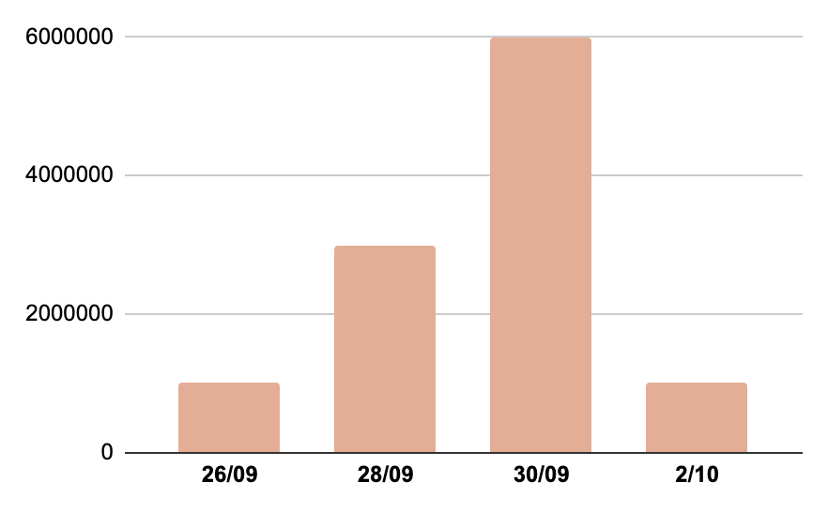
PARIS FASHION SHOW
Likes on content mentioning Paris fashion shows
#parisfashionshow
6,000,000
SEPTEMBER 30TH
The most important day in mentions on social media
Follow the link in the graph to modify its data and then paste the new one here. For more info, click here

Slide 15
PARIS FASHION SHOW
Paris fashion show highlights
SOCIAL RISING STAR | UNEXPECTED MODEL | BEST LOCATION
Saturn is a gas giant @social media | Neptune is an ice giant @social media | Mars is a very cold place @social media
37%
FEMALE CREATIVE DIRECTORS

Slide 16
PARIS FASHION SHOW
Important numbers about the Paris fashion show
150
€ 105 M.
FASHION SHOWS
VISITOR SPEND
3,200
MEDIA PRESENT

Slide 17
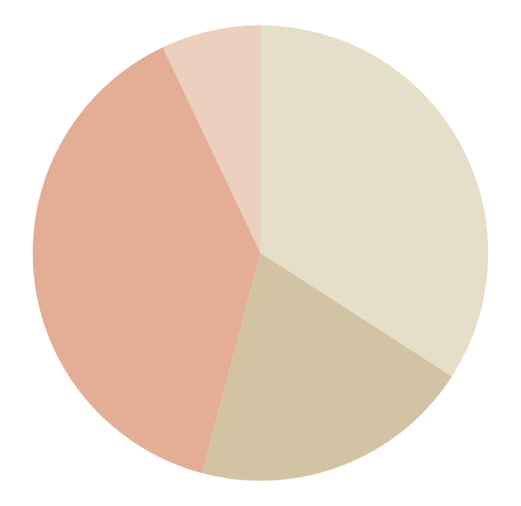
PARIS FASHION SHOW
Most popular brands at the Paris fashion show
29%
BRAND 1
06%
BRAND 4
Venus is the second planet from the Sun
Despite being red, Mars is a cold place
17%
BRAND 2
33%
BRAND 3
Saturn is a gas giant and has several rings
Jupiter is the biggest planet of them all
Follow the link in the graph to modify its data and then paste the new one here. For more info, click here

Slide 18
PARIS FASHION SHOW
Trends and themes
SPACE AGE
Mercury is the closest planet to the Sun
DESIGNER NAME
BRAND NAME
PASTELS
Venus is the second planet from the Sun
DESIGNER NAME
BRAND NAME
PLEATS
Despite being red, Mars is a cold place
DESIGNER NAME
BRAND NAME
EMBROIDERY
Jupiter is the biggest planet of them all
DESIGNER NAME
BRAND NAME
LACE
Saturn is composed of hydrogen and helium
DESIGNER NAME
BRAND NAME

Slide 19
PARIS FASHION SHOW
Weekly agenda about recognized brands
MON | TUE | WED | THU | FRI | SAT | SUN
10 AM Brand 1 Gallery 1 | 10 AM Brand 4 Gallery 4 | 11 AM Brand 7 Gallery 5 | 09 AM Brand 10 Gallery 1 | 10.30 AM Brand 13 Gallery 2 | 11 AM Brand 16 Gallery 1 | 09:30 AM Brand 19 Gallery 2
3 PM Brand 2 Gallery 2 | 2:30 PM Brand 5 Gallery 1 | 3:30 PM Brand 8 Gallery 4 | 2 PM Brand 11 Gallery 6 | 2:15 PM Brand 14 Gallery 3 | 3 PM Brand 17 Gallery 4 | 2 PM Brand 20 Gallery 1
9 PM Brand 3 Gallery 3 | 7 PM Brand 6 Gallery 2 | 8 PM Brand 9 Gallery 3 | 8:30 PM Brand 12 Gallery 3 | 7 PM Brand 15 Gallery 5 | 8:45 PM Brand 18 Gallery 3 | 7 PM Brand 21 Gallery 5

Slide 20
PARIS FASHION SHOW
Fashion shows timeline
Earth is the third planet from the Sun
Neptune is very far away from the Sun
Saturn is a gas giant and has several rings
BRAND 2
BRAND 4
BRAND 6
01
02
03
04
05
06
07
BRAND 1
BRAND 3
BRAND 5
BRAND 7
Despite being red, Mars is a cold place
Jupiter is the biggest planet of them all
Venus is the second planet from the Sun
Actually, Mercury is a small planet

Slide 21
PARIS FASHION SHOW
Program of the day
BRAND 1
11:00 am - 12:00 am
BRAND 4
5:00 pm - 6:00 pm
Presentation
Jupiter doesn’t have a solid surface
Show
Saturn is not the only planet with rings
BRAND 2
1:30 pm - 2:30 pm
BRAND 5
6:30 pm - 8:00 pm
Digital show
Despite being red, Mars is very cold
Presentation
Neptune is very far away from the Sun
BRAND 3
3:00 pm - 4:30 pm
BRAND 6
8:30pm - 10:00 pm
Presentation
Venus is the second planet from the Sun
Digital show
Actually, Venus has a toxic atmosphere

Slide 22
PARIS FASHION SHOW
Top brands at the Paris fashion show
1
BRAND 1
Mars is a cold place. It’s full of iron oxide dust
2
BRAND 2
Jupiter is the biggest planet in the Solar System
3
BRAND 3
Mercury is the closest planet to the Sun
4
BRAND 4
Neptune is the farthest planet from the Sun

Slide 23
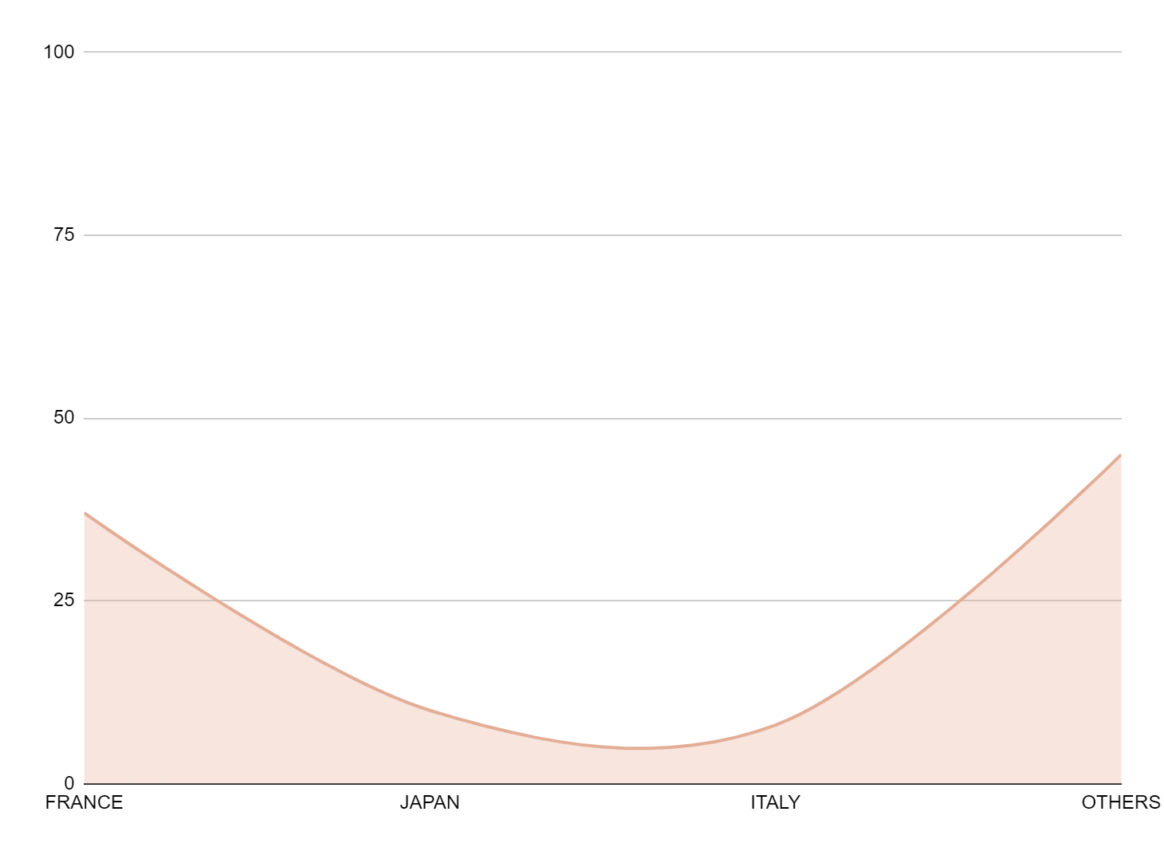
PARIS FASHION SHOW
Origin of designers at the Paris fashion show
37%
FRANCE
Saturn is the ringed planet
10%
JAPAN
We all live on Earth
08%
ITALY
Venus has a toxic atmosphere
Follow the link in the graph to modify its data and then paste the new one here. For more info, click here
45%
OTHERS
Mars is a cold place

Slide 24
PARIS FASHION SHOW
The trending designs in the shows
23%
29%
22%
METALLIC
LEATHER
FLORAL
Venus has a beautiful name
Jupiter is the biggest planet
Saturn is a gas giant
10%
PLEATS
20%
OVERSIZE
30%
GRAFFITI
40%
ANIMAL

Slide 25
PARIS FASHION SHOW
What about the colours?
BOLD COLOURS
PASTEL SCALE
YELLOW
33%
NUDE
53%
ORANGE
26%
BLUSH
25%
PURPLE
21%
BABY PINK
13%
BLUE
16%
BABY BLUE
06%
EMERALD
03%
BABY GREEN
03%
BLACK IS ALWAYS THE NEW BLACK
BLACK
39%
COLOR
61%

Slide 26
PARIS FASHION SHOW
01
02
03
04
Top art directors of the Paris fashion show
DIRECTORNAME 1
DIRECTORNAME 2
DIRECTORNAME 3
DIRECTOR NAME 4
Venus is the second planet from the Sun
Jupiter is the biggest planet of them all
Actually, Saturn is a gas giant and has several rings
Mercury is the closest planet to the Sun

Slide 27
PARIS FASHION SHOW
Designer profile
20XX
MERCURY
Designer | Susan Bones
Age | 30
Location | Paris
Style | Actually, Saturn is a gas giant and has several rings
Mercury is a small planet
20XX
MARS
Mars is actually a very cold place
20XX
SATURN
Saturn has several rings

Slide 28
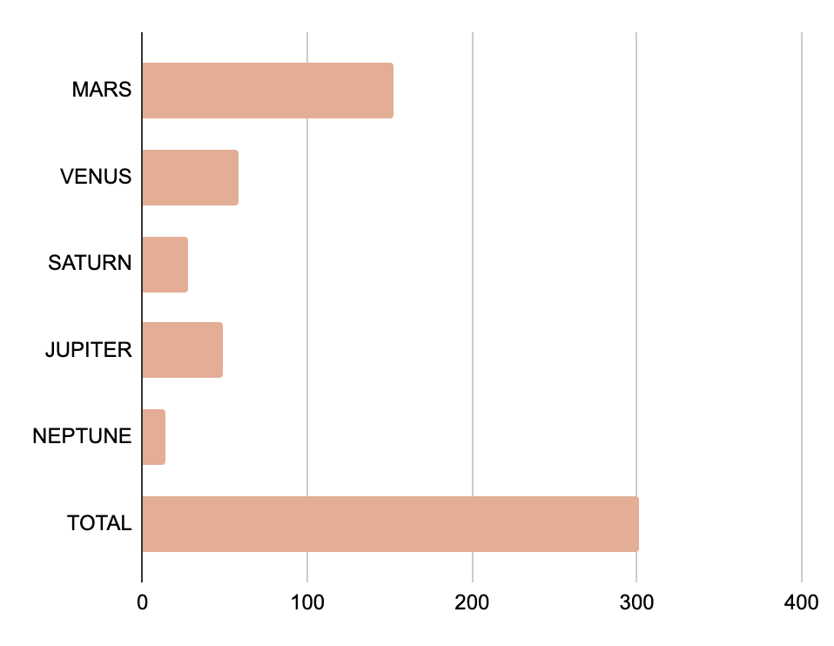
PARIS FASHION SHOW
Top designer trends
MARS
152 K
VENUS
58 K
SATURN
28 K
JUPITER
49 K
NEPTUNE
14 K
TOTAL
310 K
Follow the link in the graph to modify its data and then paste the new one here. For more info, click here

Slide 29
PARIS FASHION SHOW
DESIGNER EVENT:
NAME OF BRAND
TIME | MON | TUE | WED | THU | FRI
8:00 PM | Reception | Reception | Reception | Reception | Reception
9:00 PM | Presentation | Presentation | Presentation | Presentation | Presentation
10:00 PM | Show 1 | Show 1 | Show 1 | Show 1 | Show 1
11:00 PM | BREAK
11:30 PM | Show 2 | Parade 1 | Parade 1 | Parade 1 | Parade 1
12:30 AM | Parade 1 | Party | Party | Party | Party
13:30 AM | Party | Party | Party | Party | Party

Slide 30
PARIS FASHION SHOW
Schedule of the week
DAY 3
Venus has a beautiful name
DAY 2
DAY 4
Mercury is a small planet
7 PM
Mars is a cold place, not hot
5:45 PM
6:30 PM
DAY 1
DAY 5
Jupiter is the biggest planet
FASHION SHOWS
Actually, Neptune is an ice giant
3 PM
8 PM

Slide 31
PARIS FASHION SHOW
Paris fashion show top models
FIRST
SECOND
1°
THIRD
2°
3°
SUSAN BONES
JENNA DOE
TIMMY JIMMY
Nationality: Polish
Age: 18
Agency: Mars
Nationality: Canadian
Age: 19
Agency: Jupiter
Nationality: Australian
Age: 23
Agency: Saturn

Slide 32
PARIS FASHION SHOW
Paris fashion show locations
PARTIES
GALLERY NAME 1 | Where: | Saturn is a gas giant
 | Opening time: | 18:00 - 21:00
GALLERY NAME 2 | Where: | Mars is a cold place, not hot
 | Opening time: | 18:00 - 21:00
GALLERY NAME 3 | Where: | Jupiter is the biggest planet
 | Opening time: | 18:00 - 21:00
GALLERY NAME 4 | Where: | Venus has a beautiful name
 | Opening time: | 18:00 - 21:00
PARIS PARTIES
Venus has a beautiful name and is the second planet from the Sun

Slide 33
Instructions for use
If you have a free account, in order to use this template, you must credit Slidesgo in your final presentation. Please refer to the next slide to read the instructions for premium users.
As a Free user, you are allowed to:
- Modify this template.
- Use it for both personal and commercial projects.
You are not allowed to:
- Sublicense, sell or rent any of Slidesgo Content (or a modified version of Slidesgo Content).
- Distribute Slidesgo Content unless it has been expressly authorized by Slidesgo.
- Include Slidesgo Content in an online or offline database or file.
- Offer Slidesgo templates (or modified versions of Slidesgo templates) for download.
- Acquire the copyright of Slidesgo Content.
For more information about editing slides, please read our FAQs or visit our blog:
https://slidesgo.com/faqs and https://slidesgo.com/slidesgo-school

Slide 34
Instructions for use (premium users)
As a Premium user, you can use this template without attributing Slidesgo.
You are allowed to:
Modify this template.
Use it for both personal and commercial purposes.
Share this template in an editable format with people who are not part of your team.
You are not allowed to:
Sublicense, sell or rent this Slidesgo Template (or a modified version of this Slidesgo Template).
Distribute this Slidesgo Template (or a modified version of this Slidesgo Template) or include it in a database or in any other product or service that offers downloadable images, icons or presentations that may be subject to distribution or resale.
Use any of the elements that are part of this Slidesgo Template in an isolated and separated way from this Template.
Register any of the elements that are part of this template as a trademark or logo, or register it as a work in an intellectual property registry or similar.
For more information about editing slides, please read our FAQs or visit our blog:
https://slidesgo.com/faqs and https://slidesgo.com/slidesgo-school

Slide 35
Infographics
You can add and edit some infographics to your presentation to present your data in a visual way.
Choose your favourite infographic and insert it in your presentation using Ctrl C + Ctrl V or Cmd C + Cmd V in Mac.
Select one of the parts and ungroup it by right-clicking and choosing “Ungroup”.
Change the color by clicking on the paint bucket.
Then resize the element by clicking and dragging one of the square-shaped points of its bounding box (the cursor should look like a double-headed arrow). Remember to hold Shift while dragging to keep the proportions.
Group the elements again by selecting them, right-clicking and choosing “Group”.
Repeat the steps above with the other parts and when you’re done editing, copy the end result and paste it into your presentation.
Remember to choose the “Keep source formatting” option so that it keeps the design. For more info, please visit our blog.

