Slide 1
알고리즘 설계 및 분석
Foundations of Algorithm
유관우

Slide 2
Chap7. Sorting Problem
O(n²) alg. : insertion, selection,…
Θ(n log n) alg. : mergesort, heapsort,quicksort
Is o(n log n) alg. possible?
    No, if by key comparisons only.
Two approaches necessary
① upper bound ↓(efficient alg.)
② lower bound ↑(no more efficient alg.)

Slide 3
Computational Complexity :
  Study of a given problem. (lower bound)
  (Eg) sorting - see above
  Matrix Multiplication
  O(n³) ➔O(n^{2.81}) ➔O(n^{2.38}) ➔…
  Ω(n² ) ➔ ? (lower bound)
  Comp. complexity analysis :
Why sorting problem for comp. complexity study?
  ① deep researches
  ② upper bound = lower bound
“Sort only by comparisons of keys”
    Comparison & Exchange
  Note: exchange op. can be costly if long records.
U.B.
(more effi. Alg.)
L.B.

Slide 4
Insertion Sort & Selection Sort
(Eg)
Note : Exchange occurs with 2 adj. keys.
stable sort !!! On-line alg.
5
7 8 9
2
4
7
8
9
5
1
3
2
4
1
3
Sorted
Unsorted
procedure insertion(n, S);
{ for i=2 to n do {
x=S[i];
j= i-1;
while j >0 and S[j] > x do {
S[j+1]= S[j];
j--; }
S[j+1]= x;
}
}

Slide 5
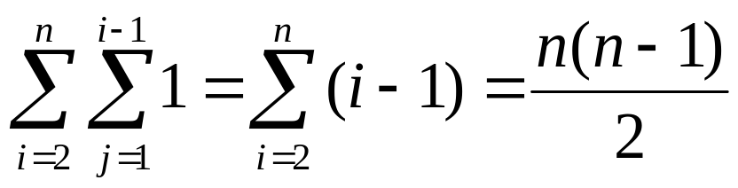
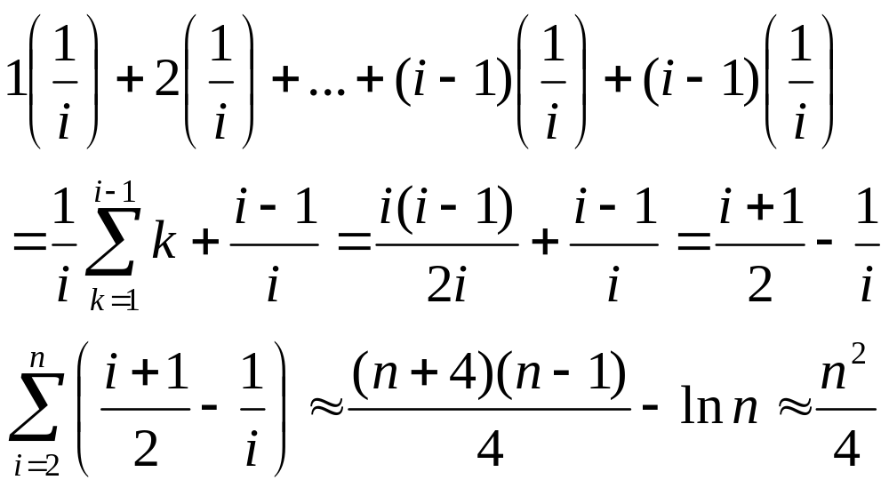
Worst-case time complexity analysis:
Avg.case t.c. Analysis :
In-place : Θ(1) extra space !

Slide 6
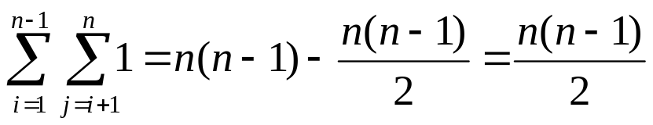
Selection Sort :
procedure selection(n, S[1…n])
{ for i = 1 to n-1 do {
smallest = i;
for j = i+1 to n do
if S[j] < S[smallest] then
smallest = j;
exchange(S[i], S[smallest]);
}
}
Every-case time complexity Analysis
Note : Comparisons of adj. Keys. Stable!
Which of I.S. and S.S. is better?
Why? Good best-case performance!!! - I.S.

Slide 7
Definition
  Input list[k₁, k₂,…, k_{n}], n keys.
  An inversion : (k_{i}, k_{j}) if i < j && k_{i} > k_{j}.
  (Eg) If k₁≤ k₂≤ …≤ k_{n}, #inversions =0
    If k₁> k₂> …>k_{n}, #inversions =n(n-1)/2
    [3,2,4,1,6,5] : 5 inversions.
(Theorem) n distinct keys.
  Any sorting alg. in which each comparison removes ≤ one inversion requires ≥ n(n-1)/2 comparisons in w.c,
  ≥ n(n-1)/4 comparisons in avg. case.
  (Proof) k₁> k₂> …>k_{n}, ➔ n(n-1)/2 inversions
  (Av.case) [k₁, k₂,…k_{n}] ➔ [k_{n}, k_{n-1},…k₁]
  each perm. its transpose
  Total #inversions : n(n-1)/2 • n!/2
  Avg. #inversions : n(n-1)/4

Slide 8
Insertion Sort :
  Removes ≤1 inversion each comp.
  ➔ n(n-1)/2 comp’s in w.-c.
  ≈ n² /4 comp’s in avg. case.
  Selection Sort : same but difficult.
Exchange Sort:
procedure exchange (n, S[1…n])
{ for i = 1 to n-1 do
    for j = i+1 to n do
    if S[i] > S[j] then
    exchange(S[i],S[j]);
    }
S[i]
.
.
.
exchange
S[j]
(j-i) inversions removed
(j-i-1) inversions inserted
≤1 inversions are removed

Slide 9
Mergesort Revisited (p267)
  Why Θ(n log n) ? When merging
  1 comp. → n/2 inversions removed.
  But, Θ(n)extra space, && off-line alg.
n/2
1
Sorted
Sorted
n

Slide 10
3 Improvements
  (1) iterative version (D.P.version)
    Bottom-up, stack space X
  (2) linked version
    Θ(n)extra space ➔only link space
    No data movement !
c
2
f
0
b
1
e
0
a
6
d
4
key
link
S[1]
[2]
[3]
[4]
[5]
[6]
merge
c
6
f
0
b
1
e
2
a
3
d
4

Slide 11
(3) Without linked list.
    Very complex.
    Huang & Langston (1988)

Slide 12
Quicksort Revisited(p273)
Procedure quicksort(low, high);
{ if low < high then {
    partition (low, high, pivotpoint);
    quicksort (low, pivotpoint-1);
    quicksort (pivotpoint+1, high);
    }
}
low
high
pivot
≤pivot
≥pivot
low
pivotpoint
high
Not stable, in-place? (stack space)
(1) smaller subarray first : ≤ lg n depth.
(2) iterative version
(3) threshold value
(4) Randomization. W(n) = Θ(n²) ➔W(n) ➔ Θ(n log n) w.h.p.
Practically best ! Why so fast? Pivot → Register !

Slide 13
Heapsort(p275)
In-place, unstable, Θ(n log n)
Complete binary tree(CBT)
  1. All internal nodes have 2 children.
  2. All leaves have depth d.
CBT
CBT(X), ECBT
X

Slide 14
Essentially CBT
  1. CBT down to depth d-1.
  2. Nodes with depth d : to the left.
Heap (Max-heap, Binary heap)
  1.ECBT
  2.value at a node ≥ values at children
  → Max key : at the root.

Slide 15
11
Delete max
11
6
9
8
9
8
4
7
2
5
4
7
2
5
3
1
5
6
3
1
5
6
Heap : ECBT ➔ 1-D array representation
11
9
8
4
7
2
5
3
1
5
6
S 1 2 3 4 5 6 7 8 9 10 11

Slide 16
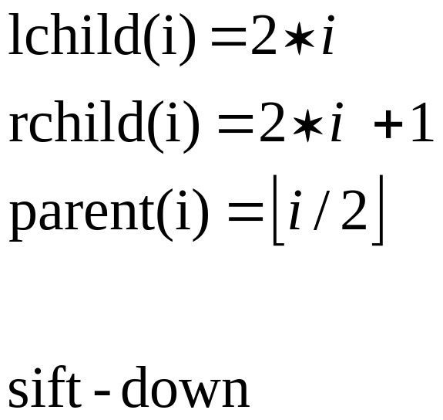
9
9
6
8
7
8
4
7
2
5
4
6
2
5
3
1
5
3
1
5
heap

Slide 17
procedure siftdown (H, i);
{
siftkey = H.S[i]; parent = i; found = false;
While (2*parent ≤ H.heapsize) && (not found)
do{
If (2*parent < H.heapsize)&&(H.S[2*parent] < H.S[2*parent +1])
then largerchild = 2*parent + 1;
else largerchild = 2 * parent;
If siftkey < H.S[largerchild] then{
H.S[parent] = H.S[largerchild];
parent = largerchild;
}
else found = true;
}
H.S[parent] = siftkey;
}
Θ(log n) time
i
6
9
8
4
7
2
5
3
1
5

Slide 18
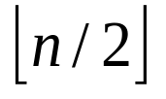
procedure makeheap (n, H);
{ H.heapsize = n;
For i = downto 1 do
siftdown (H, i);
}
O.K.
2
4
5
3
1
9
6
7
10
8
S 1 2 3 4 5 6 7 8 9 10
2
4
5
3
1
9
6
10
8
9
6
`
7
10
8
7
3
1
Initial structure
Depth d-1 -> heap
5
9
6
4
10
10
10
8
4
8
7
8
9
7
3
1
7
3
1
4
3
1
5
6
Depth d-2 --> heap

Slide 19
Analysis of makeheap :Θ(n) time
  Assume n = 2^{d} (depth : d)
  consider
0
1
.
.
d-1
d
Depth
0
1
2
:
j
:
d-1
#nodes
2⁰
2¹
2²
:
2^{j}
:
2^{d-1}
#sifts
d-1
d-2
d-3
:
d-j-1
:
0

Slide 20
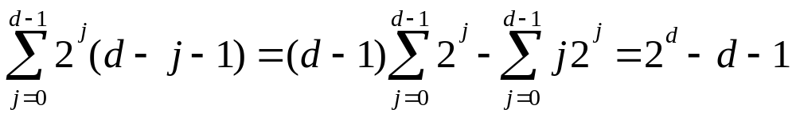
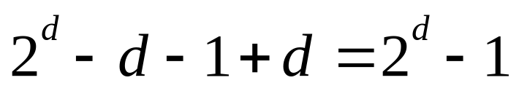
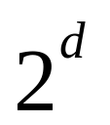
Total #sifts : at most
Actual upper bound :
Total # comp. : ≤ 2( -1) = 2(n-1).

Slide 21
function root(H); // Θ(log n)
{ // delete-max //
keyout = H.S[1];
H.S[1] = H.S[heapsize];
H.heapsize = H.heapsize-1;
siftdown(H, 1);
root = keyout;
}
procedure removekeys(n, H, S);
{
for i = n down to 1 do
S[i] = root(H); //heapsort
}
Procedure heapsort (n, H);
{
makeheap (n, H);
removeKeys (n, H, S);
}
1
11
6
Siftdown
↓
9
8
4
7
2
5
3
1
5
6
Analysis
  Θ(n) + Θ(n log n) = Θ(n log n) time
  Extra space : Θ(1)

Slide 22
Heap insert?
Θ(log n) time
Construct heap
    for i=2 to n do
    Insert_heap(i);
Priority queue (c.f. FIFO queue)
  Insert & delete_max (or min)
  ➔ binary Heap :Θ(log n) time
11
11
9
8
9
10
4
7
2
5
4
7
8
5
3
1
5
6
10
3
1
5
6
2
on-line alg.
Θ(n log n) time

Slide 23
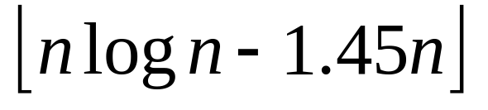
Theorem : Any deterministic(comparison-based) sorting alg. ≥ comparisons
(lower bound of sorting prob. : Ω(n log n))
Sorting by Distribution (Radix sort)
Θ(n) time
c.f. Sorting by comparison

Slide 24
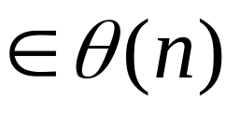
Counting Sort
each key: integers, [1..k], k
idea
  1. compute rank of each key.
  2. permute to final place.
Eg) A[1..n] : initial input
B[1..n] : final output
C[1..k] : counting

Slide 25
1 2 3 4 5
1 2 3 4
A
1
4
3
1
3
C
2
0
2
1
C
2
2
4
5
1 2 3 4
B
3
2
2
3
5
1
3
1
2
3
5
1
3
3
1
2
2
5
1
3
3
4
1
2
2
4
1
1
3
3
4
0
2
2
4

Slide 26
procedure countsort (A, B, k, n);
{
for i = 1 to k do C[i] = 0;
for j = 1 to n do C[A[j]]++;
for i = 2 to k do C[i] += C[i-1]; // prefix sums
for j = n to 1 do B[C[A[j]]--] = A[j];
}
Θ(n) time (since k ) (or Θ(n+k) time)
not in-place.
Q: Why down in the last for loop?
A: stability (o/w, reverse order)

Slide 27
Radix sort
shortcoming of counting sort -
  only for too small integers.
Eg) Sort 100 #’s within [1..10⁶]
Array C[1..10⁶]? Initialization of C?
No!! ➔ Radix Sort
Idea : n #’s d digits (each digit ≤ k)
  Sort stably repeatedly LSD ➔ MSD
  (use counting sort)

Slide 28
eg) 246 923 923 238
925 925 925 246
238 246 238 923
923 238 246 925
Radix_sort (A[1..n], d){
for I = 1 to d do
count_sort w.r.t. i-th lowest order digit.
}
Running time : Θ(d(n+k)) time
if d:constant & k = Θ(n), then Θ(n).

Slide 29
Q: sort n keys in [1..n^{O(1)}]
  (e.g. i.e. n keys in [1..n^{d}].)
Eg) 2¹⁰ #’s in [1..2⁵⁰]. (d=5, n=k= 2¹⁰)
  counting sort 2¹⁰ #’s 5 times.
Θ(d(n+k)) time. Θ(n) if d is constant.
k=n=2^{l}
l bits
l bits
log n = l bits
MSD
stably
LSD
50 bits
10
10
10
10
10 bits

