Slide 1
알고리즘 설계 및 분석
Foundations of Algorithm
유관우

Slide 2
Chap2. Divide-and-Conquer
  (i) Divide into ≥ 2 smaller instances
  (ii) Solve each instance (Recursively)
  (iii) Combine the subsolutions.
  (Eg) merge sort, Quick sort, …
  Top-down : more natural
  iteration : faster

Slide 3
  Binary Search : locate x in a sorted array.
    Strategy (or approach)
    If x equals S[mid], return with mid.
    1. Divide into 2 subarrays.
    If x < s[mid], left subarray. Right subarray otherwise.
    2. Conquer(Solve) the chosen subarray.
    Unless sufficiently small, use recursion.
    3. Obtain the solution from the subsolution.
    (Eg) x=18 S :
10 12 13 14 18 20 25 27 30 35 40
Choose L.S.A
Because x<20
mid
10 12 13 14 18
Choose R.S.A
Because x>13
mid
14 18
mid
18
return (mid)
mid

Slide 4
    function location (low, high : index) : index;
    var mid : index;
    begin
    if low > high then location = 0;
    else mid = (low + high) / 2;
    if x = S[mid] then location = mid;
    else if x < S[mid] then
    location = location(low, mid – 1);
    else location = location(mid + 1, high);
    end;
  n, S, x : global variables. Why? (ugly)
    In implementation of recursive routine,
    call-by-value in each rec. call.
    unchanging variables : parameters ×

Slide 5

    Call-by-address? No. Confusing.
    Another technique – good!
    procedure binsrch2 (n : integer;
    S : array [1..n] of keytype;
    x : keytype) : index;
    var locationout : index;
    { function location is defined here }
    begin
    locationout = location( 1, n );
    end;
  Recursion : more natural, concise, clear, …
  iteration : faster, save memory space.
  (because of stack manipulation)
  stack depth (recursion depth) :

Slide 6


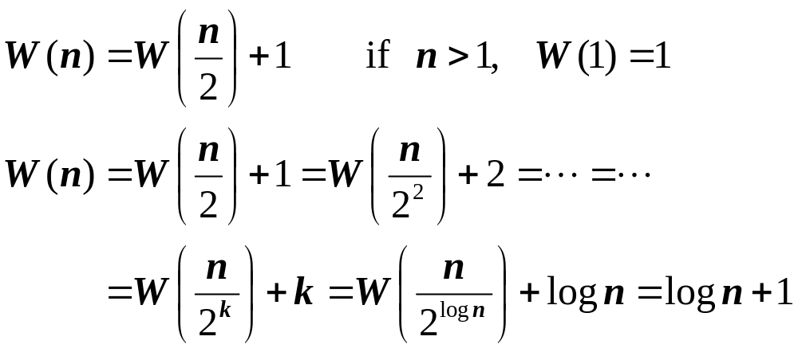
    No every-case time complexity
    Best-case :
    Avg-case, worst-case :
    Worst-case time complexity analysis
      Basic operation : element comparison.
      ( x : S[mid] ) why?
      Input size : n (size of array S)
      (case 1) n is a power of 2

Slide 7

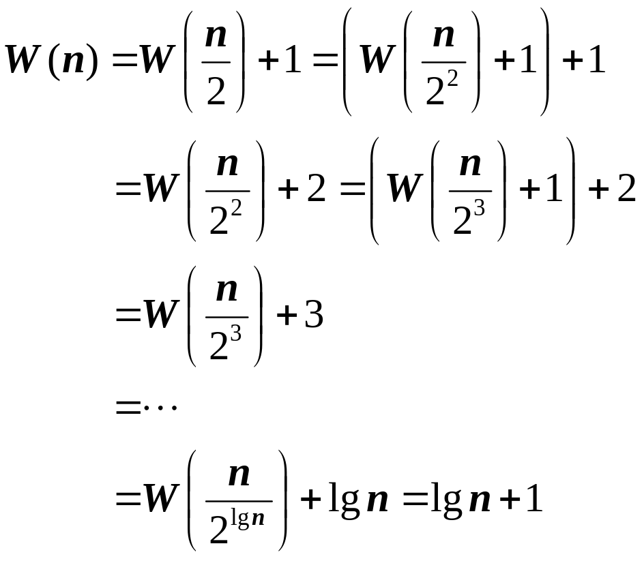
      (case 2) n is not a power of 2

Slide 8
  Merge Sort : 2-way mergesort
    Note : k-way mergesort (k > 2)
    Strategy (or approach)
    1. Divide into 2 subarrays of same size
    2. Conquer (solve) each subarray. (sort)
    Unless sufficiently small, use recursion.
    3. Combine the subsolution : merge
    (Example)
  1. Divide the array :
  2. Sort each subarray :
  3. Merge the subarrays :
  see Fig 2.2. In page 53
27 10 12 20 25 13 15 22
27 10 12 20 25 13 15 22
10 12 20 27 13 15 22 25
10 12 13 15 20 22 25 27

Slide 9
    procedure mergesort ( n : integer;
    var S : array [1..n] of keytype);
    const h=n/2;
    m=n-h;
    var u : array [1..h] of keytype;
    v : array [1..m] of keytype;
    begin
    if n > 1 then
    {
    copy S[1] ~ S[h] to u;
    copy S[h+1] ~ S[n] to v;
    mergesort ( h, u );
    mergesort ( m, v );
    merge ( h, m, u, v, S );
    }
    end;

Slide 10
    procedure merge ( h, m, u, v, S )
    var i, j, k ; index;
    begin
    i = 1; j = 1; k = 1;
    while i ≤ h and j ≤ m do {
    if u[ i ] < v[ j ] then {
    S[ k ] = u[ i ]; i++
    }
    else {
S[ k ] = v[ j ]; j++
}
    k++
    }
    if i > h then copy v[ j..m ] to S[ k..h+m ];
    else copy u[ i..h ] to S[ k..h+m ];
    end;

Slide 11

    worst-case analysis of merge
    Basic op. : element comparison
    Input size : h & m (array sizes)
u v
10 12 20 27 13 15 22 25
i j
S : 10 12 13 15 20 22 25 27
k

Slide 12
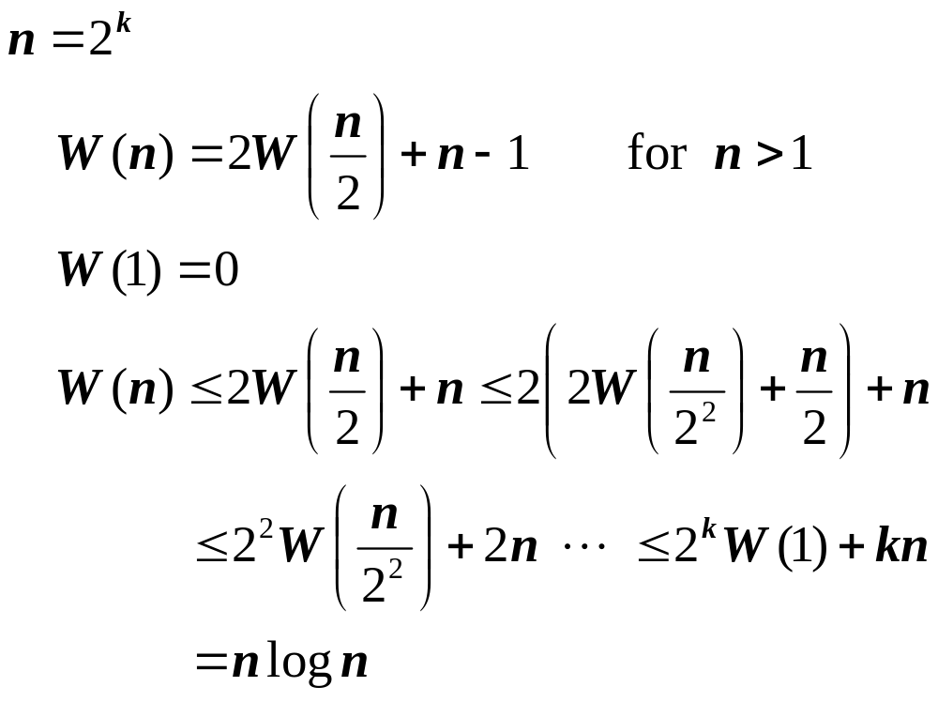
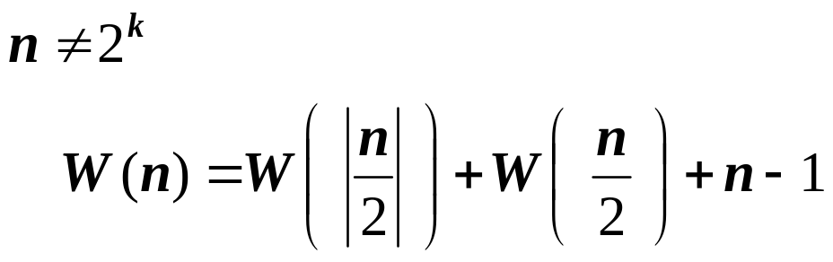
    worst-case time comp. Analysis of mergesort.
    Basic op. : element comp. In merge
    Input size : n (size of S)
    (i)
    (ii)

Slide 13


  In-Place Sort
    “Only constant extra space.”
    extra memory space (why?)
    Reduce to n ? Yes!
    produce mergesort2 ( low, high : index);
    var mid : index;
    begin
    if low < high then
    {
    mid = ( low + high ) / 2;
    mergesort2( low, mid );
    mergesort2( mid + 1, high );
    merge2( low, mid, high );
    }
    end;

Slide 14
    procedure merge2 ( low, mid, high : index ) ;
    begin
    i = low; j = mid + 1; k = low;
    while i ≤ mid and j ≤ high do
    {
    if S[ i ] < S[ j ] then {
    U[ k ] = S[ i ]; i++
    }
    else {
    U[ k ] = S[ j ]; j++
    }
    k++
    }
    if i > mid then copy S[ j .. high ] to U[ k .. high ];
    else copy S[ i .. mid ] to U[ k .. high ];
    move U[ low .. high ] to S[ low .. high ];
    end;

Slide 15
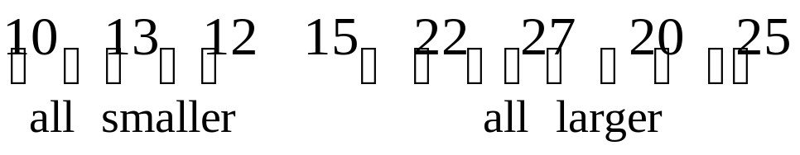
Quick Sort – Hoare (1962)
  Strategy (approach)
    Choose a pivot item (randomly)
    Partition into 2 subarrays.
    Sort each subarray recursively.
  (Eg)
    1. Partition.
    2. Sort subarrays recursively.
pivot item

Slide 16
    procedure quicksort ( low, high : index) ;
    var pivotpoint : index;
    begin
    if high > low then {
    partition( low, high, pivotpoint );
    quicksort( low, pivotpoint – 1 );
    quicksort( pivotpoint + 1, high );
    }
    end;
    n, S : parameters ×
    main : quicksort (1, n );

Slide 17
    Procedure partition ( low, high : index;
    var pivotpoint : index );
    var i, j : index;
    pivotitem : keytype;
    begin
    pivotitem = S[ low ]; j = low;
    for i = low + 1 to high do
    if S[ i ] < pivotitem then {
    j++; exchange S[ i ] & S[ j ]; }
    pivotpoint = j;
    exchange S[ low ] and S[ pivotpoint ]
    end;
    (Eg)
i | j | S[1] | S[2] | S[3] | S[4] | S[5] | S[6] | S[7] | S[8]
– | – | 15 | 22 | 13 | 27 | 12 | 10 | 20 | 25
2 | 1

Slide 18
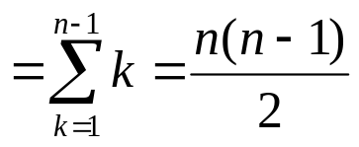
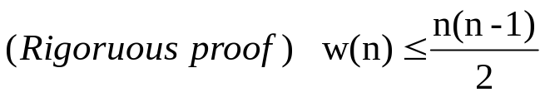
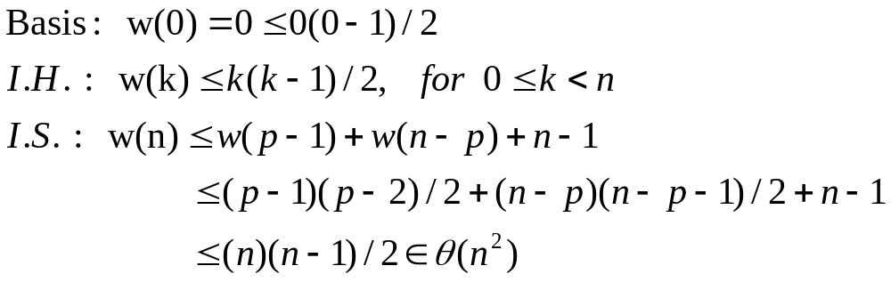
Stable? No. Why?
In-place? Yes. If we ignore stack space.
(Every-case) Time complexity Analysis of Partition
  Basic op. : element comp.(S[i]: pivotitem)
  Input size : n=high-low+1
  T(n)=n-1
Worst-case t.c. Analysis of Quicksort
  T(n)=T(0) + T(n-1) + n-1
  T(n)=T(n-1)+(n-1) for n>0
  T(0)=0
  T(n)= T(n-1)+n-1=T(n-2)+(n-2)+(n-1)=…

Slide 19
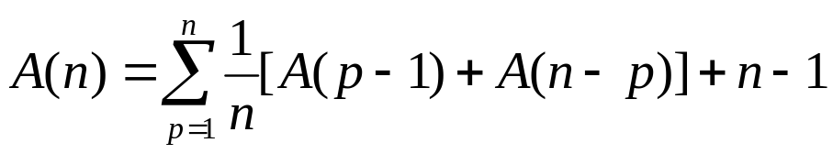
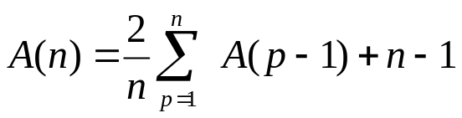
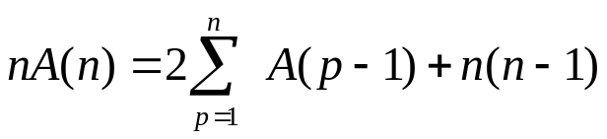
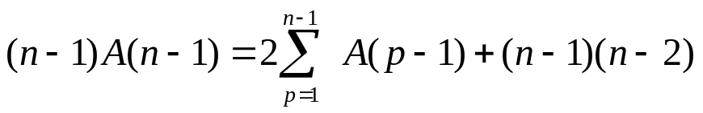
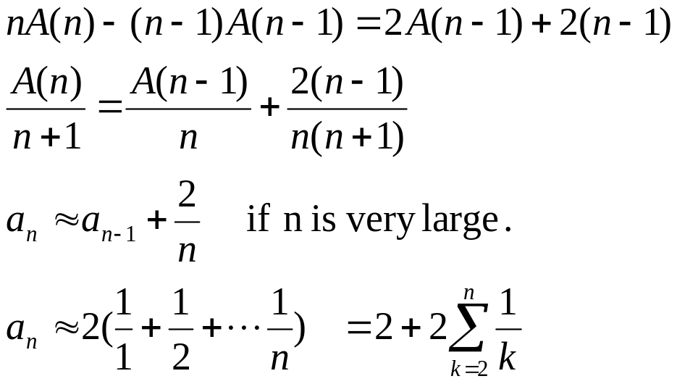
Averge-case T.C. And of Quicksort
Avg.time to sort subarrays
Time to partition
Prob.(pivot is p-th elt.)
-①,
- ②
① - ② :

Slide 20
Procedure quicksort(low,high:index)
var pivotpoint :index;
{
while low< high do {
  partition(low, high, pivotpoint);
  If pivotpoint-low <= high-pivotpoint
  {
  quicksort(low, pivotpoint-1);
  low← pivotpoint+1;}
  else {
  quicksort(pivotpoint+1,high);
  high ←pivotpoint-1; }
  }
  }

Slide 21
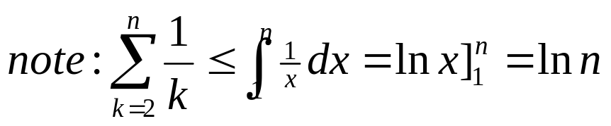
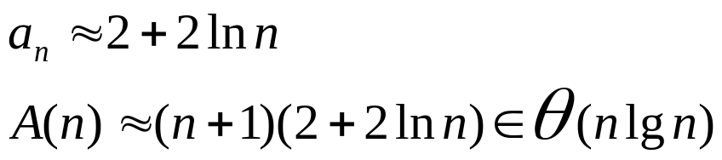
y=1/x
1
….
1
2
3
n-1 n
Randomized Quicksort?
  Procedure rand_partition (low,high: index; var pivotpoint : index);
  { i ← random(low, high);
  exchange s[low] and s[i];
  partition(low, high, pivotpoint); }
  Procedure rand_Quicksort(low,high:index)l
  { if low>high then{
  rand_partition(low, high, pivotpoint);
  rand_Qucksort(low, pivotpoint-1);
  rand_Qucksort (pivotpoint+1, high);
  }}

Slide 22

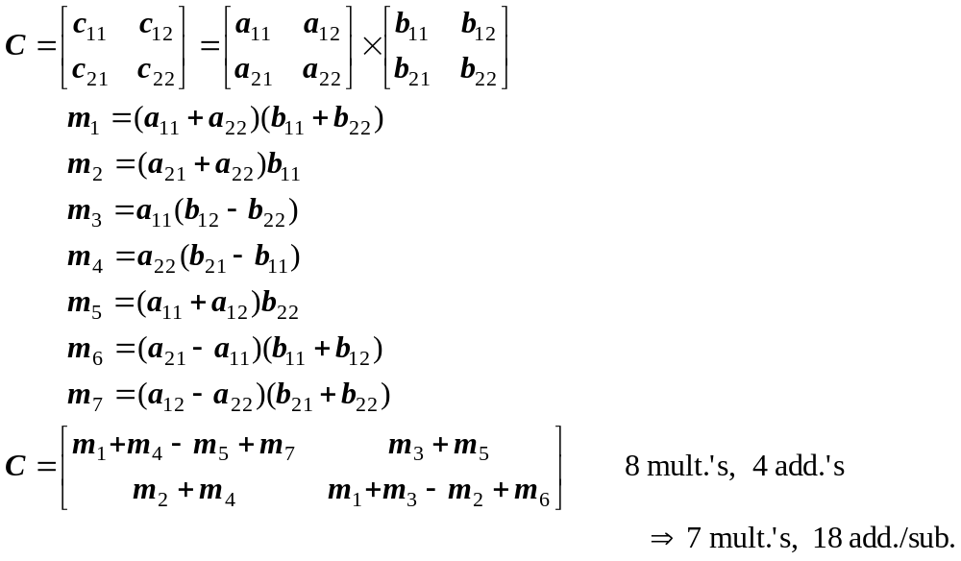
Strassen’s Matrix Multiplication ㅡ1969
  # multiplication + # additions :
  Better algorithm? Asymptotically yes.

Slide 23
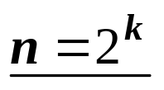

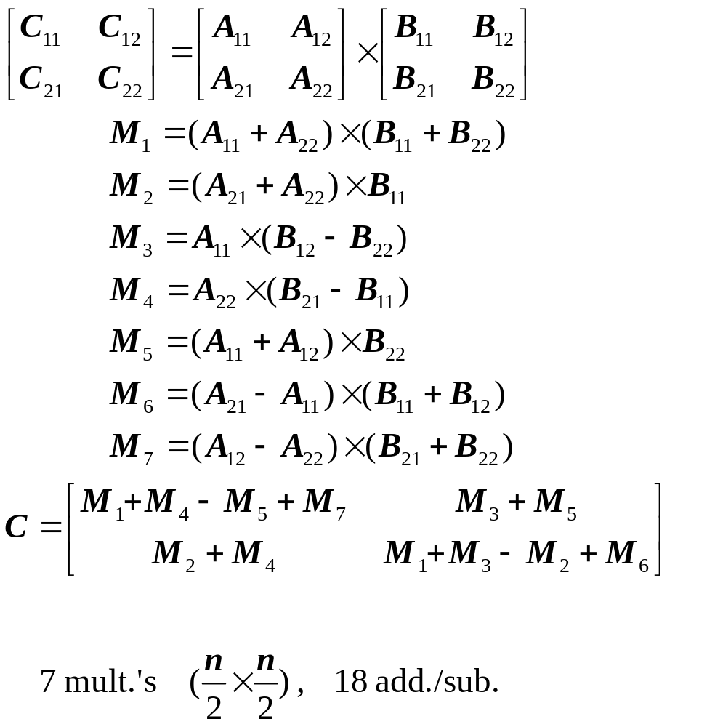

  Generally, A, B, C : n×n matrices 가정

Slide 24

procedure Strassen (n, A, B, C); {
if n ≤ threshold then
Compute C = A × B using standard alg.;
else {
X₁ = A₁₁ + A₂₂; X₂ = B₁₁ + B₂₂; X₃ = A₂₁ + A₂₂;
X₄ = B₁₂ － B₂₂; X₅ = B₂₁ － B₁₁; X₆ = A₁₁ + A₁₂;
X₇ = A₂₁ － A₁₁; X₈ = B₁₁ + B₁₂;
X₉ = A₁₂ － A₂₂; X₁₀= B₂₁ + B₂₂;
Strassen( n/2, X₁, X₂, M₁ );
Strassen( n/2, X₃, B₁₁, M₂ );
Strassen( n/2, A₁₁, X₄, M₃ );
Strassen(n/2, X₉, X₁₀, M₇ );
C₁₁=M₁+M₄－M₅+M₇;
C₁₂=M₃+M₅;
C₂₁=M₂+M_{4;}
C₂₂=M₁+M₃－M₂+M₆; }
}

Slide 25
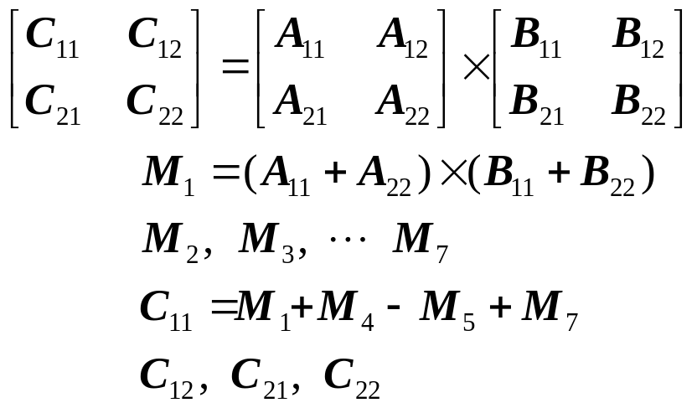
procedure strassen ( n : integer; A, B : n×n matrix;
var C : n×n matrix; ); {
if n ≤ threshold then
Compute C = A × B using standard alg.;
else {
partition A into A₁₁, A₁₂, A₂₁, A₂₂ ;
partition A into B₁₁, B₁₂, B₂₁, B₂₂ ;
Compute C = A × B using standard alg.;
{ Strassen( n/2, A₁₁ + A₂₂, B₁₁ + B₂₂, M₁ ) … }
}
}
Eg.

Slide 26
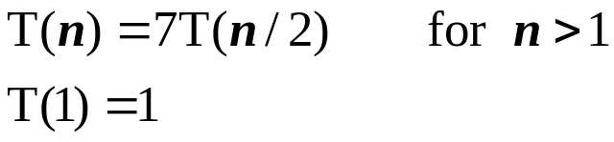
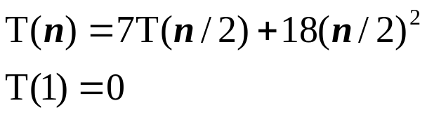
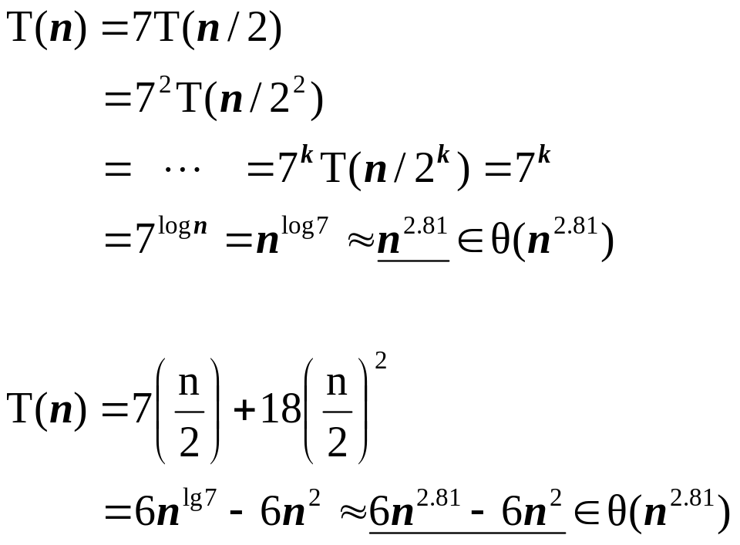
    # multiplications :
    # additions/subtractions :
    (standard M. : n³ mult. , n³－n² Add. )

Slide 27
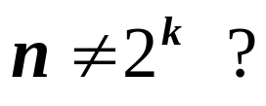



    “ add one extra column & one extra row
    if # rows is odd. “
    Current best : Coppersmith & winograd (1987)
    ( In my opinion, )
    lower bound
      No better lower bound yet.
      No better upper bound yet.
    Matrix inversion, Determinant, … :
    Same time complexity.

Slide 28
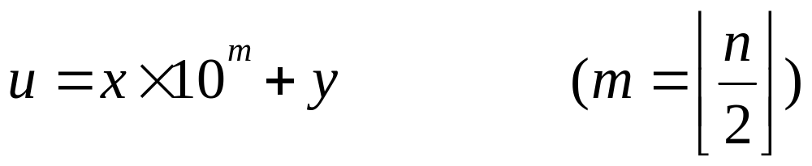
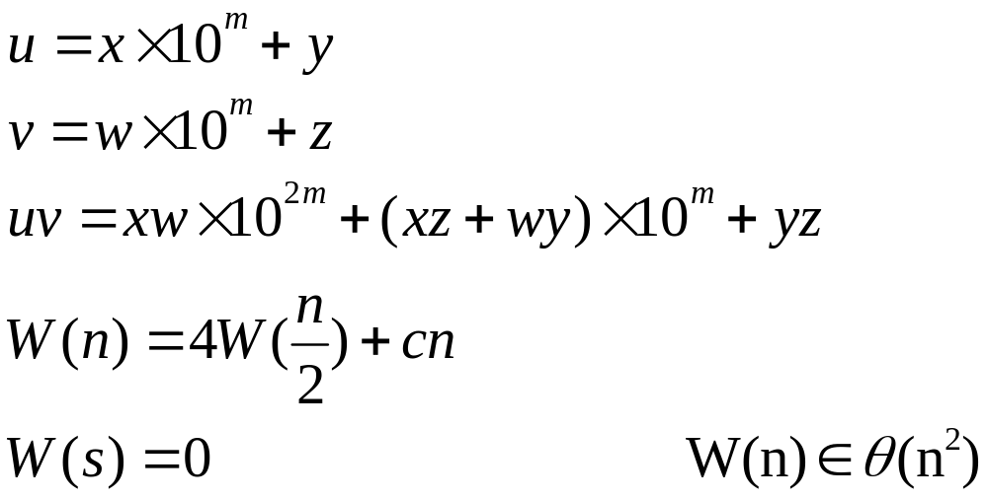
Arithmetic with large Integers
9,423,723 = 9423 X 10³ + 723
n digits
n/2 digits
n/2 digits

Slide 29
