Slide 1
알고리즘 설계 및 분석
Foundations of Algorithm
유관우

Slide 2


Chap9. Theory of NP
Solving a problem:
  ① D & A of an efficient algorithm.
  ② Lower bound.
  If cannot find efficient alg.? NP-Complete?(NP-hard?)
  If NP_hard, approximate solution.
Classification
Sovlable, (computable, recursive)
Unsovlable prob.’s,(Uncomputable Fcn’s, irrecursive lang.’s)
NP
NP_complete
Partially sol.
(recursively enu. Partially comp.)
P
NC
P_complete
Countable.
Probably
NC P NP
NC P NP

Slide 3

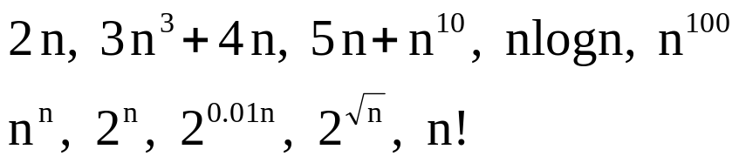
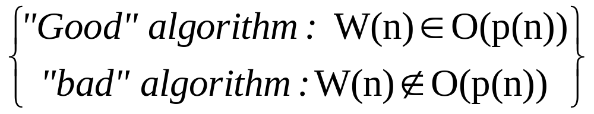
9.1 Intractability
Intractable – “difficult to treat or work.”
Definition : polynomial-time algorithm.
“Easy” Problem : Good algorithm 존재.
“Intractable” Problem : No polynomial time algorithm.

Slide 4
Intractable problem
  No polynomial time algorithm
  “I cannot find a polynomial time alg.” ⅹ
  “∃an exp. time alg. for the problem” ⅹ
  (Eg) 0/1-Knapsack, n-queues, TSP, HP,…
  (c.f. Chained Matrix Mult. : O(n3)
  But recursion → exp. time alg. )

Slide 5
  n = 100, 10⁻⁹ sec./op.
    W(n) = n³ : 1 milli second.
    W(n) = 2^{n} : ≥ 10⁹⁰ years
  However, ∃extreme case n=10⁶
    W(n) = 2^{0.00001n} = 1024
    W(n) = n¹⁰ = 10⁶⁰

Slide 6
3 categories
  1. Problems proven to be in P (tractable).
  2. Problems proven to be not in P (intractable).
  3. Problems proven neither to be in P
  nor to be not in NP

Slide 7
9.2 Input size revisited(p366)
Q : Input size?
  (Eg) Sorting, Searching, … : #keys = n.
  Always n ? → Be careful !!!
function prime(n)
{
prime = true; i = 2;
while prime && i < n do
if n mod i = 0 then prime = false;
else i++;
}
W(n) = θ(n)
Polynomial time alg?
No, Why?

Slide 8
(Def) Input size :
# characters for writing the input.
  ☻Encoding : binary, decimal, unary, …
  (Eg) prime-checking : ≈ lg n , ≈ log n, n, ….
  Sorting n Keys ≤ L : ≈ n lg n , ≈ n log n, n·L, …
  lg n = lg 10 · log n , log n = log 2 · lg n
  → polynomially equivalent.
  n = 2 ^{lg n} (polynomially non-equivalent.)

Slide 9
  ☻ reasonable encoding
  Binary, decimal encoding : O
  unary encoding : X
  Why the input size of sorting = n ?
  polynomially equivalent, & simpler

Slide 10
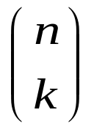
  ☻ Prime checking problem
  input size : ≈ lg n
  W(n)=θ(n)=θ(2^{lgn}) → exponential-time alg.
  (Eg) nth Fibonacci # : θ(n)
  : θ(n)
  ♠ 0/1 knapsack : θ(nW)
  input size : ≈ n lg W
  → exponential alg. in size alone
  pseudopolynomial-time alg.

Slide 11
9.3 3 general Categories
(1) problems in P
  →polynomial time algorithms found.
  sorting, searching, matrix mult., …
(2) problems not in P
  → proven to be intractable.
  (ㄱ) nonpolynomial amount of output.
  “Determine all Hamiltonian Circuits.”
  (n-1) ! Circuits.

Slide 12
9.3 3 general Categories
  (ㄴ) Halting problem - partially solvable.
  Presburger Arithmetic - solvable, intractable.
  …
  relatively few such problems
(3) Neither proven to be intractable,
Nor proven to be tractable
  TSP, 0/1-Knapsack, HC, m-coloring(m≥3),…

Slide 13
9.4 Theory of NP
Optimization problems
Decision problems : yes or no
  (Eg)
  ♠ TSP optimization problem : optimal tour.
  TSP decision problem :
  ∃a tour with cost ≤ d ?
  ♠ 0/1 Knapsack O.P. : max total profit.
  0/1 Knapsack D.P. : set with profit ≥ p ?

Slide 14
  ♠ Graph coloring O.P. : chromatic #.
  Graph coloring D.P. : colorable with ≤ m ?
  ♠ Clique problem:
  Clique : complete subgraph
  maximal clique : maximal size
  clique O.P.
  clique D.P. : ≥ k ?

Slide 15
An optimal solution for O.P. →
  (easy)→ A solution for D.P.
  But Sol. for D.P → opt. sol. for O.P ? No!
Polynomial time alg. for O.P.
  → Poly. time alg. for D.P. vice versa.

Slide 16
The Sets P and NP
  (Def) P : set of poly. time solvable D.P.’s.
  (Eg) Sorting, Searching, MM, CMM, MST, …
  TSP D.P ? 0/1 Knapsack D.P. ? …
  Graph coloring D.P. ? Clique D.P. ? …
  Nobody knows whether in P or not in P!!!
  Almost probably not in P.

Slide 17
Decision Problems not in NP.
  Relatively few D.P.’s. Presburger Arithmetic proven to have no poly. time alg.
Polynomial time verification
  Possibly difficult to solve a D.P.,
  but easy to verify it.
  (TSP, 0/1-K.S., Graph.C., Clique, …)
  (Eg) TSP
  “Given a tour with cost ≤ d,
  the tour can be verified in P. time.”

Slide 18
Nondeterministic Algorithm
  1. Guessing (Nondeterministic) stage :
    “Given an instance, guess a correct solution in unit time if exists.”
  2. Verification (Deterministic) stage:
    “verify the guessed solution.”

Slide 19
(Eg) TSP
Digraph & d (∃ tour ≤ d ? )
Guessing Stage : A tour ≤ d.
Verifying Stage : verify it is a tour & ≤ d.
Definition Poly. time nondeterministic alg.:
Nondet. alg. s.t. verification in p. time.
Definition NP : the set of all problems solvable
by poly. time nondeterministic alg.

Slide 20
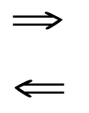
“Solvable in P-time by nondet. Turing machine.”
(Eg) TSP ∈ NP, 0/1 K.S., G.C., Clique ∈ NP.
➔”Easy to verify but possibly hard to solve.”
(주의 : Easy verification Easy solution)
  P ⊆ NP : O.
  P = NP ? Most probably No!

Slide 21
Why easy verification ➔ easy sol.?
  Exponential # candidates.
  Unit time guessing is not realistic.
  (useful only for problem classification)
Partially solvable
sovable
Halting prob
NP
NC
P
☺
☺
☺
Presburger Arith
?

Slide 22
Almost all important problems are in NP.
Why most researcher believe in P NP?
  1. Too many problems cannot be proven to be
  in P.
  2. Only one of them is in P
  ➔ All of them are in P, i.e , P=NP.

Slide 23
9.4.2 NP-complete Prob’s
TSP 0/1-Knapsack
D.P θ(n²2^{n}) θ(min(2^{n}, nW))
B & B (n-1)! Leaves 2^{n}
  ➔TSP seems more difficult .
  But, polynomially equivalent.
(Actually, only one of NP-C. prob.’s is poly. time solvable, so are all of them.)

Slide 24


CNF-satisfiability prob.
  Logical variables : x, y, x1, x2, …
  Literal : x or
  Clause : v (or)
CNF(Conjunctive Normal Form)

Slide 25



CNF-satisfiability decision prob.
  ∃ a satisfying truth assignment?
  (Eg)
  “yes” since x1=T, x₂ = x₃ = F.
  : NO!
CNF NP.
CNF P? Most probably no!
Cook(1971) : If CNF ∈ P, then P=NP.
  “polynomial-time reducibility”

Slide 26
Transformation algorithm :
  Want to solve prob. A.
  Have an alg. to solve prob. B.
  ∃ an alg. to transform an instance x of A to an instance y of B s.t. x is yes iff y is yes.
➔To solve A,
  1. Transform x → y.
  2. Apply alg. for B.

Slide 27
y=trans(x)
Yes
Or
no
x
Alg. for
Prob. B
trans
Algorithm for problem A
(Eg) Prob. A : Is one of n logical var. true?
Prob. B : Is one of n #’s positive?

Slide 28
k₁, k₂, …, k_{n} = trans(x₁, x₂, …, x_{n})
(x_{i} = true iff k_{i} = 1)
Alg. for B returns “yes” iff ≥1 k_{i}’s is 1
iff ≥1 x_{i}’s is true.
  ➔Can solve A by transforming &
  applying alg. for B.
(Def) A is poly. time (many-one) reducible to B, if ∃p. time trans. Alg. from A to B.
(A ∝ B)

Slide 29
Theorem 9.1 If Decision Prob. B ∈ P,
and A ∝ B ⇒ A ∈ P.
  (Proof) p(n) : transformation alg. A→B.
  q(n): alg. for solving B.
  x : instance for A.
  y : instance for B s.t. y = trans(x).
  |x |= n ⇒ |y| ≤ P(n).
  Time to solve x = p(n) + q(p(n)).
  ∴ A ∈ P.

Slide 30
Definition A problem B is NP-complete if
1. B ∈ NP, and
2. ∀A ∈ NP, A ∝ B.
Thm 9.2 (Cook’s Theorem) CNF is NP-C.
Thm 9.3 A problem C is NP-C if
1. C∈NP, and
2. for NP-C. problem B, B ∝ C.

Slide 31
  (Proof) Let A any prob. in NP
  Since B is NP-C., A ∝ B.
  Since A ∝ B and B ∝ C, A ∝ C.
  Since A ∝ C, for any prob. A ∈ NP and
  C is in NP, C is NP-Complete.

Slide 32

(Eg) “Clique Decision Prob. is NP-complete.”
(Proof) CNF∝Clique.
  (“clique is at least as hard as CNF.”)
  Let B = C₁ ∧ C₂ ∧ … ∧ C_{k}.
  x₁, x₂, … , x_{n} : variables in B.
  Transform B to a graph G = (V, E) s.t.
  V = {(y,i) | y is a literal in C_{i}}
  E = {((y,i),(z,j)) | i≠j, }

Slide 33







(1)Clique∈NP
  (Given k vertices, verify whether it is a clique.)

Slide 34
(2) Polynomial-time transformation.
(3) B is CNF-satisfiable iff
G has a clique of size ≥ k
  (⇒) B is CNF-satisfiable.
  ⇒ ∃truth assignments for x₁, x₂,…, x_{n}.
  ⇒ ≥ 1 literal in each C_{i} is true.
  ⇒ V’={(y,i)| y is the true literal in C_{i}}
  forms a clique in G of size k.

Slide 35
  (⇐) Note that ∃ edge ((y,i), (z,i)).
  A clique in G has ≤ k vertices.
  Hence, if G has a clique of size ≥ k,
  G has a clique of size exactly k.
  Let S = {y | (y, i) ∈ V’ (clique)},
  then S contains k literals.
  Each such literal from different clause.
  Both y and y cannot be in S, since ((y,i),(y,j)) ∉E.
  Set x_{i} = true if x_{i}∈S,
  false if x_{i}∉S.
  Then all C_{i}’s are true.
  ∴ B is CNF-satisfiable.

Slide 36
Hamiltonian Circuit Decision Problem(HCDP)
(Theorem) HCDP is NP-Complete.
  (Proof) (1) HCDP is in NP.
  (2) CNF-Satisfiability ∝ HCDP.
  (HCDP is NP-hard.)
  (Eg 9.10) TSP (undirected) DP.
  “Given G & d, ∃ a tour of cost ≤ d?”

Slide 37
(Theorem) TSPUDP is NP-Complete.
  (Proof) (1) TSPUDP ∈ NP.
  (2) TSPUDP is NP-hard
  (HCDP ∝ TSPUDP).
  W(u,v) = 1 if (u,v) ∈ E,
  2 if (u,v) ∉ E.
  (V,E) has HC iff (V,E’) has a tour of cost n.
1
2
1
1
2
1
HCDP
TSPUDP

Slide 38
  (Eg 9.11) TSPDP is NP-complete.
  TSPUDP ∝ TSPDP
  (u,v) ∈ E ⇒ <u,v>,<v,u>∈E’.
  undirected tour ≤ d ⇔ directed tour ≤ d.

Slide 39
C.f. Complementary Prob.’s
Composite #’s Problems : (CNP)
is n = m·k ? (m >1, k>1)
Nobody knows whether CNP∈P or CNP∈NP-C.
Note that CNP is easy to verify.
But, Primes Problem : (PP) is n a prime #?
⇒ difficult to verify (Anyway PP ∈ NP).
Complementary TSPDP (TSPDP).
∃no tour of cost ≤ d in G?
Nobody knows whether TSPDP∈ NP.

Slide 40
9.5 Handling NP-hard Problems
Dynamic Programming,
Backtracking, Branch & Bound.
⇒ exponential-time in W.C.
⇒ approximation alg. (Heuristic Alg.)

Slide 41
Approximation Algorithms
Not optimal solution but approx. sol.
Good if we can give a bound.
(eg. minapprox < 2 * mindist)
Better if better bound.

Slide 42
(Eg. 9.17) TSP with Triangular Inequality. weighted, undirected graph G=(V,E).
  1. Complete graph.
  2. W(u,v) ≤ W(u,y) + W(y,v) (t.I.)
Also, NP-hard problem.
  (1) Determine an MST.
  (Note : cost(MST) < cost(TSP tour).)
  (2) Create a path around the MST.
  (Each city twice.)
  (3) Short-Cut ⇒ a tour.
  P.-time algorithm.

Slide 43
(Thm) minapprox < 2 * mindist.
  (Proof) cost(MST) < cost(TSP Tour).
  Triangle Inequality.
  (Note : ∃instances s.t. minapprox ≅ 2 * mindist.)
3
3
2
2
2
2
2
2
4
4
4
4
2
2
2
2
2
2
2
2
3
Weighted,
undirected G
Twice
around MST
MST
Tour with S.C.

Slide 44
Better approximation algorithm?
(minapprox2 < 1.5 * mindist)
  (1) Determine an MST.
  (2) V’ : Set of odd-degree vertices in MST.
  (Note : |V’| is even) Why?
  obtain a minimal weight
  matching (MWM) for V’.
  (3) Create an Euler tour.
  (4) Short-Cut. (* poly. time alg.)

Slide 45
MST
MST U MWM
Short-Cut

Slide 46
(Thm) minapprox < 1.5 * mindist.
  (Proof) Optimal tour --(short cut)--> path for V’.
  ⇒ 2 matchings, M₁ & M₂.
  Cost(MWM) ≤ min(Cost(M₁), Cost(M₂)) ≤ ½mindist.
  minapprox < Cost(MWM)+Cost(MST) ≤ 1.5*mindist.
  (Note) : ∃ an instance s.t. minapprox ≅ 1.5*mindist.
  If given graph satisfies triangular inequality.
  (1) Approximation solution : O.K.
  (2) Optimal sol ?
  ① find approx.sol.
  ② B-&-B with the approx.sol.

Slide 47
Bin packing Problem
  N items with sizes
  S₁, S₂, … , S_{n} , where 0 < S_{i} ≤ 1.
  Determine min # of bins (unit-cap. bins).
NP-hard problem (optimization problem).
First-fit strategy (c.f. best-fit).
Nonincreasing first-fit (NFF) (off-line),
① sort in nonincreasing order, and
② pack into as close bin as possible.

Slide 48
  (Eg) size : 0.85, 0.5, 0.4, 0.4, 0.3, 0.2, 0.2, 0.1
“Greedy algorithm within a greedy alg.”
Θ(n²) time. Why?
  (n items, size of each item = 0.51.)
Non-optimal solution.
  (Eg.) B2 : 0.5, 0.3, 0.2.
  B3 : 0.4, 0.4, 0.2. 3 bins!!!!!!
0.1
0.2
0.4
0.3
0.85
0.5
0.4
0.2
B₁
B₂
B₃
B₄

Slide 49
Lemma 9.1 OPT : optimal # bins.
Any item placed by NFF in an extra
bin has size ≤ 1/3.
  (Proof) S_{i} : first item placed in B_{opt+1}.
  Since NFF, it suffices to show S_{i} ≤ 1/3.
  (Why?) Suppose b.w.o.c that S_{i} > 1/3.
  Then S₁ ≥ S₂ ≥ … ≥ S_{i-1} > 1/3
  ⇒ ≤ 2 items in B₁, B₂, …, B_{opt}.
  (Q?) ∃≥1 bin, whose index ≤ opt, having 1 items.
  (Q?) ∃≥1 bin, whose index ≤ opt, having 2 items.

Slide 50
  (Q?) ∃j ( 0 < j < opt ) s.t.
  (Q?) Otherwise, ∃B_{k}, B_{m} (k<m ≤ opt) s.t.
  B_{k} : 2 items, B_{m} : 1 item ⇒ 모순.
  In optimal sol., s₁, … , s_{j} → j bins,
  s_{j+1}, … ,s_{i-1} → (opt-j) bins.
  (Q?) S_{i} cannot be placed to any of them
  ⇒ 모순.
S₁
S_{j}
S_{j+1}
B₁
B_{j}
B_{j+1}
B_{opt}
S₁ … S_{j}
S_{j+1} …S_{i-1}

Slide 51
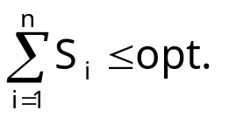
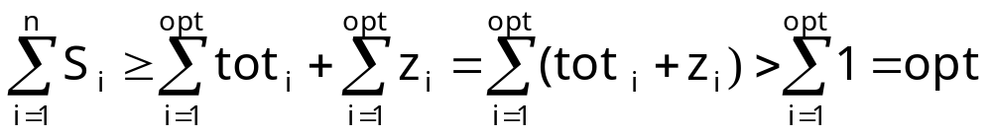
Lemma 9.2 # items placed by NFF in extra bins is ≤ opt –1.
  (Proof)
  Suppose b.w.o.c that ≥ opt items → extra bins.
  z₁, z₂, …, z_{opt} : their sizes.
  tot_{i} (1 ≤ i ≤ opt) : total size in B_{i} (by NFF).
  tot_{i} + z_{i} > 1
  -→ 모순.

Slide 52
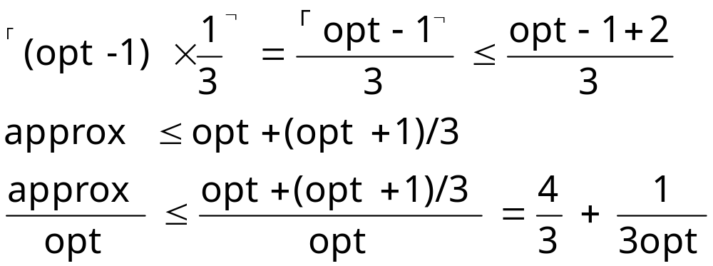
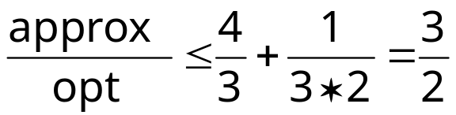
Theorem 9.8 approx ≤ 1.5 * opt (NFF)
  (Proof) #extra bins is ≤
  Maximized if opt = 1.
  But if opt =1, opt = approx. (Why?)
  Hence, maximized if opt = 2.

Slide 53
☺ ∃ an instance s.t. approx = 1.5 * opt
 시험문제 
Empirical Test – real data.
Especially ∃bound.
Compare several heuristic alg.’s.
(Bench mark Test data.)

