Slide 1
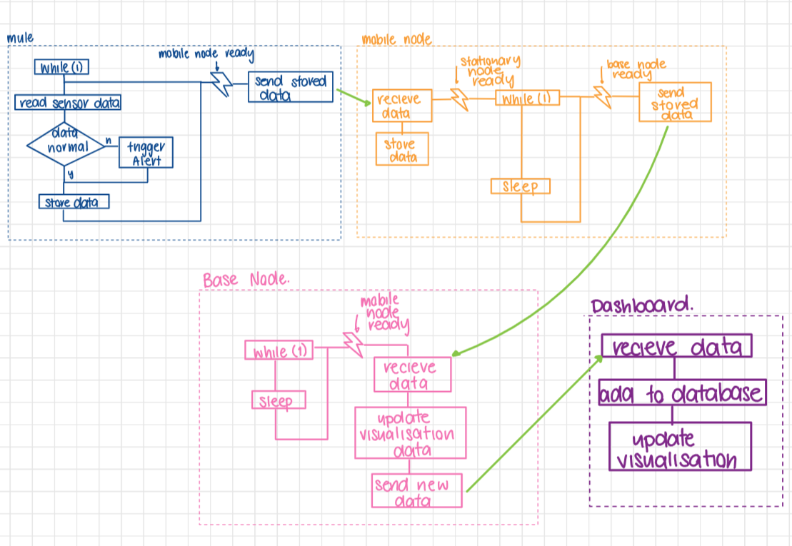
Remote Monitoring with Data muling
Noah Trevena, Molly Harper, Tafadzwa Chimwe GROUP: Lyssa - Amber
DATA MULING FOR REMOTE MONITORING
The project implements a mobile data mule system that wirelessly collects patient vital signs and environmental data such as heart rate CO₂ and air quality from sensor-equipped nodes.
KEY DESIGN FEATURES
SCALABILITY
The architecture supports multiple patient and mobile nodes, making it scalable for healthcare, disaster relief, or remote field environments where continuous connectivity is not feasible.
ENERGY EFFICIENCY
By using Bluetooth Low Energy (BLE) and scheduled sampling, the system minimizes power consumption on sensor nodes while enabling reliable data transfer to a central base station.
DATA NOTIFICATION
Each sensor node includes onboard data analysis capable of detecting potential health risks and alerting patients in real time, enabling timely intervention. Once transmitted to the base node, the data is visualized to support accurate monitoring and informed decision-making.
SYSTEM OVERVIEW
PATIENT NODE
The patient nodes are equipped with:
MAX30102 heart rate sensor
Temperature sensor
CO2 sensor
eVOC sensor
Utilizing Zephyr RTOS threading, the node concurrently and continuously samples data from all sensors. The data is processed in real time for anomaly detection, in the instance of such, a buzzer is triggered indicating there is a potential issue. Data is logged for every 10 minutes over a 12-hour sampling period.
MOBILE NODE
The mobile node is a dual role BLE device, advertising itself as a connectable Nordic UART service (NUS) peripheral whilst simultaneously acting as an observer, scanning for patient nodes. This node uses RSSI threshold values to evaluate the proximity of a patient node and begin data transfer. On connection to the base node, the collected sensor sample is streamed to the base using GATT notifications.
BASE NODE
The base node received the data from the mobile node and through UART communication, parses the data and creates JSON objects for the samples. This data through a HTTP POST request is sent to a Tago instance which undergoes the data visualisation for that patient.
NODE INTERACTION
FINDINGS
RSSI PROXIMITY
The patient nodes
COMMUNICATION METHODS
The patient nodes
DATA STORAGE
The patient nodes
FINDINGS

