Slide 1

CentsTrip Beautiful Singapore, Satisfactory Cost
CS5224 Cloud Computing Assignment 2
Yu Yingchen
Ding Wenjia
Lu Yifan
Zhu Longwei
Huang Mengying

Slide 2
Contents
Motivation
Target users
Services Comparison
Why using Cloud services
SaaS architecture
Data preprocessing
Data analysis
Front-end GUI
Back-end system
Economic factor

Slide 3
Motivation
Singapore, whose main industry is tourism, has suffered from tourist reduction problem since 2014.
Service quality is always a concern for tourists, especially with limited budge available.
Raise necessity of such a service:
Maintain the low budget and fulfil the service quality at the same time.
Satisfy the tourists’ travel requirements based on different travelling preference.
We hope to attract more people come to Singapore and visit this beautiful country.

Slide 4



Target Users
Teenagers
Limited money
Travel to Singapore

Slide 5
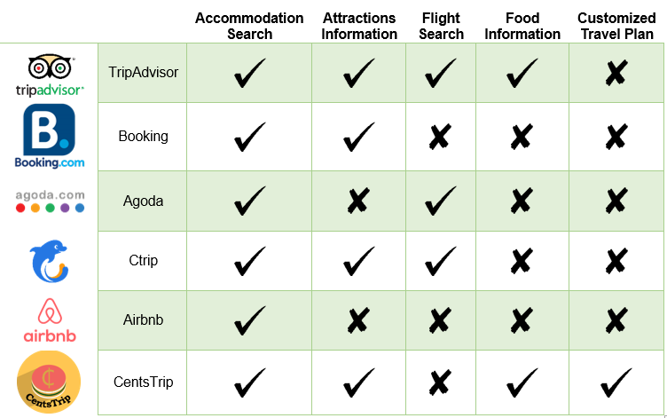
Services Comparison
Customized travel plan consists of recommended accommodation and attractions based on user preference.
Centstrip is the only one which provides the customized travel plan.

Slide 6
Why Cloud
1. Capable of handling workload fluctuations.
2. Help to reduce cost without limiting the capacity
1. Shorten the development cycle.
2. Chance to take the first mover advantage.
1. Reduce Up-front Cost.
2. Measured operational expenditures.
Cost Reduction
Elasticity
Business Agility

Slide 7
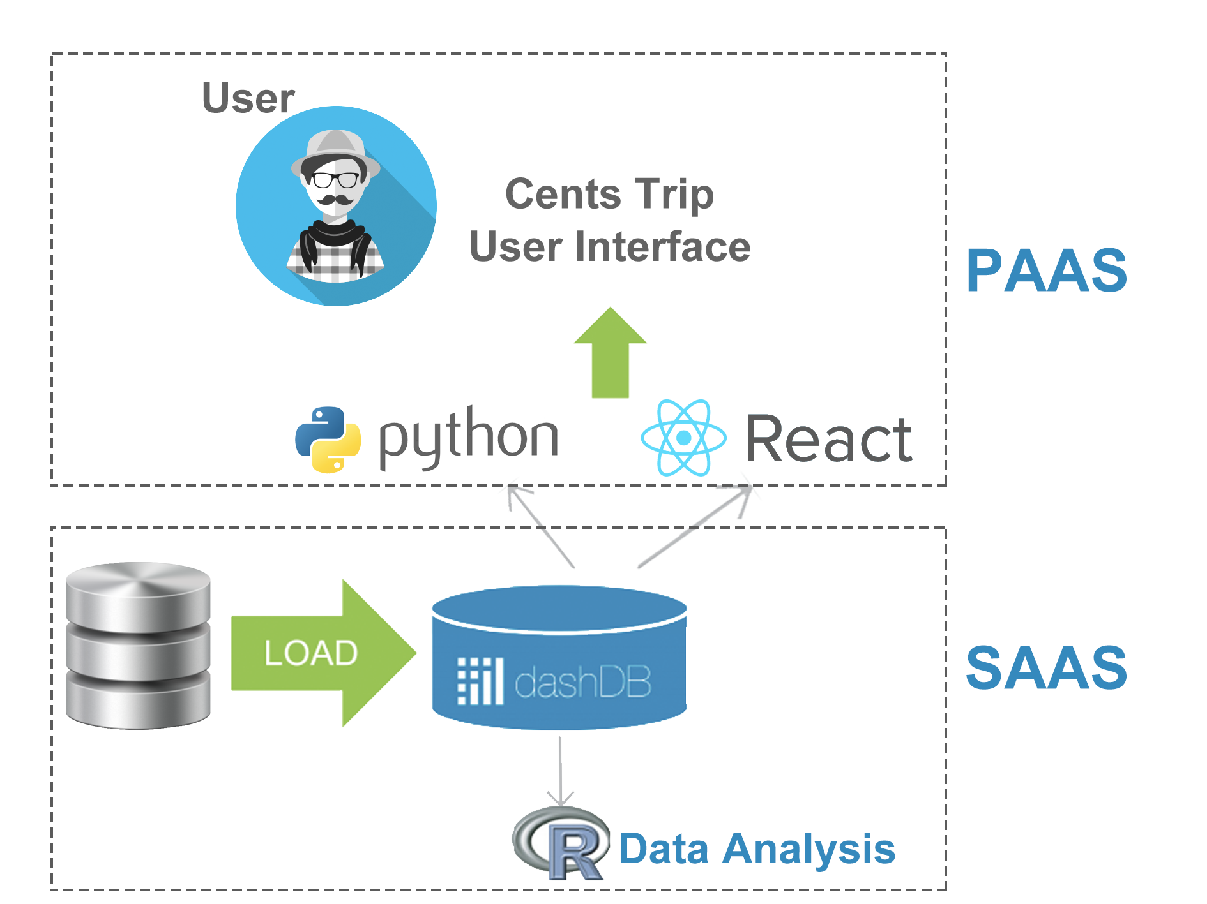
Architecture Overview
Web-based application.
Hosted on IBM Bluemix could platform.

Slide 8

Data Preprocessing
Airbnb
Unofficial API
roomID,name,loca-tion,etc
Attract-ion
KML format convert
name,longitude,lat-itude,etc
Food court
name,longitude,lat-itude
Python script
MRT
name,longitude,lat-itude

Slide 9
Data Analysis – Cost Efficiency
Taking different attributes into account to measure the quality as Airbnb's cost efficiency.
attributes
Distance between b&b and famous attraction
Distance between b&b and nearest MRT
Weighted least square estimation regression model
Cost Efficiency
The rating of b&b
The popularity of b&b

Slide 10
Data Analysis – Similarity
Calculating similar attractions for recommendation to users based on what they select.
description
TF-IDF
new factor
Similarity
price
cosine similarity
popularity
rating

Slide 11
Front-end Flow
Input Expected Budget
Choose Traveling Duration
Select Tourist Attractions
Get the Recommendation Results
Confirm Airbnb
Summary Page
Select Interested Places

Slide 12
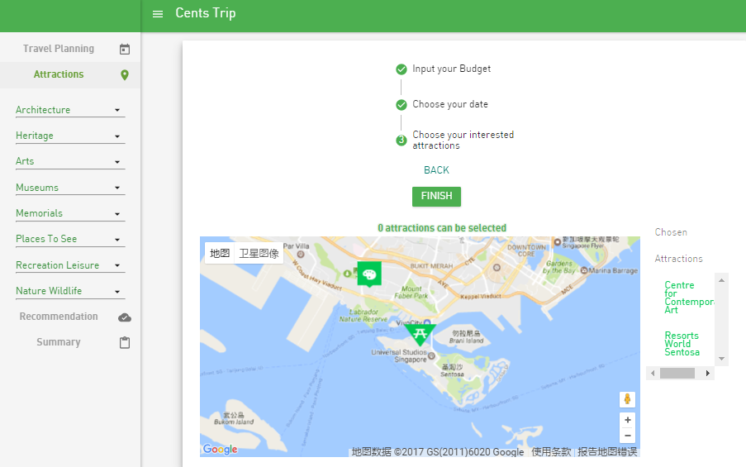
Front-end GUI Snapshot

Slide 13
Back-end System
Front-end
Selected attractions
Find nearest 20 Airbnbs
Filter price
5 highest cost efficiency Airbnbs
3 nearest food courts
Return results to front-end
Check similarity value
Similar attractions
3 nearest food court
Return results to front-end

Slide 14
Economic Factor
Economic Benefits
Key Considerations
Pricing Model
Contributes to tourism activity in Singapore.
Improves the flow in the region.
Generates profit when the users access the website due to website traffic.
The placement of advertisem-ents.
The population size, the distance among different destinations, the budget quality, the duration of time are the key factors.
Different seasons affect the transaction of the service.
dashDB entry plan, 0 dollar with less than 1GB data.
The cost may increase when more requests come in.
Revenue generated will be used to support the cost with Bluemix.
On-demand model at current stage.

Slide 15
Future Work
Update price of Airbnb in real time.
Specify the recommended traveling plan in daily level.
May make use of distances between different attractions and group close attractions to one daily traveling plan.
Collect and analyze duration of visiting each attractions for different type of tourists.
Develop new revenue model.
Using different pricing model to support free and paid/subscribed users.
Paid/subscribed users may get better recommendations.

Slide 16
Thank You

