Slide 1
Draw your music
Molly & Sophia

Slide 2
OUTLINE
Concept
Demo
Execution
Code snippets
Reflections
Real-time user test

Slide 3
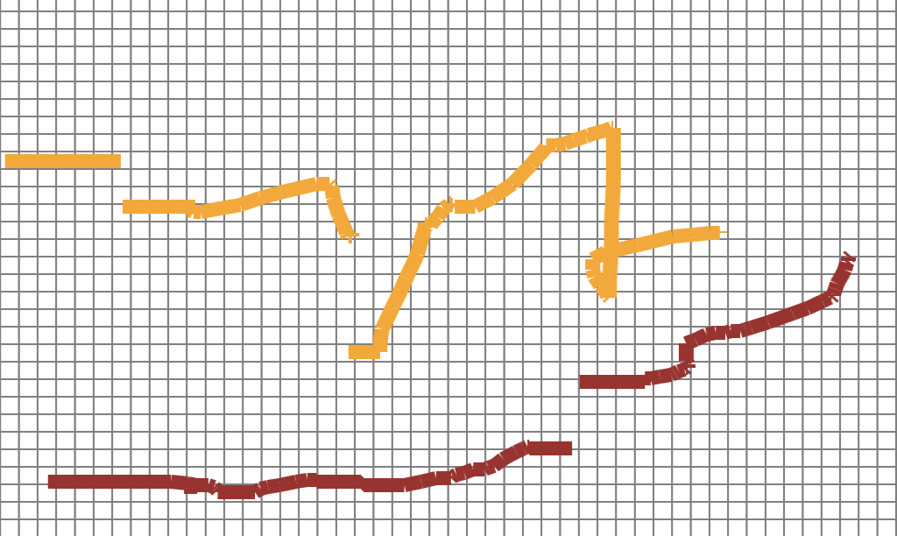


Concept
Drawing
Spectrum/Piano roll
Music
* Inspiration from: Hyperscore @MIT

Slide 4
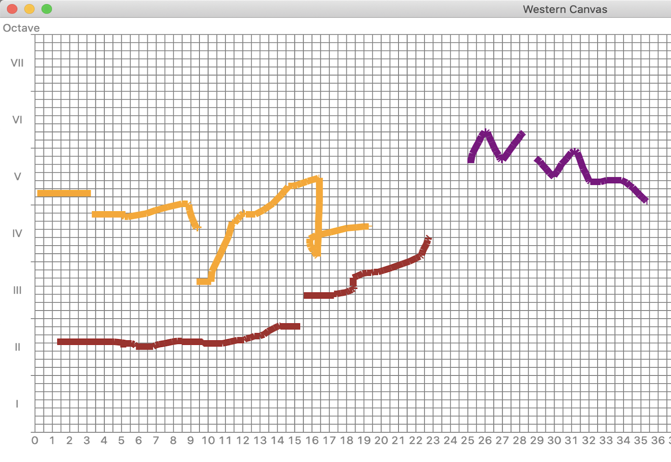
2. Demo
C-major
Orange: violin
Brown: cello
Purple: flute

Slide 5
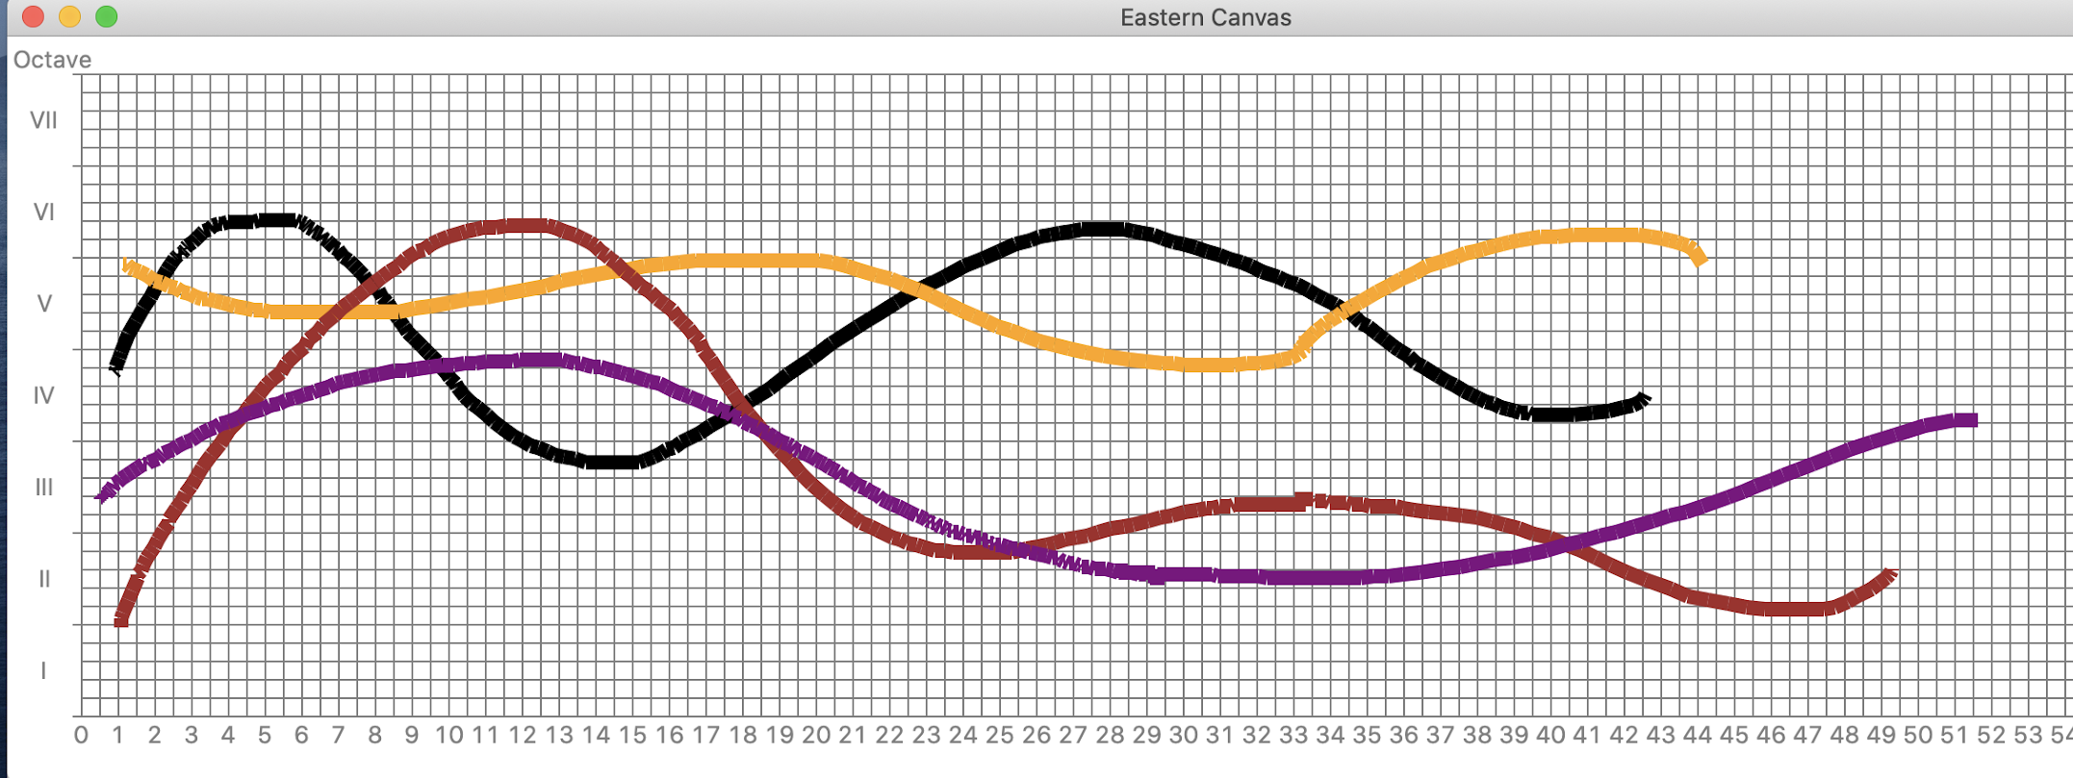
2. Demo
C-Chinese
Orange: violin
Brown: cello
Purple: flute
Black: piano

Slide 6
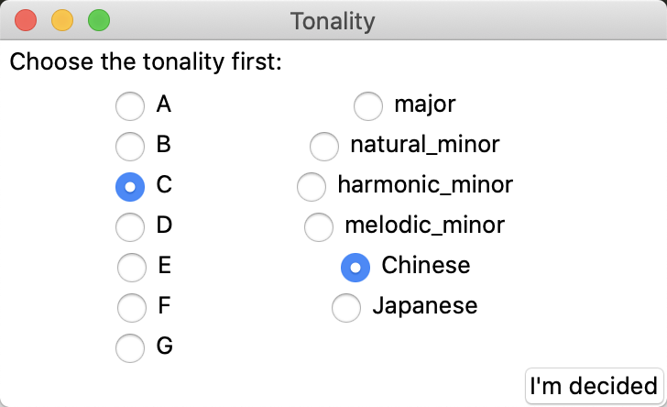
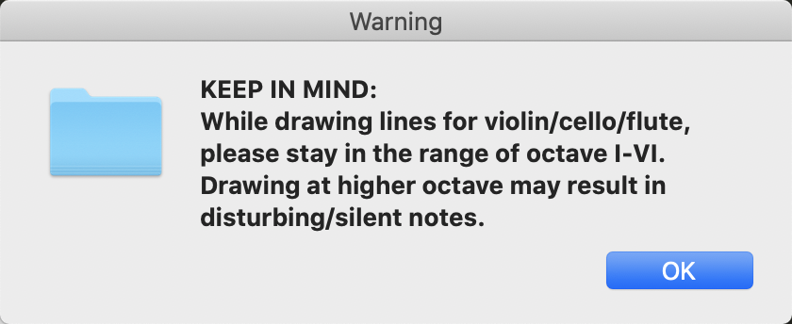
2. Demo - GUI

Slide 7
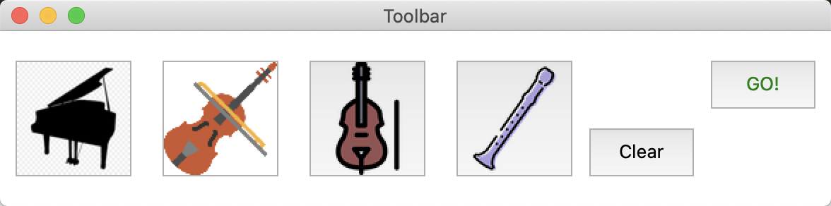
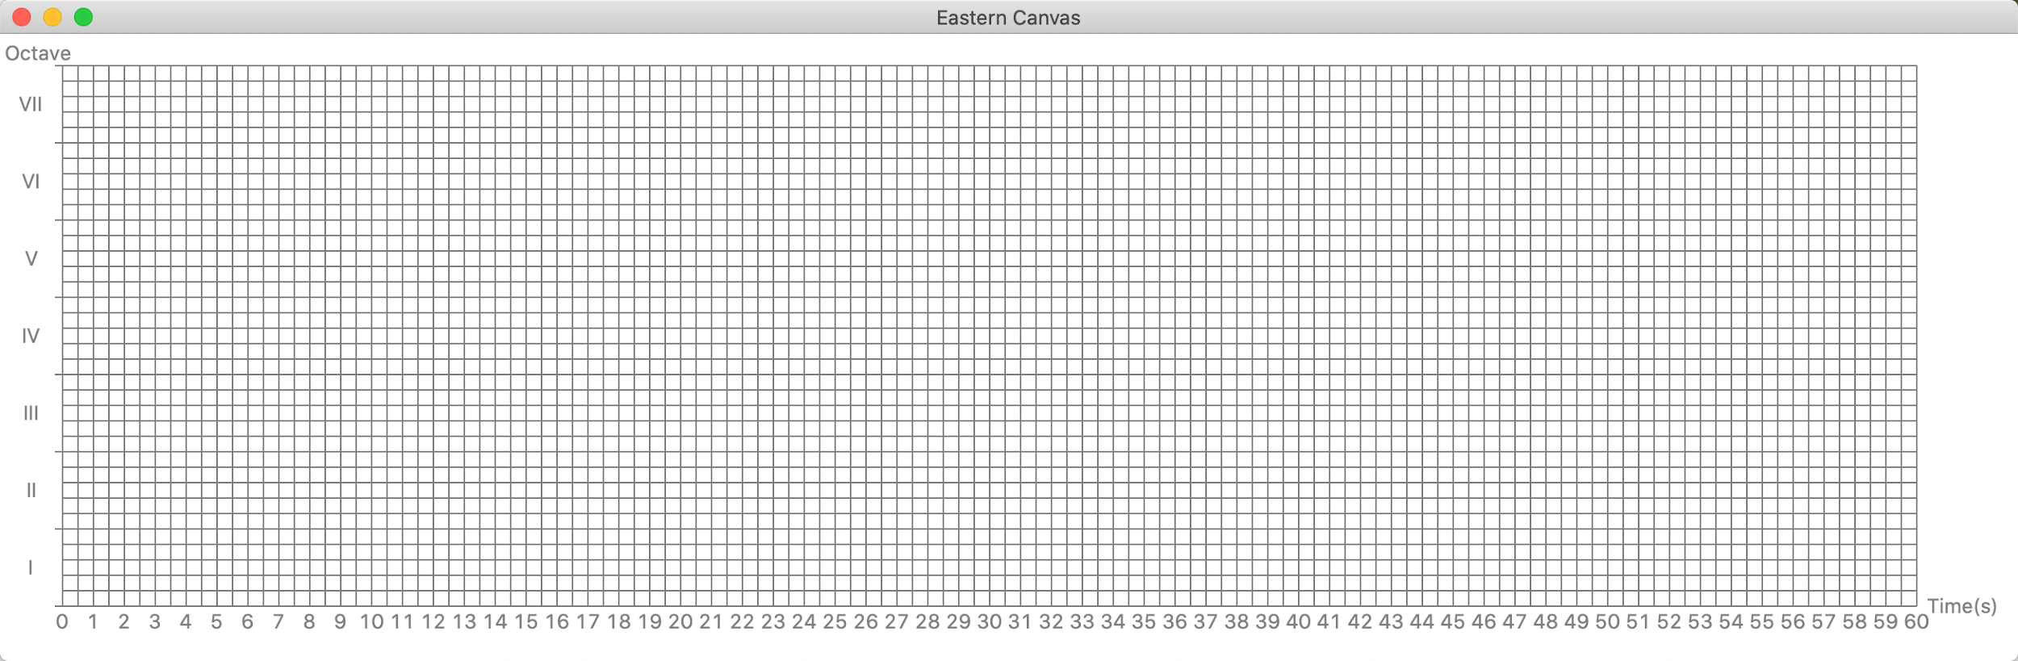
2. Demo - GUI

Slide 8
3. Execution
User’s input (drawing)
Grids + Filter rate
Pretty_midi
1
2
3
Analysis
Synthesis

Slide 9
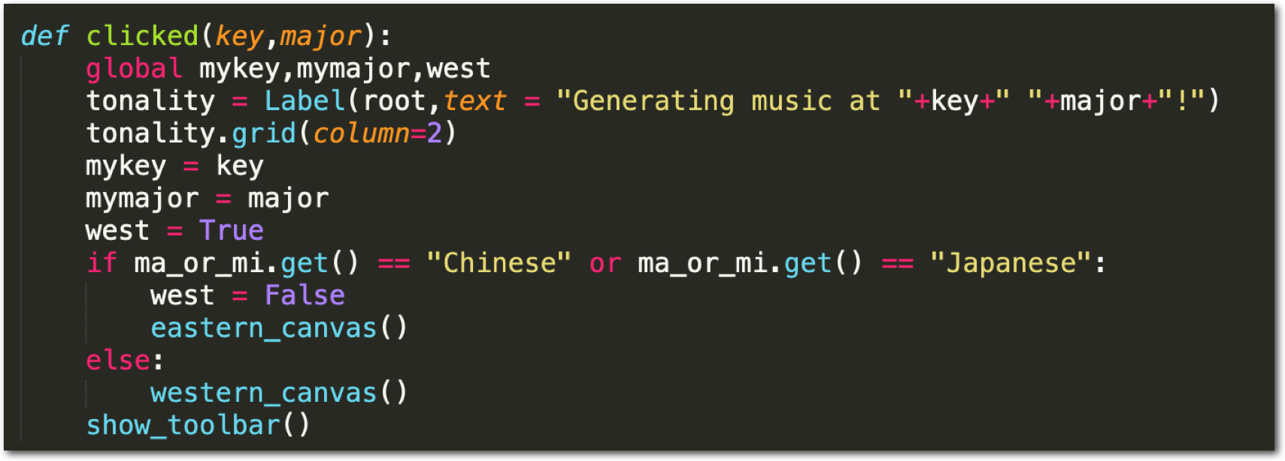
4. Code snippets -- GUI

Slide 10
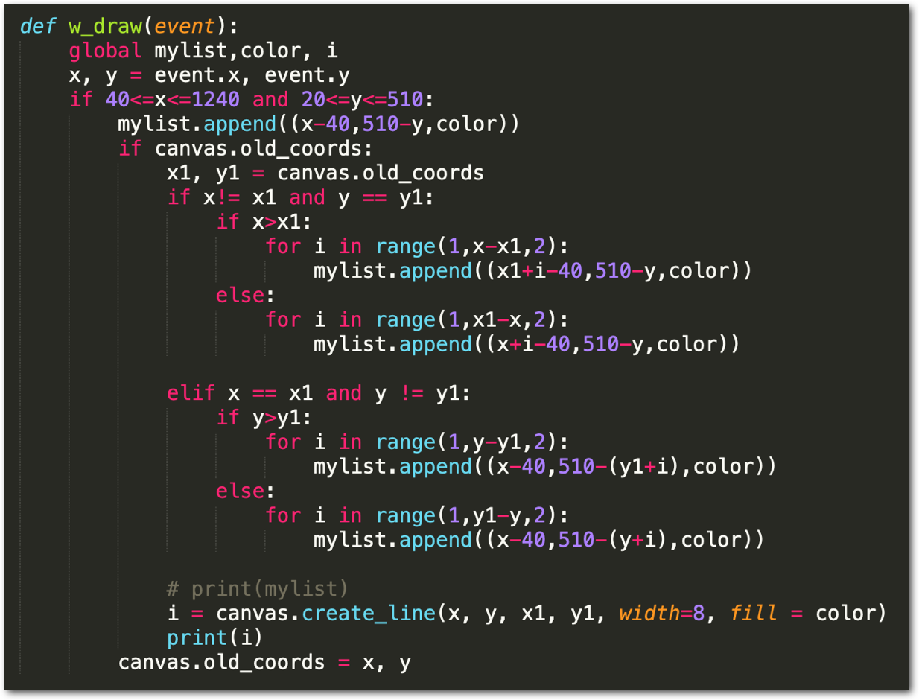
4. Code snippets -- Draw

Slide 11
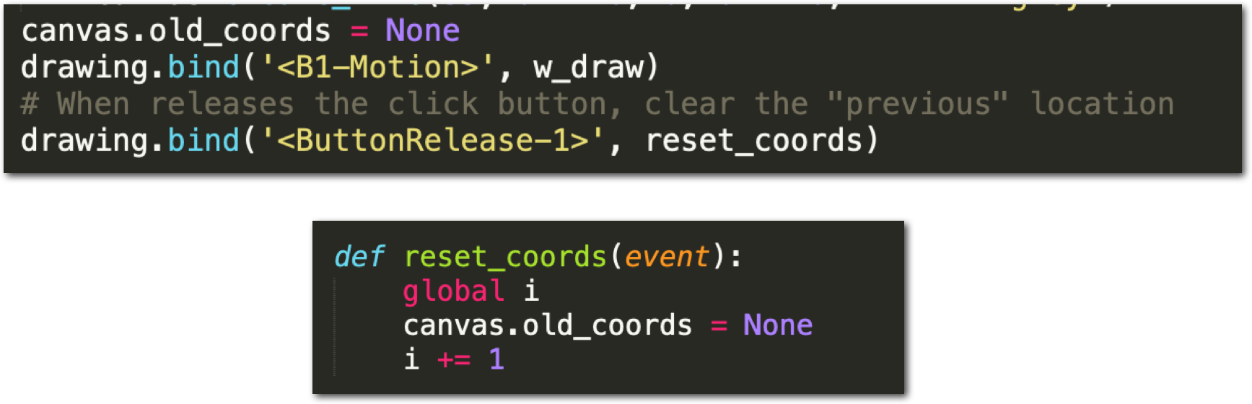
4. Code snippets -- Draw

Slide 12
Collect data
Map to a dictionary : {“color”: note_dic}, {note_dic:

Slide 13
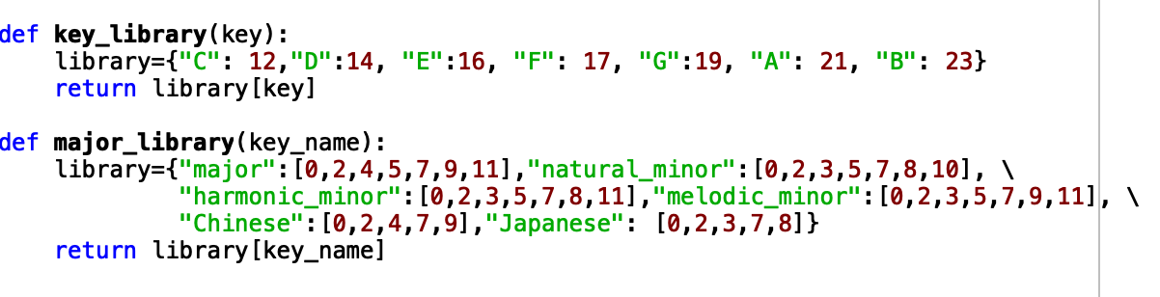
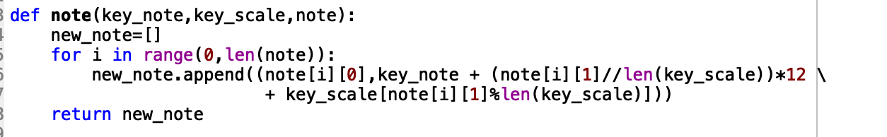
4. Code snippets -- Draw

Slide 14
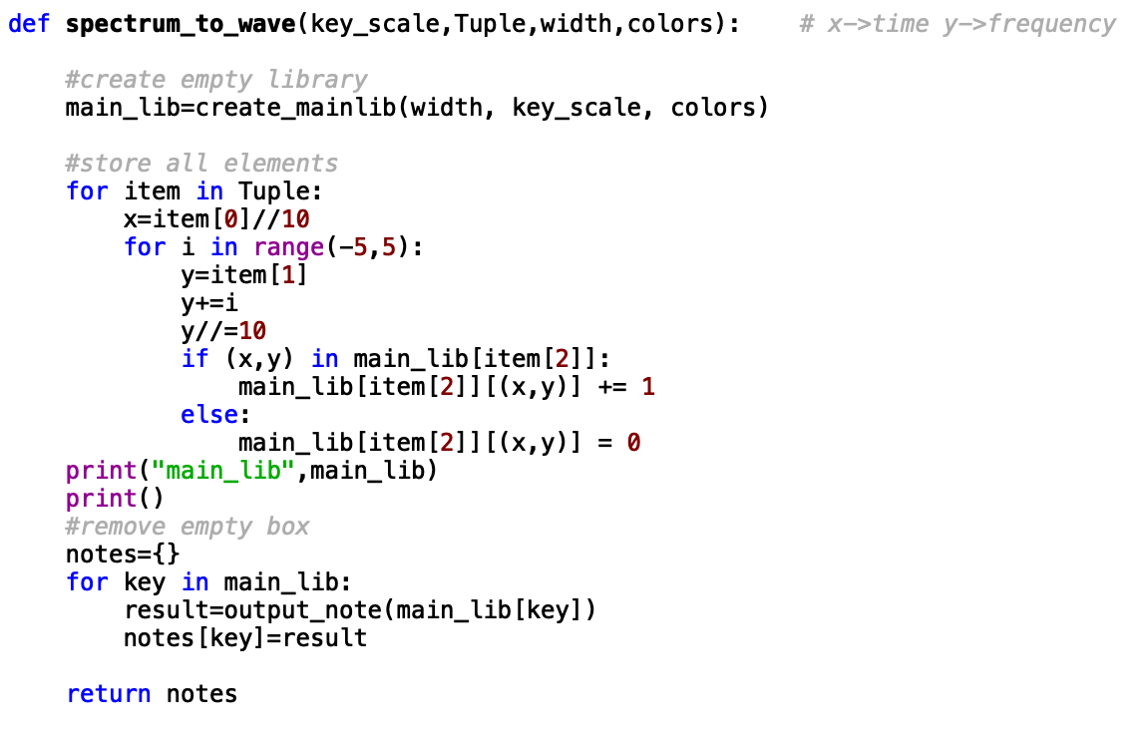
4. Code snippets -- Draw

Slide 15
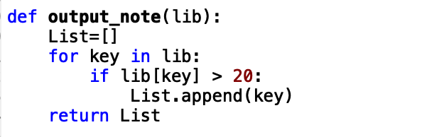
4. Code snippets -- Draw

Slide 16
5. Reflections
More flexibility at user’s end: speed, velocity, volume, start and end of each note.
More accuracy over the translation between image and piano roll.
More controllability: make the drawing itself easier + recall/eraser function.
Longer: support drawing longer pieces of music

Slide 17
User test, Q & A

