Slide 1

Hand-writing detection using neural networks CPT_S 437 project TEAM: Molly Iverson, Caitlin graves, chandler juego

Slide 2
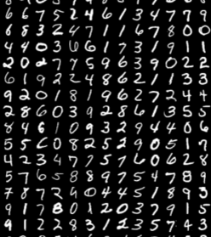
PROBLEM STATEMENT
"Handwriting detection remains a challenging task due to variations in writing styles, sizes, and orientations. This project evaluates 3 neural networks to identify the most effective."

Slide 3
DAtASET
Source: MNIST (Modified National Institute of Standards and Technology) Dataset
Description: Handwritten digit images
Dimensions: 28x28 pixel grayscale images
Classes: 10 digits (0-9)
Training Set Size: 60,000 images
Test Set Size: 10,000 images

Slide 4

SOLUTION APPROACH

Slide 5
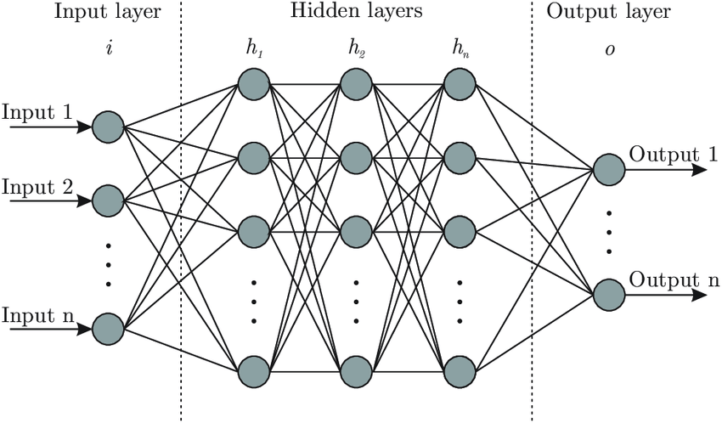
CAPSULE NN, CNN, 2-LAYER NN
Neural Network Approach: non-linearity of dataset capturing complex patterns, scalability (28x28 pixels)
Capsule Neural Network - advanced neural network architecture that models hierarchical relationships between features, capturing spatial and pose information (orientation, scale)
Convolutional Neural Network - neural network designed to process data with a grid-like topology, using convolutional layers to extract spatially invariant features like edges and textures
Traditional Neural Network - fully connected neural network where each node in one layer is connected to every node in the next

Slide 6
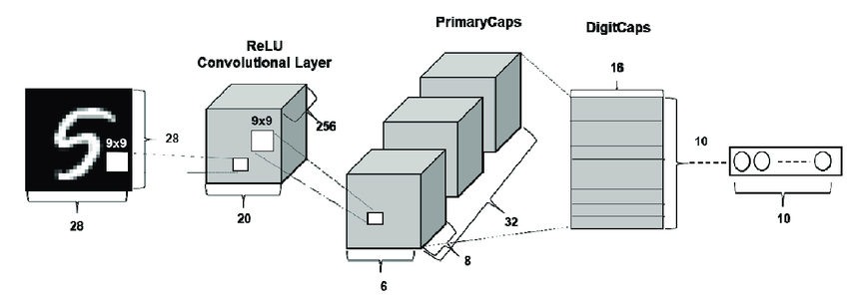
CAPSULE NEURAL NETWORK
Created by Geoffrey Hinton in 2017 in his team's paper "Dynamic Routing Between Capsules" to overcome the limitations of traditional CNNs
Structure: Capsules output vectors to represent features, preserving spatial and pose information.
Key Features:
Dynamic Routing: Allows lower-level capsules to decide how much influence they have on higher-level capsules.
Capsules: Groups of neurons that collectively encode properties of features and vectors, enable complex spatial and pose relationships

Slide 7
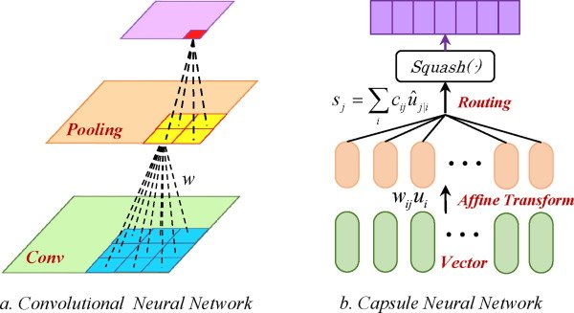
CAPSULE NEURAL NETWORK
Strengths:
Models hierarchical relationships between features
Superior accuracy compared to CNN's
Effectively recognizes objects when rotated or resized
Weaknesses:
High computation cost (5 hours to run 5 epochs)
Sensitive to hyperparameter settings
Limited Availability of Implementation tools

Slide 8
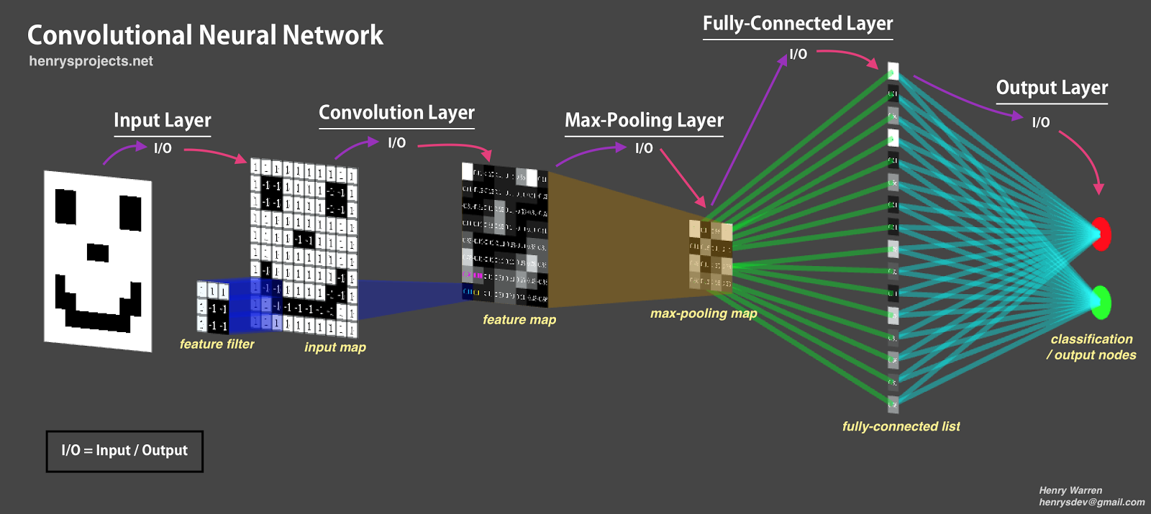
CONVOLUTIONAL NEURAL NETWORK
Structure:
Convolutional Layers: Extract features like edges or textures
Pooling Layers: Reduce image size to improve processing efficiency
Fully Connected Layers: Combine extracted features for decision-making
Key Features:
Local Connectivity: Focus on small image regions to detect patterns
Weight Sharing: Reuse the same filters to process different parts of the image
Hierarchical Learning: Build from simple to complex patterns

Slide 9
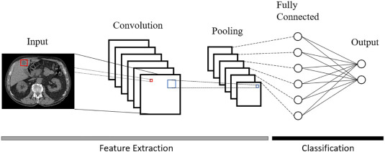
CONVOLUTIONAL NEURAL NETWORK
Strengths:
Designed for visual data like photos or videos
Automatic feature extraction
High accuracy in image classification and recognition tasks
Weaknesses:
Requires large datasets for good performance
Training can be computationally expensive
Can have trouble recognizing rotated, scaled, or distorted objects

Slide 10
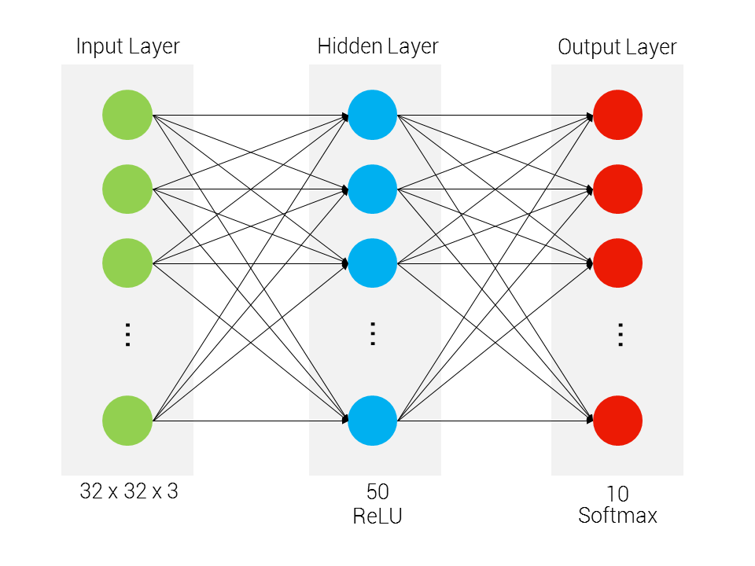
2-LAYER NEURAL NETWORK
Architecture
Input: 784 Neurons
300 Neurons w/ ReLU activation function
10 Neurons w/ Softmax activation function
Techniques
Kaiming He Initialization (weights)
Cross-Entropy Loss (loss function)
Optimization Strategies
Mini-Batch Gradient Descent
Learning Rate Decay
Notes:
This implementation focuses on a simple yet foundational two-layer neural network designed to classify handwritten digits from the MNIST dataset. The goal was to develop a basic neural network that can recognize and classify individual digits with reasonable accuracy.
Network Architecture: Input Layer: 784 neurons (28x28 flattened image) Hidden Layer: 300 neurons with ReLU activation Output Layer: 10 neurons with Softmax activation
Preprocessing Data:
Pixel Normalization: Scaled pixel values from [0, 255] to [0, 1] 2. One-Hot Encoding: Converted integer labels to categorical vectors
Model Techniques:
Model Techniques
1. Activation Functions
- Hidden Layer: ReLU (Rectified Linear Unit)
- If input is negative: output is 0
- If input is positive: output is the input itself
- Unlike sigmoid/tanh, ReLU doesn't "squash" positive values
- Simple mathematical operation
- Very fast to compute
- Low computational overhead
- Output Layer: Softmax
- Provides probabilistic interpretation of classification
- Ensures output probabilities sum to 1
2. Weights Initialization
- He Initialization
- Specifically designed for ReLU activation
- Helps prevent vanishing/exploding gradients: values become too small/too large
- Improves initial model convergence
3. Loss Function
- Cross-Entropy Loss
- Measures how well predicted probabilities match true labels and punishes confident wrong predictions more heavily
- More suitable for multi-class classification
- Provides better gradient information
4. Optimization Strategies
- Mini-Batch Gradient Descent: updates model parameters using small subsets of training data
- It's faster than batch gradient descent, which processes the entire training set at once
- Learning Rate Decay
- Dynamically adjusted learning rate: its ability to help a neural network converge to a better solution by gradually reducing the learning rate during training, preventing overshooting the optimal minimum and promoting stability

Slide 11
2-LAYER NEURAL NETWORK
Strengths:
Simplicity of architecture
Computationally efficient
Weaknesses:
Spatial Information Loss
Performance Limitations
Notes:
Strengths:
Simple architecture: easier to implement and straightforward layer structure
Computationally efficient: less complex computational graph, lower memory requirements, faster training on datasets
Weaknesses:
Spatial information loss: flattens the input images which destroys the spatial relationships between pixels
Performance Limitations: struggles with more complex images and less effective at capturing local patterns

Slide 12
INSIGHTS

Slide 13
Test accuracy results
Feature | Traditional NN | CNN | CapsNet
Test Accuracy | 96.54% | 97.72% | 99.3%

Slide 14
INSIGHTS AND TAKEAWAYS
Traditional Neural Network Application to MNIST:
Least accurate and least computationally expensive
More generalized pattern detection – does not consider spatial information
Convolutional Neural Network Application to MNIST:
Achieves high accuracy by learning spatial hierarchies of features
More efficient than many traditional networks due to local connectivity and weight sharing
Capsule Neural Network Application to MNIST:
High accuracy with better robustness than CNNs
Excels at handling variations in orientation and style

Slide 15

THANK YOU

