Slide 1
Japan: After the Disasters
CS171 Final Project
Process Book
Eric Coletti, Molly Lloyd, Tony Thul

Slide 2
Overview and Motivation
In 2011, Japan suffered the blow of three major disasters. A massive earthquake led to an even more devastating tsunami.
The tsunami reached heights of 40 meters in some areas of Japan, and it overwhelmed the sea-wall protecting the Fukushima-Daiichi nuclear power plant resulting in the meltdown of its reactors.
The motivation behind this project is to showcase the myriad effects the disasters had on Japan and its people, and the persistent impact they have on life in Japan today.

Slide 3
Questions?
The objectives of the project were:
To answer questions about the effects of the disasters on the people and environment of Japan, including the lasting effects that persist now, three years after the incident.
To illustrate the ideas and opinions that the survivors have surrounding the disaster, its aftermath, and the future of nuclear energy in Japan.
How do the Japan disasters relate to similar catastrophes across the globe?

Slide 4
Related Work
Neue Zurcher Zeitung, 2013: No Time for Anger: four destinies two years after “Fukushima” (2)
The Guardian, 2011: Visualizing radiation leaks from the Fukushima nuclear power plant
Google maps and Fukushima: Collective Memory and Data Visualization
ABC.au News: Japan Earthquake: before and after
Harvard University: Japan Map
Fukushima Radiation Map

Slide 5
Data
Costly / Deadly Disasters: Munich Re NatCatService
Death and Damages: National Police Agency of Japan
Earthquakes: USGS
Country GDP / Population: World Bank
Tsunami wave height: National Geophysical Data Center, (2)
Radiation:
Survey: We created our own dataset by creating a survey, translating it into Japanese, and publicizing it on social media in Japan. We got a total of 324 responses. The survey can be accessed at www.fukushimajapan.org

Slide 6
Data Munging
Some data came easily in .csv, but some had to be scraped from the web (see wave height data)
We did have to do some munging in order to manipulate the geoJSON and JSON into topoJSON, and to add our .csv data to the topoJSON files. (see datamunging1.js)
The most difficult part [for Molly] was manipulating and understanding the topoJSON data for the various visualizations without much prior programming experience.
The data for the earthquake needed to be sorted in order of date to display in the correct sequence on the map.
The radiation data needed to be rolled up to correctly show the reading locations along with the sum and different nuclide.

Slide 7
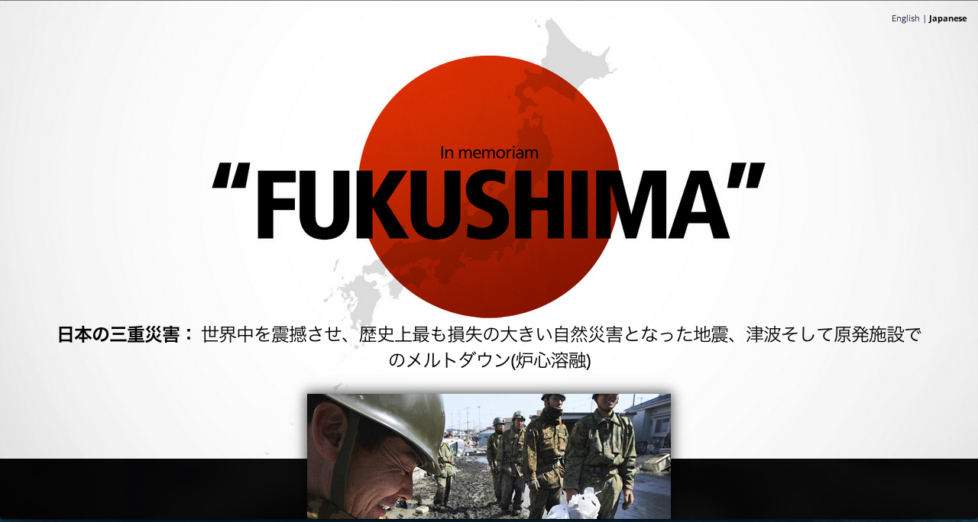
Survey

Slide 8
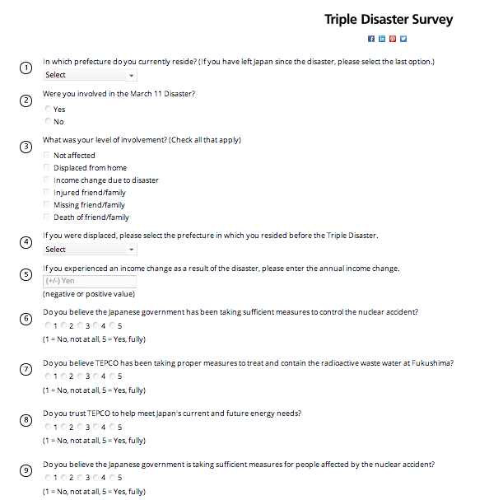
Survey Questions

Slide 9
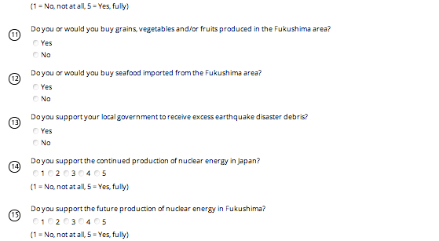
Survey Questions

Slide 10
Munich Re(Insurance)

Slide 11
Munich Re(Insurance)

Slide 12
National Police Agency of Japan

Slide 13
Exploratory Data Analysis
Originally the plan was to make a single map-based visualization that would show, interactively, the three separate disasters. (i.e. buttons for “earthquake”, “tsunami”, and “nuclear meltdown”)
After deciding on the animated time-line for the earthquake data, it became clear that a single visualization would be extremely messy, so we moved on to separating out the visualizations of the disasters.
Visualizing the tsunami wave height was difficult at first, because the dataset is so huge (over 9000 lat/long points) and point data does not indicate height very well.
To accommodate this, we used a heat map with hexbins (a d3.js plugin) to compress the data and extract meaning in a visually digestible manner.

Slide 14
Design Evolution
We wanted to showcase the social and economic effects of the disaster, but the data we wanted was not readily available.
Much of the data on displacement / evacuation is on the Fukushima Prefecture website (according to citations from other visualizations), but the website is impossible to navigate without some knowledge of Japanese.
For the proportional symbols in the global disasters and the earthquake visualizations, we used exponential scales because perceptual science shows that users judge differences in shapes’ area to be the squared difference of the radii.

Slide 15
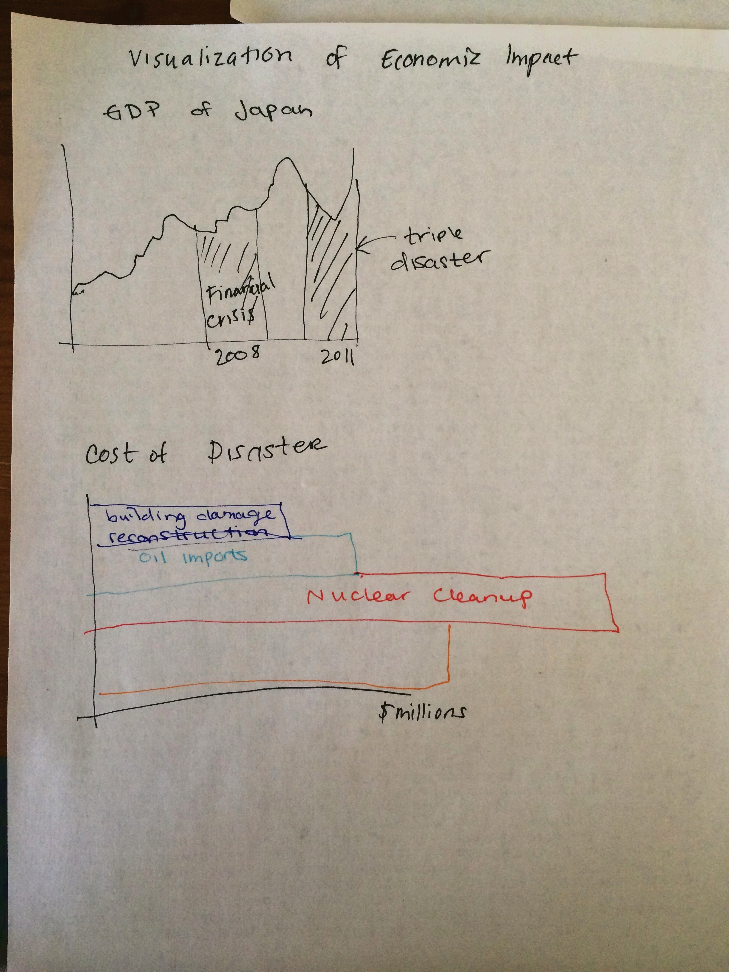
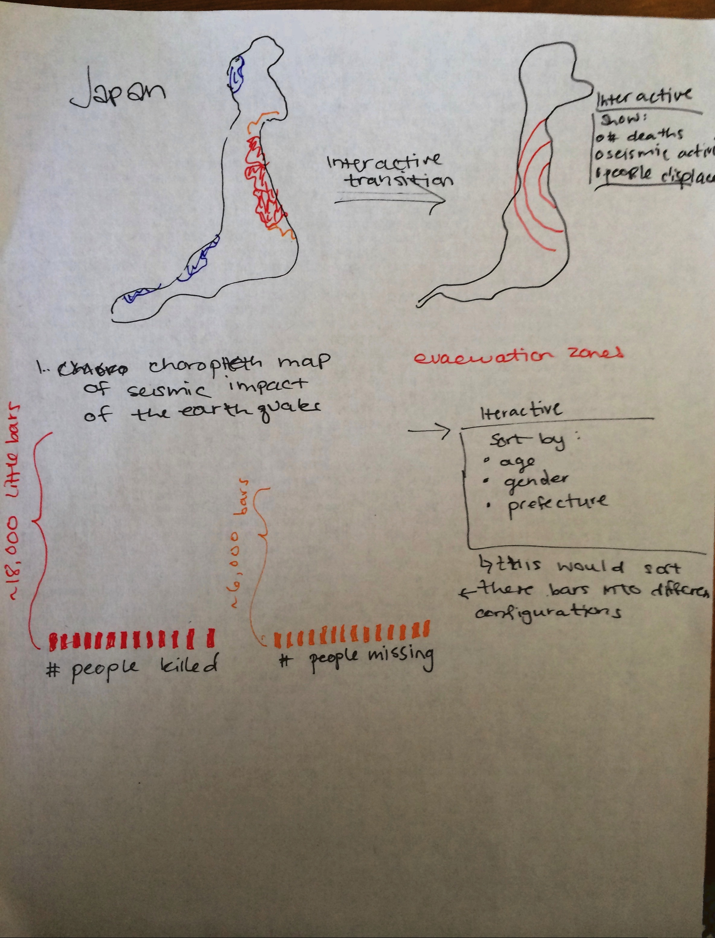
Early Sketches

Slide 16
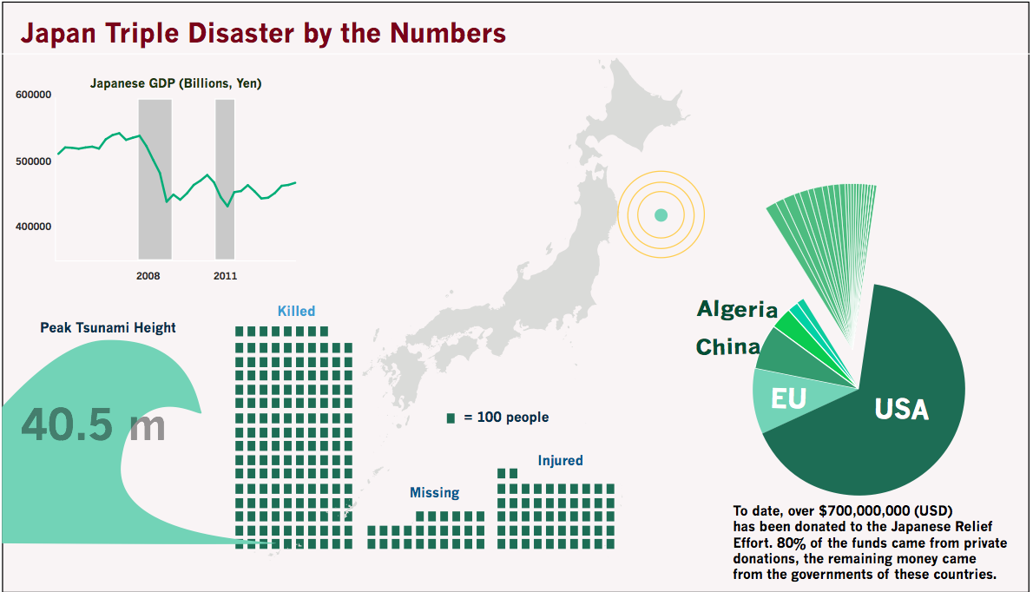
Design Evolution: social data sketch

Slide 17
Implementation
The goal was to have a one-page website that would go through the stages of the disaster chronologically and build on the data to develop a complete narrative of the event.
We also were not able to find the specificity and depth of data we had hoped for, largely due to the language barrier and difficulty navigating Japanese websites.
We struggled getting the website perfected as well as responsive to different screen resolutions. It was tested and works well on 1920x1080.

Slide 18
Evaluation
We learned that its very difficult to get detailed data relating to major disaster. This was partly because it was prohibitively time consuming to navigate and procure data from the Japanese government agencies.
We also focused heavily on the visualizations, and underestimated the length of time it would take to put it all together and make a functional website– also a product of the impracticality of group projects in an online course.
Our individual visualizations work well as distinct pieces, and when taken together, give a well balanced portrait of the reality of the experiences of those affected by the 2011 disasters.

