Slide 1


Slide 2
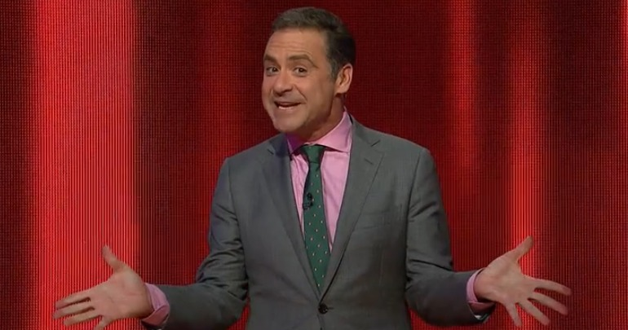

Slide 3


Slide 4
Game play
WHY?
You demanded it, and I delivered.
I was jealous of all your cool games.
Three rounds
1) Cash build – gets.chomp – 30 seconds
2) Facing the Chaser – TTY Prompt, text-table
3) Final Chase – gets.chomp – 30 seconds

Slide 5
Challenges
Writing the logic for Round two
Binding.pry didn’t bind or pry
Anhar called my practices “terrible”
Use of global variables?
Second attempt at a Terminal App

