Slide 1
Image Deblurring through
Blind Deconvolution
November 10, 2017
Gloria Diederich
Alyson Grassi
Molina Nichols

Slide 2
Outline
Introduction
Image Deblurring
Blind Deconvolution
Model
Terminology
Algorithms
Results
MATLAB Implementation
Conclusions

Slide 3
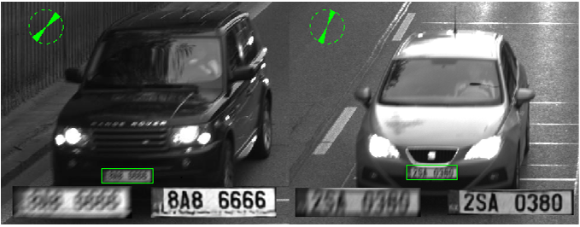
Introduction: Image Deblurring
Significance
Relevance to Matrix Theory
Goal: Restore as much information as possible
Source: https://www.semanticscholar.org/paper/CNN-for-license-plate-motion-deblurring-Svoboda-Hradis/1a16cae98556f70b10571a8906fe967ee1b1496b

Slide 4
Introduction: Blind Deconvolution
Deriving the original sources of signal through the convolution of the two sources
In the context of Image Deblurring: Achieving signal from the convolution of signal, background and Poisson noise
Process is done by using iterative processes to find the maximum likelihood of sources (Holmes, Biggs)

Slide 5

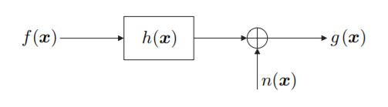
Model: Terminology
Source: Ayers, Biggs
g – convoluted signal (blurred image)
f – image source (image of ideal clarity)
h – Point Spread Function, PSF (blur of image)
n – additional noise
(Ayers, Biggs)
Source: Hansen

Slide 6
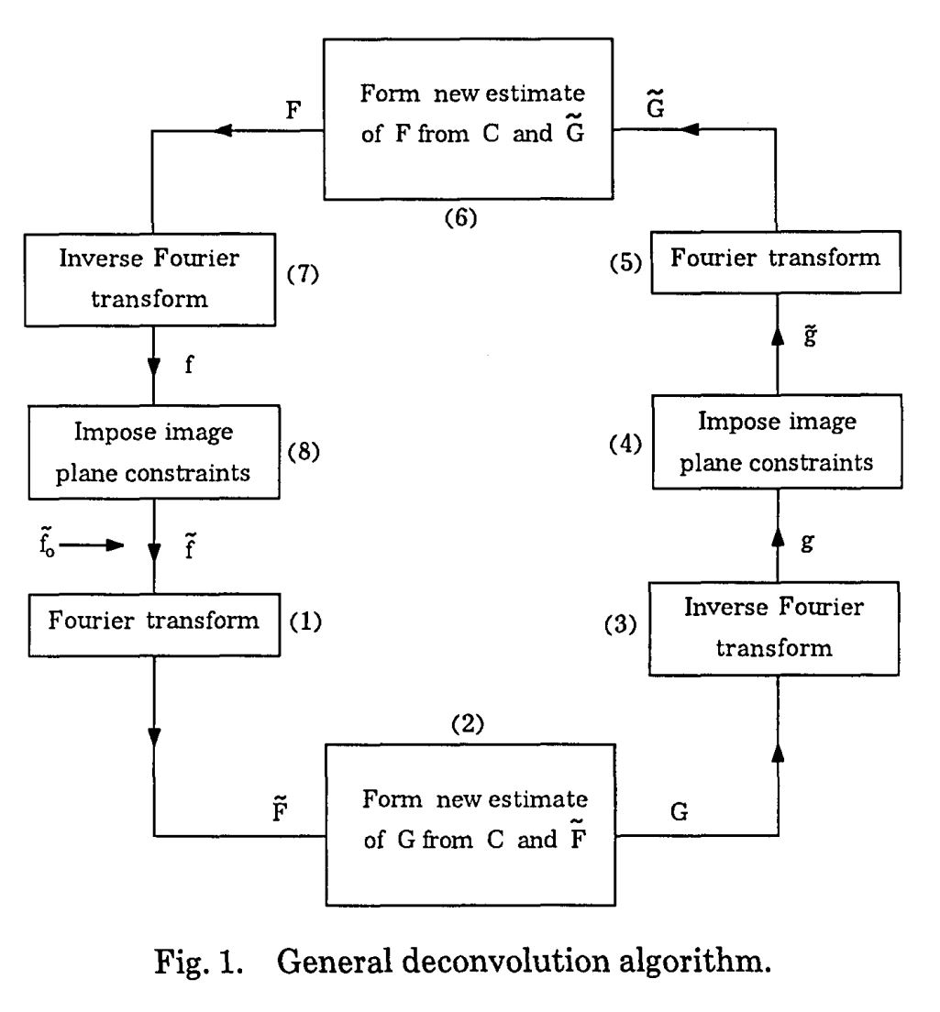
Model: Algorithms
General:
Source: http://jacobwinick.me/imagedeblurring/

Slide 7
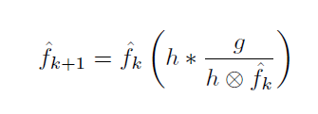

Model: Algorithms (cont.)
Maximum Likelihood Estimation (Holmes)
Richardson-Lucy algorithm (Biggs)
Source: Biggs

Slide 8
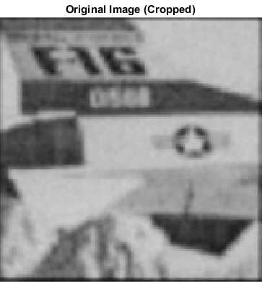

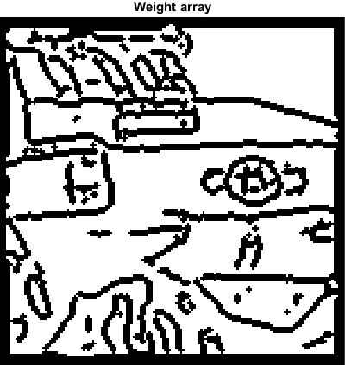
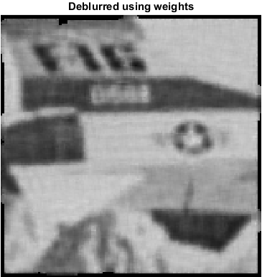
Results: Matlab Implementation
deconvblind documentation
[J, P] = deconvblind(blurred(:,:,1),INITPSF,20,[],WEIGHT);
Do it yourself: How to deblur using the deconvblind algorithm in matlab

Slide 9
Summary/Conclusions
Image deblurring significance
Blind deconvolution
Relevance to Matrix Theory

Slide 10
References
Hansen, Per Christian., et al. Deblurring Images: Matrices, Spectra, and Filtering. Society for Industrial and Applied Mathematics, 2006, from http://epubs.siam.org/doi/book/10.1137/1.9780898718874
Ayers, G. R., and J. C. Dainty. ``Iterative blind deconvolution method and its applications.'' Optics Letters, vol. 13, no. 7, Jan. 1988, p. 547., doi:10.1364/ol.13.000547. Retrieved from https://www.osapublishing.org/ol/abstract.cfm?uri=ol-13-7-547
Holmes T.J., Biggs D., Abu-Tarif A. (2006) Blind Deconvolution. In: Pawley J. (eds) Handbook Of Biological Confocal Microscopy. Springer, Boston, MA. Retrieved from https://link.springer.com/chapter/10.1007/978-0-387-45524-2_24
Biggs, David S. C., and Mark Andrews. ``Acceleration of iterative image restoration algorithms.'' Applied Optics, vol. 36, no. 8, Oct. 1997, pp. 1766–1775., doi:10.1364/ao.36.001766. Retrieved from https://www.osapublishing.org/ao/abstract.cfm?uri=ao-36-8-1766
Campisi, P., and Egiazarian, K., (2001). Blind image deconvolution: theory and applications. Retrieved from http://ivpl.ece.northwestern.edu/sites/default/files/Campisi_Egiazarian_BIDmain_FOR_CH1.pdf
Deconvblind function documentation, MathWorks. Retrieved from http://www.mathworks.com/help/images/ref/deconvblind.html?s_tid=srchtitle&requestedDomain=www.mathworks.com

