Slide 1
Image Deblurring through
Blind Deconvolution
November 10, 2017
Gloria Diederich
Alyson Grassi
Molina Nichols

Slide 2
Outline
Introduction
Motivation
Image Deblurring
Blind Deconvolution
Model
Terminology
Algorithms
Results
MATLAB Implementation
Conclusions

Slide 3
Introduction
Motivation
Discuss relevance and significance
Explain theory and concept
Demonstrate methods in Matlab

Slide 4
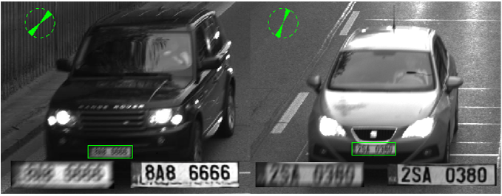
Introduction: Image Deblurring
Significance
Relevance to Matrix Theory
Goal: Restore as much information as possible
Source: https://www.semanticscholar.org/paper/CNN-for-license-plate-motion-deblurring-Svoboda-Hradis/1a16cae98556f70b10571a8906fe967ee1b1496b

Slide 5
Introduction: Blind Deconvolution
Deriving the original sources of signal through the convolution of the two sources
In the context of Image Deblurring: Achieving signal from the convolution of signal, background and Poisson noise
Process is done by using iterative processes to find the maximum likelihood of sources (Holmes, Biggs)

Slide 6

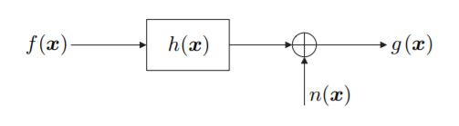
Model: Terminology
Source: Ayers, Biggs
g – convoluted signal (blurred image)
f – image source (image of ideal clarity)
h – Point Spread Function, PSF (blur of image)
n – additional noise
(Ayers, Biggs)
Source: Hansen

Slide 7
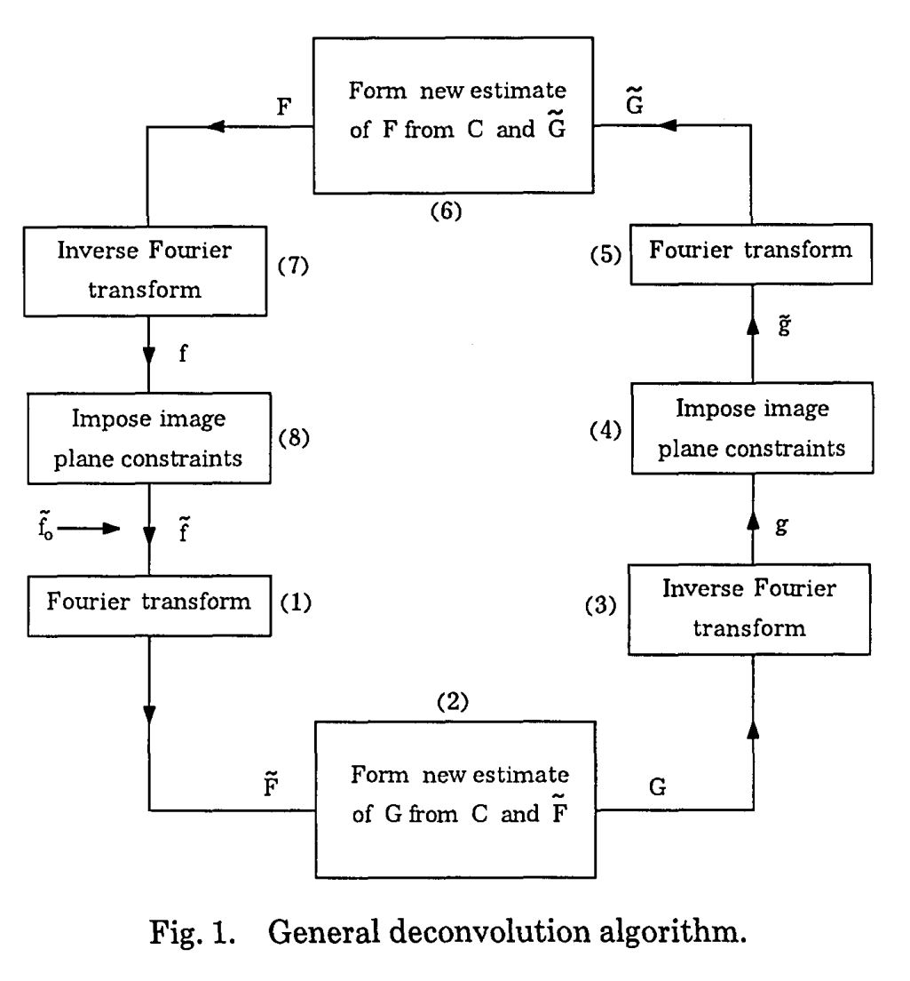
Model: Algorithms
General:
Source: http://jacobwinick.me/imagedeblurring/

Slide 8
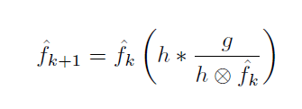

Model: Algorithms (cont.)
Maximum Likelihood Estimation (Holmes)
Richardson-Lucy algorithm (Biggs)
Source: Biggs

Slide 9
Results: Matlab Implementation
deconvblind documentation
*blip of code*
*image comparison*
Do it yourself: How to deblur using the blind econvolution algorithm in matlab

Slide 10
Summary/Conclusions
Summary
Image deblurring and significance
How Matrix Theory is instrumental to this application
Conclusions
Able to replicate results and therefore demonstrate the application
Emphasize relevance to real world, can use cheaper cameras, tackle challenging observation environment, restore images that have degraded or were poor quality to begin with

Slide 11
References
Hansen, Per Christian., et al. Deblurring Images: Matrices, Spectra, and Filtering. Society for Industrial and Applied Mathematics, 2006, from http://epubs.siam.org/doi/book/10.1137/1.9780898718874
Ayers, G. R., and J. C. Dainty. ``Iterative blind deconvolution method and its applications.'' Optics Letters, vol. 13, no. 7, Jan. 1988, p. 547., doi:10.1364/ol.13.000547. Retrieved from https://www.osapublishing.org/ol/abstract.cfm?uri=ol-13-7-547
Holmes T.J., Biggs D., Abu-Tarif A. (2006) Blind Deconvolution. In: Pawley J. (eds) Handbook Of Biological Confocal Microscopy. Springer, Boston, MA. Retrieved from https://link.springer.com/chapter/10.1007/978-0-387-45524-2_24
Biggs, David S. C., and Mark Andrews. ``Acceleration of iterative image restoration algorithms.'' Applied Optics, vol. 36, no. 8, Oct. 1997, pp. 1766–1775., doi:10.1364/ao.36.001766. Retrieved from https://www.osapublishing.org/ao/abstract.cfm?uri=ao-36-8-1766
Campisi, P., and Egiazarian, K., (2001). Blind image deconvolution: theory and applications. Retrieved from http://ivpl.ece.northwestern.edu/sites/default/files/Campisi_Egiazarian_BIDmain_FOR_CH1.pdf
Deconvblind function documentation, MathWorks. Retrieved from http://www.mathworks.com/help/images/ref/deconvblind.html?s_tid=srchtitle&requestedDomain=www.mathworks.com

