Slide 1
Image Deblurring:
Blind Deconvolution
November 10, 2017
Gloria Diederich
Alyson Grassi
Molina Nichols

Slide 2
Outline
Introduction
Image Deblurring
Significance
Blind Deconvolution
Model
Terminology
Variable and Function Definitions
Algorithms
Results
MATLAB Implementation
Conclusions

Slide 3
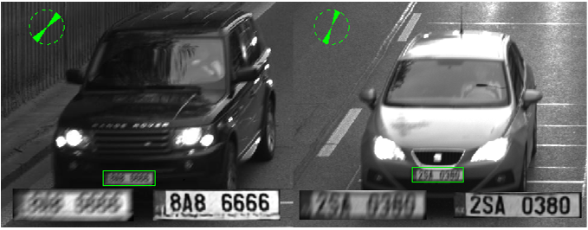
What is image deblurring?
Restore as much information as possible!
Obtained from: https://www.semanticscholar.org/paper/CNN-for-license-plate-motion-deblurring-Svoboda-Hradis/1a16cae98556f70b10571a8906fe967ee1b1496b

Slide 4
What is blind deconvolution?
I honestly have no idea what to actually put on this slide…

Slide 5
Model
Terminology
Noise, Background, Signal
Blind Deconvolution
Deriving the original sources of signal through the convolution of the two sources
In the context of Image Deblurring: Achieving signal from the convolution of signal, background and Poisson noise
Process is done by using iterative processes to find the maximum likelihood of sources

Slide 6
Model (cont.)
*function and variable definitions*
Algorithms (functions)
Expectation-Maximization (EA)
Richardson-Lucy (R-L)

Slide 7
Results
Matlab Implementation
Insert deblurred images

Slide 8
Summary/Conclusions
Summary
Image deblurring and significance
How Matrix Theory is instrumental to this application
Conclusions
Able to replicate results and therefore demonstrate the application
Emphasize relevance to real world, can use cheaper cameras, tackle challenging observation environment, fix pics that have already been taken a long time ago…

Slide 9
BACKUP

Slide 10
Introduction
What is Image Deblurring?
Restoring an image without reference of the original source
Significance
Clarity in images can define the results in certain fields of research
Motivation/Goal
Investigate models that Matlab’s built-in method is based on
Replicate selected results to show magnitude of algorithms and methods

