Slide 1
homework
File created on: 6/17/19 8:40:13 PM PDT

Slide 2


Slide 3


Slide 4
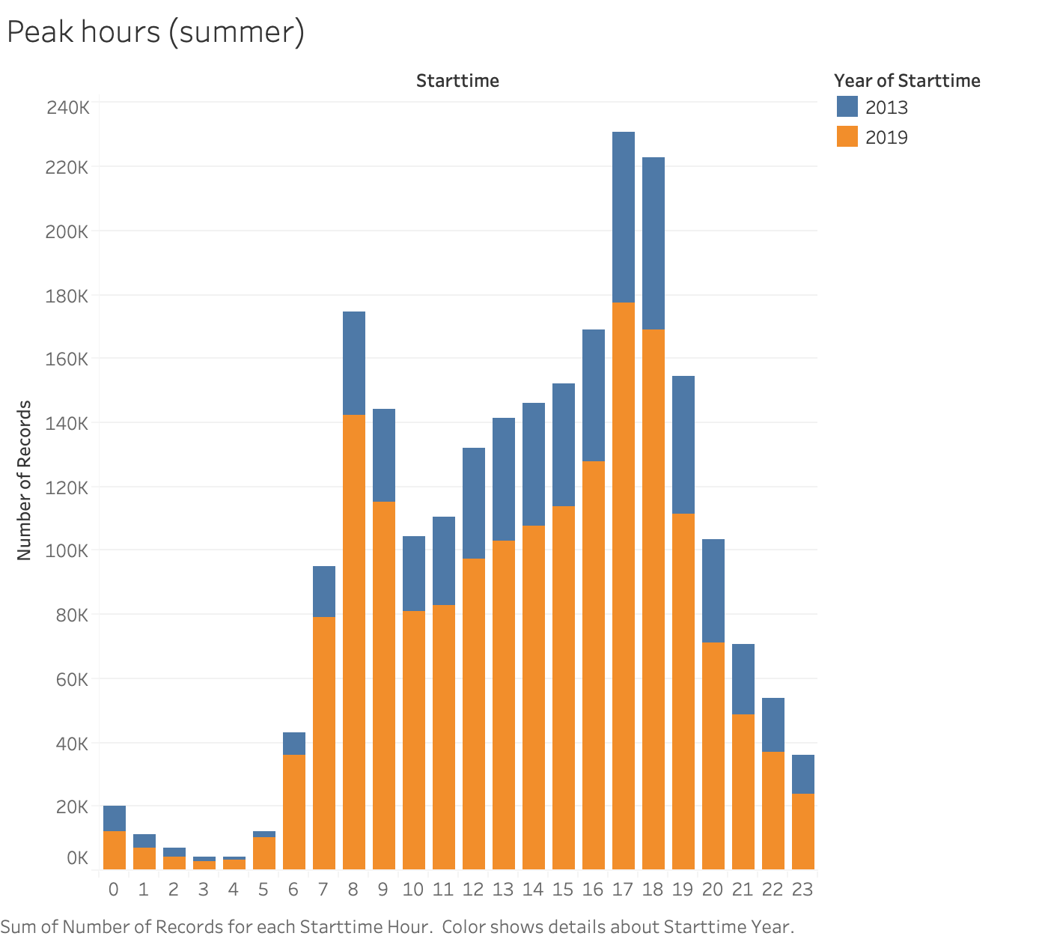

Slide 5
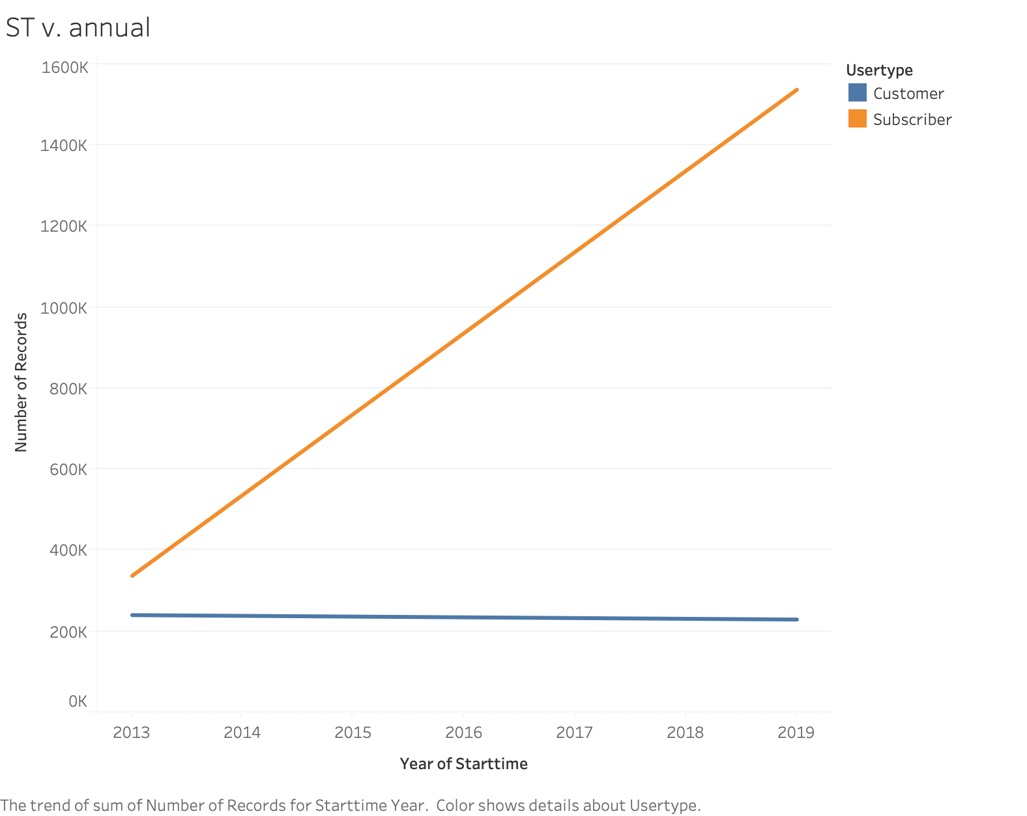

Slide 6
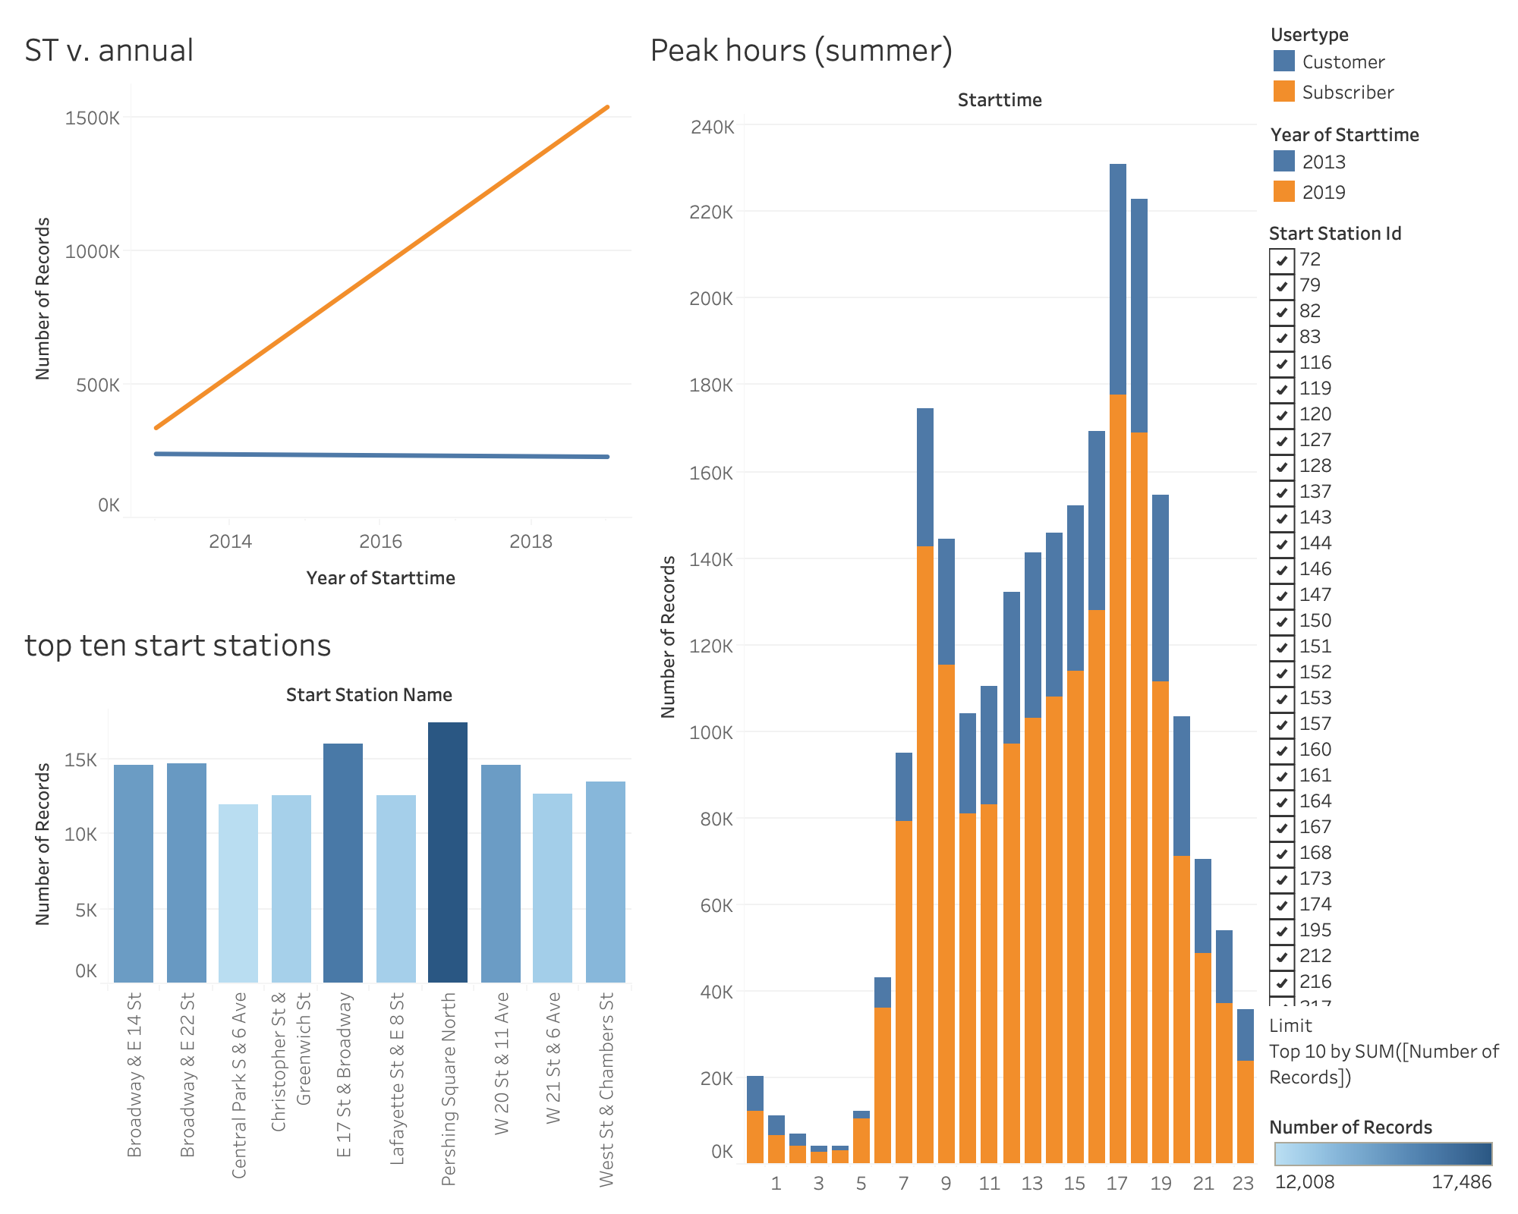

Slide 7
