Slide 1
Agentic AI for Personalized Course Pathways.
CAPSTONE PROJECT
Presented By:
NAME - MOLLY PRIYA
COLLEGE- NETAJI SUBHAS UNIVERSITY OF TECHNOLOGY
MAILID- molly.priya.ug22@nsut.ac.in

Slide 2
OUTLINE
Problem Statement
Proposed System/Solution
System Development Approach
Algorithm & Deployment
Result (Output Image)
Conclusion
Future Scope
References

Slide 3
Problem Statement
Problem Statement No.12 -
The Challenge - Students often struggle to identify the right learning path that aligns with their interests and long-term goals due to the overwhelming number of online courses and a lack of personalized guidance. Many students struggle to identify the right learning path due to the overwhelming number of online courses and lack of personalized guidance. This often leads to confusion, wasted time, and unstructured learning. Existing systems provide generic recommendations that don't adapt to individual interests, skill levels, or career goals. Students need a dynamic solution that understands their background and guides them step by step. LearnMate addresses this challenge by acting as an Agentic AI coach that interacts with learners, assesses their needs, and builds personalized, evolving course roadmaps. This ensures focused learning, better outcomes, and increased motivation.

Slide 4
Proposed Solution
LearnMate is an intelligent Agentic AI coach developed on IBM Cloud using Watsonx AI, designed to help students create and follow personalized learning roadmaps. By leveraging Agentic AI principles, it dynamically interacts with students to:
Understand their career interests (e.g., Frontend Development, Cybersecurity, UI/UX Design).
Assess their current skill level, time commitment, and learning goals.
Recommend a step-by-step, adaptive course roadmap that evolves based on student feedback and progress.

Slide 5
Key Features and Architecture
Built with:
IBM Watsonx AI platform
LangGraph Framework
ReAct Architecture (for decision-making and interaction planning)
Agent developed using the "Build an AI Agent" module on Watsonx
Agent Capabilities:
Acts as an interactive coach, not just a chatbot
Collects contextual input: skill level, weekly learning hours, timeframe
Provides customized learning plans (e.g., a 6-month roadmap for Frontend Development)
Updates recommendations based on learner progress and changing interests
Dynamic Adaptation:
Weekly check-ins to reassess learner goals and pace
Suggests alternative resources or deeper topics when progress is rapid
Offers motivational nudges and productivity tips

Slide 6
Algorithm & Deployment
Developed using IBM Watsonx AI with the “Build an AI Agent” tool to enable Agentic AI behavior.
Integrated the Mistral Large language model hosted on IBM Cloud for powerful natural language understanding and response generation.
Follows the ReAct (Reason + Act) architecture to allow the agent to reason through user inputs and generate dynamic learning plans.
Implements LangGraph to manage agent state, task orchestration, and decision-making based on user profiles and feedback loops.
Collects and processes user preferences, skill levels, and learning goals via interactive dialogue.
Dynamically creates and updates personalized course roadmaps that adapt over time as the learner progresses.
Deployed on IBM Cloud, ensuring scalable, secure, and real-time access across devices and platforms.

Slide 7
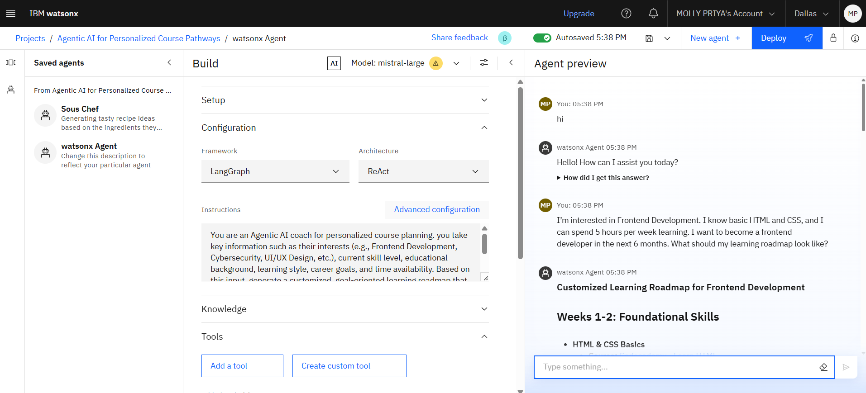
Result
.
GITHUB : https://github.com/mollypriya/EDUNET-FOUNDATION---IBM-SKILLSBUILD-4WEEKS-INTERNSHIP-ON-AI-IBM-CLOUD-TECHNOLOGIES

Slide 8
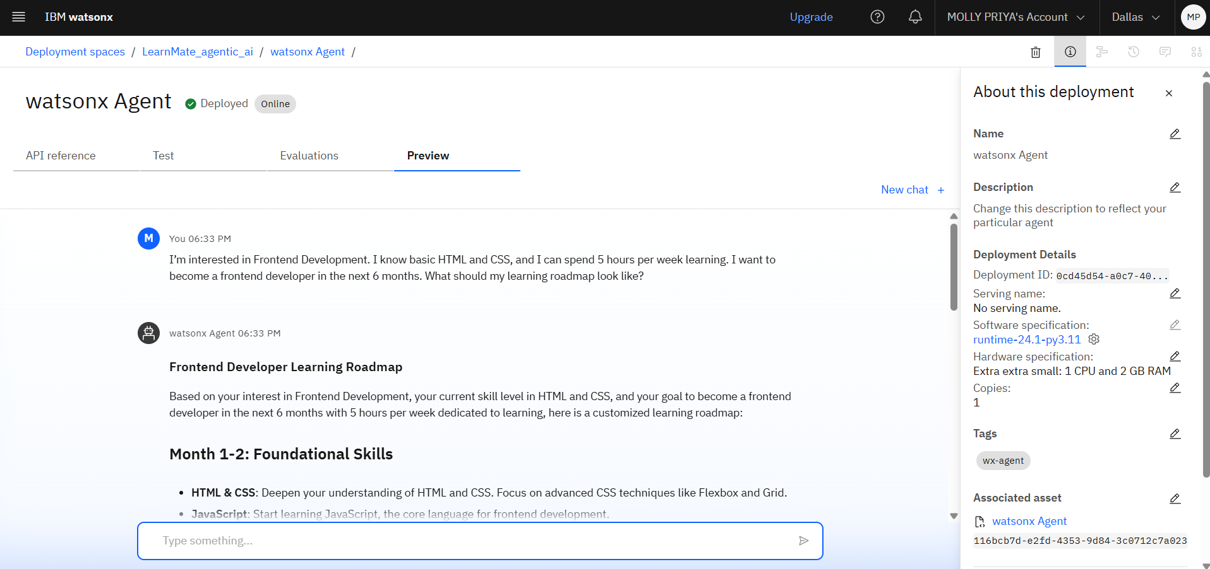
DEPLOYMENT
.

Slide 9
Conclusion
LearnMate demonstrates the potential of Agentic AI in revolutionizing personalized education. By leveraging the Mistral Large model on IBM Cloud and Watsonx's powerful Agentic AI tools, the system provides students with dynamic, adaptive learning roadmaps tailored to their individual goals and progress. The conversational agent not only guides learners intelligently but also evolves with them, ensuring long-term engagement and skill development. This solution bridges the gap between overwhelming course choices and meaningful learning, making career-oriented education more accessible and effective.

Slide 10
Future scope
Multi-Modal Interaction: Integrate voice input and visual learning aids (e.g., flowcharts, mind maps) to enhance user experience.
Integration with Learning Platforms: Connect with platforms like Coursera, Udemy, or edX to recommend real-time course links and track completion.
Skill Assessment Modules: Incorporate quizzes or coding challenges to evaluate the learner's progress and refine the roadmap accordingly.
Community & Mentorship Features: Enable peer-to-peer collaboration, discussion forums, and expert mentorship for additional support.
Gamification: Introduce badges, progress streaks, and leaderboards to keep learners motivated and consistent.
Multilingual Support: Expand accessibility by supporting regional languages, allowing non-English speakers to benefit.
AI Feedback Loop: Continuously improve roadmap generation using user feedback and performance analytics via reinforcement learning.

Slide 11
References
IBM SkillsBuild
Getting Started with AI – Learned fundamentals of artificial intelligence and how AI can be applied in real-world scenarios.
Journey to Cloud – Understood cloud computing concepts, deployment models, and how cloud technologies support AI development.
LangChain & RAG
Retrieval Augmented Generation (RAG) with LangChain – Explored how to integrate external data sources with LLMs using LangChain to build smarter, context-aware AI agents.
Edunet Foundation Educators
Attended expert-led sessions and hands-on activities focused on AI, cloud, and building agentic systems for personalized learning.

Slide 12
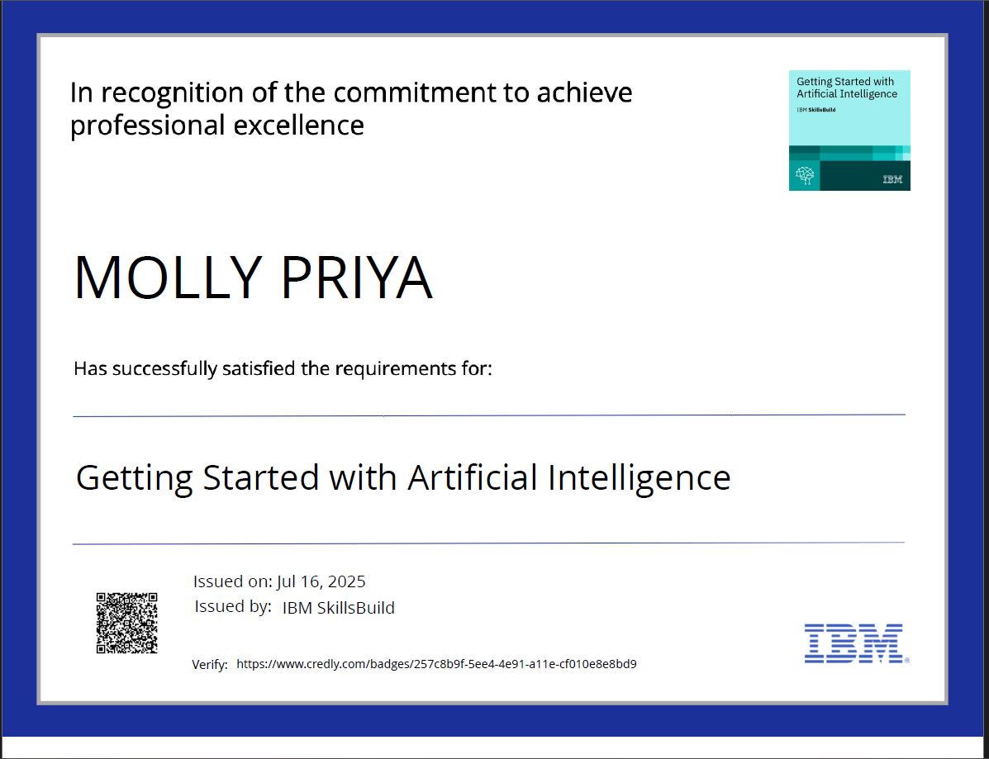
IBM Certifications: GETTING STARTED WITH AI
Verify: https://www.credly.com/badges/257c8b9f-5ee4-4e91-a11e-cf010e8e8bd9

Slide 13
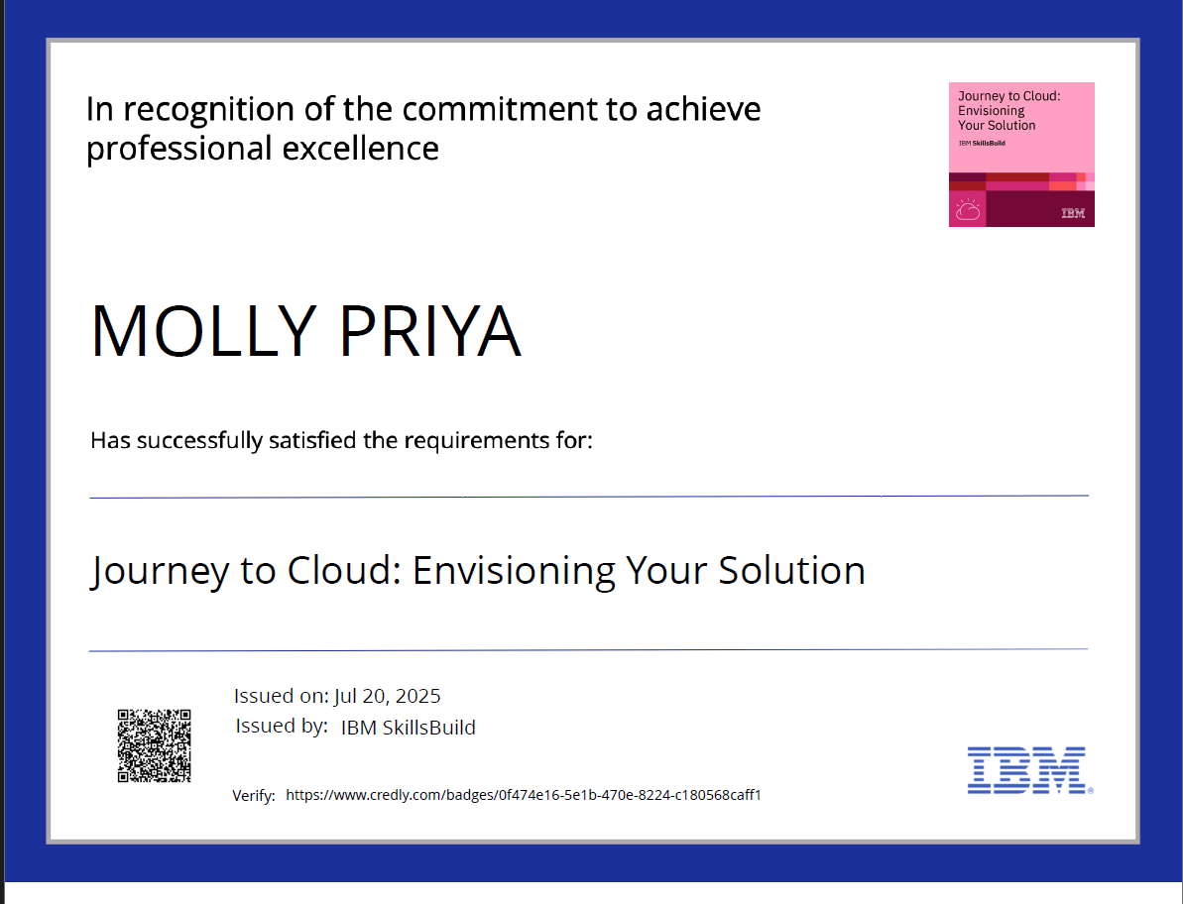
IBM Certifications : journey to cloud
Verify: https://www.credly.com/badges/0f474e16-5e1b-470e-8224-c180568caff1

Slide 14
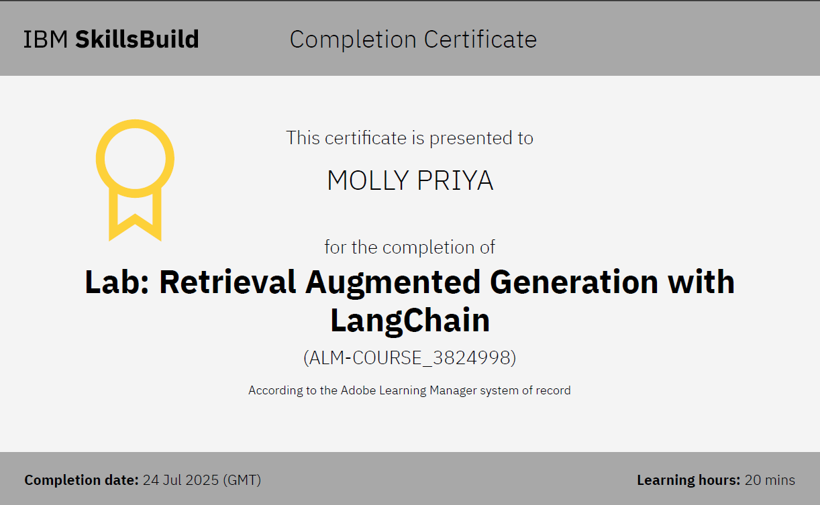
IBM Certifications : RAG LAB

Slide 15
GITHUB LINK
https://github.com/mollypriya/EDUNET-FOUNDATION---IBM-SKILLSBUILD-4WEEKS-INTERNSHIP-ON-AI-IBM-CLOUD-TECHNOLOGIES

Slide 16
THANK YOU

