Slide 1







Emerging Skills Trends Survey 2019
Shumei Wu
January 18, 2023

Slide 2




OUTLINE
Executive Summary
Introduction
Methodology
Results
Visualization – Charts
Dashboard
Discussion
Findings & Implications
Conclusion
Appendix

Slide 3

EXECUTIVE SUMMARY
Nowadays, technologies are changing unprecedentedly. In order to keep pace with changing technologies and remain competitive, it is critical to identify future IT skill requirements and trends.
This presentation will display the status of current technology usage and future technology trends.
Through the insights of data analysis, it is helpful for the firm to make informed data-driven decisions, like hiring plan and budget plan.

Slide 4

INTRODUCTION
This presentation is made for stakeholders in the domain of global IT and business consulting services.
The nature of this analysis is quantitative and descriptive.
This analysis will answer three questions:
What are the top programming languages in demand?
What are the top database skills in demand?
What are the popular integrated development environments(IDEs)?

Slide 5

METHODOLOGY
Data source:
Using a modified subset of the 2019 Stack Overflow Developer Survey dataset.
The Process of dealing with data:
Collecting Job related data using APIS and web scraping
Wrangling data by finding missing data and duplicates, normalizing data, and so forth.
Making exploratory data analysis on distribution, outliers and correlation.
visualizing data on distribution, relationship, composition, and comparison.
Using Cognos Dashboard Embedded(CDE) to create three dashboards:“Current Technology Usage”, “Future Technology Trends”, and ‘’Demographics”.

Slide 6
RESULTS
The data is a modified subset from the 2019 Stack Overflow Developer Survey dataset under a ODbL: Open Database License.
It contains two data sets:
One is survey data technologies normalized, which consists of approximate 75,000 respondents engaged in the survey.
The other one is survey data demographics, which has about 11,400 respondents answering demographics questions such as age, education level, gender and so on.

Slide 7
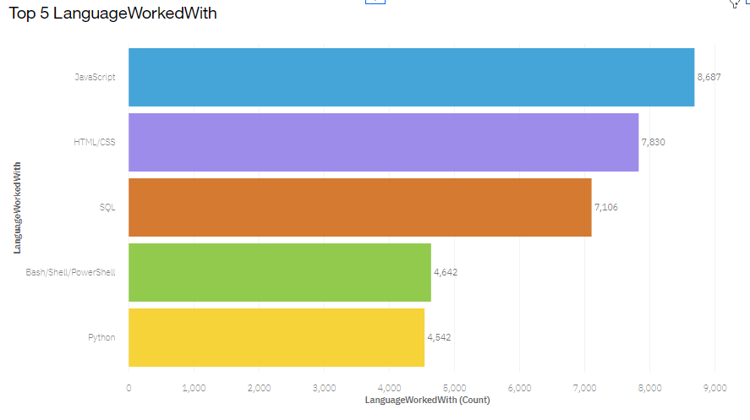
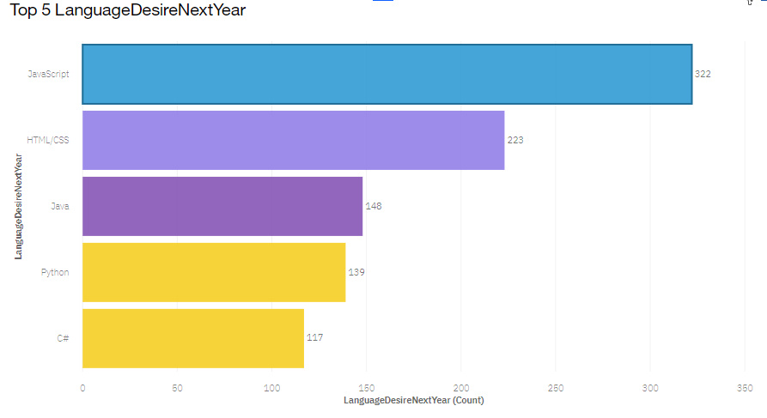
PROGRAMMING LANGUAGE TRENDS
Current Year
Next Year

Slide 8
PROGRAMMING LANGUAGE TRENDS - FINDINGS & IMPLICATIONS
Findings
JavaScript and HTML/CSS continue to be the top two most popular programming languages for this year and next.
Java, python and C# rank up top five next year
SQL and Bash/Shell/PowerShell rank down from top five next year.
Implications
Continue to hire the same number of staff skilled at JavaScript and HTML/CSS.
Hire more staff skilled at Java, python and C#.
Hire less staff skilled at SQL and Bash/Shell/PowerShell.

Slide 9
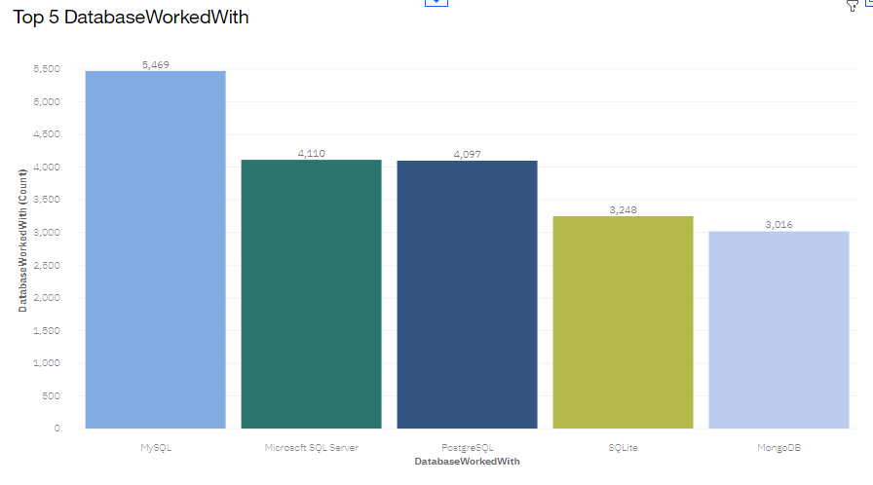
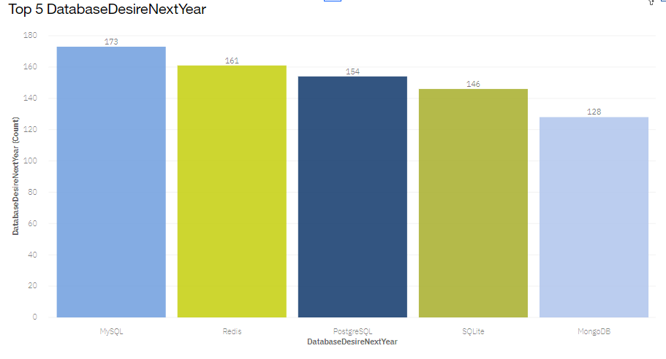
DATABASE TRENDS
Current Year
Next Year

Slide 10
DATABASE TRENDS - FINDINGS & IMPLICATIONS
Findings
My SQL continues to be the most popular database for this year and next.
Microsoft SQL Server drops from top five for next year.
Redis ranks up to the top second for next year.
Implications
Hire the same number of staff skilled at My SQL next year.
Hire less staff skilled at Microsoft SQL Server next year.
Hire more staff skilled at Redis next year.

Slide 11

DASHBOARD
The permanent link of viewing the Cognos:
https://dataplatform.cloud.ibm.com/dashboards/1fd2bf30-a26d-40fe-8c43-b755c576491b/view/6306bc3938b731d36ffde6e4079c2b0e7434225de3bb8551d5817b4959357297f06e1398c87a4908d3165132a2ba1151ce

Slide 12
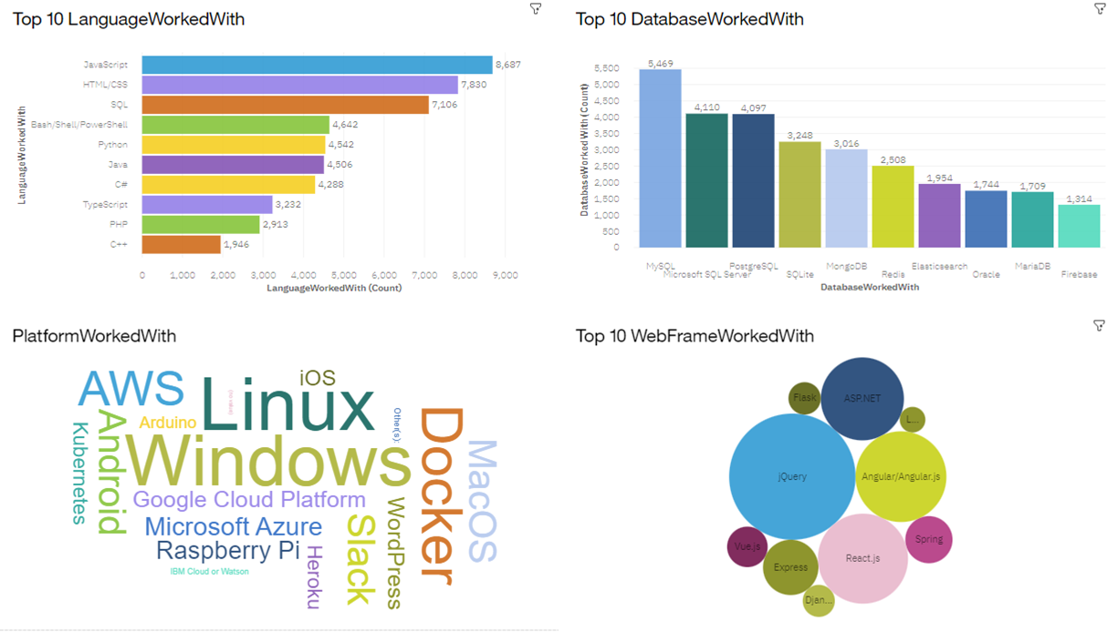
CURRENT TECHNOLOGY USAGE DASHBOARD

Slide 13
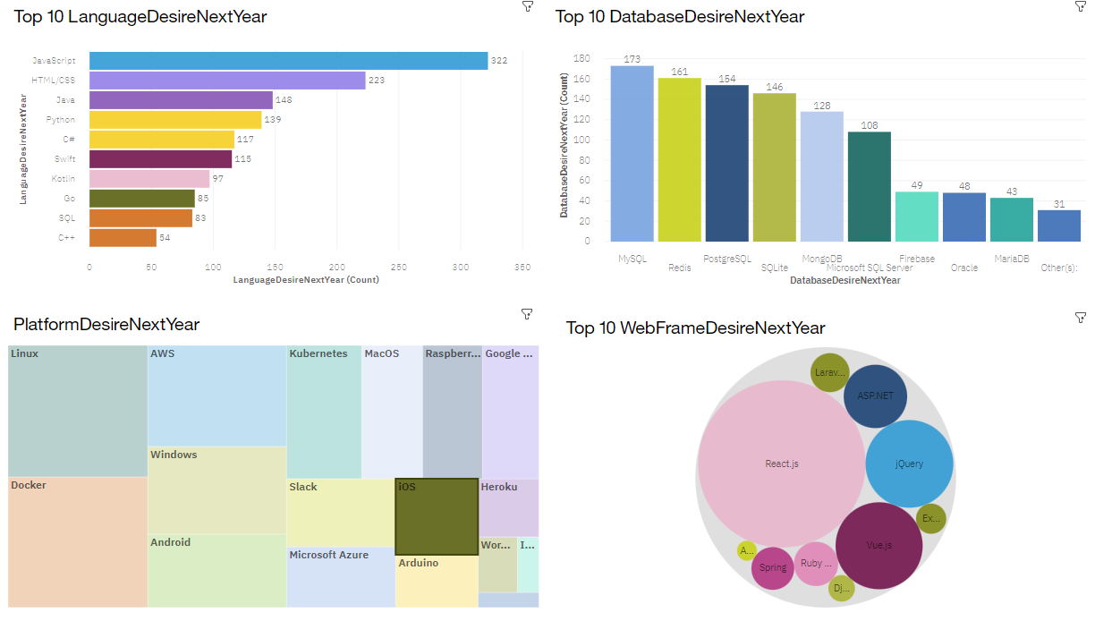
FUTURE TECHNOLOGY DASHBOARD

Slide 14
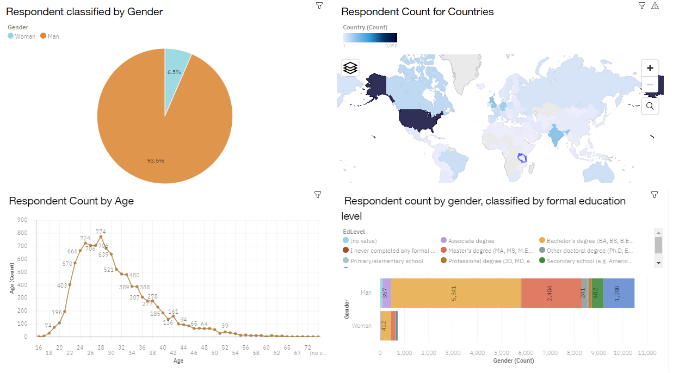
DEMOGRAPHICS DASHBOARD

Slide 15
DISCUSSION

Slide 16
OVERALL FINDINGS & IMPLICATIONS
Findings
Language: JavaScript and HTML/CSS remain top two, Java, python and C# rank up to top five.
Database: MySQL remains top one. Microsoft SQL Server drops from top five. PostgreSQL, SQLite and MongoDB are still of the top five. Redis ranks up to top two.
Platform: Windows drops dramatically, whereas Android rocks up to second.
Webframe: jQuery, Angular/Angular.js and ASP.NET drops a lot, whereas Laravel rocks up to top one.
Implications
Continue to hire same staff skilled at JavaScript and HTML/CSS, and more Java, python and C#
Hire more staff skilled at Redis.
Hire more staff skilled at Android.
Hire more staff skilled at Laravel, but less jQuery, Angular/Angular.js and ASP.NET.

Slide 17

CONCLUSION
Carve out budget to hire more staff with skilled needed to fill any gaps.
Organize some program to upskill those already hired to keep competitive.
Make staff adjustments for those no longer in demand.

Slide 18

APPENDIX

Slide 19
JOB POSTINGS

Slide 20
POPULAR LANGUAGES

Slide 21
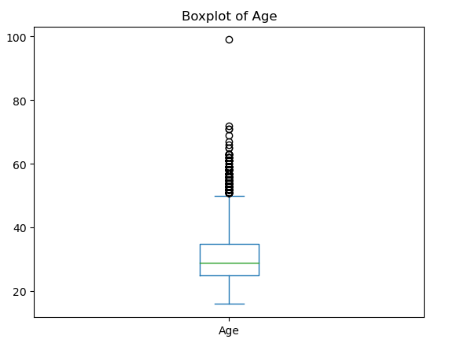
ADDITIONAL CHART

Slide 22
DATA RESOURCE
https://stackoverflow.blog/2019/04/09/the-2019-stack-overflow-developer-survey-results-are-in/
http://api.open-notify.org/astros.json
https://cf-courses-data.s3.us.cloud-object-storage.appdomain.cloud/IBM-DA0321EN-SkillsNetwork/labs/datasets/Programming_Languages.html
m5_survey_data_demographics.csv
m5_survey_data_technologies_normalised.csv

