Slide 1
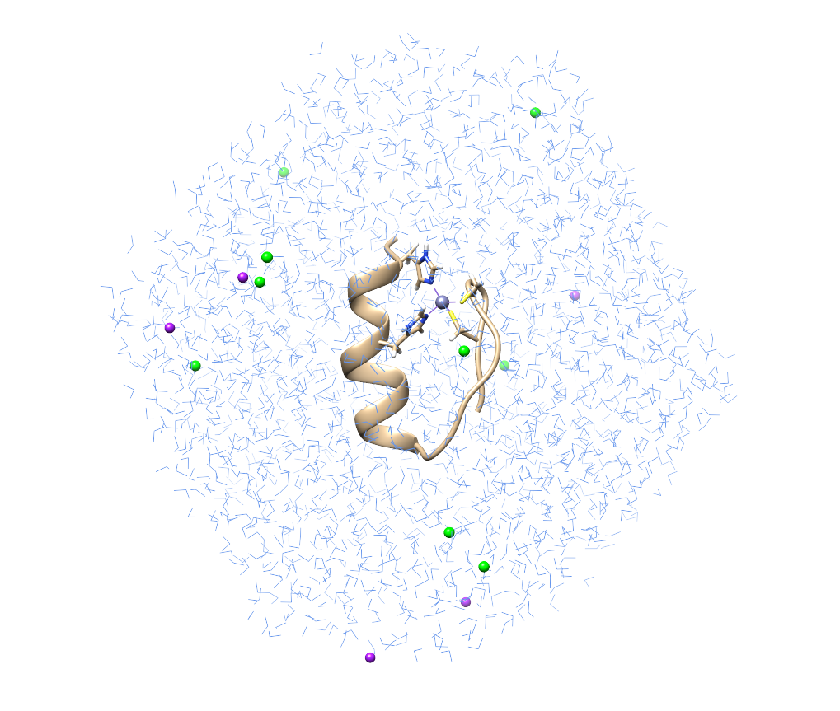
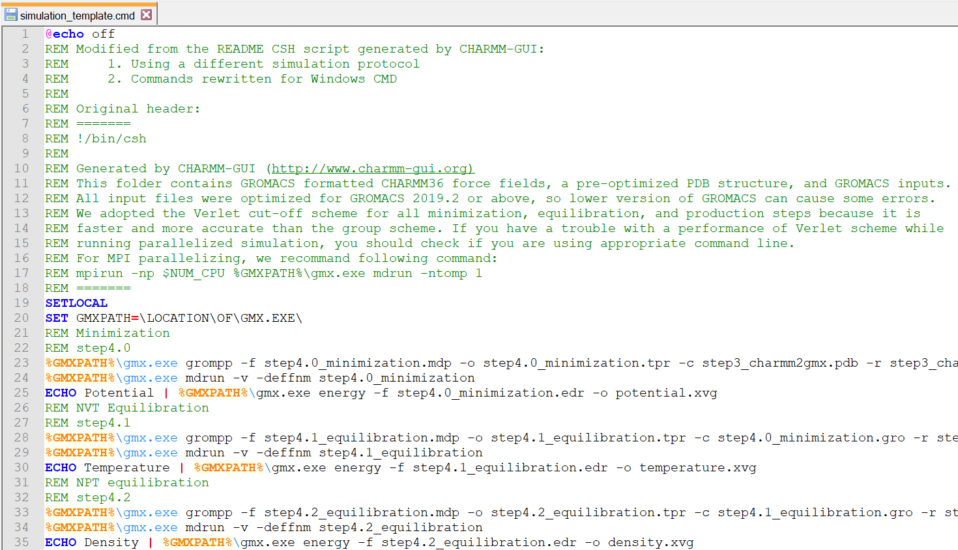
Protein Simulation with GROMACS for Beginners:
A quick demo using the CHARMM-GUI input generator & a short Windows CMD script

Slide 2
Table of Contents

Slide 3
Files in this archive
Filler
  filler

Slide 4
Software/Web Services Used in This Demo
GROMACS 2019.6 for Windows (OpenMP acceleration) | For MD simulation Provided in this zip file
QtGrace | For plotting graphs in .xvg files Provided in this zip file
UCSF Chimera | For molecular visualization Download the latest version from http://www.cgl.ucsf.edu/chimera/download.html
Notepad | Plain-text editor that should be available in all Windows installation
CHARMM-GUI Input Generator (Solution Builder) | For generating GROMACS input files Access from http://www.charmm-gui.org/?doc=input/solution

Slide 5
Introduction system requirement
Platform | Windows 10
* Please make sure that the path to (i) the folder containing GROMACS and QtGrace and (2) the folder containing GROMACS input files do not contain any non-ASCII characters.

Slide 6
Introduction background
1ZNF
  Filler

Slide 7
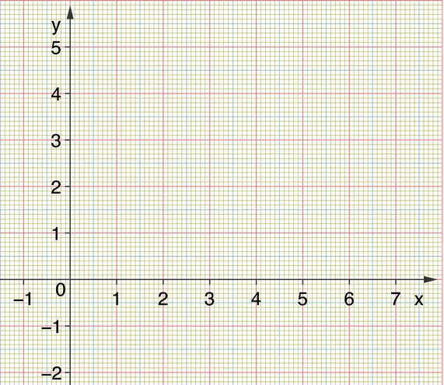
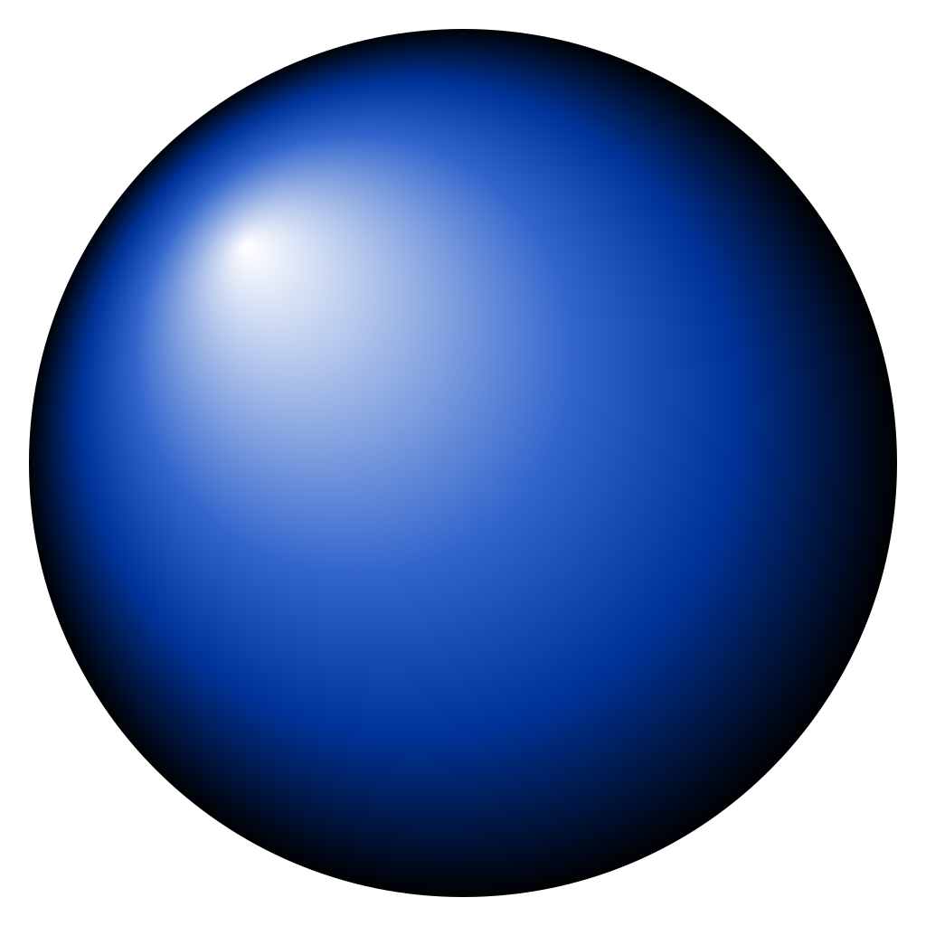
Theories Molecular dynamics (MD) simulation
Input initial conditions:
  Position: r
r₁(x₁, y₁, z₁)
r₂(x₂, y₂, z₂)
Notes:
First we input the initial conditions, including the position,

Slide 8
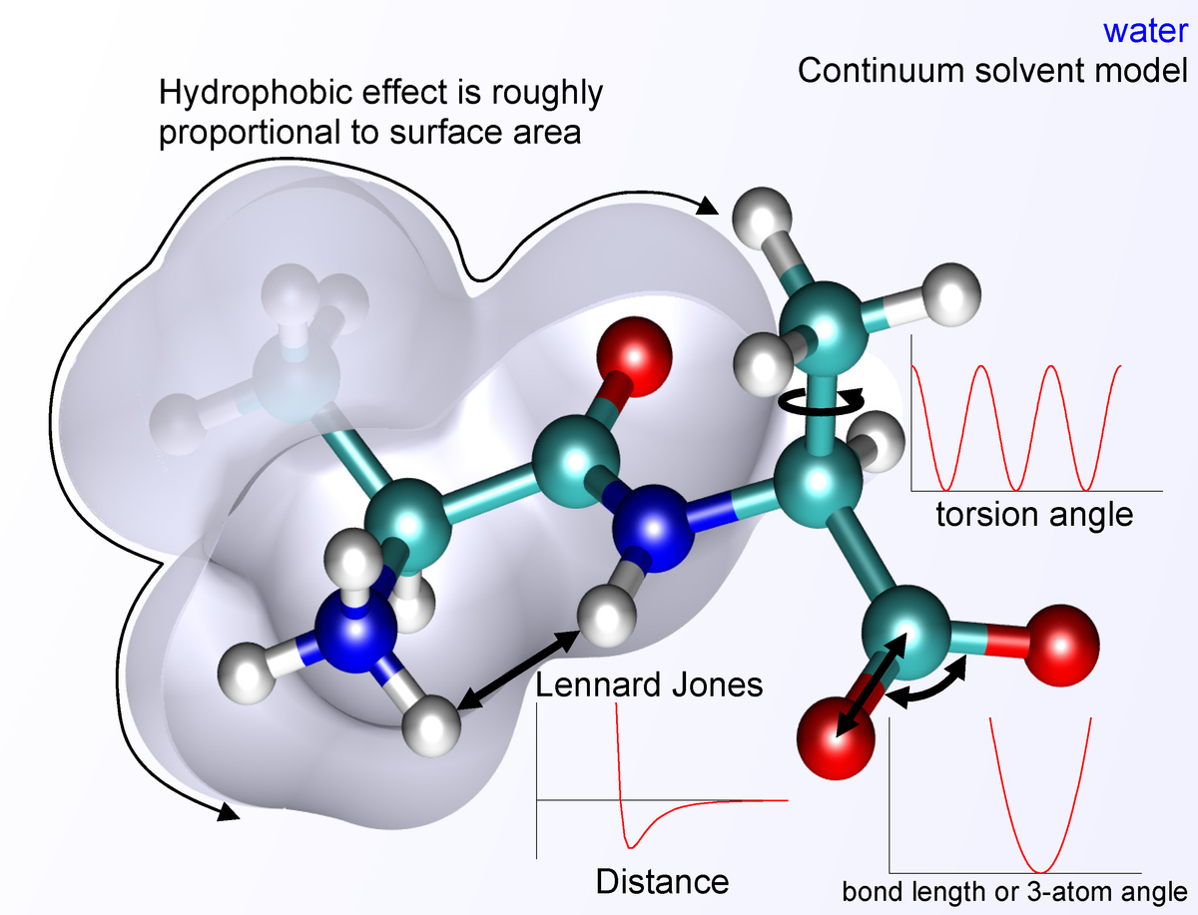
Theories Molecular dynamics (MD) simulation
Input initial conditions:
  Position: r
  Potential interaction: V
(Force field)
r₁(x₁, y₁, z₁)
r₂(x₂, y₂, z₂)
This Photo by Unknown Author is licensed under CC BY-SA
Notes:
And the potential interaction, which is also called the “force field” in computational chemistry.

Slide 9
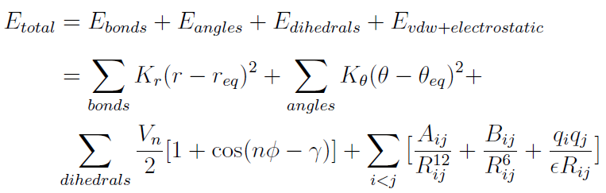
Theories Molecular dynamics (MD) simulation
Input initial conditions:
  Position: r
  Potential interaction: V
(Force field)
r₁(x₁, y₁, z₁)
r₂(x₂, y₂, z₂)
Notes:
And the potential interaction, which is also called the “force field” in computational chemistry.

Slide 10

Theories Molecular dynamics (MD) simulation
Input initial conditions:
  Position: r
  Potential interaction: V
Calculate forces: Newton’s 2nd law
(Force field)
r₁(x₁, y₁, z₁)
r₂(x₂, y₂, z₂)
Notes:
The force between the to particles is then calculated using newton’s second law F equals to ma.

Slide 11
Theories Molecular dynamics (MD) simulation
Input initial conditions:
  Position: r
  Potential interaction: V
Calculate forces: Newton’s 2nd law
Update configurations
(Force field)
F
Notes:
The new positions of the particles are then calculated,

Slide 12

Theories Molecular dynamics (MD) simulation
Input initial conditions:
  Position: r
  Potential interaction: V
Calculate forces: Newton’s 2nd law
Update configurations
(Force field)
F
Notes:
and the system configuration is updated

Slide 13
Theories Molecular dynamics (MD) simulation
Input initial conditions:
  Position: r
  Potential interaction: V
Calculate forces: Newton’s 2nd law
Update configurations
(Force field)
F
Notes:
These steps would be repeated throughout the whole simulation, allow us to study the system behavior within a certain period of time.

Slide 14
Overall Procedures filler
Filler
  Filler

Slide 15
1. “Local” Installation of GROMACS and QtGrace Filler
Filler
  Filler

Slide 16
2. Modify “simulation_template.cmd” for later use Filler
Filler
  Filler

Slide 17
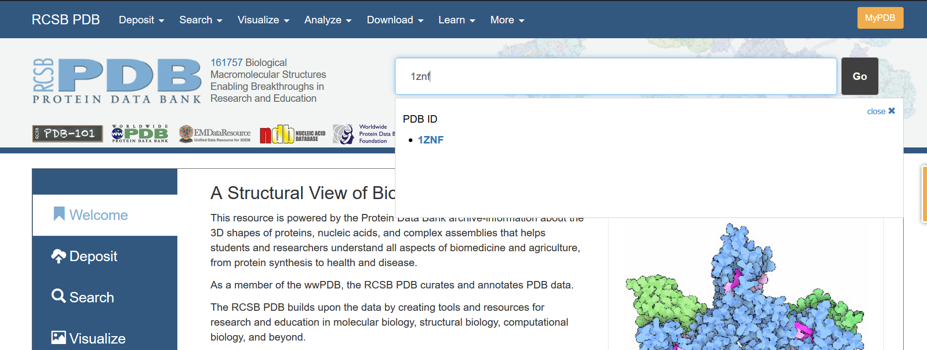
3a. Download the protein crystal structure from RCSB PDB Filler
Search 1ZNF in the RCSB PDB to download the PDB file
(or use this URL directly: https://files.rcsb.org/download/1ZNF.pdb)

Slide 18
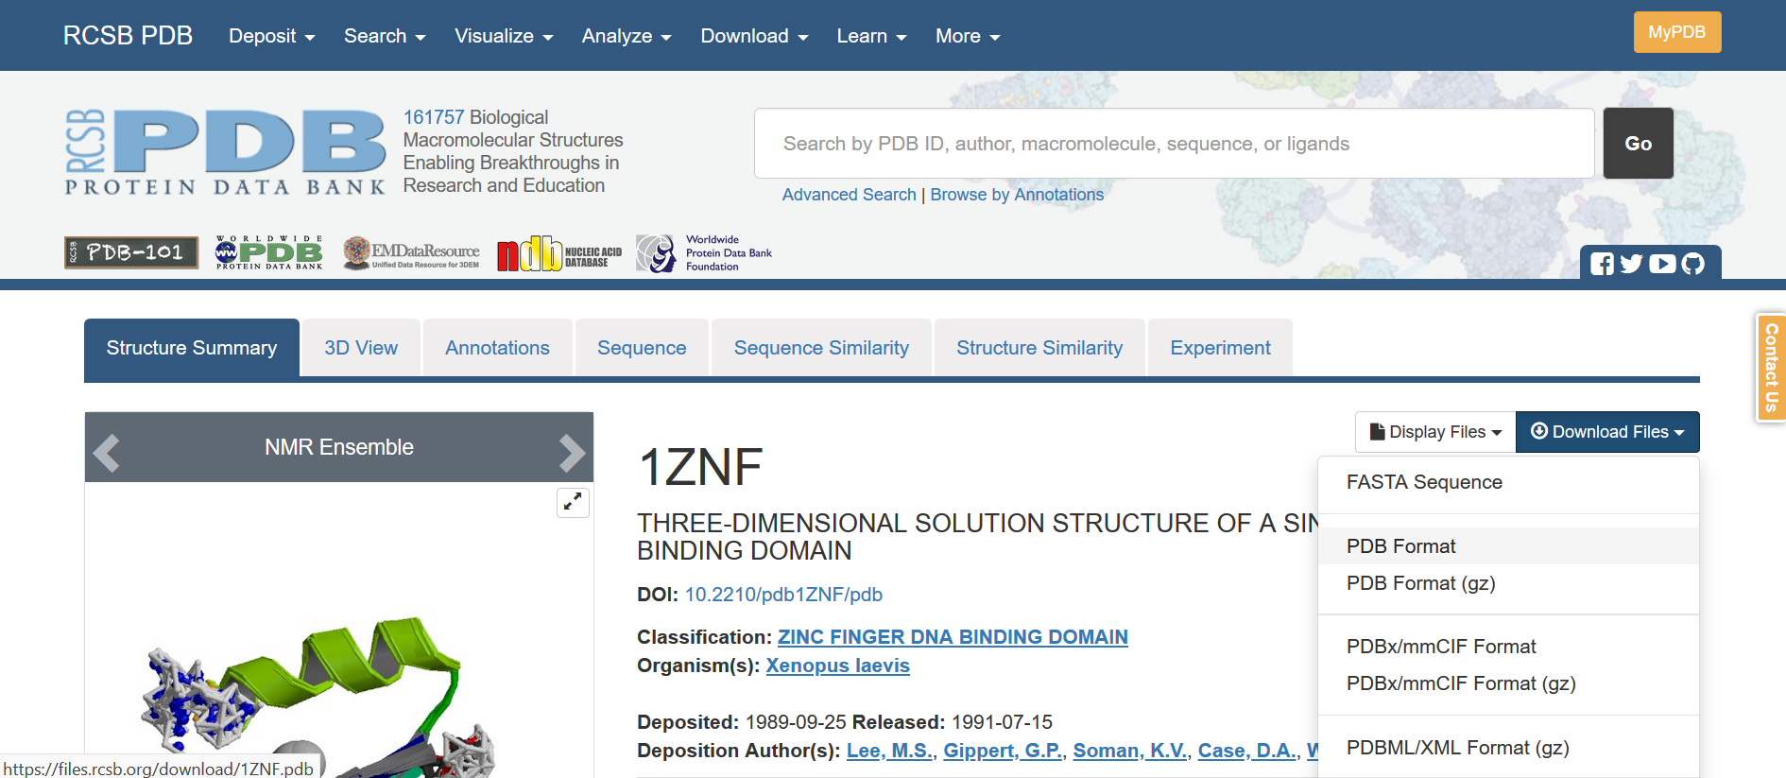
3a. Download the protein crystal structure from RCSB PDB Filler
Search 1ZNF in the RCSB PDB to download the PDB file
(or use the following URL directly: https://files.rcsb.org/download/1ZNF.pdb)

Slide 19
3b. Inspect and extract the interested model with UCSF Chimera Filler
Check mutation and missing residues
  Filler

Slide 20
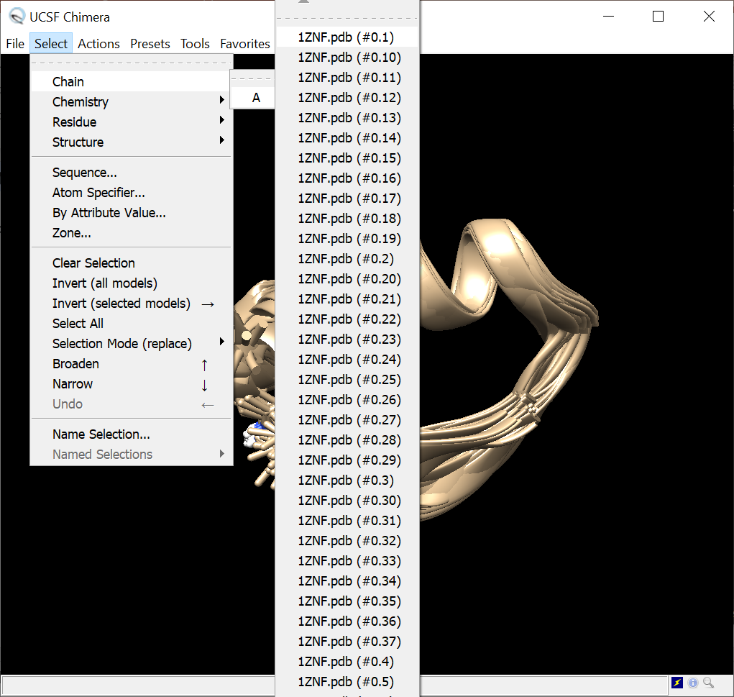
3b. Inspect and extract the interested model with UCSF Chimera Filler
Filler
  Filler

Slide 21
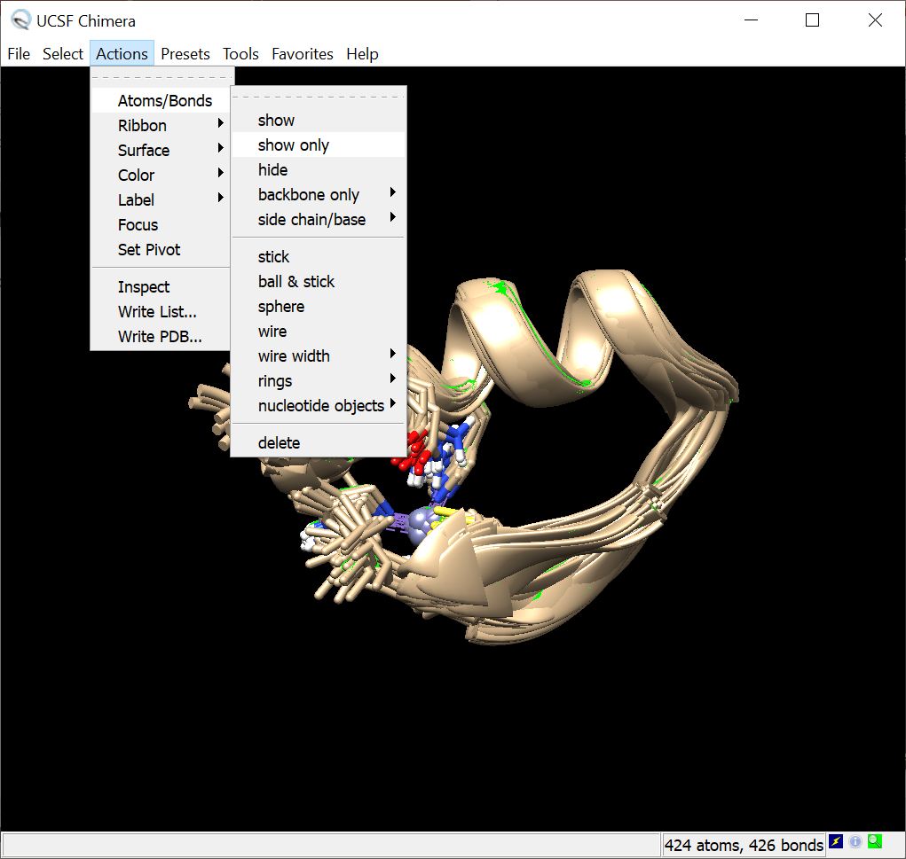
3b. Inspect and extract the interested model with UCSF Chimera Filler
Filler
  Filler

Slide 22
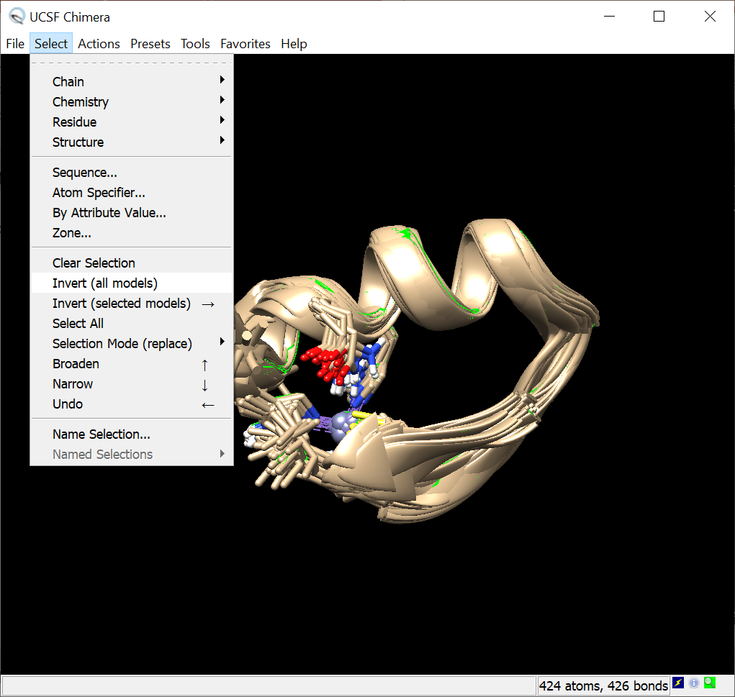
3b. Inspect and extract the interested model with UCSF Chimera Filler
Filler
  Filler

Slide 23
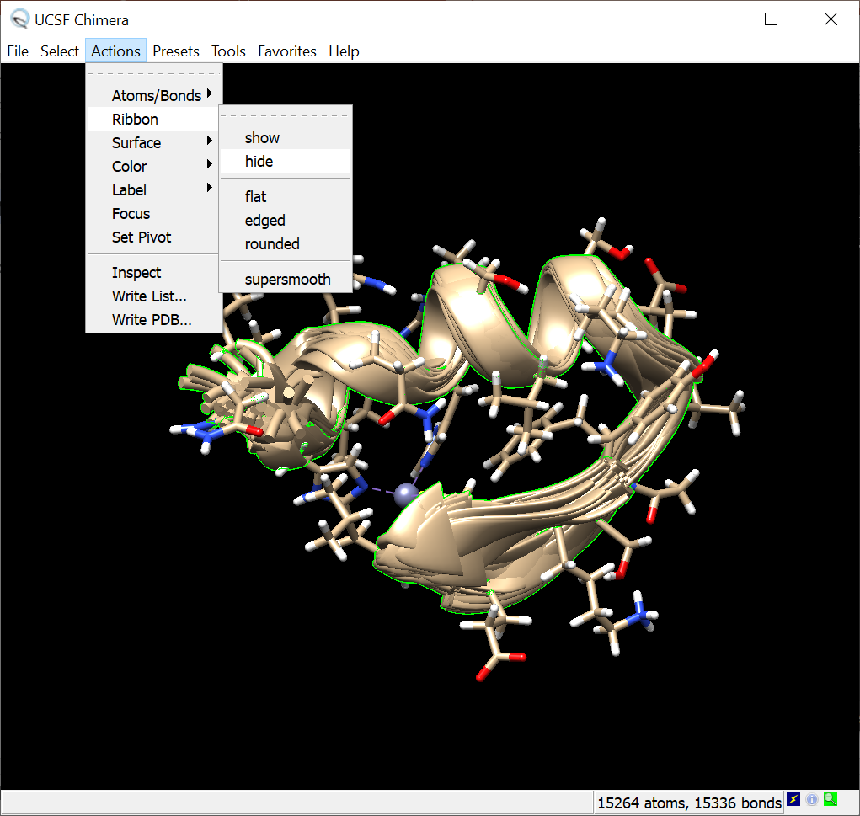
3b. Inspect and extract the interested model with UCSF Chimera Filler
Filler
  Filler

Slide 24
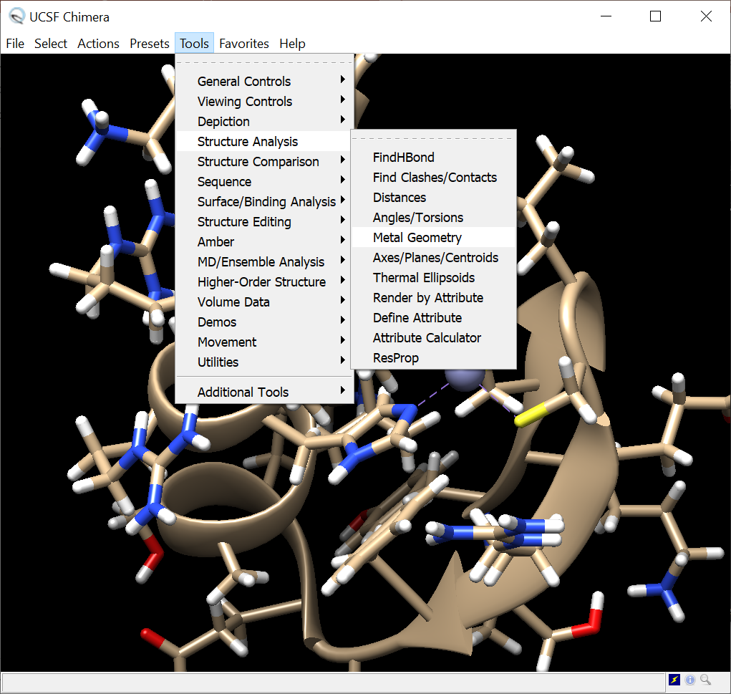
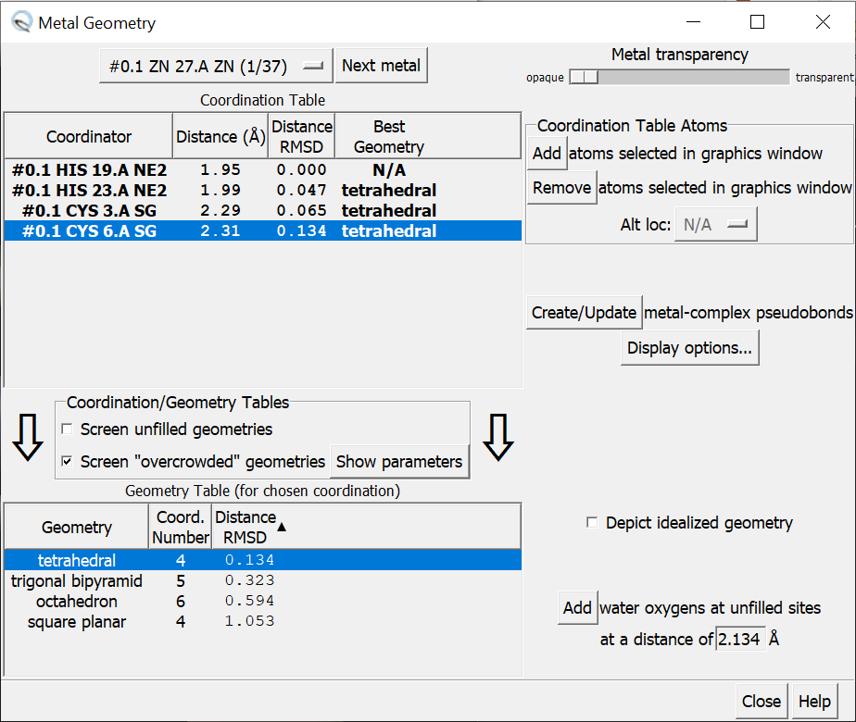
3b. Inspect and extract the interested model with UCSF Chimera Filler
Filler
  Filler

Slide 25
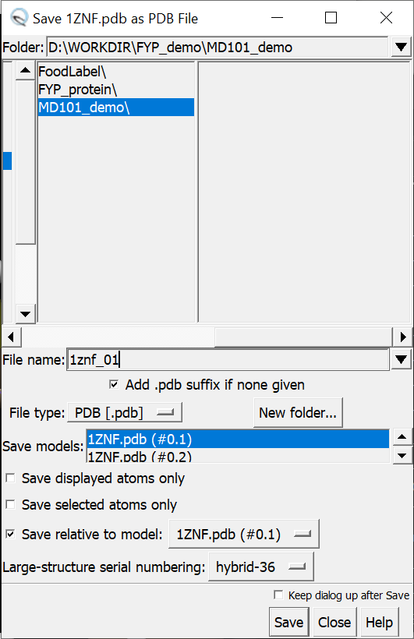
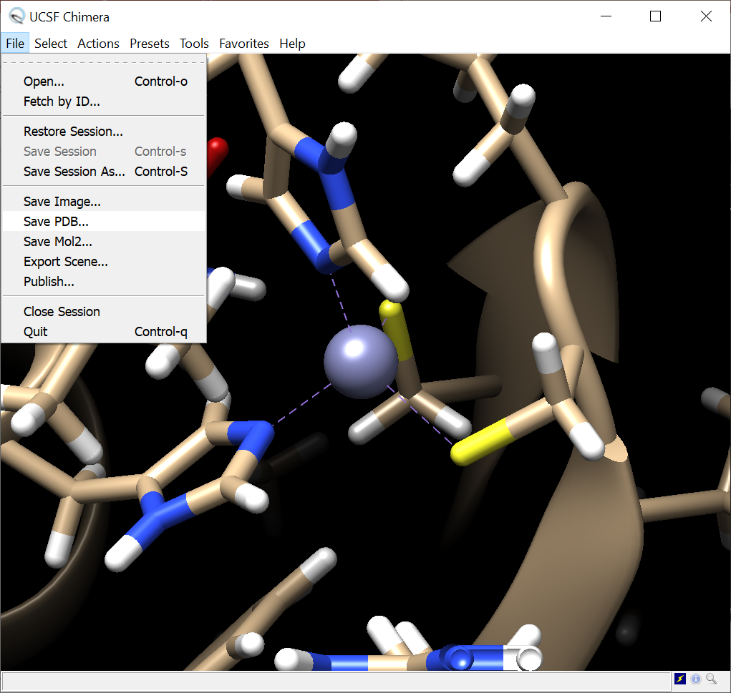
3b. Inspect and extract the interested model with UCSF Chimera Filler
Filler
  Filler

Slide 26
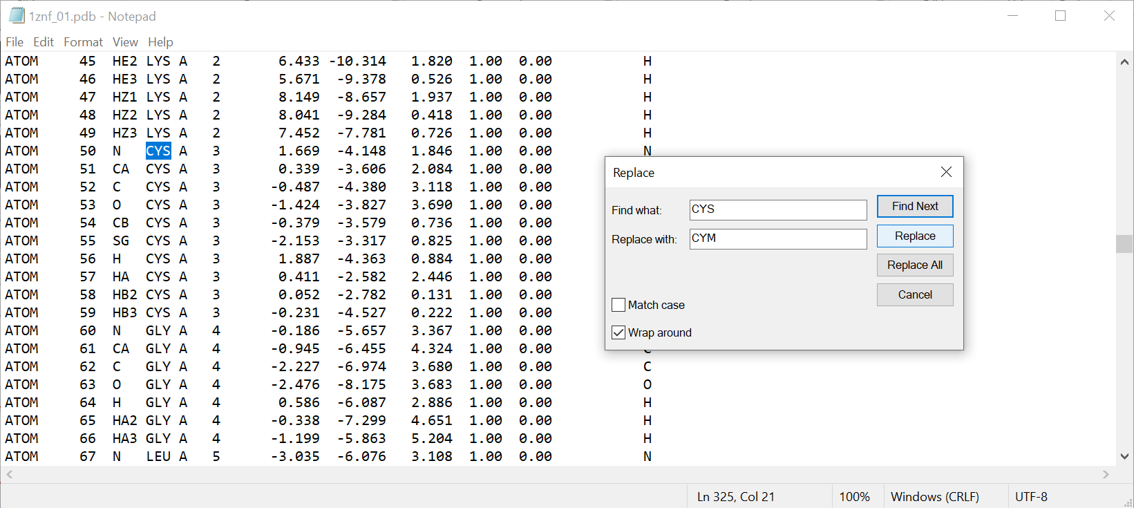
3c. Modify the extracted PDB file for CHARMM-GUI Filler
Filler
  Filler

Slide 27
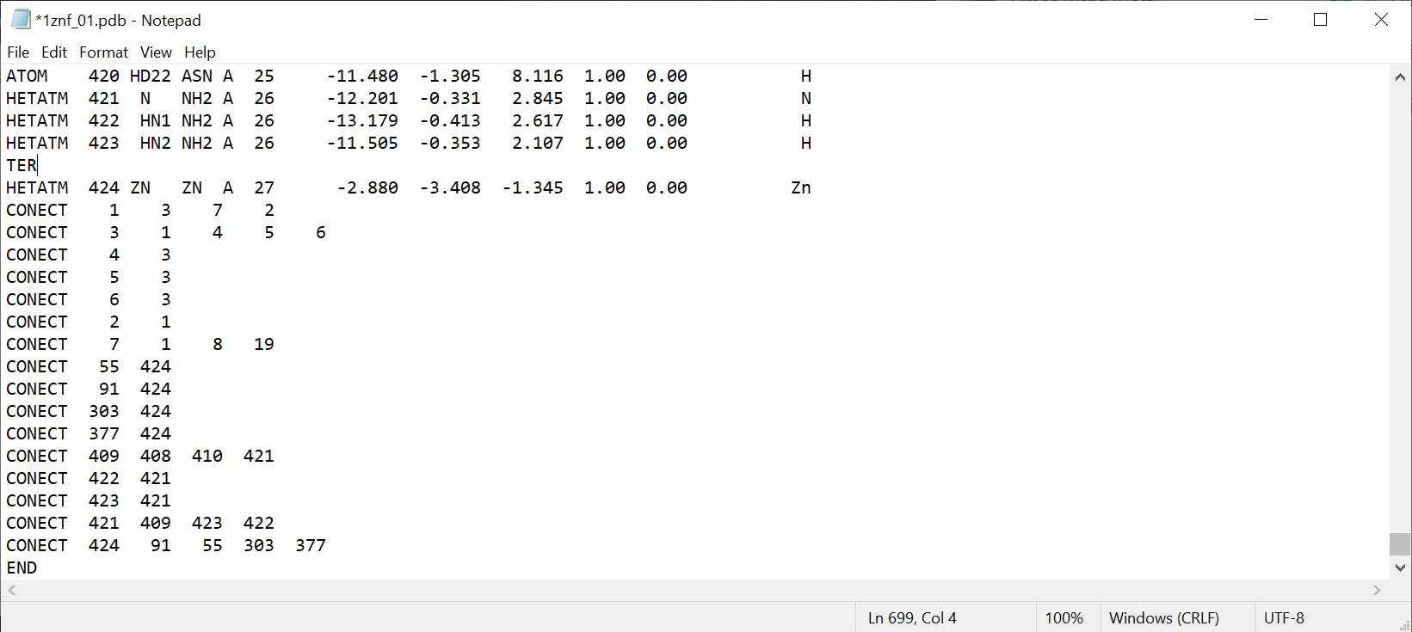
3c. Modify the extracted PDB file for CHARMM-GUI Filler
Filler
  Filler

Slide 28
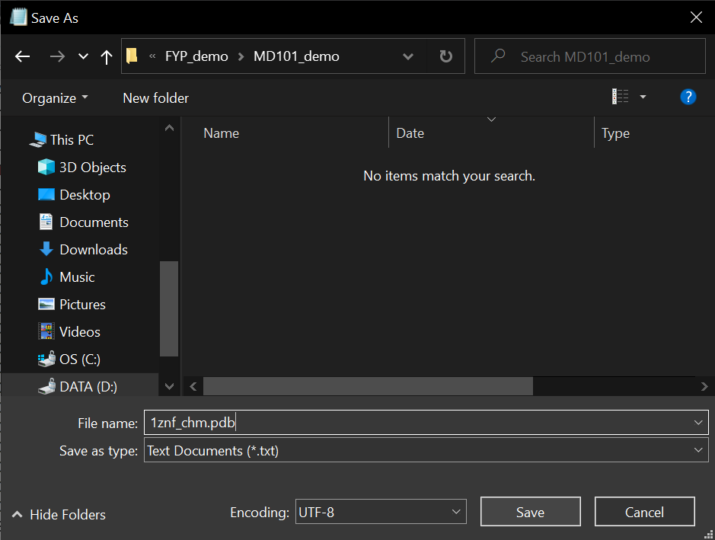
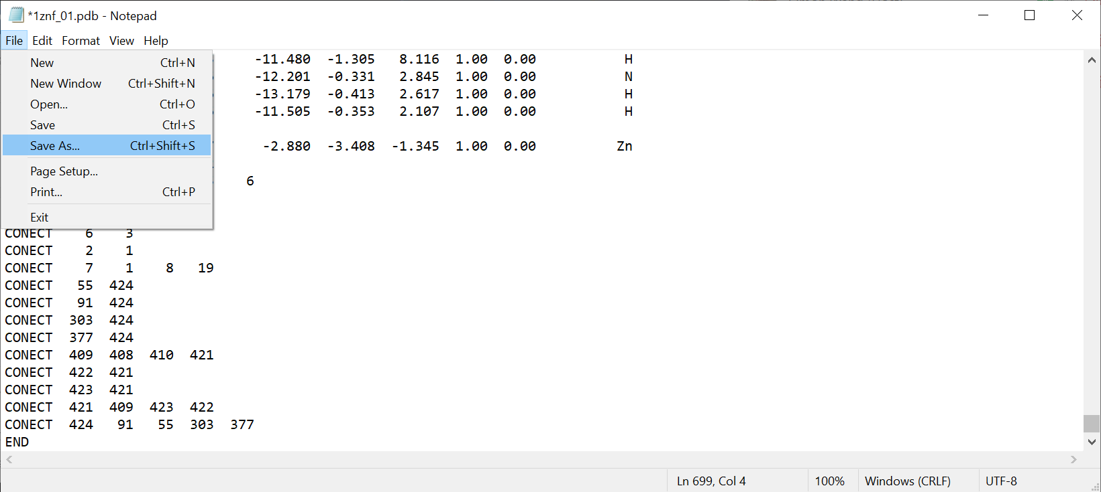
3c. Modify the extracted PDB file for CHARMM-GUI Filler
Filler
  Filler

Slide 29
4. Submit your PDB file to CHARMM-GUI Filler
Filler
  Filler

Slide 30
4. Submit your PDB file to CHARMM-GUI Filler
Filler
  Filler

Slide 31
4. Submit your PDB file to CHARMM-GUI Filler
Filler
  Filler

Slide 32
4. Submit your PDB file to CHARMM-GUI Filler
Filler
  Filler

Slide 33
4. Submit your PDB file to CHARMM-GUI Filler
Filler
  Filler

Slide 34
Theories Periodic Boundary Conditions
Simulation cell
Images
Notes:
Answer to: hitting the wall of the box? System size?

Slide 35
4. Submit your PDB file to CHARMM-GUI Filler
Filler
  Filler

Slide 36
4. Submit your PDB file to CHARMM-GUI Filler
Filler
  Filler

Slide 37
5a. Download and extract the achieve from CHARMM-GUI Filler
Filler
  Filler

Slide 38
5b. Check the files generated by CHARM-GUI Filler
Filler
  Filler

Slide 39
6. Modify the files generated by CHARMM-GUI Filler
Filler
  Filler

Slide 40
6. Modify the files generated by CHARMM-GUI Filler
Simulation protocol
  Filler

Slide 41
7. Prepare the script for MD simulation Filler
Filler
  Filler

Slide 42
8. Run the MD simulation Filler
Filler
  Filler

Slide 43
9. Analyze the results Filler
Filler
  Filler

Slide 44
9. Analyze the results Filler
Filler
  Filler

Slide 45
9. Analyze the results Filler
Filler
  Filler

Slide 46
Reference filler
Filler
  Filler

Slide 47
Further Readings filler
Filler
  Filler

