Slide 1

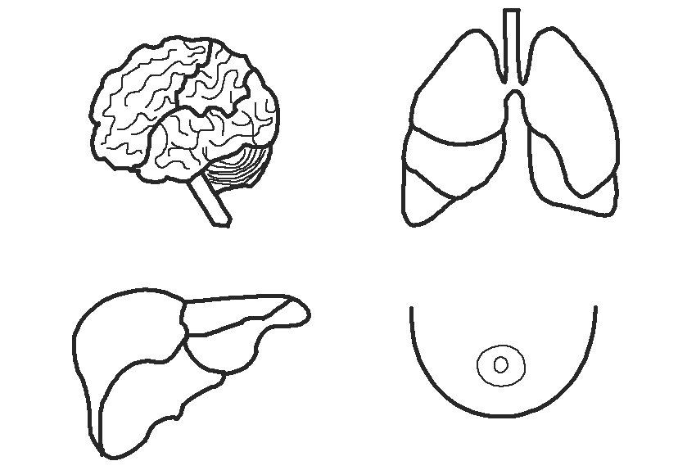






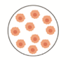
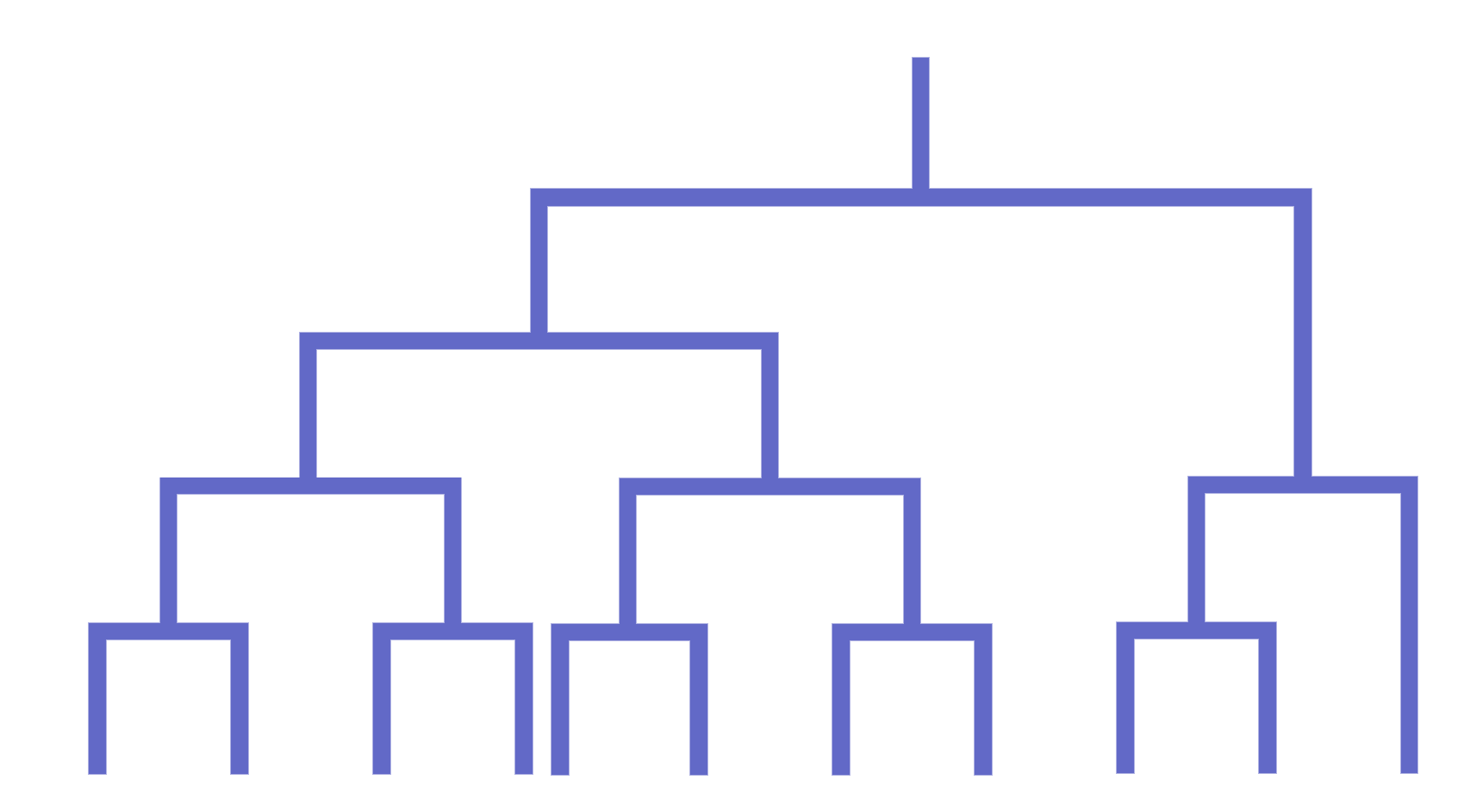
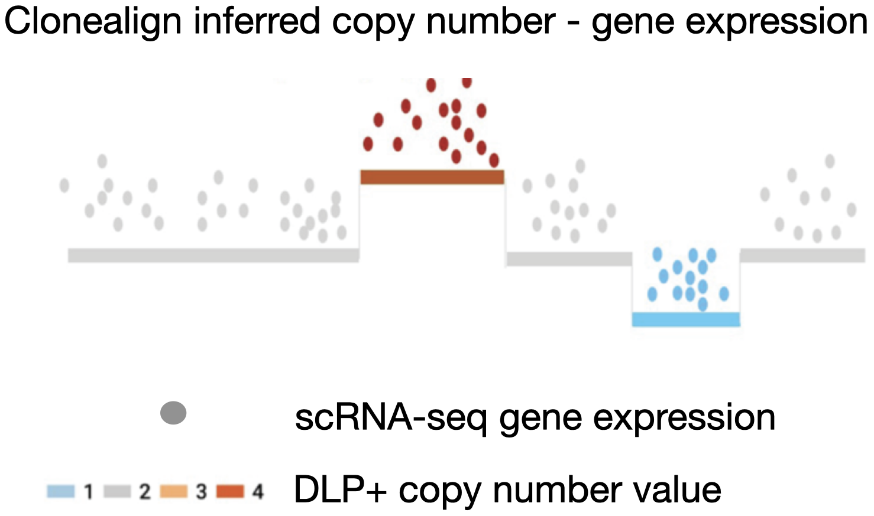
a)
TNBC patient
tissue extraction
Mammary fat pad transplant
Monitoring for metastasis
Metastasis
re-transplant
Primary tumour removal
Metastatic tumour removal
Metastatic tumour removal
b)
DLP+, scRNA-seq, Bulk RNA-seq, H & E
Lung Metastasis
Axillary Metastasis
…
Nonmetastatic
Highly Metastatic
Inguinal Metastasis
Sitka phylogenetic inference
Metastatic Clonal Analysis
c)
Joint tumour cell populations
(DLP+, scRNA-seq)
d)
Interferon alpha response
TNFalpha up-regulated
E2F target
Significant pathways and genes related to metastasis

