Slide 1
Weather Forecast Subscription Editor
A tool to manage weather subsciptions
Date
Dan McCreary
President
Dan McCreary & Associates
dan@danmccreary.com
(952) 931-9198
M
D
Metadata Solutions

Slide 2
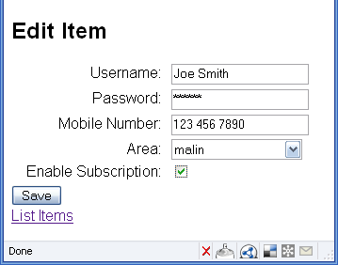
Edit Form

Slide 3
Thank You!
Please contact me for more information:
Metadata Management Services
Web Services
Service Oriented Architectures
Business Intelligence and Data Warehouse
Metadata Registries
Semantic Web
Dan McCreary, President
Dan McCreary & Associates
Metadata Strategy Development
dan@danmccreary.com
(952) 931-9198

