Slide 1
A New Parallel Algorithm for Connected Components in Dynamic Graphs

Slide 2
Overview
Introduction
Related work
Problem
Algorithm
Result
Demo
Notes:
Intro + related work: 5’
Problem: 5’
PN-subgraph: 12’
Result+application:3’
Demo: 5’

Slide 3
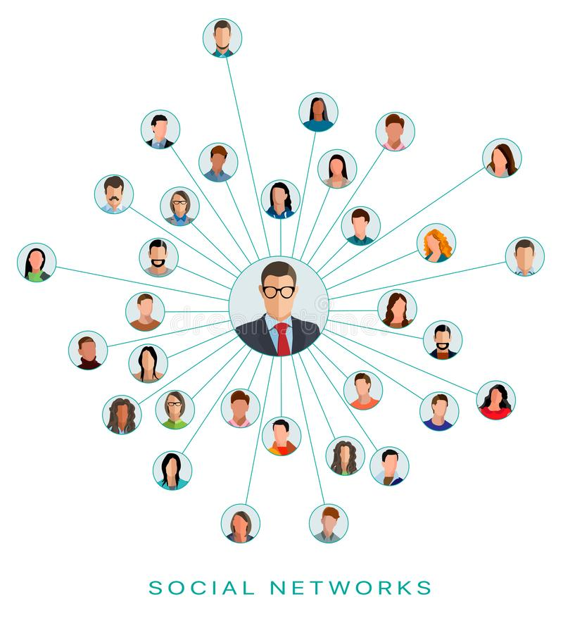
INTRODUCTION
Social networks, communication networks, business intelligence databases, and large scientific data sources now contain hundreds of millions elements with billions of relationships
Over time relationships change rapidly and complexity
These datasets as dynamic and semantic graphs of vertices and edges can describe the structure and relationship between vertices
This has led to the development of dynamic graph algorithms
Notes:
Social networks, communication networks, business intelligence databases, and large scientific data sources now contain hundreds of millions elements with billions of relationships
Over time relationships change rapidly and complexity
These datasets as dynamic and semantic graphs of vertices and edges can describe the structure and relationship between vertices
This has led to the development of dynamic graph algorithms

Slide 4
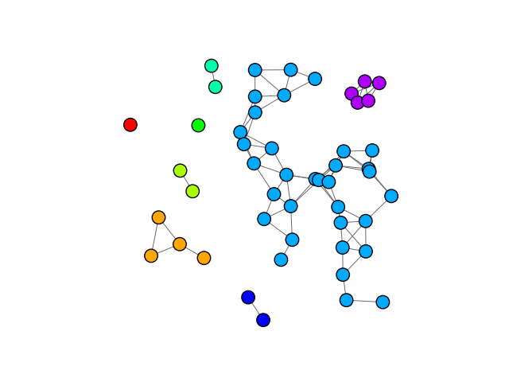
Connected Components
Given an undirected graph G = (V, E)
A connected component C ⊆ V ensures that for each s, t ∈ C there is a path between s and t
Each Connected Component can be detected by an DFS or BFS

Slide 5
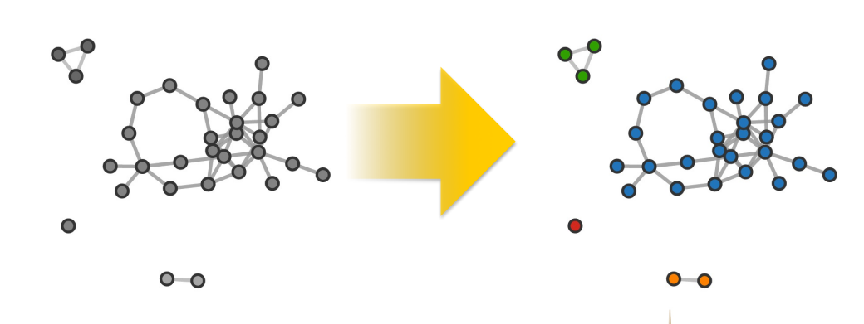
Connected Labeling
If u and v have the same components when there is a path between these two vertices
The component labeling of a graph can be used as building block within other calculations: betweenness centrality, community detection, image processing, and others

Slide 6
Related Work
Hirschburg et al : CONNECT algorithm ( 1979)
Two variations : |V | and and V |VlogV| processors.
Time complexity : O(log2V ).
Shiloach and Vishkin (1982)
|V | + 2|E| processors and O(logV) time complexity
In the average case, it completes in ∼d/2 iterations, where d is the diameter of the graph
Shiloach and Even (1981)
Algorithm maintain a structure representing the vertices in the levels of breadth first search tree for each component
Update time : O(E + V logV ) and worst-case query time of O(V ).

Slide 7
Real World Graph Properties
PROBLEM :
Too expensive to compute in practice
Require too much storage
Ignore real world graph properties

Slide 8
TRACKING CONNECTED COMPONENTS IN A DYNAMIC GRAPH
Dynamic graph algorithms :
Challenge :
Correctness :
Parallelism
Time complexity
Storage complexity

Slide 9
ALGORITHM

Slide 10
Parent-neighbor subgraph
G(V, E)
Root
Node
PN edge
non-PN edge
Component 1
Component 2

Slide 11
Maintain one PN Subgraph per component
Select a vertex at random
Perform a breadth-first traversal of the component
Construct a directed subgraph where each vertex tracks its parents and neighbors
Parents: adjacencies in previous frontier
Neighbors: adjacencies in same frontier
Record the distance to the root
Limit the total number of PN tracked per vertex to threshPN
Prefer parents over neighbors
This subgraph maintains various paths back to the root
If each vertex has a path to the root through its PN, component is connected

Slide 12
Extract PN subgraph with parallel BFS
Node | PN
0 | []
1 | [0, -2]
2 | [0, -1]
3 | [0]
4 | [2,3]
5 | [6]
6 | [1,2]
Node | PN
0 | []
1 | [0]
2 | [0]
3 | [0]
4 | []
5 | []
6 | []
Node | PN
0 | []
1 | [0, -2]
2 | [0, -1]
3 | [0]
4 | [2,3]
5 | []
6 | [1,2]
Node | PN
0 | []
1 | []
2 | []
3 | []
4 | []
5 | []
6 | []
Node | PN
0 | []
1 | [0, -2]
2 | [0, -1]
3 | [0]
4 | []
5 | []
6 | []
0
Level 0
0
3
1
3
1
2
2
Level 1
6
6
4
4
Level 2
5
5
Level 3
0
1
2
3
4
6
5
ThreshPN = 2

Slide 13
In the event of an insertion
Vertices on the same frontier or one apart, same component:
Check for opportunity to add a parent or neighbor
Check for opportunity to replace neighbor with parent
Vertices are farther apart but in the same component:
Perform the same as above
The distances will now be incorrect; however, they are still acceptable for our purposes
Incorrect distances will eventually be cleaned up by merger or delete

Slide 14
Insert Edges
0
1
2
3
6
4
5

Slide 15
Insert Edges
Node | PN
0 | []
1 | [0, -2]
2 | [0, -1]
3 | [0]
4 | [2,-6]
5 | [6]
6 | [1,-4]
Node | PN
0 | []
1 | [0, -2]
2 | [0, -1]
3 | [0]
4 | [2,1]
5 | [6, 2]
6 | [1,-4]
Node | PN
0 | []
1 | [0, -2]
2 | [0, -1]
3 | [0]
4 | [2,-6]
5 | [6, 2]
6 | [1,-4]
0
Level 0
Insert:
[[1,4], [2,5]]
1
2
3
Level 1
6
4
Level 2
5
Level 3

Slide 16
Joining two components
Join the smaller component into the larger PN subgraph
Start a search from the connection point(s) outward and rebuild the smaller subgraph
0
1
2
3
8
10
6
4
9
5
7

Slide 17
In the event of a deletion
Check for remaining parents or neighbors that still have parents
Have parents with paths to root:
Do nothing
Have neighbors with paths to root:
Change distance to indicate to children and neighbors not to depend on you
Else (no parents or neighbors with paths to root):
Assume components have split
Start search and relabel process down the PN subgraph
If a node in the frontier above can be reached, still connected. Backtrack and rebuild traversed section of PN. – Otherwise a new PN subgraph and component is built.

Slide 18
Delete Edges
Node | PN
0 | []
1 | [0, -2]
2 | [0, -1]
3 | [0]
4 | [2,3]
5 | [6]
6 | [1,2]
0
Delete Edges:
[[1,2], [2,4], [3,4], [6, 5]]
1
2
3
6
4
5

Slide 19
Delete Edges
Node | PN
0 | []
1 | [0, -2]
2 | [0, -1]
3 | [0]
4 | [6]
5 | []
6 | [1,2]
0
Delete Edges:
[[1,2], [2,4], [6, 5]]
1
2
3
6
5
4

Slide 20
Repair after delete
0
1
2
3
4
5
6

