Slide 1
What to Present ?!
In this seminar we are going to present an application of Primal Decomposition method. First we consider the system model, then after formulating the problem and the constraints, we will try to find a solution for the optimization problem using Primal Decomposition.

Slide 2
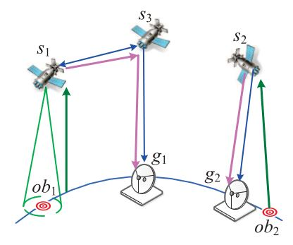
Mission Aware Contact Plan Design in Resource-Limited Small Satellite Networks
Small satellite networks (SSNs) are playing an increasing role in nowadays earth observation due to their less development cost and energy consumption.
The goal of Small Satellite Networks is to transmit the observation data from the satellites to the ground stations, such that the satellites collect data from the observable objects, and then via the Predictable SSNs (Small Satellite Networks) the data will be delivered to the ground stations.

Slide 3
System Model
M small satellites (S set)
N ground stations (G set)
L observable objects (OB set)
A time-slotted system with T time slots (Predictable)
Small satellites only collect mission data when the observing objects lie in their coverage region.
Small satellites only transmit mission data when other small satellites or ground stations are in their coverage region.
Each small satellite is equipped with two transponders: one for S2S link establishment and another for S2G link establishment and S2S links are bidirectional.
Each ground station can be accessed by only one small satellite at the same time.

Slide 4
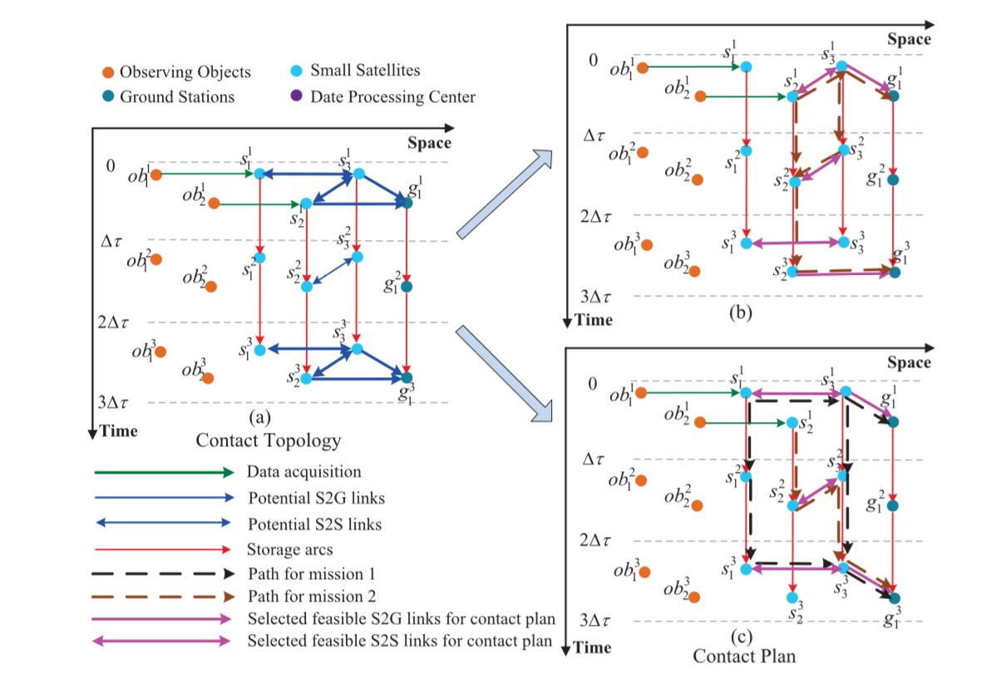

Capacity of each link is $C\left( v_{i}^{t}, v_{j}^{t}\right).$
Each satellite has a buffer with a limited size, which means at the end of each time slot it can store the mission data. ( b )
Satellites have their own battery and it can be charged by Solar Panel.
The processes of data collection and delivery for observing objects are called Flow. (f )

Slide 5
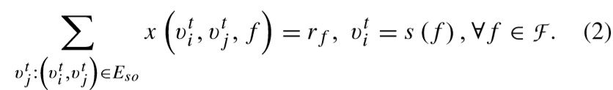
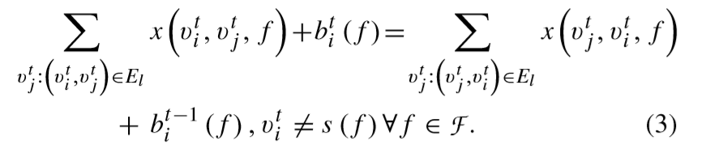

Problem and Constraints Formulation
Sum of all the outgoing links of an Observable Object is equal to data volume of flow f.
Sum of incoming and outgoing data volumes of flow f in every satellite are equal.
A Boolean variable is utilized to indicate whether a links is being used or not.

Slide 6
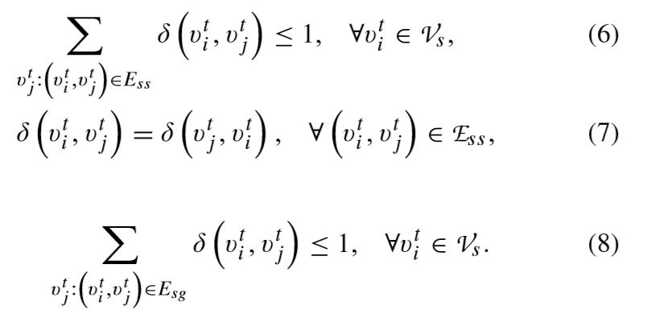
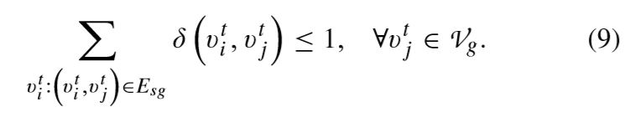
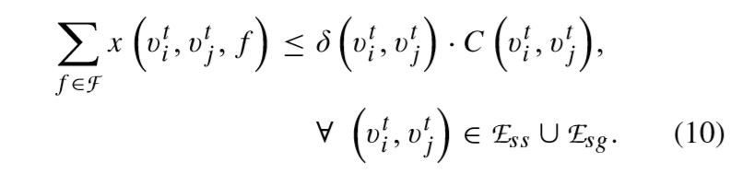
Each small satellite is equipped with two transponders: one for S2S link establishment and another for S2G link establishment and S2S links are bidirectional.
Each ground station can be accessed by only one small satellite at the same time.
Capacity of each link is limited.

Slide 7
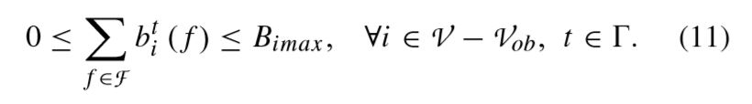

Each satellite has a buffer with a limited size.
The battery of each satellite should be:

Slide 8
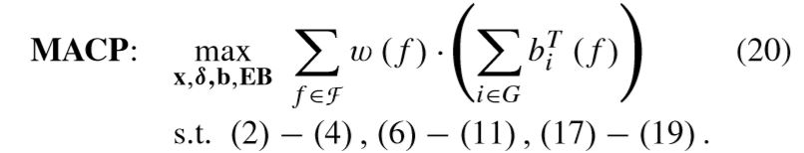
Optimization Problem
This optimization problem is MILP and NP-hard in general.

Slide 9
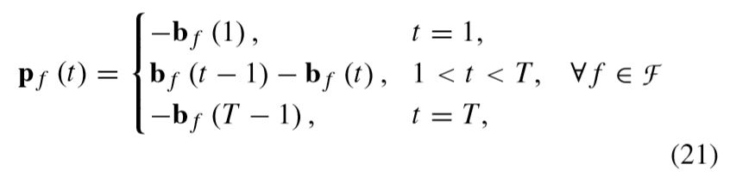
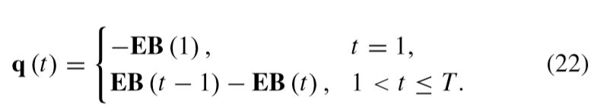
Proposed Solution
We now use Primal Decomposition in order to solve the original problem. As it can be seen, according to constraints ( 3 ),( 18 ) time slots are coupled to each other. For decoupling the problem in time slots, we define new variables:

Slide 10
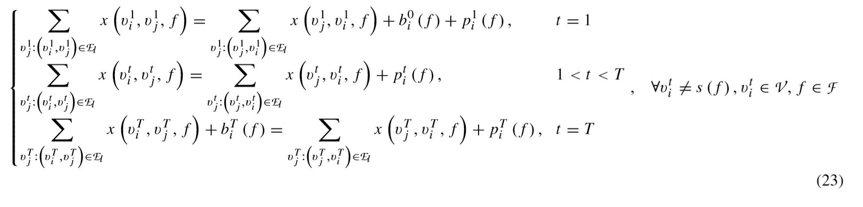
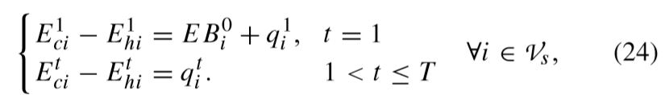
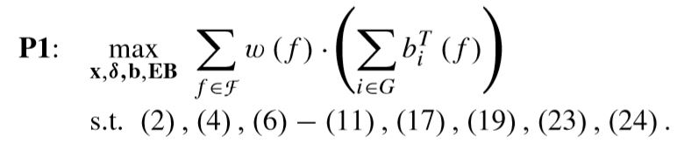
Now the constraints ( 3 ),( 18 ) becomes:
Now we can rewrite the problem as follows, which is the same but decoupled in time slots.

Slide 11
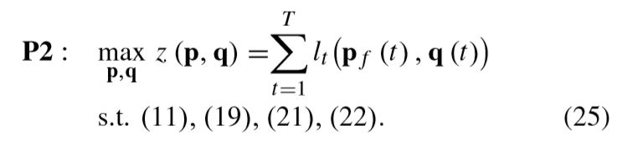
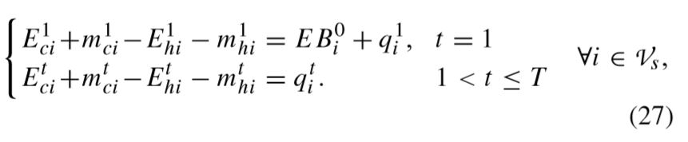
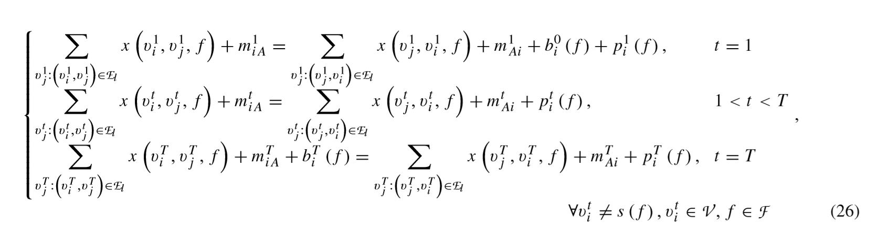
Now we exploit Primal Decomposition and decompose decoupled problem into a main problem P2 and a nested problem P3.
The objective function of problem P2 is the summation of all slot network proﬁts, which can be achieved by solving the nested P3 with given p and q.
Note that with the given p,q ( assume initialization ), constraints (23),(24) may not be feasible in each slot of P3. to this end we define some virtual nodes, such that :

Slide 12
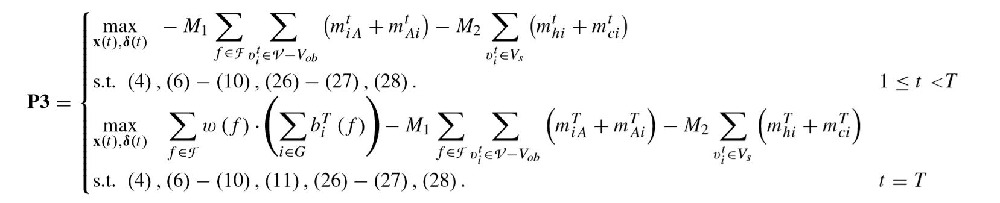
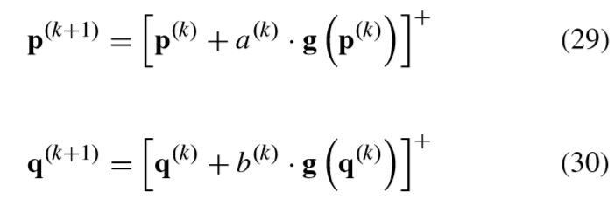
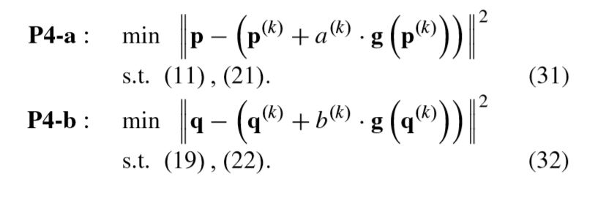
Now our nested problem (P3) is:
Which M1 and M2 are two large positive numbers.
According to P2 problem, the Update formula of p,q are as follows:

Slide 13
