Slide 1
Improved Dual Decomposition Based Optimization for DSL Dynamic Spectrum Management
In the name of God
Mojdeh Karbalaee Motalleb

Slide 2
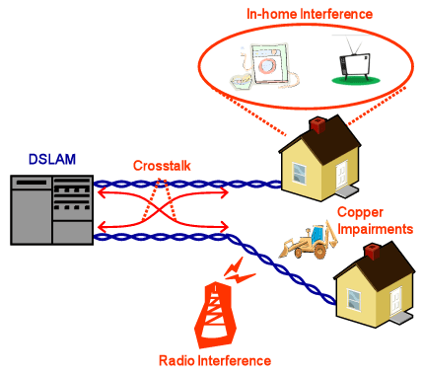
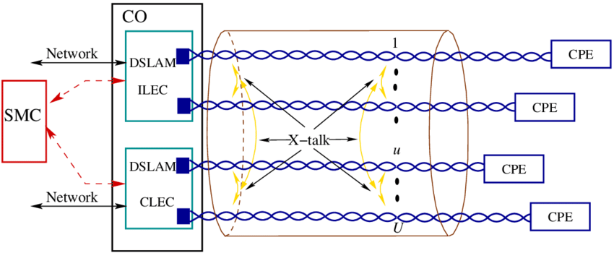
Introduction to DSL and Crosstalk

Slide 3
Introduction to DSM
Dynamic spectrum management (DSM) : key technology to improve the performance of digital subscriber line (DSL) broadband access networks
The basic concept of DSM is to coordinate transmission over multiple DSL lines so as to mitigate the impact of crosstalk interference amongst them
In this paper we propose a novel improved dual decomposition approach inspired by recent advances in mathematical programming.
It uses a smoothing technique for the Lagrangian combined with an optimal gradient based scheme for updating the Lagrange multipliers. The step size parameters are furthermore selected optimally removing the need for a tuning strategy.

Slide 4
cWRS
Problems in which a weighted sum of user data rates is maximized subject to power constraints ,will be referred to as constrained weighted rate sum maximization (cWRS)
The cWRS problem is known to be an NP-hard, separable nonconvex optimization problem, that can have many locally optimal solutions
Difficulty in tuning the step size
By using our method, the convergence of current state-of-the-art DSM algorithms based on iterative convex can be speed up by one order of magnitude, without increasing the computational complexity for each iteration.

Slide 5


System Model
N Interfering DSL user :
with standard synchronous discrete multitone (DMT) modulation with tones
The transmission can be modeled independently on each tone by
The vector contains the transmitted signals on tone k, where refers to the signal transmitted by user on tone k .
The transmit power of user n on tone k , also referred to as transmit power spectral density

Slide 6
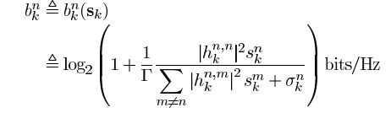

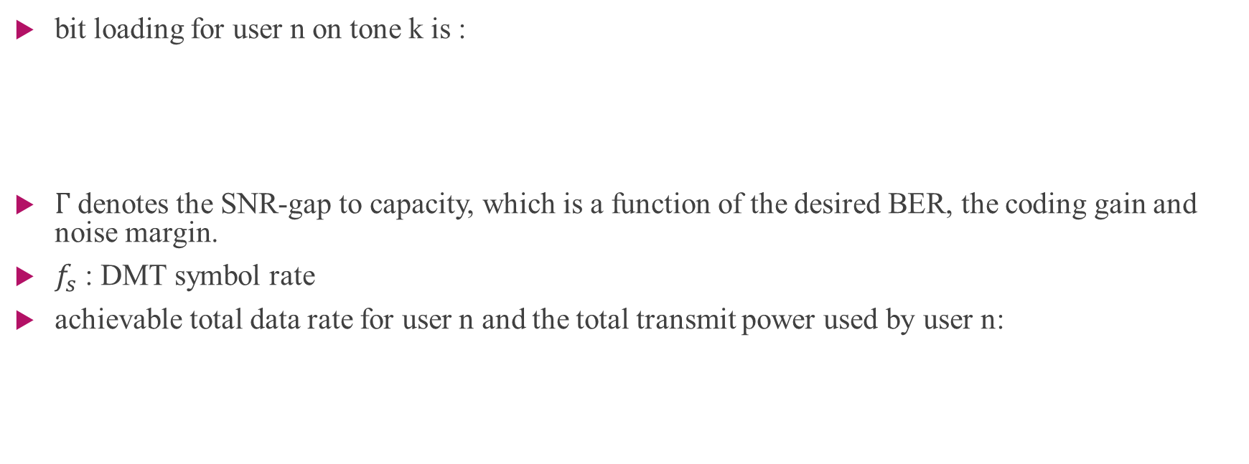
System Model
bit loading for user n on tone k is :
$Γ$denotes the SNR-gap to capacity, which is a function of the desired BER, the coding gain and noise margin.
$f_{s}$ : DMT symbol rate
achievable total data rate for user n and the total transmit power used by user n:

Slide 7


Dynamic Spectrum Management Problem
The basic goal of DSM through spectrum level coordination is to allocate the transmit powers dynamically in response to physical channel conditions.
Constraint:
The set of all possible data rate allocations that satisfy the constraints

Slide 8
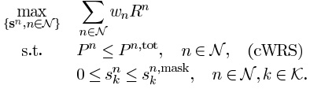
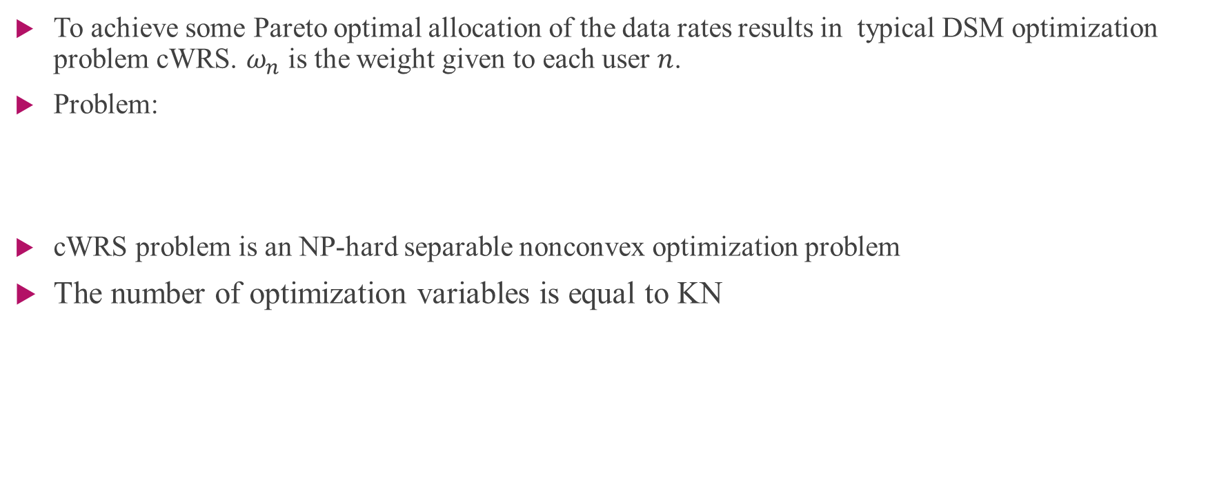
Dynamic Spectrum Management Problem
To achieve some Pareto optimal allocation of the data rates results in typical DSM optimization problem cWRS. $ω_{n}$ is the weight given to each user $n$.
Problem:
cWRS problem is an NP-hard separable nonconvex optimization problem
The number of optimization variables is equal to KN

Slide 9
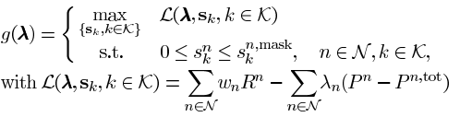


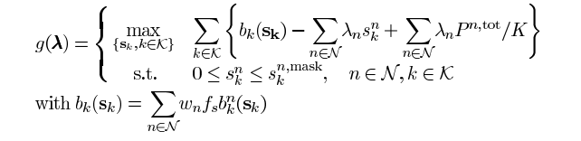
Dynamic Spectrum Management Algorithms
Dual problem (master problem)
Where
Slave problem

Slide 10




Dynamic Spectrum Management Algorithms
The slave optimization problem can then be decomposed into K independent nonconvex subproblems
A subgradient updating approach is proposed for this dual master problem, where the subgradient is defined as

Slide 11



Dynamic Spectrum Management Algorithms
$s_{k}(λ)$ refers to the optimal solution
Subgradient update :
when strong duality “holds” $K→∞$

Slide 12
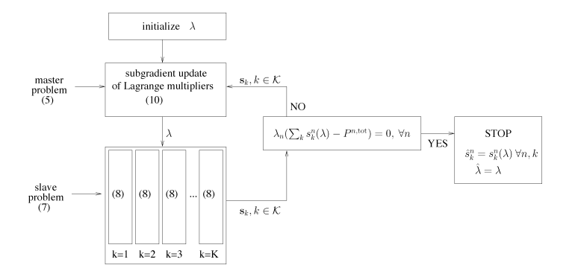
General structure of subgradient based dual decomposition approach for DSM

Slide 13
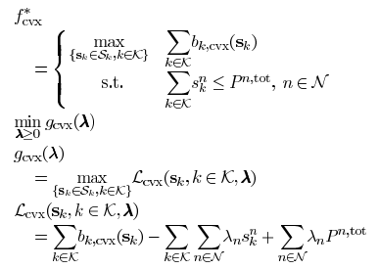
An Improved Dual Decomposition Approach for Iterative Convex Approximation Based DSM Algorithms
we will propose an improved dual decomposition approach for solving the convex optimization problem

Slide 14
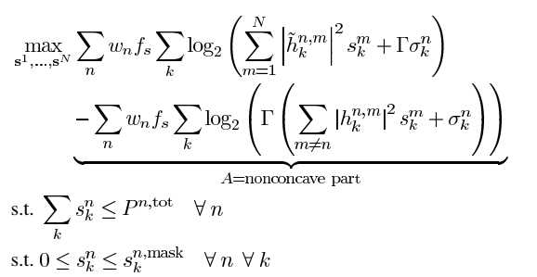
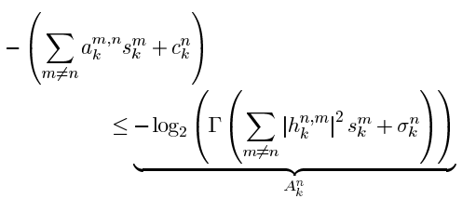
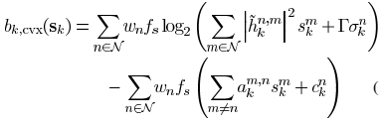

An Improved Dual Decomposition Approach

Slide 15
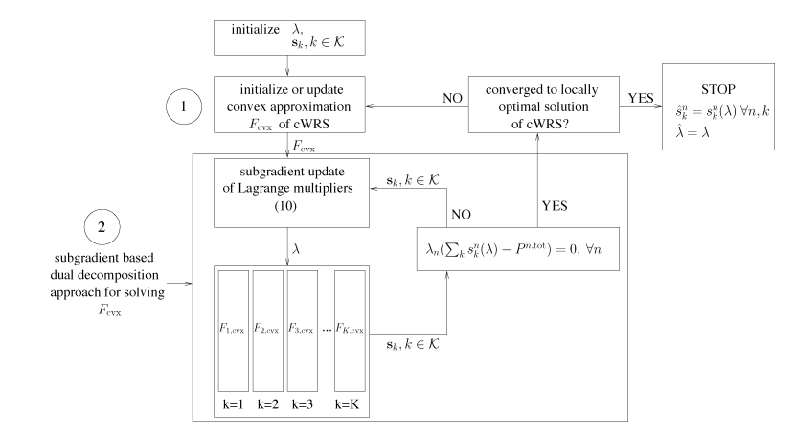
Structure of iterative convex approximation approach for DSM

Slide 16



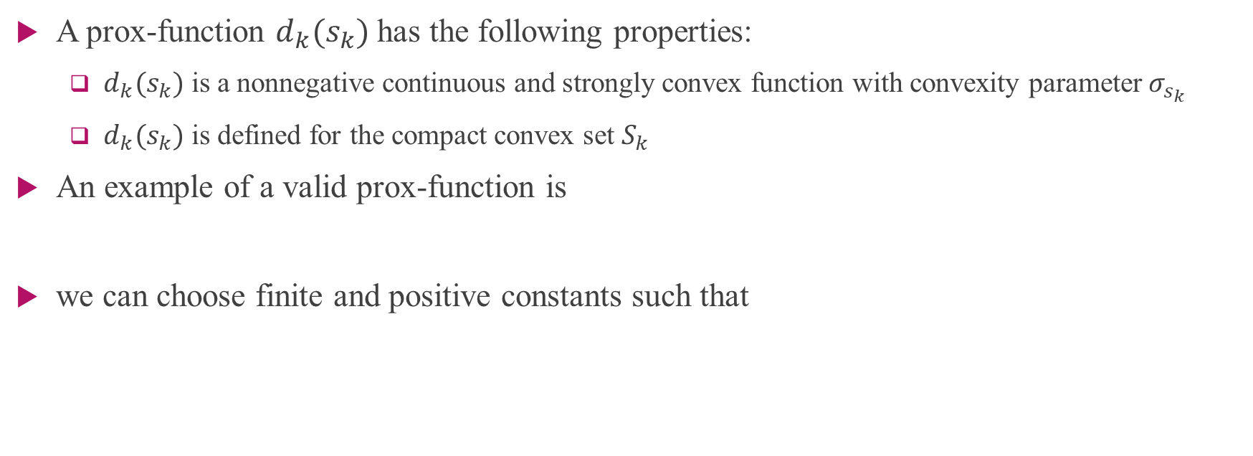
Prox-Function
A prox-function $d_{k}(s_{k})$ has the following properties:
$d_{k}(s_{k})$ is a nonnegative continuous and strongly convex function with convexity parameter $σ_{s_{k}}$
$d_{k}(s_{k})$ is defined for the compact convex set $S_{k}$
An example of a valid prox-function is
we can choose finite and positive constants such that

Slide 17
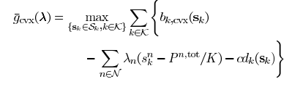
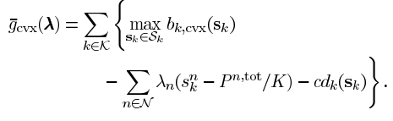
Prox-Function
The prox-functions can be used to smoothen the dual function
One useful property of the particular choice of prox-functions is that they do not destroy the separability of the objective function

Slide 18



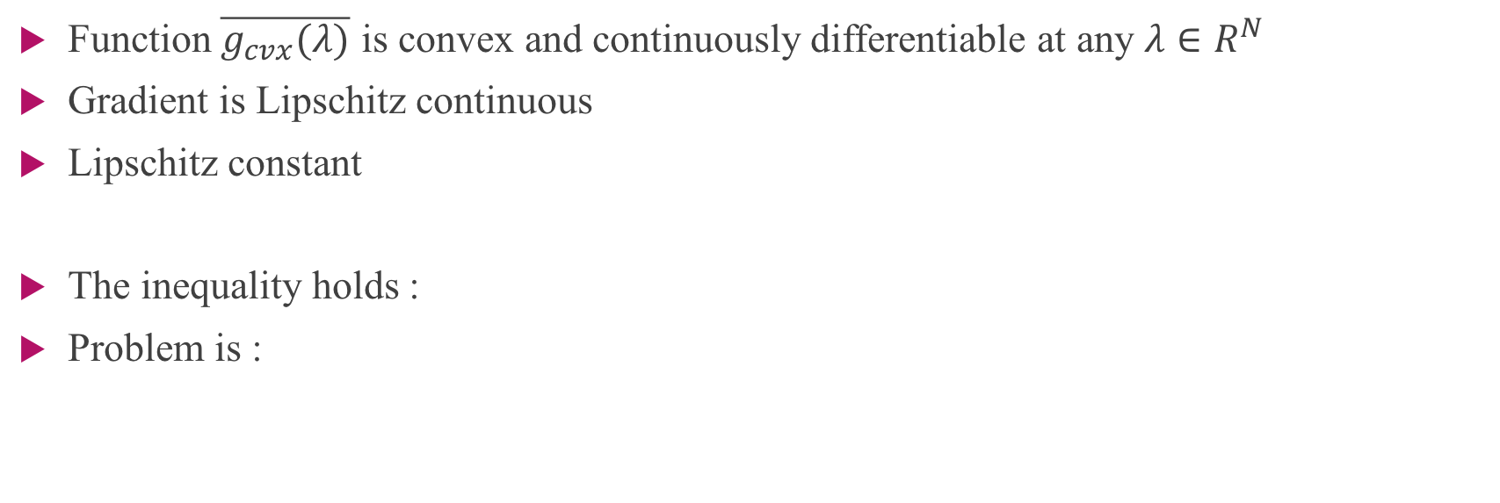
Theorem
Function $\overline{g_{cvx}(λ)}$ is convex and continuously differentiable at any $λ∈R^{N}$
Gradient is Lipschitz continuous
Lipschitz constant
The inequality holds :
Problem is :

Slide 19
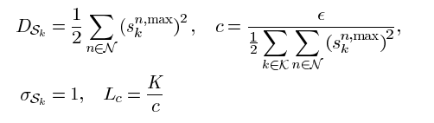
Prox Function
For
We have :

Slide 20
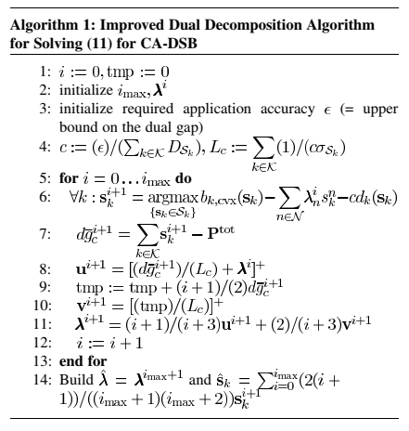

Slide 21

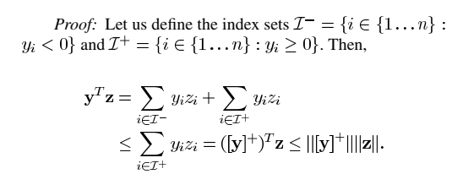

Lemma 1
For any $y∈R^{N}$ and $z≥0$, the following inequality holds:

Slide 22

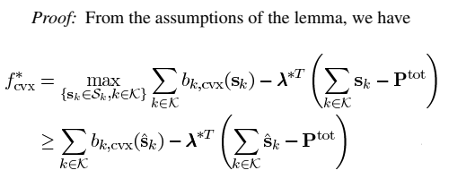
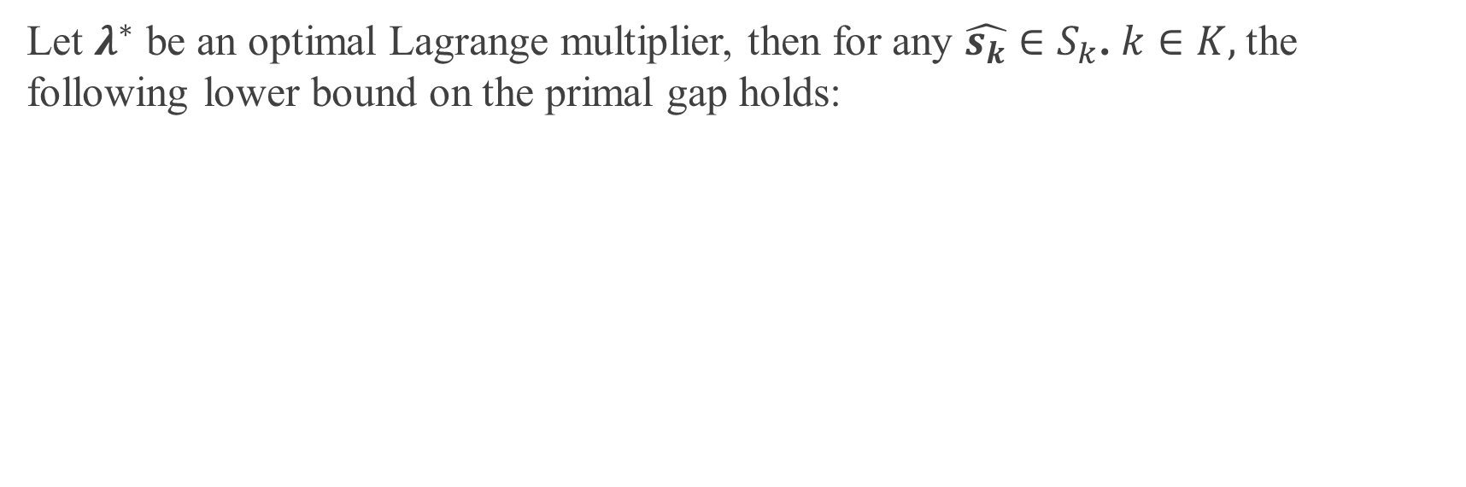
Lemma 2
Let $λ^{∗}$ be an optimal Lagrange multiplier, then for any $\hat{s_{k}}∈S_{k}$. $k∈K,$the following lower bound on the primal gap holds:

Slide 23
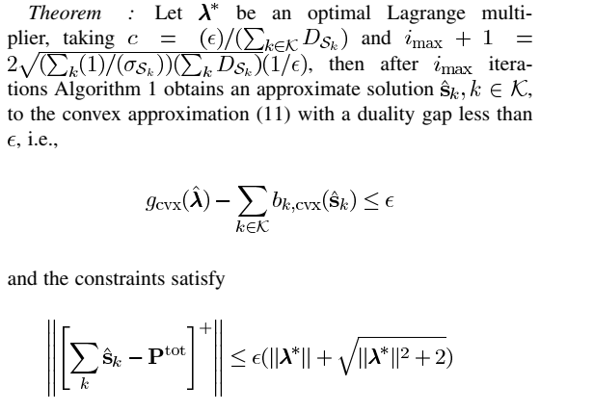
Theorem

Slide 24
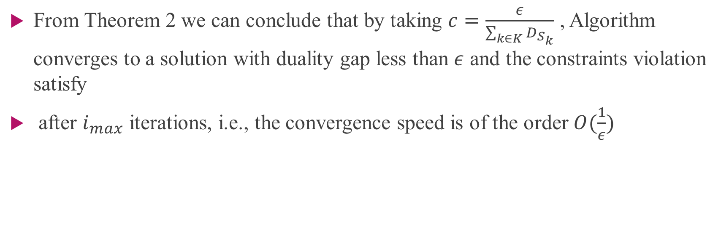
Theorem
From Theorem 2 we can conclude that by taking $c=\frac{ε}{\sum_{k∈K}{D_{S_{k}}}}$ , Algorithm converges to a solution with duality gap less than $ε$ and the constraints violation satisfy
after $i_{max}$ iterations, i.e., the convergence speed is of the order $O(\frac{1}{ε})$

Slide 25
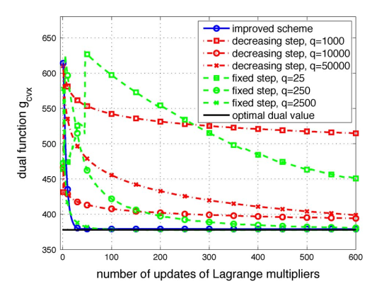
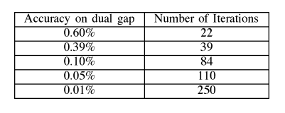
Simulation

Slide 26
Thank you Any Question

