Slide 1
Part1 ADMM

Slide 2




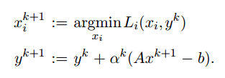
Distributed Optimization and Statistical Learning via the Alternating Direction Method of Multipliers

Slide 3

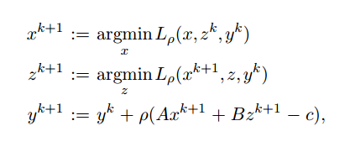

Slide 4
Convergence

Slide 5



We will refer to sk+1 as the dual residual at iteration k + 1, and to rk+1 = Axk+1 + Bzk+1 - c as the primal residual at iteration k + 1.

Slide 7



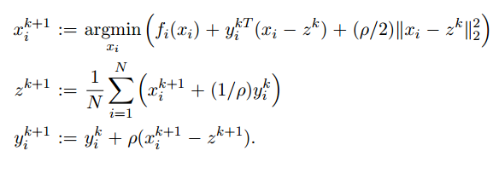
Global Variable Consensus Optimization

Slide 8


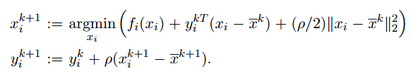




With the average (over i = 1,...,N) of a vector denoted with an overline, the z-update can be written
Substituting the first equation into the second shows that yk+1 = 0, i.e., the dual variables have average value zero after the first iteration. Using zk = xk, ADMM can be written as

Slide 10

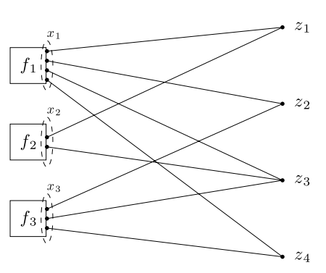

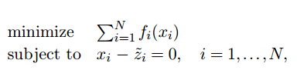
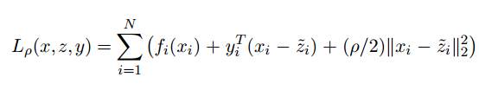
General Form Consensus Optimization
with the objective f1(x1) + ··· + fN(xN) separable in the xi.
The mapping from local variable indices into global variable index can be written as g = G(i, j), which means that local variable component (xi)j corresponds to global variable component zg.

Slide 11
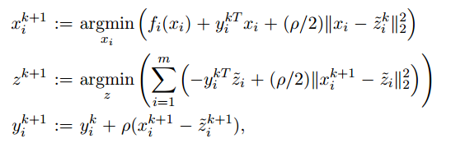


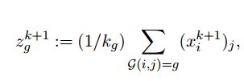

Slide 12
Part 2

Slide 13
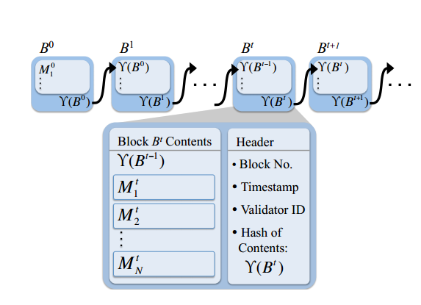
Blockchains for Decentralized Optimization of Energy Resources in Microgrid Networks
Eric Munsing1, Jonathan Mather2, and Scott Moura1;3

Slide 14
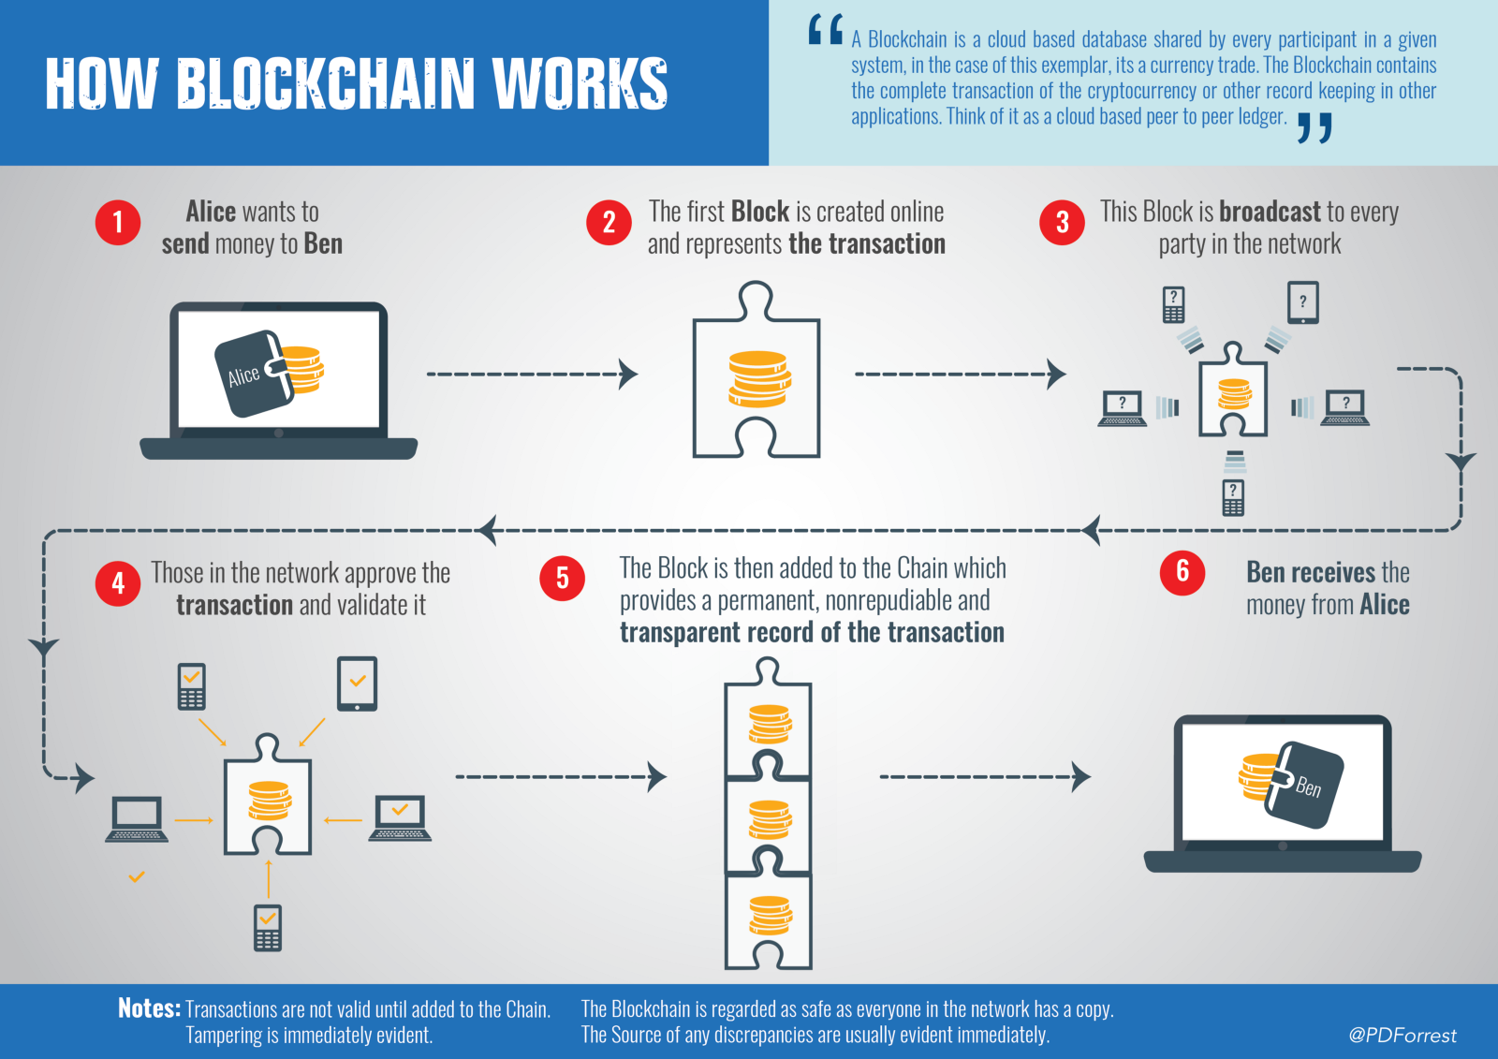

Slide 15
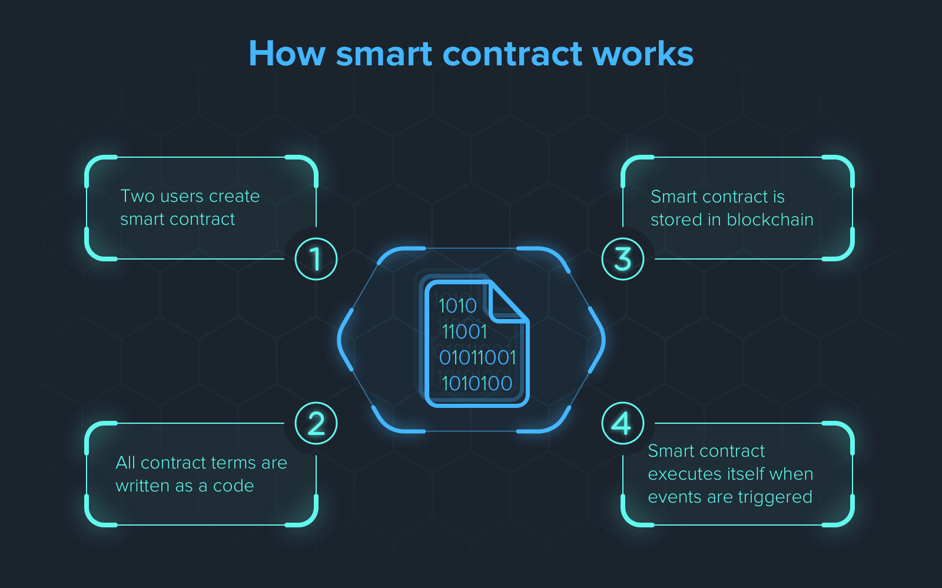

Slide 16
part3

Slide 17
monopoly incentive issues
trust
Microgrids and Monopoly Economics
billing

Slide 18
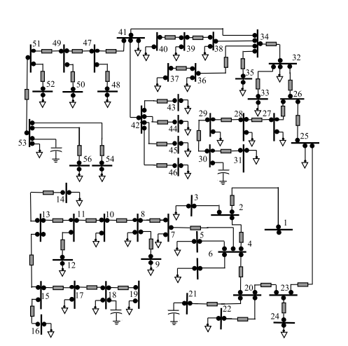

Slide 19
Network Model
The distribution network is modeled as an undirected radial graph G(N ; E), consisting of a set of nodes N and a set of distribution lines (a.k.a. edges) E connecting these nodes. Using the notation described in [36], we index the nodes in N by i = 0; 1; : : : ; n, where node 0 represents the root node (substation) and other nodes in N represent branch nodes. We also denote a line in E by the pair (i; j) of nodes it connects where j is closer to the feeder 0. We call j the parent of i, denoted by π(i), and call i the child of j. Denote the child set of j as δ(j) := fi : (i; j) 2 Eg. Thus a link (i; j) can be denoted as (i; π(i)).

Slide 20
For each line (i; π(i)) 2 E, let zi = ri + ixi be the impedance of the line, let Ii be the complex current flowing from nodes i to π(i), and Si = Pi + iQi be the complex power flowing from nodes i to π(i). On each node i 2 N , let Vi be the complex voltage, and si = pi + iqi be the net complex power injection. We assume the complex voltage V0 at the substation node is given and fixed. We define li := jIij2, vi := jVij2.

Slide 21
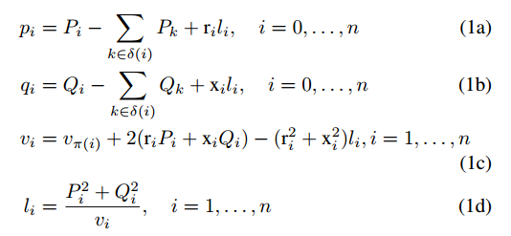

Slide 22

The final equation (1d) forms a non-convex set. It is relaxed to an inequality, which yields a second-order cone constraint:

Slide 23



s gi Dispatchable generators su i Uncontrollable loads sr i Renewable generators sd i Deferrable loads sb i Stationary batteries ss i Shapable loads
The net complex injection at a node i in period t is

Slide 25


z := [P >; Q>; v>]> 2 R3n
xi := [sg i ; sb i; sd i ; ss i ; li]>
x~i = [Pi>; Q> i ; vi>; Pδ>(i); Q> δ(i); vπ>(i)]>

Slide 26


At each iteration k, each node i, receives z~ik from the central aggregator, and solves
over xi; x~i
The node then sends its new x~k+1 i to the central aggregator, who computes the following update for each individual global variable zgk+1

Slide 27



The central aggregator then updates ξi as

Slide 28
