Slide 1
Distributed Optimization Over Time-Varying Directed Graphs
Kiana Noroozi
Winter 2019

Slide 2
Outline
Introduction
Problem, Algorithm, Main results
Perturbed Push-Sum Protocol
Convergence Results for Subgradient-Push method

Slide 3
Introduction
Study of a distributed optimization problem
Sum of n convex functions
Each function is known to a single node
A broadcast-based protocol
Communication between nodes
Directed
Time-varying
Each node aware of
Out-degree
No knowledge of number of agents or graph sequence
No need of being doubly stochastic

Slide 4




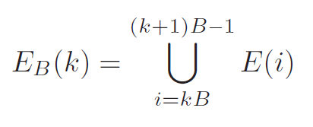
Problem, Algorithm, Main results
Graph G(t)
Vertex set {1,…,n}
E(t) edge set
Sequence {G(t)}: B-strongly connected:

Slide 5
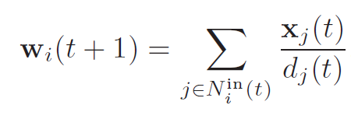
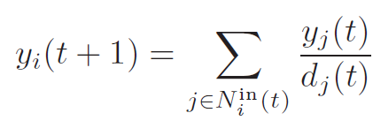

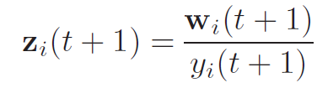



Subgradient-Push Method
Every node i maintain vector variables $x_{i}\left(t\right),w_{i}\left(t\right) ∈ℝ^{d}$
$d_{i}$ : out-degree of node I
$g_{i}\left(t+1\right)$ : subgradient of $f_{i}\left(z\right)$ at z= $z_{i}\left(t+1\right)$

Slide 6

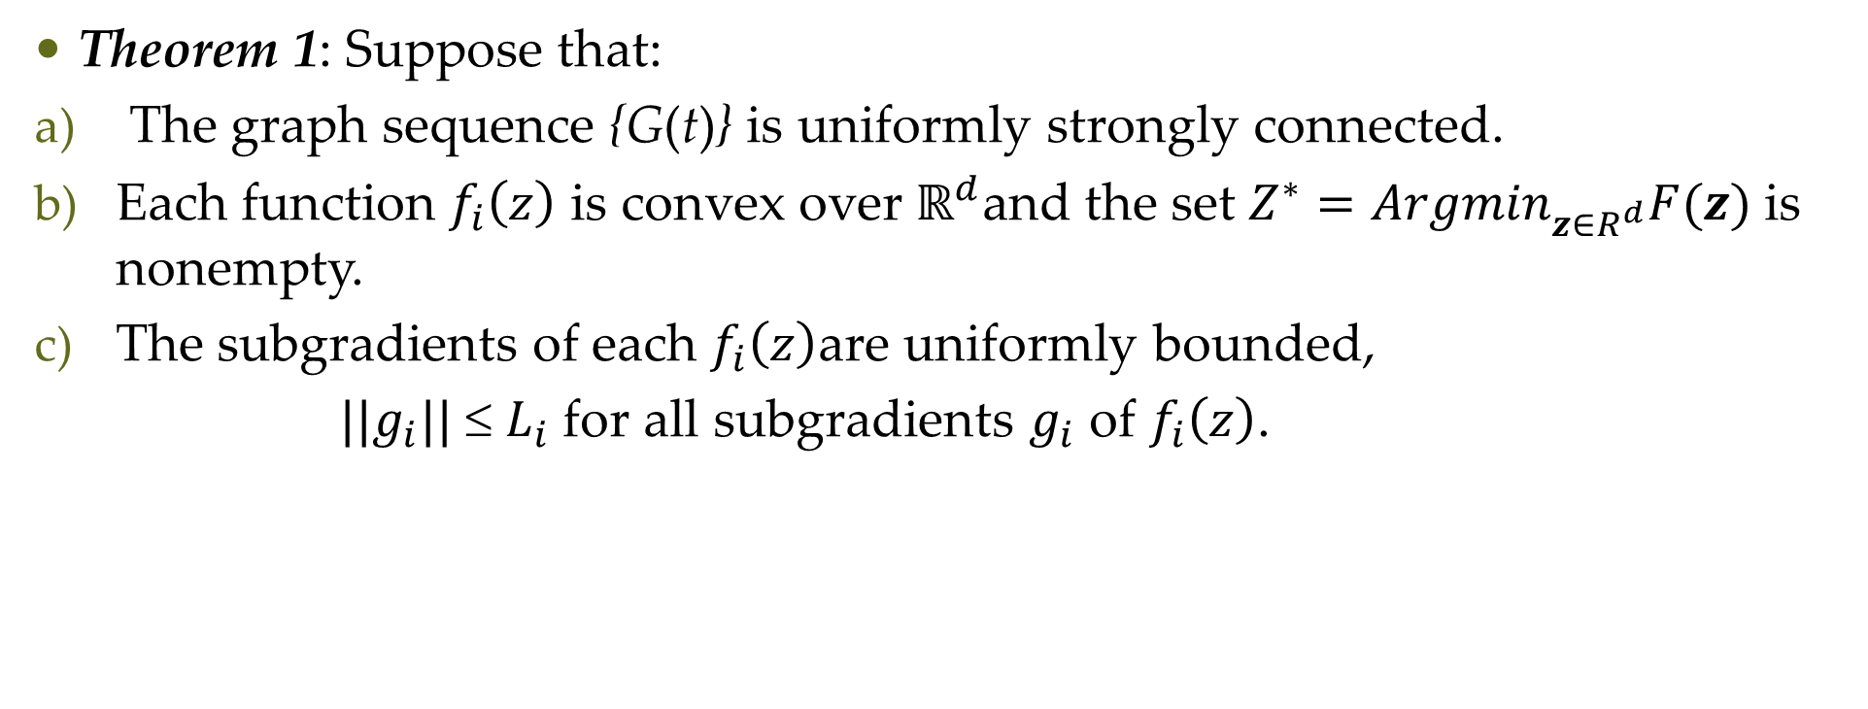
Main Results
Theorem 1: Suppose that:
The graph sequence {G(t)} is uniformly strongly connected.
Each function $f_{i}\left(z\right)$ is convex over $ℝ^{d}$and the set $Z^{∗}={Argmin}_{z∈R^{d}}F(z)$is nonempty.
The subgradients of each $f_{i}\left(z\right)$are uniformly bounded,
${||g}_{i}||$ ≤ $L_{i}$ for all subgradients $g_{i}$ of $f_{i}\left(z\right)$.

Slide 7

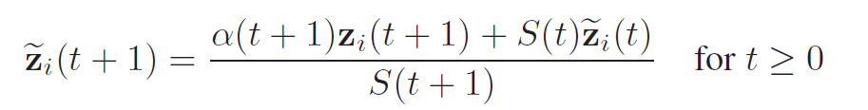


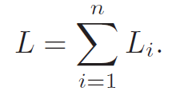
Main Results
Theorem 2: suppose that:
where

Slide 8
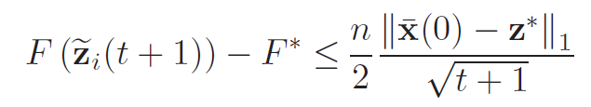
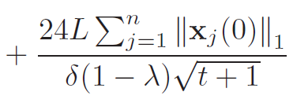
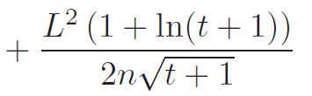
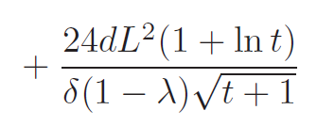
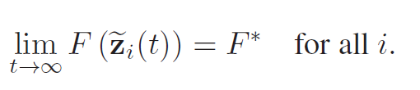

Main Results
Which implies:
For all $t≥1$

Slide 9
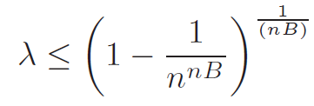
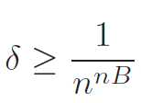
Main Results
Closeness of λ to 1 measures the speed of information diffusion among nodes:
δ is a measure of the imbalance of influences among the nodes:

Slide 10
Perturbed Push-Sum Protocol
The push-sum is a protocol for node interaction
The iterate sequences converge to the average of the initial values of the nodes
When,the state of the nodes is perturbed at each step
Perturbations decay to zero
the iterate sequences produced need not converge to a common point
They converge to each other over time
F. Benezit, V. Blondel, P. Thiran, J. Tsitsiklis, and M. Vetterli, “Weighted gossip: Distributed averaging using non-doubly stochastic matrices,” in Proc. IEEE Int. Symp. Inform. Theory, Jun. 2010, pp. 1753–1757.

Slide 11
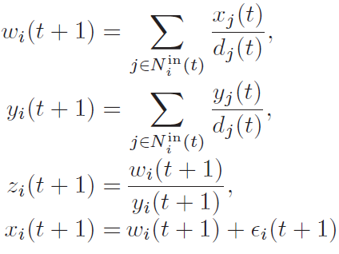
Perturbed Push-Sum Protocol
Perturbed push-sum update rule

Slide 12
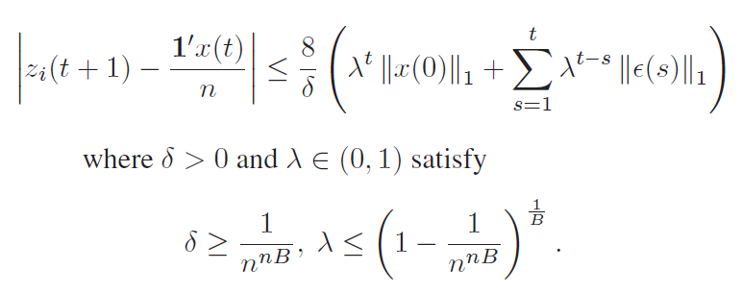
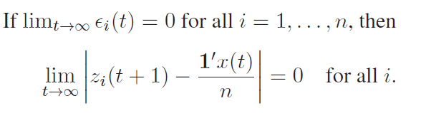
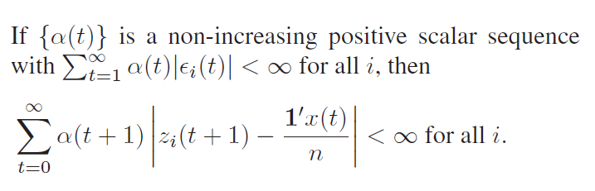
Perturbed Push-Sum Protocol
Lemma 1: assuming that {G(t)} uniformly strongly connected:

Slide 13
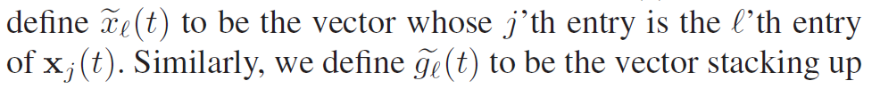
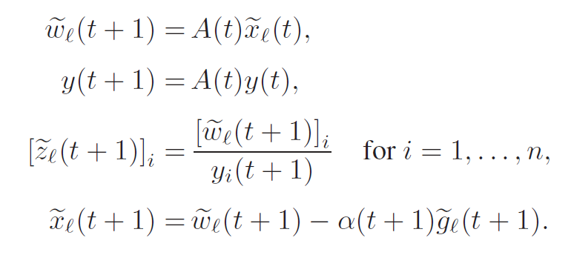

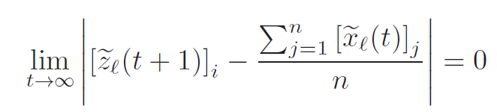
Proof of Theorem1

Slide 14
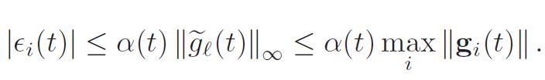
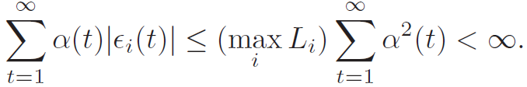

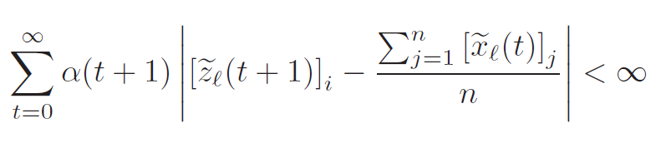
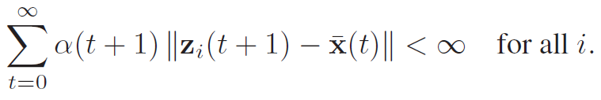
Proof of Theorem1

Slide 15
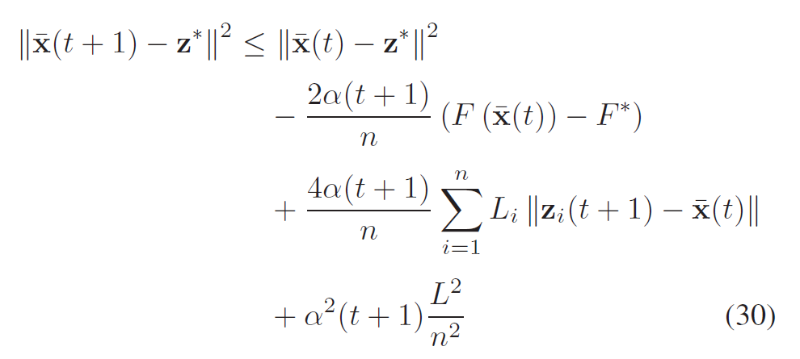

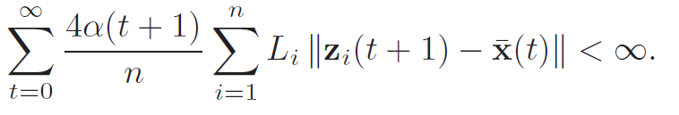
Proof of Theorem1

Slide 16
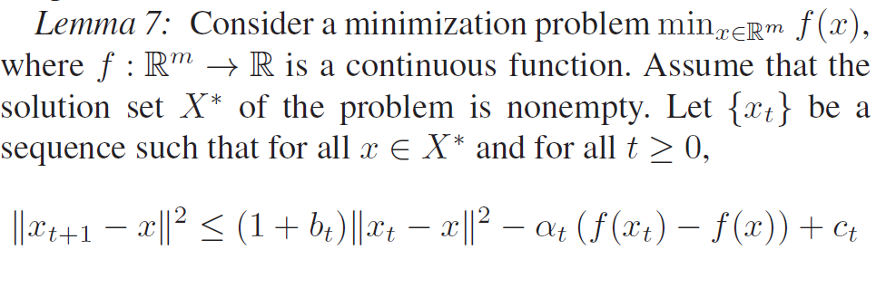
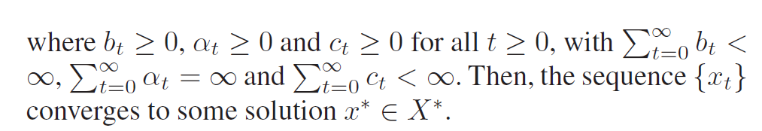
Proof of Theorem1

Slide 17
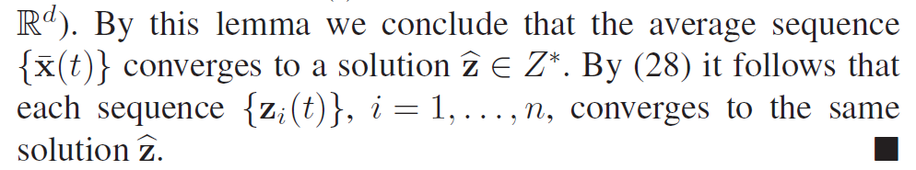
Proof of Theorem1

Slide 18
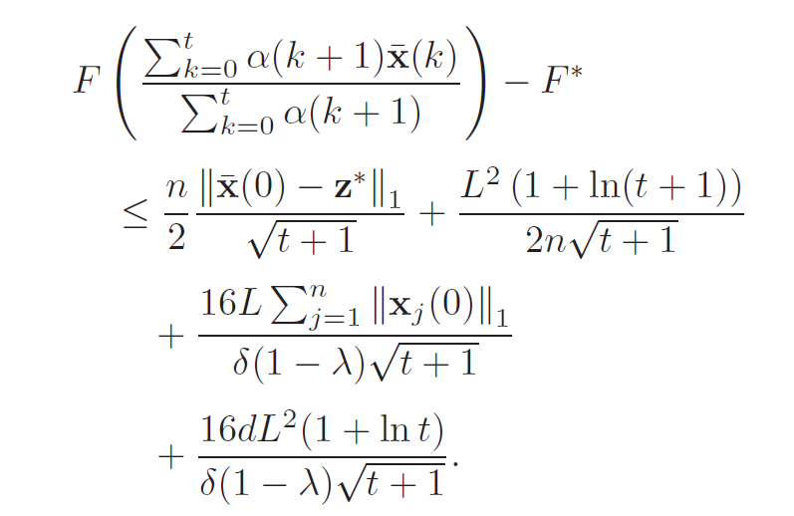
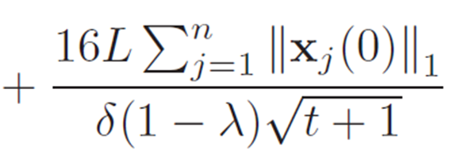
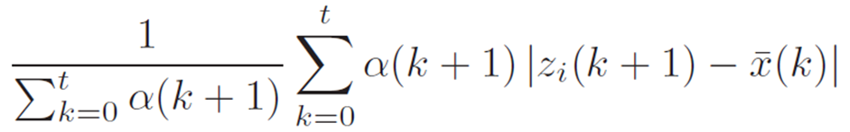
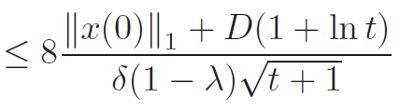

Proof of Theorem2
As it can be proved that:
And show that for every i = 1,…,n and $t≥1$

Slide 19
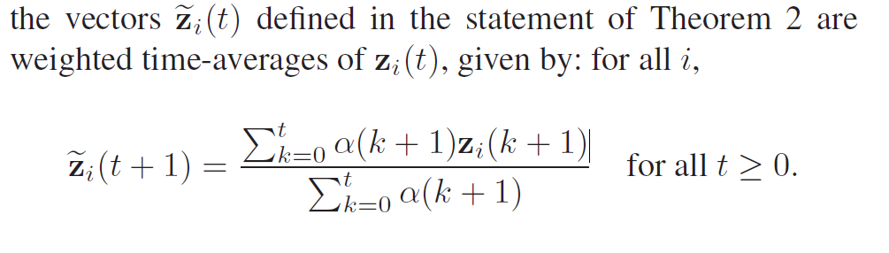
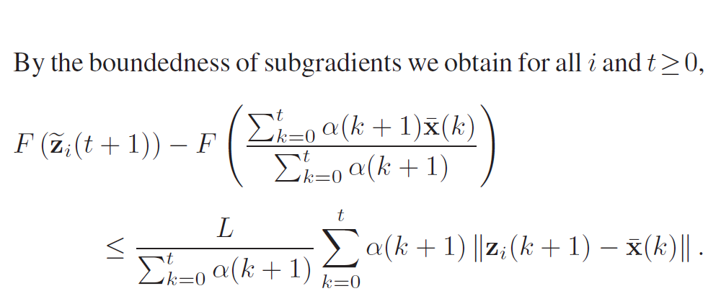
Proof of Theorem2

Slide 20
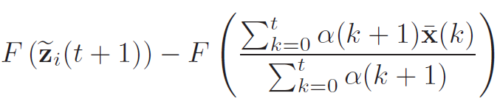
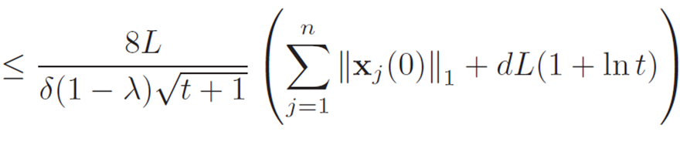
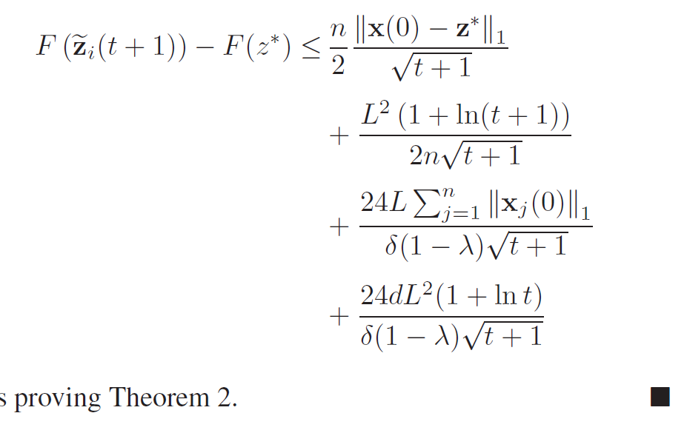
Proof of Theorem2
We can obtain :
Finally:

Slide 21
Thanks for Your Attention

