Slide 1
A Necessary and Sufficient Condition for Consensus Over Random Networks
In the name of God
Mojdeh Karbalaee Motalleb
810196074

Slide 2

Abstract
Consensus problem for stochastic discrete time linear dynamical systems
Underlying graph of systems at a given time instance
A necessary and sufficient condition for almost sure asymptotic consensus

Slide 3
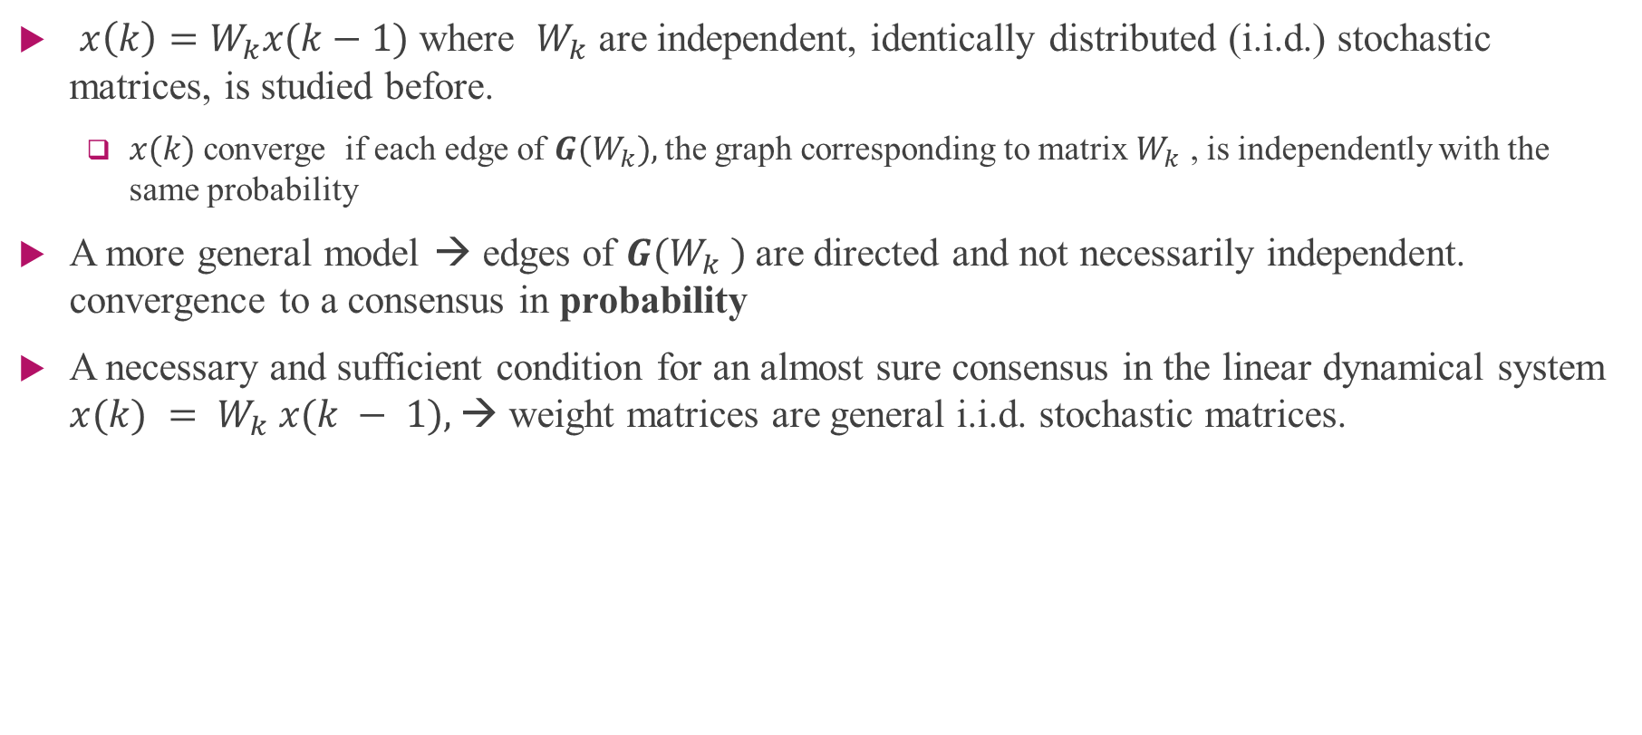
Introduction
$x\left(k\right)=W_{k}x(k−1)$ where $W_{k}$ are independent, identically distributed (i.i.d.) stochastic matrices, is studied before.
$x(k)$converge if each edge of $G(W_{k}),$the graph corresponding to matrix $W_{k}$ , is independently with the same probability
A more general model → edges of $G(W_{k} )$are directed and not necessarily independent. convergence to a consensus in probability
A necessary and sufficient condition for an almost sure consensus in the linear dynamical system $x(k) = W_{k} x(k − 1),$→ weight matrices are general i.i.d. stochastic matrices.

Slide 4

Probability Space
a probability space has three components (Ω, B, P), respectively the sample space, event space, and probability function.
Ω: sample space. Set of outcomes of an experiment.
P: a probability function P assigns a number (“probability”) to each event in B
B: An event is a subset of Ω.
the event space B is modelled as a σ-algebra (or σ-field) of Ω, which is a collection of subsets of Ω with the following properties:

Slide 5
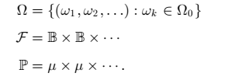
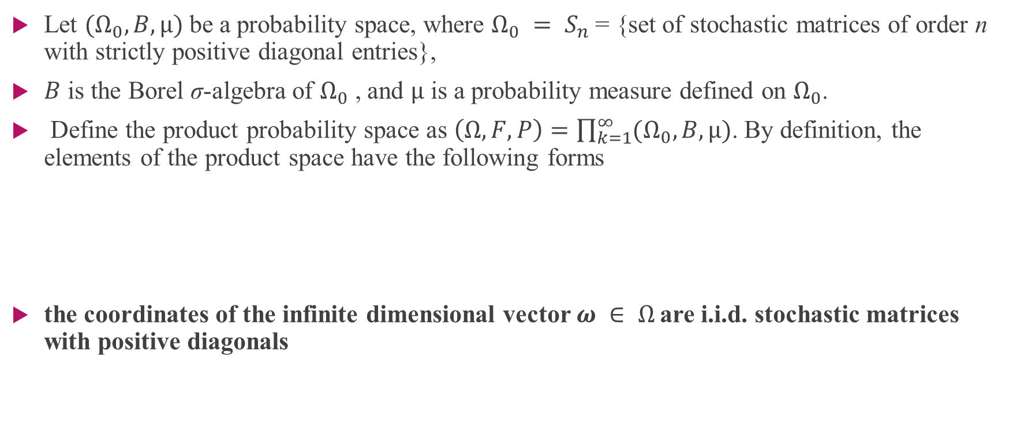
Problem Setup
Let $(Ω_{0}, B, µ)$be a probability space, where $Ω_{0} = S_{n}$= {set of stochastic matrices of order n with strictly positive diagonal entries},
$B$ is the Borel σ-algebra of $Ω_{0}$ , and $µ$ is a probability measure defined on $Ω_{0}$.
Define the product probability space as $\left(Ω, F, P\right)=\prod_{k=1}^{∞}{(Ω_{0}, B, µ)}$. By definition, the elements of the product space have the following forms
the coordinates of the infinite dimensional vector $ω ∈ Ω$are i.i.d. stochastic matrices with positive diagonals

Slide 6
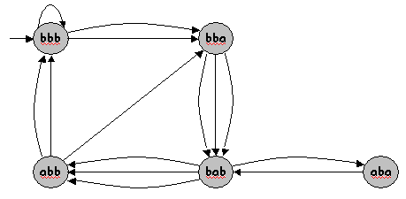
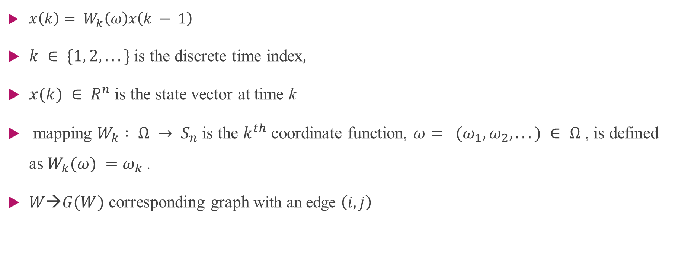
Problem Setup
$x\left(k\right)= W_{k}\left(ω\right)x\left(k − 1\right)$
$k ∈ \{1, 2, . . .\}$is the discrete time index$,$
$x(k) ∈ R^{n}$is the state vector at time k
mapping $W_{k} : Ω → S_{n}$is the $k^{th}$ coordinate function, $ω= (ω_{1}, ω_{2}, . . .) ∈ Ω$ , is defined as $W_{k}(ω) =ω_{k}$.
$W→G(W)$ corresponding graph with an edge $\left(i, j\right)$

Slide 7
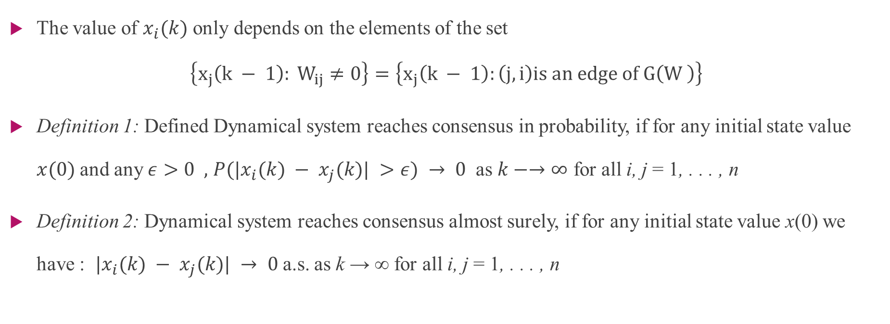
Problem Setup- Definition
The value of $x_{i}(k)$ only depends on the elements of the set
$$\left\{x_{j}\left(k − 1\right): W_{ij}≠0\right\}=\left\{x_{j}\left(k − 1\right):\left(j, i\right)is an edge of G\left(W \right)\right\}$$
Definition 1: Defined Dynamical system reaches consensus in probability, if for any initial state value $x(0)$and any $ε>0 ,$ $P(|x_{i}(k) − x_{j}(k)| >ε) → 0$ as $k−→∞$ for all i, j = 1, . . . , n
Definition 2: Dynamical system reaches consensus almost surely, if for any initial state value x(0) we have : $|x_{i}(k) − x_{j}(k)| → 0$a.s. as k → ∞ for all i, j = 1, . . . , n

Slide 8


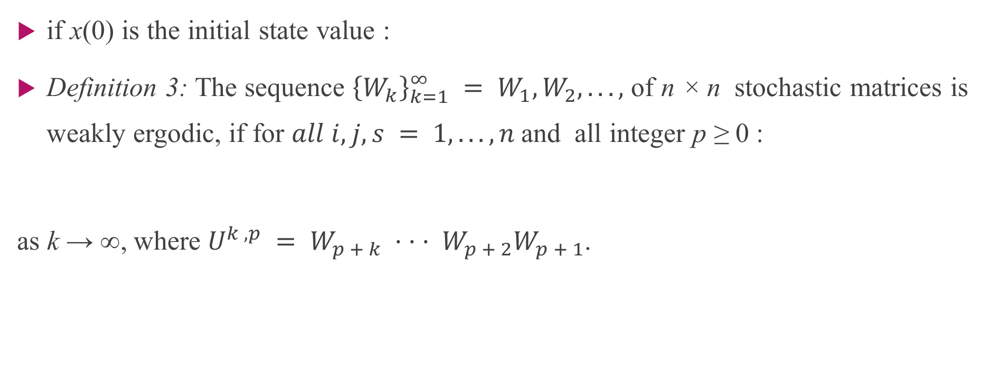
Weakly Ergodicity
if x(0) is the initial state value :
Definition 3: The sequence ${\left\{W_{k}\right\}}_{k=1}^{∞} = W_{1}, W_{2}, . . . ,$ of n × n stochastic matrices is weakly ergodic, if for $all i, j, s = 1, . . . , n$and all integer p ≥ 0 :
as k → ∞, where $U^{k ,p} = W_{p + k} · · · W_{p + 2}W_{p + 1}$.

Slide 9

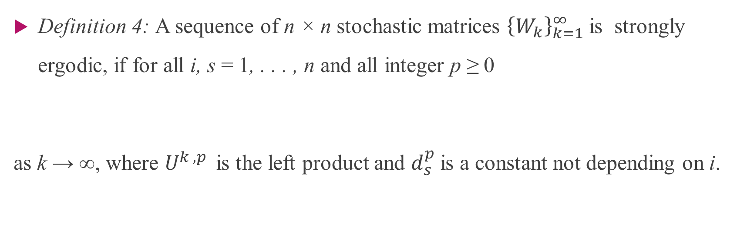
Strongly Ergodicity
Definition 4: A sequence of n × n stochastic matrices ${\left\{W_{k}\right\}}_{k=1}^{∞}$is strongly ergodic, if for all i, s = 1, . . . , n and all integer p ≥ 0
as k → ∞, where $U^{k ,p }$is the left product and $d_{s}^{p}$is a constant not depending on i.

Slide 10


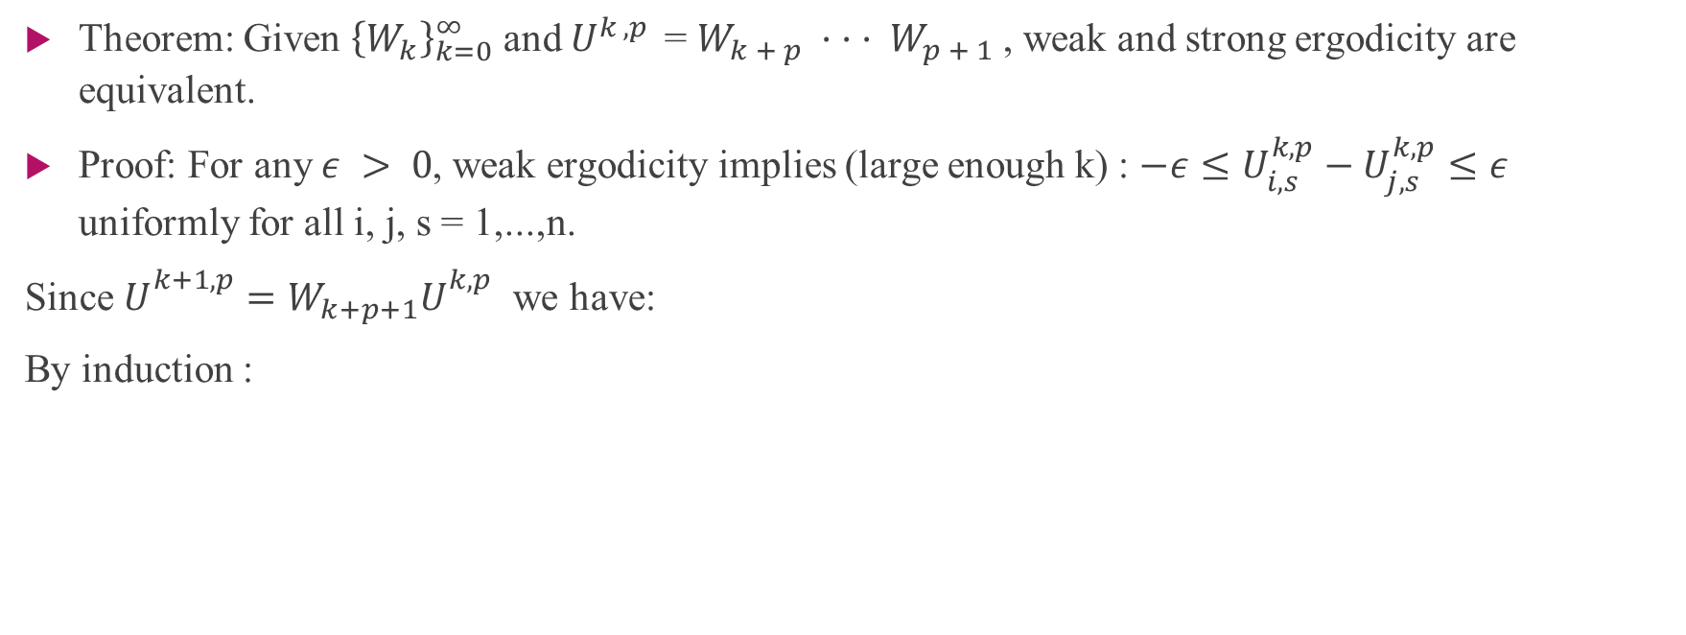
Ergodicity-Theorem 1
Theorem: Given ${\left\{W_{k}\right\}}_{k=0}^{∞}$ and $U^{k ,p }$= $W_{k + p} · · · W_{p + 1}$, weak and strong ergodicity are equivalent.
Proof: For any $ε > 0$, weak ergodicity implies (large enough k) : $−ε≤U_{i,s}^{k,p}−U_{j,s}^{k,p}≤ε$ uniformly for all i, j, s = 1,...,n.
Since $U_{}^{k+1,p}=W_{k+p+1}U_{}^{k,p}$ we have:
By induction :

Slide 11
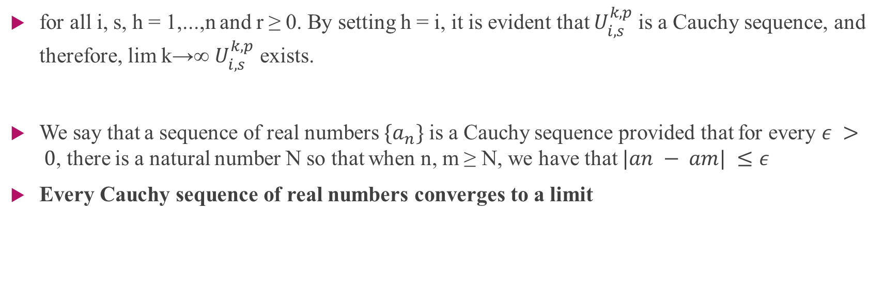
Cauchy sequence
for all i, s, h = 1,...,n and r ≥ 0. By setting h = i, it is evident that $U_{i,s}^{k,p}$is a Cauchy sequence, and therefore, lim k→∞ $U_{i,s}^{k,p}$ exists.
We say that a sequence of real numbers $\{a_{n}\}$is a Cauchy sequence provided that for every $ε > 0$, there is a natural number N so that when n, m ≥ N, we have that $|an − am| ≤ε$
Every Cauchy sequence of real numbers converges to a limit

Slide 12

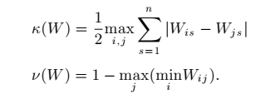

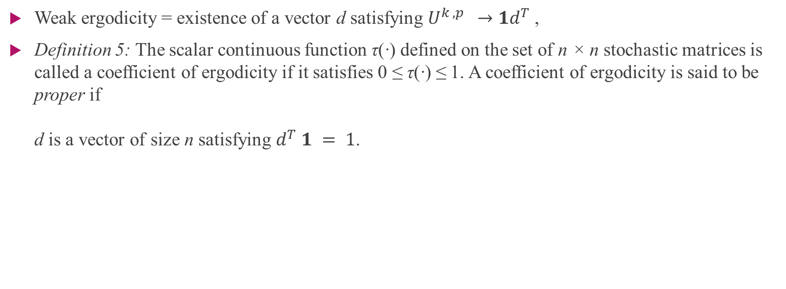
Ergodicity
Weak ergodicity = existence of a vector d satisfying $U^{k ,p } →1d^{T}$,
Definition 5: The scalar continuous function τ(·) defined on the set of n × n stochastic matrices is called a coefficient of ergodicity if it satisfies 0 ≤ τ(·) ≤ 1. A coefficient of ergodicity is said to be proper if d is a vector of size n satisfying $d^{T} 1 = 1$.

Slide 13



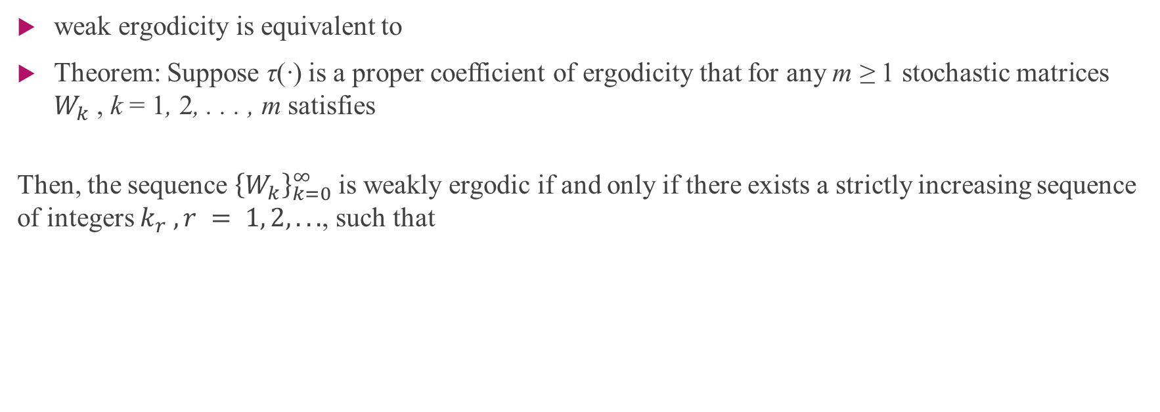
Ergodicity-Theorem 2
weak ergodicity is equivalent to
Theorem: Suppose τ(·) is a proper coefficient of ergodicity that for any m ≥ 1 stochastic matrices $W_{k}$ , k = 1, 2, . . . , m satisfies
Then, the sequence ${\left\{W_{k}\right\}}_{k=0}^{∞}$is weakly ergodic if and only if there exists a strictly increasing sequence of integers $k_{r} , r = 1, 2, . . .$, such that

Slide 14


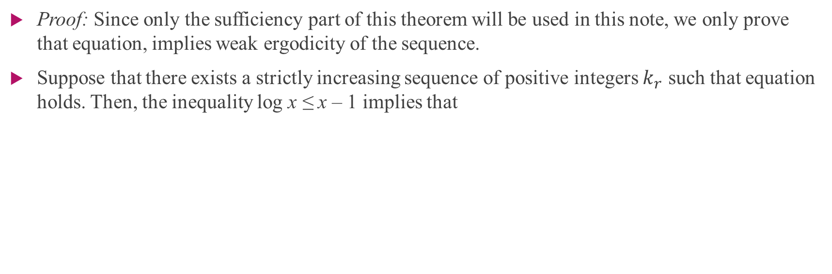
Ergodicity- Proof of Theorem 2
Proof: Since only the sufficiency part of this theorem will be used in this note, we only prove that equation, implies weak ergodicity of the sequence.
Suppose that there exists a strictly increasing sequence of positive integers $k_{r}$ such that equation holds. Then, the inequality log x ≤ x – 1 implies that

Slide 15


Kolmogorov's zero–one law
Kolmogorov's zero–one law holds for sequences of independent σ-algebras. Let (Ω,F,P) be a probability space and let F_{n} be a sequence of mutually independent σ-algebras contained in F.
Be the smallest σ-algebra containing F_{n}, F_{n+1}, …. Then Kolmogorov's zero–one law asserts that for any event
one has either P(F) = 0 or 1.

Slide 16


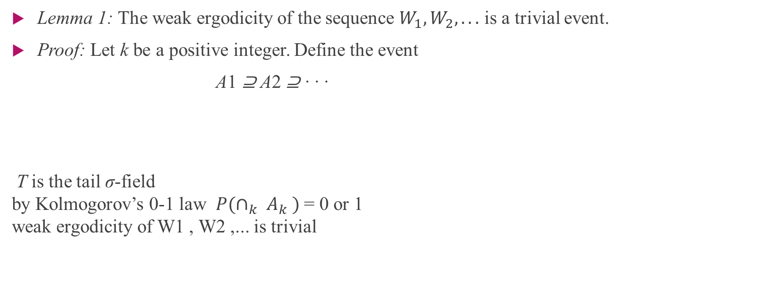
NECESSARY AND SUFFICIENT CONDITIONS FOR ERGODICITY
Lemma 1: The weak ergodicity of the sequence $W_{1}, W_{2}, . . .$ is a trivial event.
Proof: Let k be a positive integer. Define the event
A1 ⊇ A2 ⊇ · · ·
T is the tail σ-field by Kolmogorov’s 0-1 law $P(∩_{k} A_{k} )$= 0 or 1 weak ergodicity of W1 , W2 ,... is trivial

Slide 17

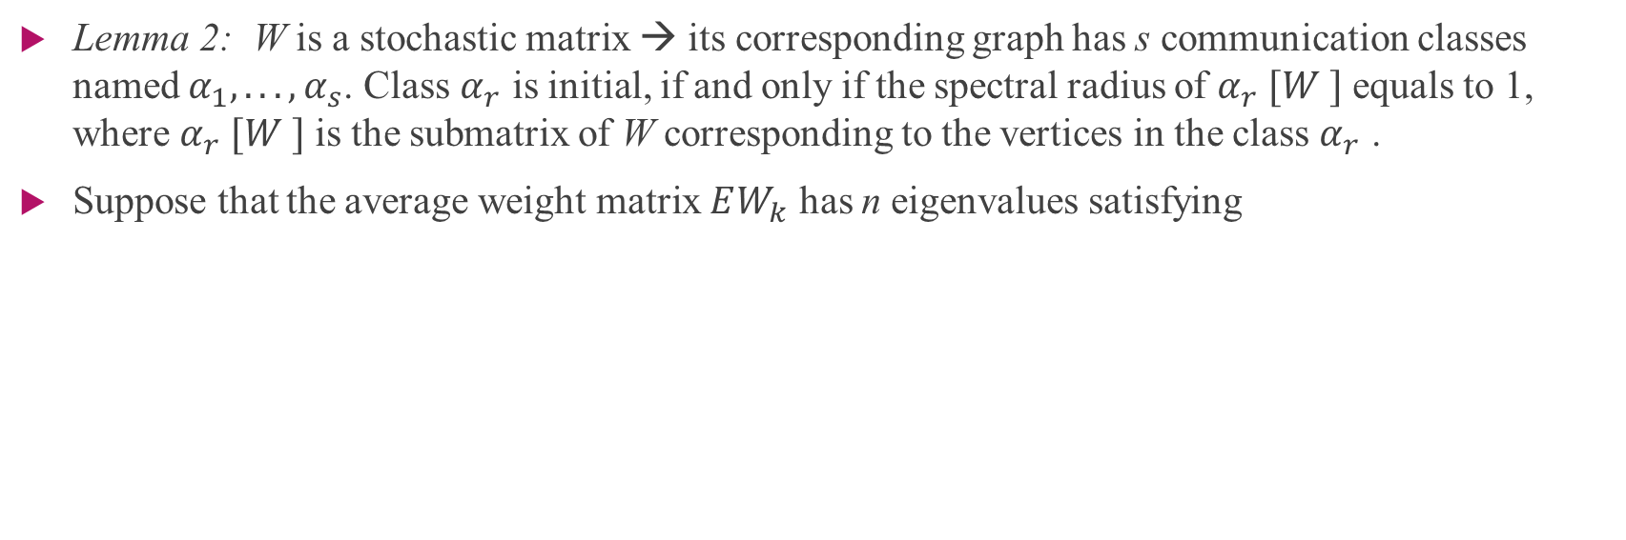
NECESSARY AND SUFFICIENT CONDITIONS FOR ERGODICITY
Lemma 2: W is a stochastic matrix → its corresponding graph has s communication classes named $α_{1}, . . . , α_{s}$. Class $α_{r}$ is initial, if and only if the spectral radius of $α_{r} [W ]$equals to 1, where $α_{r} [W ]$is the submatrix of W corresponding to the vertices in the class $α_{r}$ .
Suppose that the average weight matrix $EW_{k}$ has n eigenvalues satisfying

Slide 18
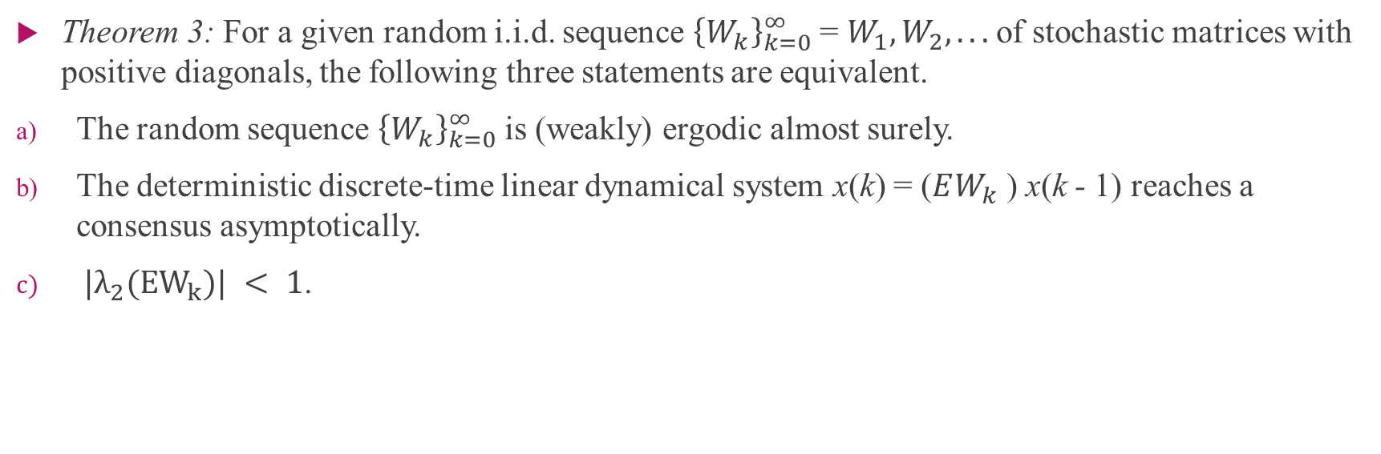
Theorem 3
Theorem 3: For a given random i.i.d. sequence ${\left\{W_{k}\right\}}_{k=0}^{∞}$= $W_{1}, W_{2}, . . .$of stochastic matrices with positive diagonals, the following three statements are equivalent.
The random sequence ${\left\{W_{k}\right\}}_{k=0}^{∞}$ is (weakly) ergodic almost surely.
The deterministic discrete-time linear dynamical system x(k) = ($EW_{k}$ ) x(k - 1) reaches a consensus asymptotically.
$|λ_{2}(EW_{k})| < 1$.

Slide 19
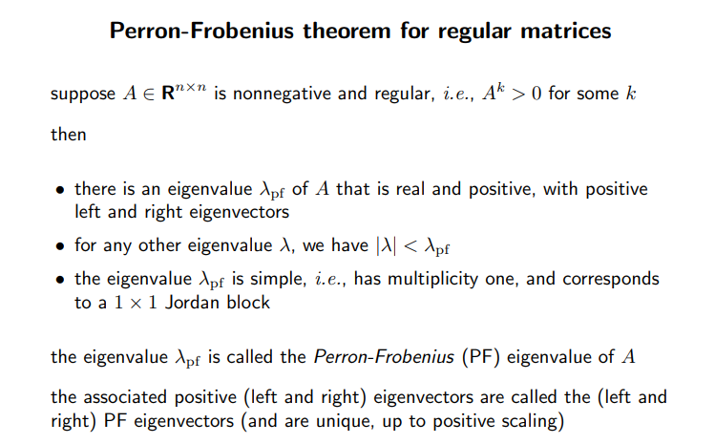
Perron-Frobenius

Slide 20


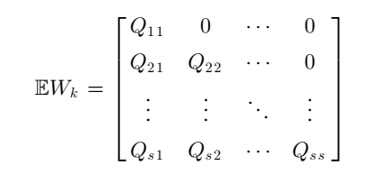
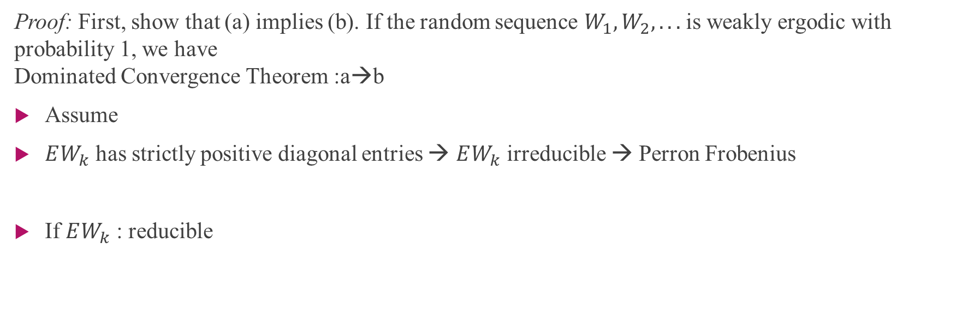
Proof of Theorem 3
Proof: First, show that (a) implies (b). If the random sequence $W_{1}, W_{2}, . . .$is weakly ergodic with probability 1, we have Dominated Convergence Theorem :a→b
Assume
$EW_{k}$ has strictly positive diagonal entries → $EW_{k}$ irreducible → Perron Frobenius
If $EW_{k}$ : reducible

Slide 21


Proof of Theorem 3
$Q_{ii}$ is an irreducible matrix → represents the vertices in the equivalence class αi
lemma 2 implies
$EW_{k}$ has two orthogonal rows, and, as a result, (b) cannot hold
assume that (c) holds
Irreducible Case
Reducible Case

Slide 22

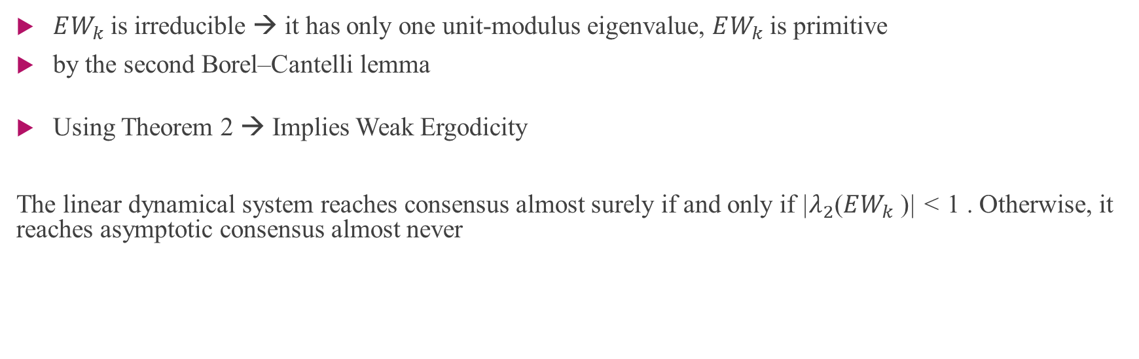
Proof of Theorem 3
$EW_{k}$ is irreducible → it has only one unit-modulus eigenvalue, $EW_{k}$ is primitive
by the second Borel–Cantelli lemma
Using Theorem 2 → Implies Weak Ergodicity
The linear dynamical system reaches consensus almost surely if and only if |$λ_{2}$($EW_{k}$ )| < 1 . Otherwise, it reaches asymptotic consensus almost never

Slide 23
Thank you Any Question

