Slide 1


Distributed Control of Multi Agent Systems
ADMM
First Paper
Seminar 2
Second Paper
“Distributed Alternating Direction Method of Multipliers “
Ermin Wei and Asuman Ozdaglar
2012
Main Paper
Convergence
“On the O(1/k) Convergence of Asynchronous Distributed Alternating Direction Method of Multipliers”
Ermin Wei and Asuman Ozdaglar
2013
Network Effects
Main Paper:
“Convergence Rate of Distributed ADMM over Networks”
Ali Makhdoumi and Asuman Ozdaglar
2017
Mohammad Mahmoodian
Mohammad Mahmoodian 810196391

Slide 2

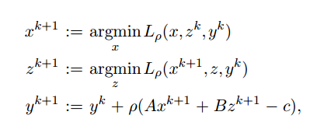

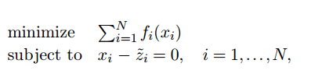
Alternating Direction Method of Multipliers (ADMM)
ADMM
First Paper
Second Paper
Main Paper
Convergence
Network Effects
Consensus form of ADMM
Mohammad Mahmoodian
1/18
Stopping criteria:

Slide 3
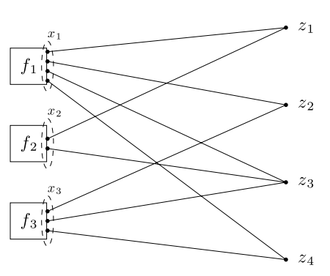
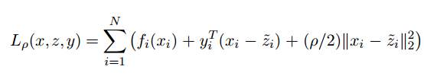
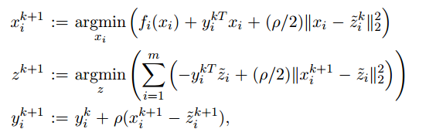
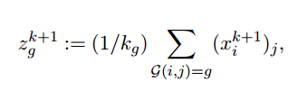
ADMM
First Paper
Second Paper
Main Paper
Lagrangian
Convergence
Network Effects
After the first iteration
Mohammad Mahmoodian
2/18
Stopping criteria:

Slide 4
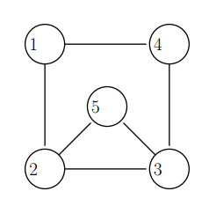
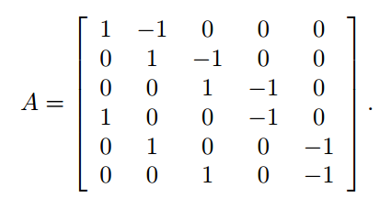
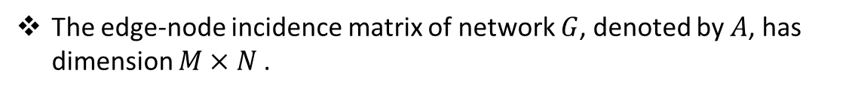

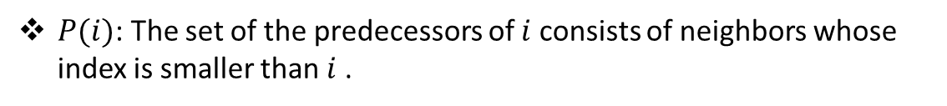
We consider a network, represented by an undirected connected simple graph with $N$ nodes and $M$ edges, $G=\{V, E\}$.
ADMM
First Paper
Second Paper
Main Paper
$P(i)$: The set of the predecessors of $i$ consists of neighbors whose index is smaller than $i$ .
Convergence
$S(i)$: successors of $i$ are the neighbors with index larger than $i$.
Network Effects
The edge-node incidence matrix of network $G$, denoted by $A$, has dimension $M×N$.
Distributed Alternating Direction Method of Multipliers
Mohammad Mahmoodian
3/18

Slide 5
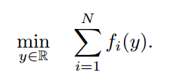
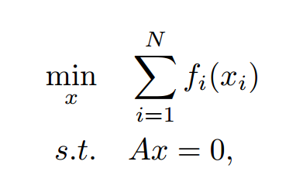
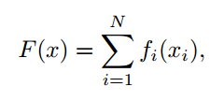

Each node is associated with a cost function${ f}_{i}:R→R$.
ADMM
First Paper
With the edge-node incidence matrix, we can now rewrite problem.
Second Paper
Main Paper
Convergence
Network Effects
For notational convenience, we define the function $F :R^{N} → R$ as:
Distributed Alternating Direction Method of Multipliers
We denote by $L : R^{N}×R^{M} →R$ the Lagrangian function given by:
Mohammad Mahmoodian
4/18

Slide 6
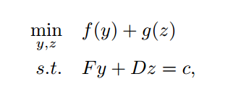
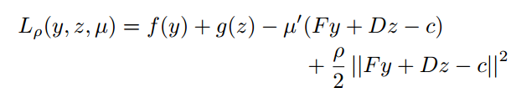


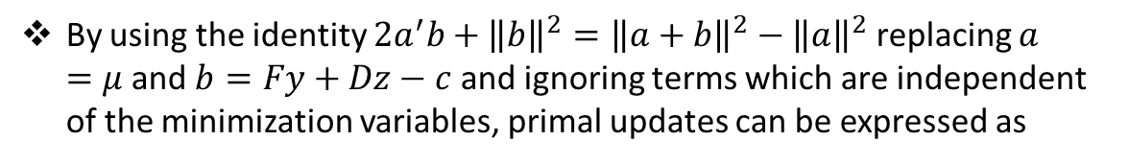
The standard ADMM algorithm solves the following problem
ADMM
First Paper
Second Paper
Main Paper
Convergence
By using the identity $2a^{′}b+{\left\|b\right\|}^{2}={\left\|a+b\right\|}^{2}−{\left\|a\right\|}^{2}$ replacing $a =μ$and $b=Fy+Dz−c$ and ignoring terms which are independent of the minimization variables, primal updates can be expressed as
Network Effects
Distributed Alternating Direction Method of Multipliers
Mohammad Mahmoodian
5/18

Slide 7
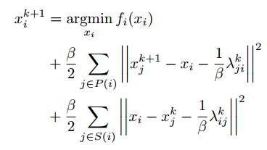

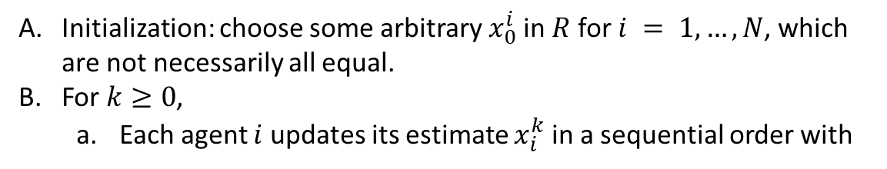
Distributed ADMM algorithm for solving problem is given as follows:
Initialization: choose some arbitrary $x_{0}^{i}$in $R$ for $i = 1,…, N$, which are not necessarily all equal.
For $k≥0$,
Each agent $i$updates its estimate $x_{i}^{k}$in a sequential order with
ADMM
First Paper
Second Paper
Main Paper
Convergence
Network Effects
Distributed Alternating Direction Method of Multipliers
b. Each agent updates $λ_{ji}$tshat he owns, for all $j$ in $P(i)$
Mohammad Mahmoodian
6/18

Slide 8
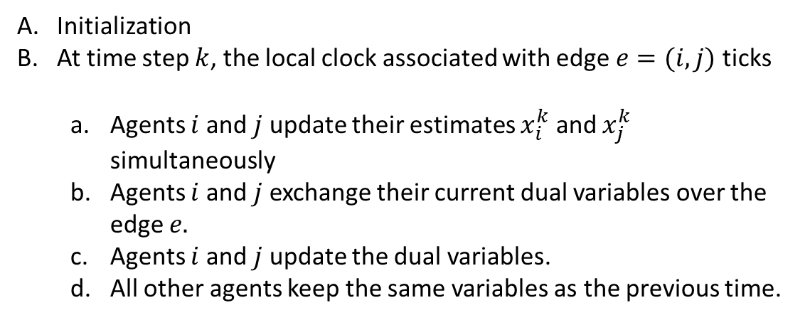
Asynchronous Edge Based ADMM algorithm:
ADMM
First Paper
Initialization
At time step $k$, the local clock associated with edge $e=(i, j)$ ticks
Agents $i$ and $j$ update their estimates $x_{i}^{k}$ and $x_{j}^{k}$ simultaneously
Agents $i$ and $j$ exchange their current dual variables over the edge $e.$
Agents $i$ and $j$ update the dual variables.
All other agents keep the same variables as the previous time.
Second Paper
Main Paper
Convergence
Network Effects
On the O(1/k) Convergence of Asynchronous Distributed Alternating Direction Method of Multipliers
Mohammad Mahmoodian
7/18

Slide 9
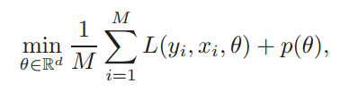

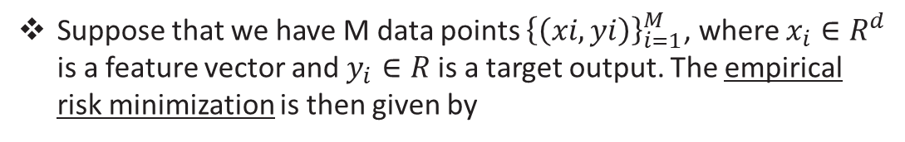
Motivation and application
ADMM
First Paper
Suppose that we have M data points ${\left\{\left(xi, yi\right)\right\}}_{i=1}^{M}$, where $x_{i}∈R^{d}$ is a feature vector and $y_{i}∈R$ is a target output. The empirical risk minimization is then given by
Second Paper
Main Paper
Convergence
Network Effects
Convergence Rate of Distributed ADMM over Networks
for some convex loss function $L:R×R^{d}×R^{d}→R$ and some convex penalty function $p:R^{d}→R$.
Mohammad Mahmoodian
8/18

Slide 10
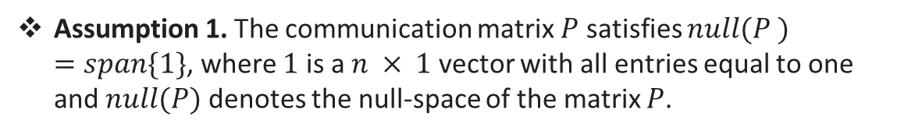
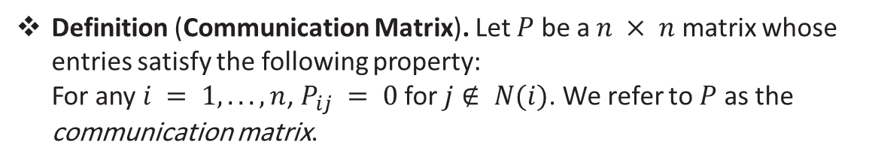
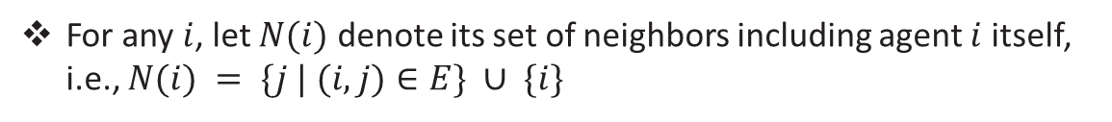
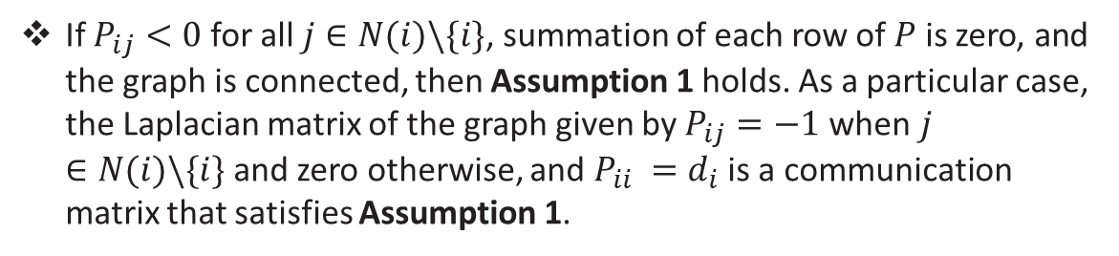
For any $i$, let $N(i)$ denote its set of neighbors including agent $i$ itself, i.e., $N(i) = \{j | (i, j)∈E\} ∪ \{i\}$
ADMM
Let $d_{i}$ denotes the degree of agent $i$, i.e., $|N(i)| =d_{i}+1$.
First Paper
Definition (Communication Matrix). Let $P$ be a $n × n$ matrix whose entries satisfy the following property: For any $i = 1, . . . , n$, $P_{ij} = 0$ for $j∉ N(i)$. We refer to $P$ as the communication matrix.
Second Paper
Main Paper
Convergence
Assumption 1. The communication matrix $P$ satisfies $null(P ) =span\{1\}$, where $1$ is a $n × 1$ vector with all entries equal to one and $null(P)$ denotes the null-space of the matrix $P$.
Network Effects
Convergence Rate of Distributed ADMM over Networks
If $P_{ij}<0$ for all $j∈N(i)\backslash \{i\}$, summation of each row of $P$ is zero, and the graph is connected, then Assumption 1 holds. As a particular case, the Laplacian matrix of the graph given by $P_{ij}=−1$ when$j∈N(i)\backslash \{i\}$and zero otherwise, and $P_{ii} =d_{i}$ is a communication matrix that satisfies Assumption 1.
Mohammad Mahmoodian
9/18

Slide 11
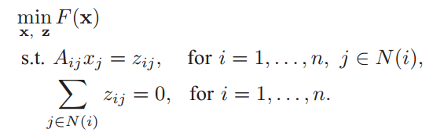
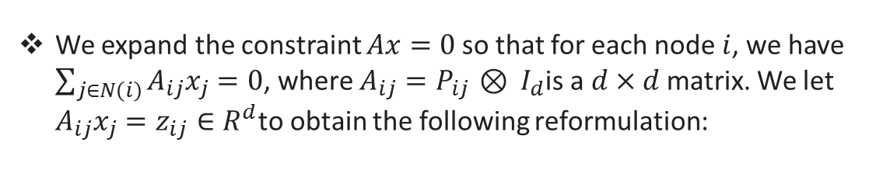

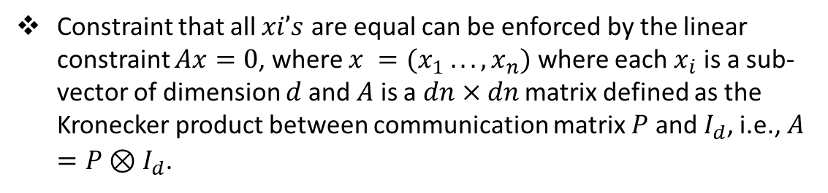
Constraint that all $xi’s$ are equal can be enforced by the linear constraint $Ax=0$, where $x =(x_{1} . . . , x_{n})$ where each $x_{i}$ is a sub-vector of dimension $d$and $A$ is a $dn×dn$ matrix defined as the Kronecker product between communication matrix $P$ and $I_{d}$, i.e., $A=P⊗I_{d}$.
ADMM
First Paper
Assumption 2. The optimal solution set of main problem is nonempty. We let $x^{∗}$ denote an optimal solution of the problem.
Second Paper
Main Paper
We expand the constraint $Ax=0$so that for each node $i$, we have $\sum_{j∈N\left(i\right)}{A_{ij}x_{j}=0}$, where $A_{ij}=P_{ij} ⊗ I_{d}$is a $d×d$ matrix. We let $A_{ij}x_{j}=z_{ij}∈R^{d}$to obtain the following reformulation:
Convergence
Network Effects
Convergence Rate of Distributed ADMM over Networks
Mohammad Mahmoodian
10/18

Slide 12
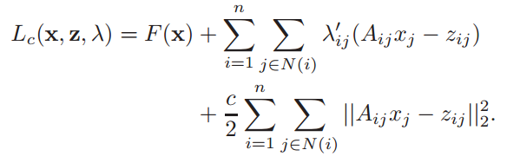



Lagrangian is
ADMM
First Paper
Second Paper
We now use ADMM algorithm
Main Paper
For any $j = 1, . . . , n$, we update $x_{j}$ as
Convergence
Network Effects
2. For any $i = 1, . . . , n$, we update the vector $z_{i}={\left[z_{ij}\right]}_{j∈N\left(i\right)}$ as
Convergence Rate of Distributed ADMM over Networks
where
Mohammad Mahmoodian
11/18

Slide 13

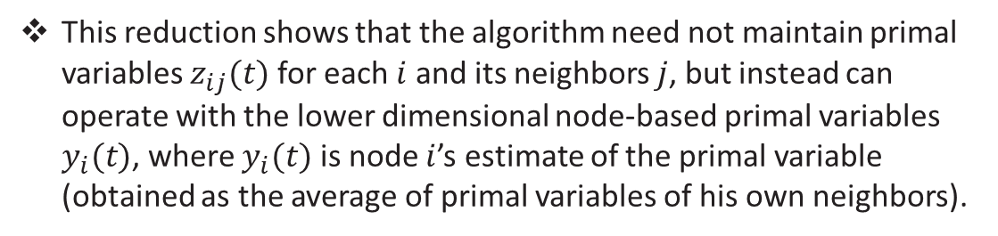
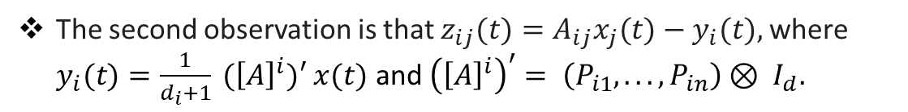
3. For $i=1, . . . , n$ and $j ∈ N(i)$ we update $λ_{ij}$ as
ADMM
First Paper
Second Paper
One can implement this algorithm in a distributed manner, where node $i$ maintains variables $λ_{ij}(t)$ and $z_{ij}(t)$ for all $j ∈N(i)$
Main Paper
We show that for all $t$, $i$, and $j∈N(i)$, we have $λ_{ij}(t) = p_{i}(t)$.
Convergence
The second observation is that $z_{ij}(t)=A_{ij}x_{j}(t)−y_{i}(t),$where $y_{i}(t)=\frac{1}{d_{i}+1} ({\left[A\right]}^{i})′ x(t)$ and ${\left({\left[A\right]}^{i}\right)}^{′}= \left(P_{i1}, . . . , P_{in}\right)⊗ I_{d}.$
Network Effects
Convergence Rate of Distributed ADMM over Networks
This reduction shows that the algorithm need not maintain primal variables $z_{ij}(t)$ for each $i$ and its neighbors $j$, but instead can operate with the lower dimensional node-based primal variables $y_{i}(t)$, where $y_{i}(t)$ is node $i$’s estimate of the primal variable (obtained as the average of primal variables of his own neighbors).
Mohammad Mahmoodian
12/18

Slide 14
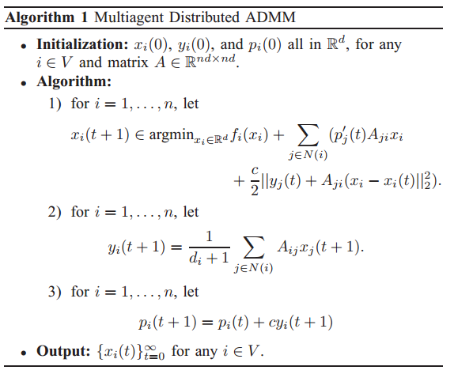
ADMM
First Paper
Second Paper
Main Paper
Convergence
Network Effects
Convergence Rate of Distributed ADMM over Networks
Mohammad Mahmoodian
13/18

Slide 15

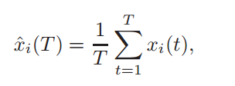

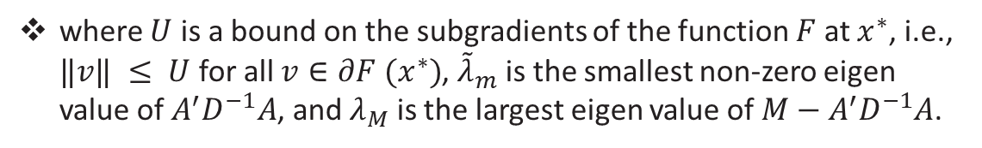
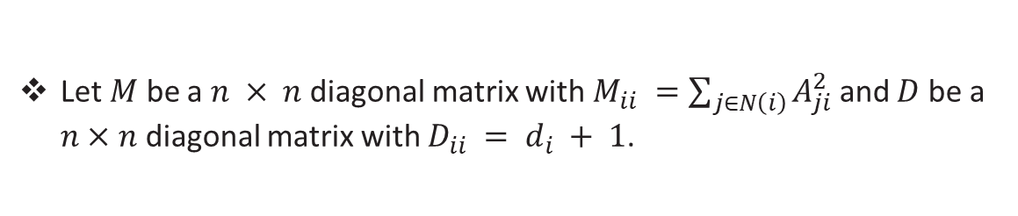
Let $M$ be a $n × n$ diagonal matrix with $M_{ii} =\sum_{j∈N\left(i\right)}{A_{ji}^{2}}$ and $D$ be a $n×n$ diagonal matrix with $D_{ii} = d_{i} + 1$.
ADMM
Theorem. For any $T$ , starting form $x(0) = 0$, we have
First Paper
Second Paper
Main Paper
where $U$ is a bound on the subgradients of the function $F$ at $x^{∗}$, i.e., $‖v‖ ≤ U$ for all $v∈∂F (x^{∗})$, ${\tilde{λ}}_{m}$ is the smallest non-zero eigen value of $A^{′}D^{−1}A$, and $λ_{M}$ is the largest eigen value of $M−A^{′}D^{−1}A$.
Convergence
Network Effects
Convergence Rate of Distributed ADMM over Networks
$\hat{x}(T) = ({\hat{x}}_{1}(T), . . . ,{\hat{x}}_{n}(T))$
Mohammad Mahmoodian
14/18

Slide 16

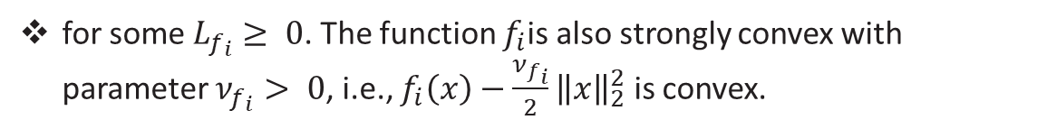
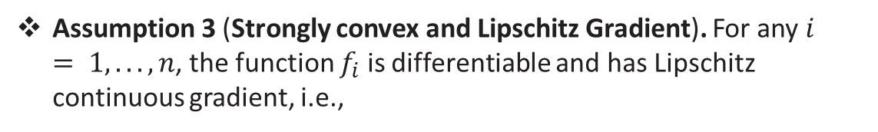
Assumption 3 (Strongly convex and Lipschitz Gradient). For any $i = 1, . . . , n$, the function $f_{i}$ is differentiable and has Lipschitz continuous gradient, i.e.,
ADMM
First Paper
Second Paper
Main Paper
for some $L_{f_{i}}≥ 0$. The function $f_{i}$is also strongly convex with parameter $ν_{f_{i}}> 0$, i.e., $f_{i}\left(x\right)−\frac{ν_{f_{i}}}{2}{\left\|x\right\|}_{2}^{2}$ is convex.
Convergence
Network Effects
Convergence Rate of Distributed ADMM over Networks
We let $ν=\min_{1≤i≤n}ν_{f_{i}}$and , $L=\max_{1≤i≤n}L_{f_{i}}$ and define the condition number of $F(x)$ as $K_{f}=\frac{L}{ν}$ .
Mohammad Mahmoodian
15/18

Slide 17

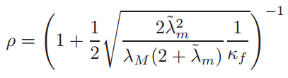

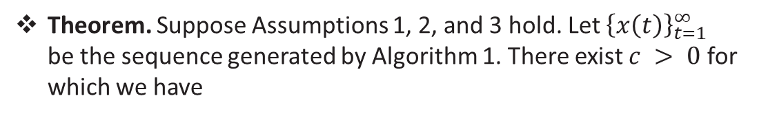
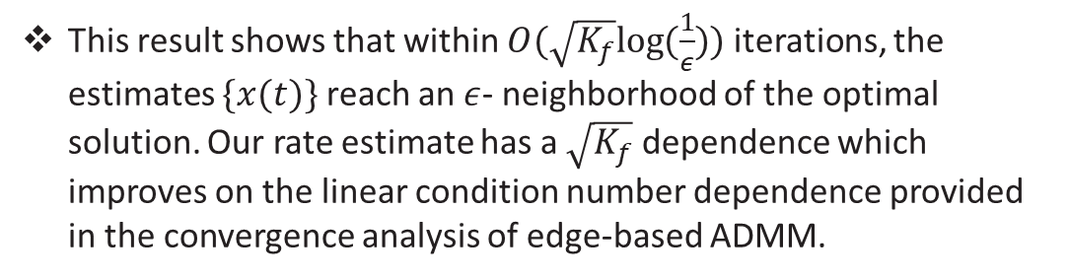
Theorem. Suppose Assumptions 1, 2, and 3 hold. Let ${\left\{x\left(t\right)\right\}}_{t=1}^{∞}$ be the sequence generated by Algorithm 1. There exist $c > 0$ for which we have
ADMM
First Paper
Second Paper
where the rate $ρ<1$is given by
Main Paper
Convergence
Network Effects
Convergence Rate of Distributed ADMM over Networks
This result shows that within $O(\sqrt{K_{f}}log⁡(\frac{1}{ε}))$ iterations, the estimates $\{x(t)\}$ reach an $ε$- neighborhood of the optimal solution. Our rate estimate has a $\sqrt{K_{f}}$ dependence which improves on the linear condition number dependence provided in the convergence analysis of edge-based ADMM.
Mohammad Mahmoodian
16/18

Slide 18


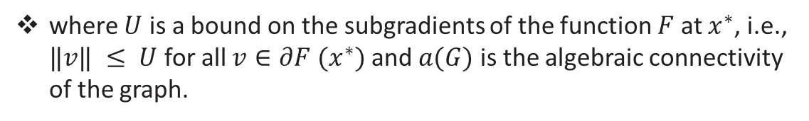
Using Laplacian as the communication matrix we can now capture the effect of network structure in the convergence rate.
ADMM
First Paper
Proposition. For any T , starting form x(0) = 0 and using standard Laplacian as the communication matrix, we have
Second Paper
Main Paper
Convergence
where $U$ is a bound on the subgradients of the function $F$ at $x^{∗}$, i.e., $‖v‖ ≤ U$ for all $v∈∂F (x^{∗})$ and $a(G)$ is the algebraic connectivity of the graph.
Network Effects
Convergence Rate of Distributed ADMM over Networks
let $d_{i}$ denote the degree of agent $i$, i.e., $|N(i)|=di+1$. We let $d_{max}=\max_{i∈V}{d_{i}}$ and $d_{min} =\min_{i∈V}{d_{i}}$.
highly connected graphs with larger algebraic connectivity has a faster convergence rate.
Mohammad Mahmoodian
17/18

Slide 19
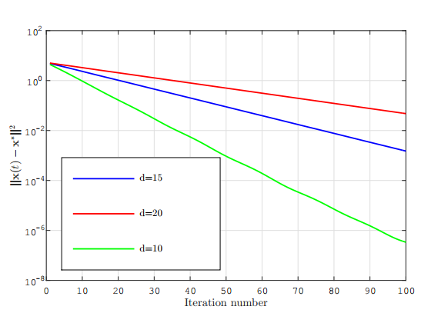
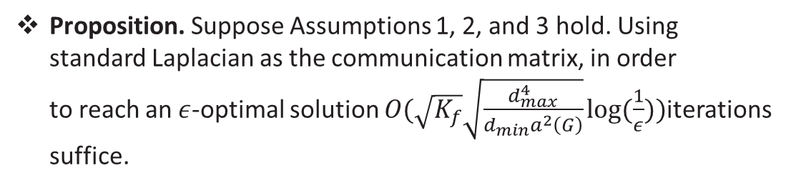
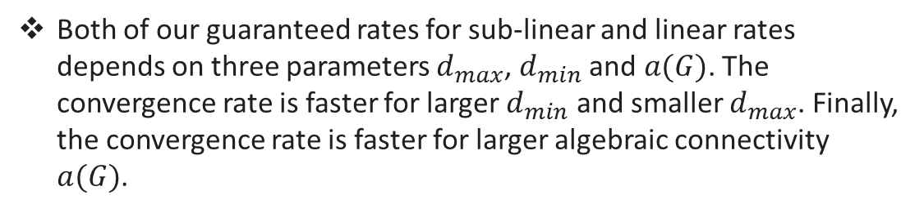
Proposition. Suppose Assumptions 1, 2, and 3 hold. Using standard Laplacian as the communication matrix, in order to reach an $ε$-optimal solution $O(\sqrt{K_{f}}\sqrt{\frac{d_{max}^{4}}{d_{min}a^{2}\left(G\right)}}log⁡(\frac{1}{ε}))$iterations suffice.
ADMM
First Paper
Second Paper
Both of our guaranteed rates for sub-linear and linear rates depends on three parameters $d_{max}$, $d_{min}$ and $a(G)$. The convergence rate is faster for larger $d_{min}$ and smaller $d_{max}$. Finally, the convergence rate is faster for larger algebraic connectivity $a(G)$.
Main Paper
Convergence
Network Effects
Convergence Rate of Distributed ADMM over Networks
Mohammad Mahmoodian
18/18

Slide 20
ADMM
THANK YOU
First Paper
Second Paper
Main Paper
and
Convergence
Any Question?
Network Effects
Convergence Rate of Distributed ADMM over Networks
Mohammad Mahmoodian

