Slide 1
Staroids
By: Eoin Lynagh, Jason Nagy, Moziah San Vicente

Slide 2
Introduction
The project is a reimplementation of HTML-5 Asteroids by Doug McInnis
The focus of this project was to create a fun portable version of asteroids
Why Asteroids?

Slide 3
Design Choices
Software Qualities we tried to keep in mind when designing our project:
Modularity
Portability
Usability

Slide 4
Demo

Slide 5
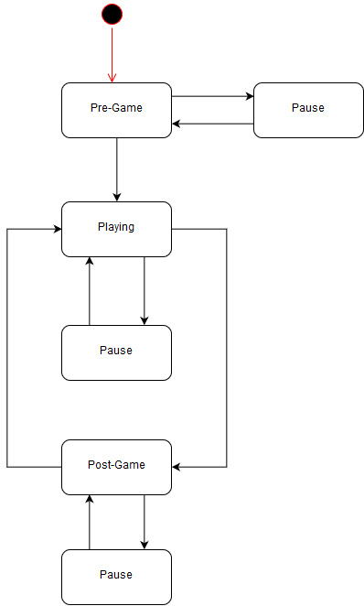
Conclusion
Recreation and Improvement over the original
Portable, Modular and Performs well
Extremely fun and fair gameplay

