Slide 1
TOURISM INDUSTRY ANALYTICS
Visitor Trends, Seasonal Demand, Economic Impact, and Travel Pattern Analysis
BY :MOMIN BUTT
Data Analytics Project • 500 Records • 20 Countries • 2020 – 2024

Slide 2
Problem Statement
The tourism industry plays a major role in economic growth and employment generation worldwide. However, tourism businesses often struggle to understand visitor behavior, seasonal demand fluctuations, spending trends, and destination performance.
This project analyzes tourism and hospitality data to identify meaningful patterns in tourist arrivals, hotel occupancy, tourism revenue, customer behavior, and travel trends — helping organizations improve business strategies, customer satisfaction, and revenue generation.
500
dataset records
20 / 56
countries / cities
2020–24
years covered
Tourism Industry Analytics | 2

Slide 3
Project Objectives
Analyze visitor trends across destinations
Identify seasonal tourism demand
1
2
Study tourist spending behavior
Analyze hotel occupancy and ratings
3
4
Examine tourism revenue patterns
Discover economic impact of tourism
5
6
Build an interactive analytics dashboard
7
Tourism Industry Analytics | 3

Slide 4
The Dataset
Tourism_Hospitality_Industry_Analysis.csv — 500 records × 23 columns
Visitor Data
Hotel & Spending
Economic Impact
Country, City, Year, Month, Number of Tourists, Purpose of Visit, Average Length of Stay
Tourist Spending, Hotel Occupancy Rate, Number of Hotels, Hotel Rating, Average Room Price
Tourism Revenue, Employment in Tourism, Contribution to GDP %
Transport
Sustainability
Experience
Number of Flights, Airport Passenger Traffic, Transport Infrastructure Quality
Eco-Tourism Revenue, Carbon Footprint, Waste Management Rating
Tourist Satisfaction Score, Number of Online Reviews
Tourism Industry Analytics | 4

Slide 5
Data Cleaning & Preparation
Missing Values
0 missing values found across all 500 records
Duplicates
0 duplicate rows found
Data Quality Fix
One blank Country value (city: Dubai) corrected to United Arab Emirates
Feature Engineering
Derived Season from Month; Revenue_Per_Tourist = Revenue / Tourists
Tourism Industry Analytics | 5

Slide 6
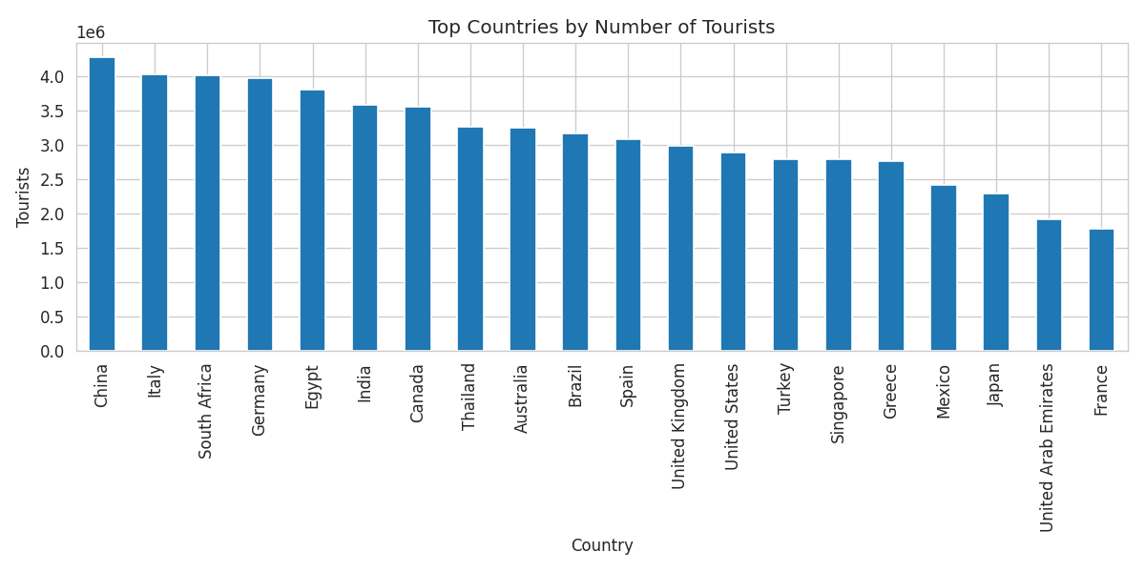
Top Countries by Tourists
Key Insight
China leads by total tourist volume — a signal for where to prioritize infrastructure investment.
Tourism Industry Analytics | 6

Slide 7
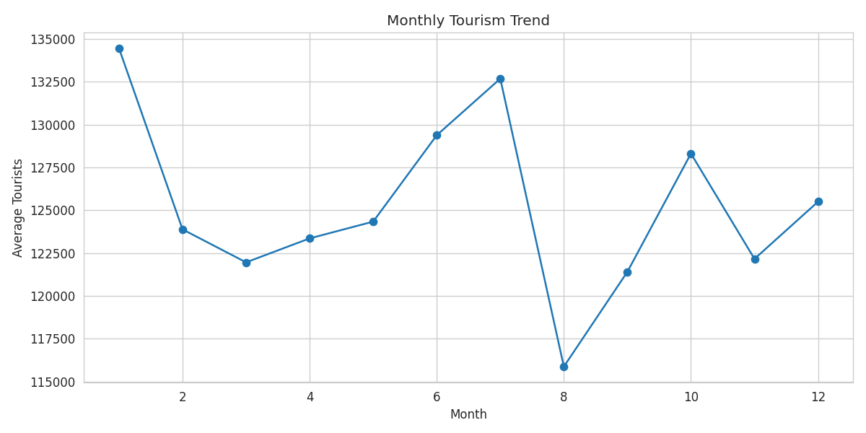
Monthly Tourism Trend
Key Insight
January is peak demand; August is weakest — a clear seasonal cycle for staffing and capacity planning.
Tourism Industry Analytics | 7

Slide 8
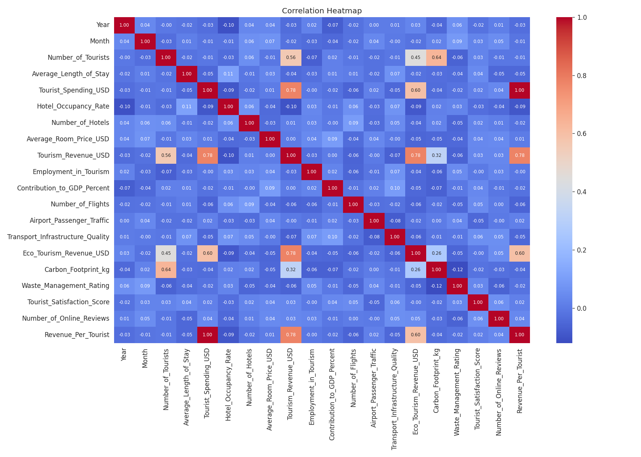
Correlation Heatmap
Key Insight
Revenue correlates most with tourist spending and eco-tourism revenue (~0.78) — not with flight capacity.
Tourism Industry Analytics | 8

Slide 9
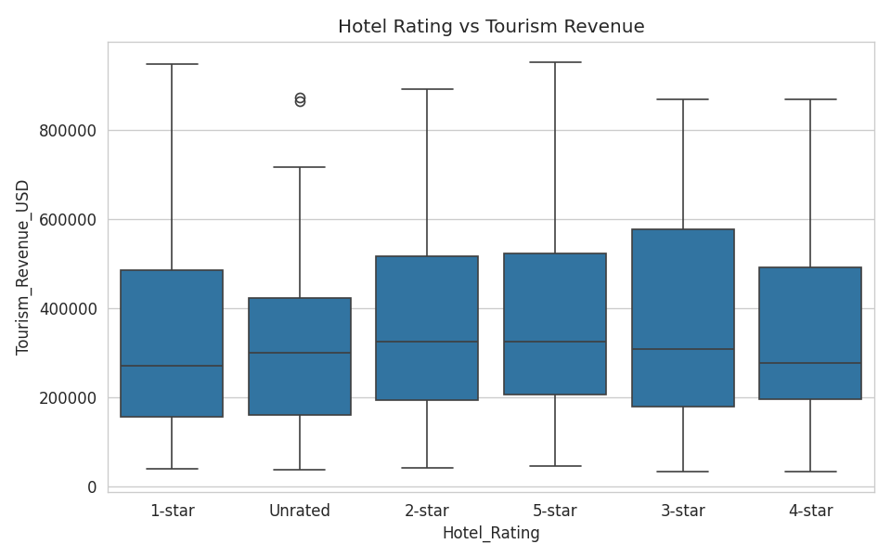
Hotel Rating vs Revenue
Key Insight
5-star hotels post the highest average revenue; unrated properties the lowest.
Tourism Industry Analytics | 9

Slide 10
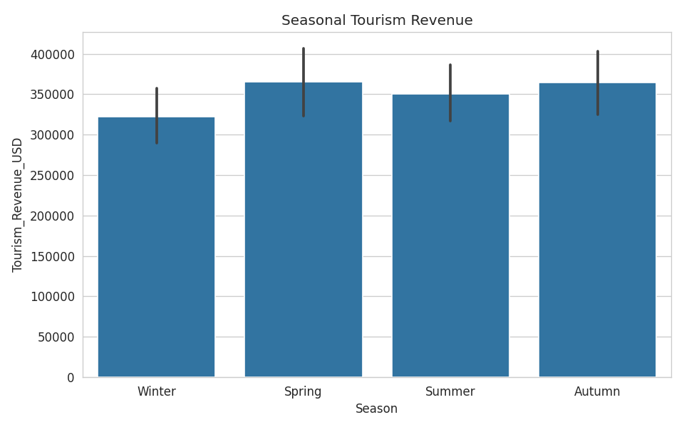
Seasonal Tourism Revenue
Key Insight
Spring and Autumn generate the highest average revenue, ahead of Summer and Winter.
Tourism Industry Analytics | 10

Slide 11
Key Insights
China draws the largest tourist volume and leads eco-tourism revenue
Hotel quality drives revenue: 5-star properties earn the most
January is peak season; August is the weakest month
Revenue tracks spending and eco-tourism revenue, not flight capacity
Tourism employment stayed stable (~26–27.5K jobs) through 2020–2024
Higher-revenue destinations show a larger carbon footprint
Tourism Industry Analytics | 11

Slide 12
Business Recommendations
1
Boost marketing & promotional pricing in the August low season
2
Upgrade unrated / 1-star hotel stock to lift destination revenue
3
Expand eco-tourism investment in high-traffic markets like China
4
Prioritize transport upgrades in lowest-scoring cities
5
Target high-spending segments (e.g., business travel) directly
6
Track and offset carbon footprint growth in top-revenue destinations
Tourism Industry Analytics | 12

Slide 13
Interactive Analytics Dashboard
Built with Streamlit + Plotly
Live filters by Country, Year, and Season
KPI cards: total tourists, total revenue, avg. occupancy, avg. satisfaction
Revenue by country, monthly trend, purpose of visit, seasonal revenue charts
Hotel rating vs revenue and GDP contribution by country
Full filtered data table for drill-down analysis
Tourism Industry Analytics | 13

Slide 14
Challenges & Limitations
Sample Size
Correlation ≠ Causation
500 records across 20 countries limits statistical power for country-level subgroup analysis
All relationships identified are linear (Pearson) and descriptive, not causal
Cross-Sectional Data
Data Quality
Records span 2020–2024 but are not a true longitudinal panel per destination
One record required manual correction (blank Country field) during cleaning
Tourism Industry Analytics | 14

Slide 15
Conclusion
This analysis shows that tourism revenue is driven primarily by tourist spending and eco-tourism performance, not by transport capacity alone. Seasonal patterns are strong and predictable, hotel quality is directly tied to revenue outcomes, and sustainability trade-offs are emerging in the highest-earning destinations.
The accompanying dashboard gives tourism organizations a live, filterable view of these dynamics to support faster, better-informed decisions.
Thank You

