Slide 1
Trustpilot Review
Sentiment Analysis Using Machine Learning
NLP • TF-IDF • Logistic Regression • Flask • Streamlit

Slide 2
Project Overview
983 cleaned Trustpilot reviews from six companies.
Three sentiment classes: Negative, Neutral and Positive.
TF-IDF created 5,000 text features.
Six model configurations were evaluated.
Logistic Regression C=2 produced the best reported result.
Two interfaces use the same production artifacts: Flask and Streamlit.

Slide 3
Problem Statement
Customer reviews are rich but time-consuming to analyze manually.
The project automates sentiment classification for review text.
It also turns the notebook analysis into reusable deployment interfaces.

Slide 4
Objectives
Clean review text and create sentiment labels.
Explore sentiment, ratings, company volume and review length.
Extract TF-IDF features and compare classifiers.
Tune Logistic Regression.
Deploy one shared prediction pipeline through Flask and Streamlit.

Slide 5
Dataset & Companies
Original: 984 reviews and 8 original columns.
Final: 983 reviews and 14 columns.
Uber Eats — Food Delivery
Temu — Online Shopping
Spotify — Streaming Services
Canva — Software
Booking.com — Travel
PayPal — Financial Services

Slide 6
Data Cleaning & Preprocessing
Lowercase conversion.
URL, HTML and email removal.
Character filtering and whitespace normalization.
Stopword removal with important negations preserved.
One empty/problematic cleaned review removed.
Notebook recorded 184 stopwords.

Slide 7
Sentiment Labeling & Class Balance
Rating 1–2 → Negative.
Rating 3 → Neutral.
Rating 4–5 → Positive.
Negative: 773 (78.64%).
Neutral: 24 (2.44%).
Positive: 186 (18.92%).
Neutral is the main class-imbalance limitation.

Slide 8
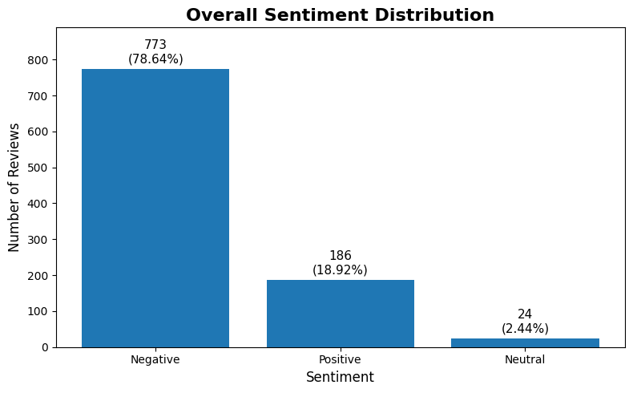
Chart 1 — Overall Sentiment Distribution
What it shows
773 Negative, 24 Neutral and 186 Positive reviews.
Negative dominates the collected sample.
Accuracy is influenced by this imbalance.

Slide 9
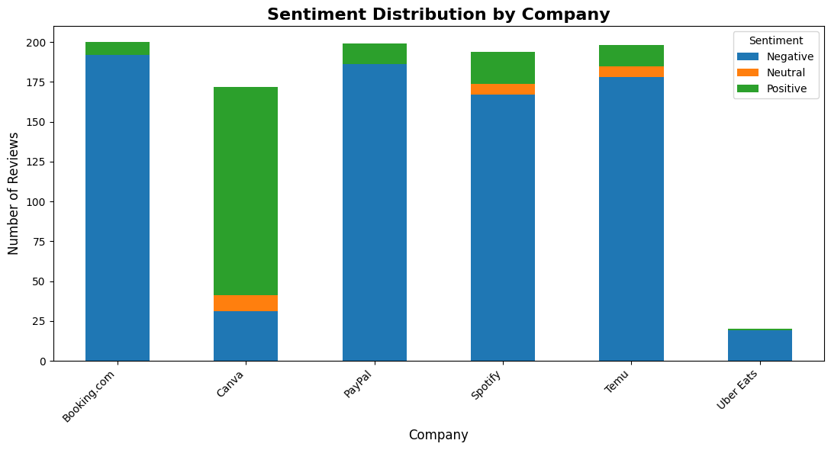
Chart 2 — Sentiment Distribution by Company
What it shows
Shows absolute sentiment counts per company.
Canva is the positive outlier.
Most other company samples are negative-heavy.

Slide 10
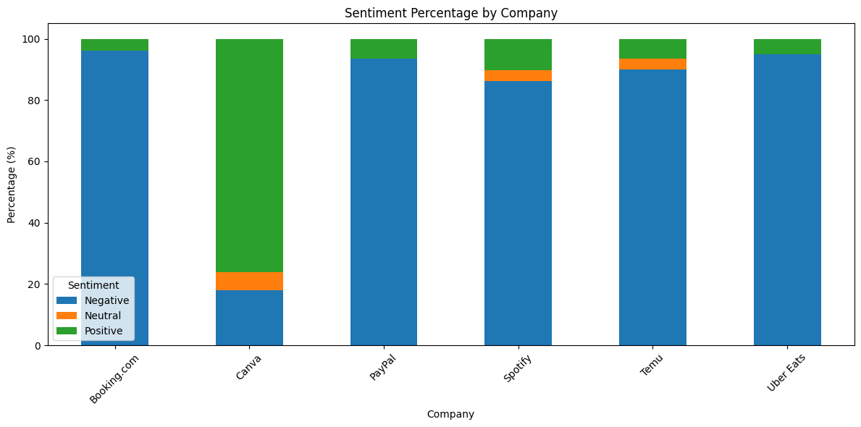
Chart 3 — Sentiment Percentage by Company
What it shows
Normalizes each company to 100%.
Canva is strongly positive in the collected sample.
This is easier to compare across different sample sizes.

Slide 11
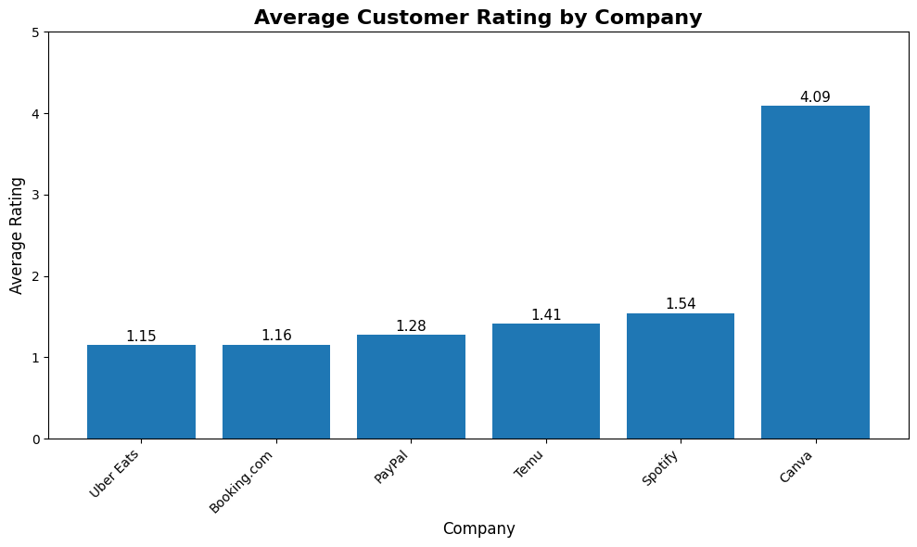
Chart 4 — Average Rating by Company
What it shows
Compares average 1–5 ratings.
Canva is about 4.09.
Other collected samples are much lower.

Slide 12
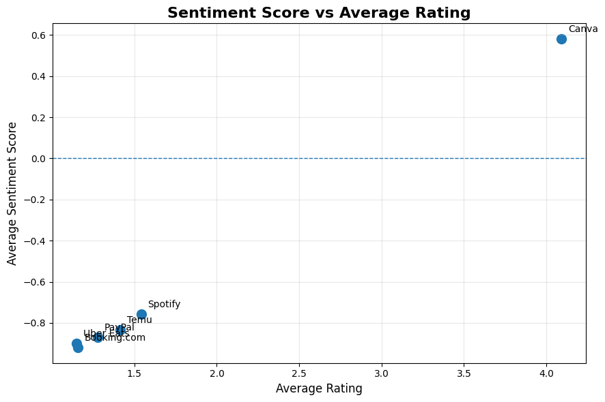
Chart 5 — Sentiment Score vs Average Rating
What it shows
Compares average rating and -1/0/+1 sentiment score.
Canva is on the positive side.
Other companies are negative in the collected sample.

Slide 13
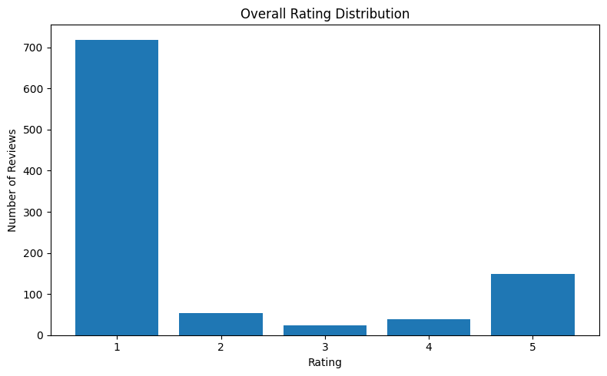
Chart 6 — Rating Distribution
What it shows
Notebook output: 719 one-star, 54 two-star, 24 three-star, 38 four-star, 148 five-star.
One-star reviews dominate.
This supports the Negative class imbalance.

Slide 14
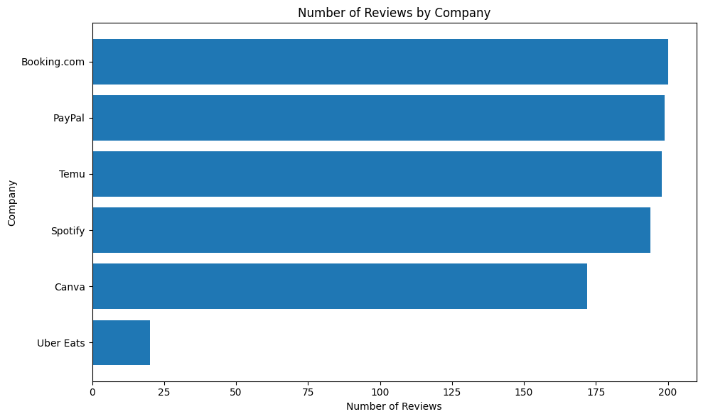
Chart 7 — Review Count by Company
What it shows
Booking.com has 200 reviews and Uber Eats only 20.
The sample sizes are not equal.
Uber Eats conclusions are less reliable.

Slide 15
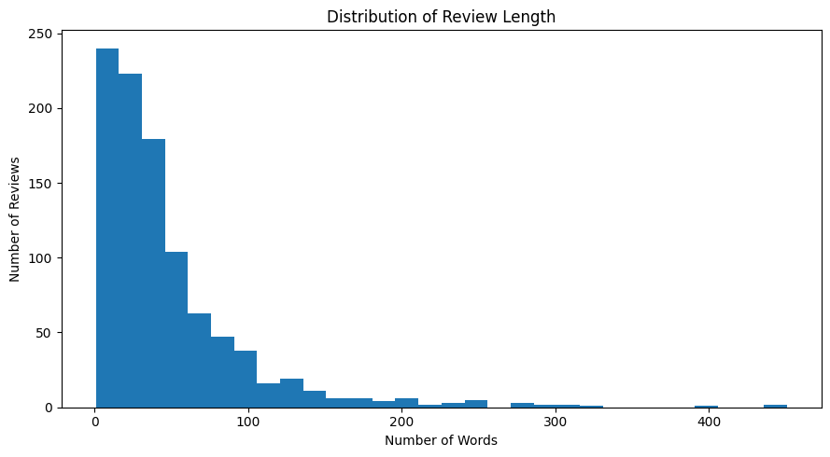
Chart 8 — Review Length Distribution
What it shows
Median word count is 32; maximum is 451.
Review lengths vary substantially.
Longer reviews may contain more detailed experiences.

Slide 16
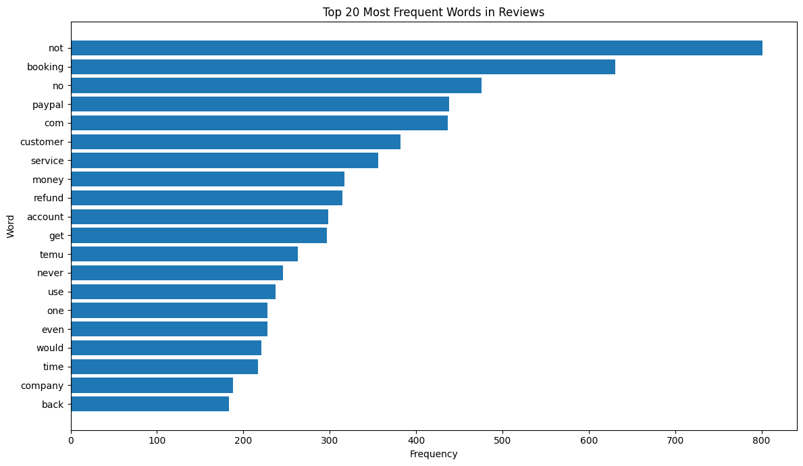
Chart 9 — Top 20 Words
What it shows
Frequent cleaned words include not, booking, no, paypal, customer and service.
Frequency alone does not imply sentiment.

Slide 17
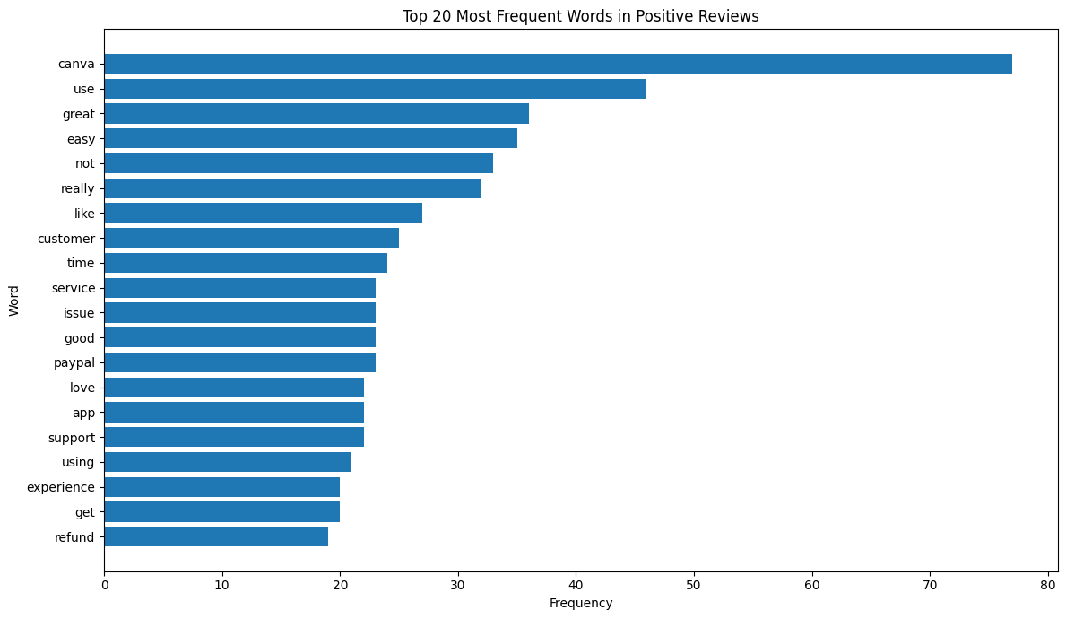
Chart 10 — Top Positive Words
What it shows
Positive-review frequencies begin with canva, use, great and easy.
Words may still occur in mixed contexts.

Slide 18
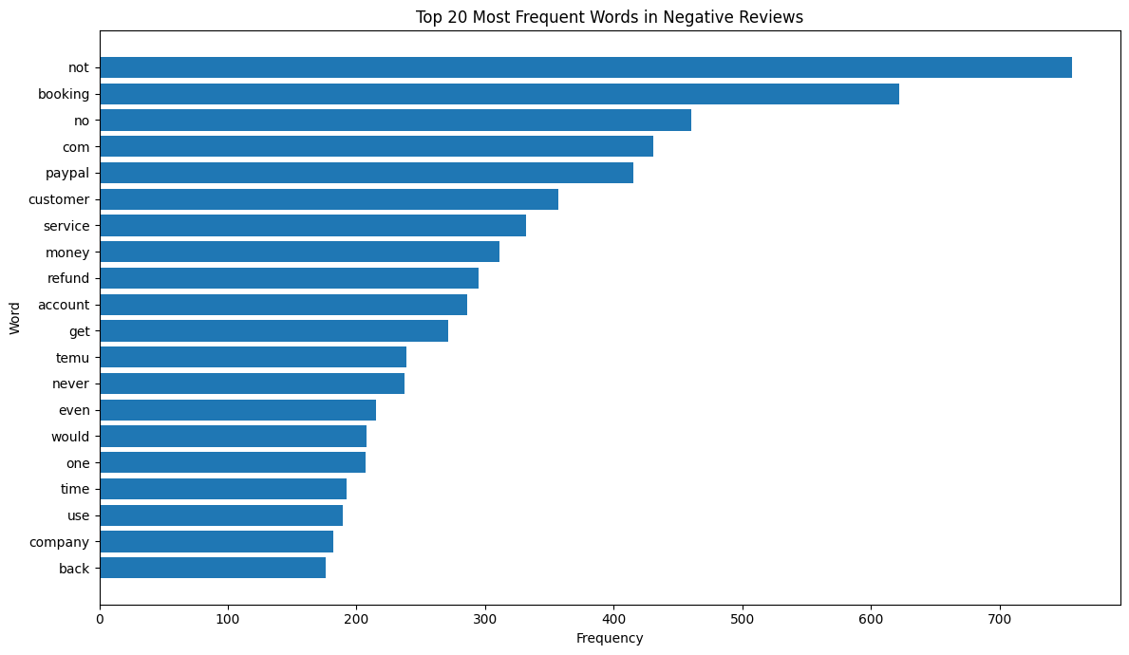
Chart 11 — Top Negative Words
What it shows
Negative-review frequencies begin with not, booking, no, paypal and customer.
Complaint vocabulary is visible.

Slide 19
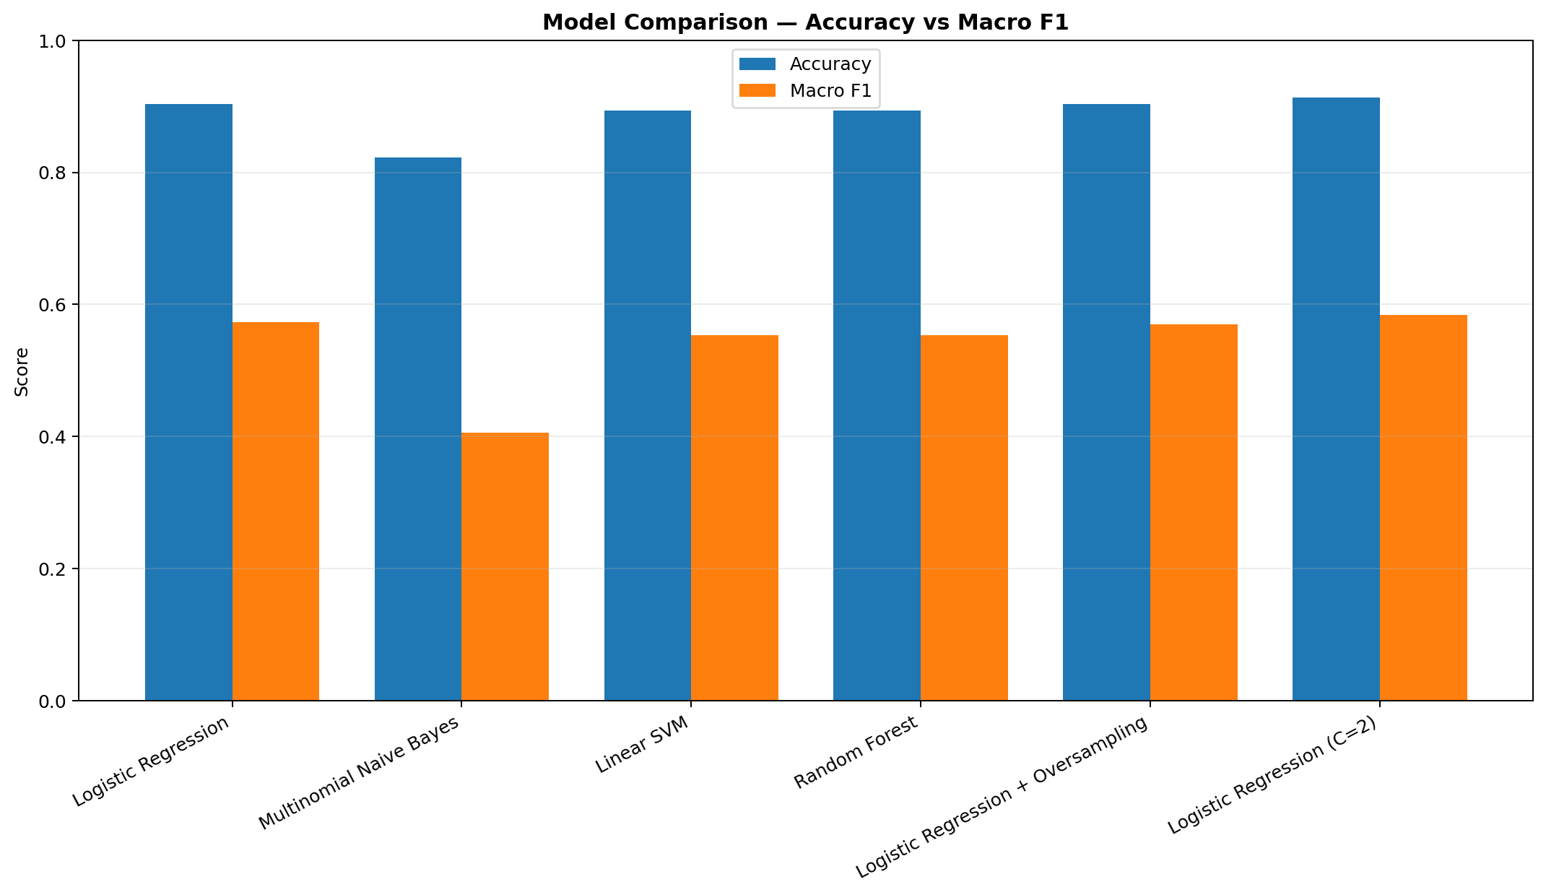
Chart 12 — Model Comparison
What it shows
Compares Accuracy and Macro F1.
Logistic Regression C=2 is best on both supplied metrics.
Macro F1 is important because of class imbalance.

Slide 20
TF-IDF Feature Engineering
max_features = 5000.
ngram_range = (1, 2).
min_df = 2; max_df = 0.95.
sublinear_tf = True.
Final matrix: X = (983, 5000).
The fitted vectorizer must be saved and reused during prediction.

Slide 21
Machine Learning Models
Logistic Regression — 90.36% accuracy, Macro F1 0.5732.
Multinomial Naive Bayes — 82.23%, 0.4056.
Linear SVM — 89.34%, 0.5534.
Random Forest — 89.34%, 0.5536.
Logistic Regression + Oversampling — 90.36%, 0.5699.
Logistic Regression C=2 — 91.37%, 0.5845.

Slide 22
Hyperparameter Tuning
C values tested: 0.01, 0.10, 0.50, 1, 2, 5 and 10.
C=2 produced the highest Accuracy: 0.913706.
C=2 produced the highest Macro F1: 0.584520.
Final production model: Logistic Regression with C=2.

Slide 23
Final Model
Logistic Regression
C = 2.0
Accuracy = 91.37%
Macro F1 = 0.5845
Negative F1 = 0.95
Neutral F1 = 0.00
Positive F1 = 0.80

Slide 24
Confusion Matrix & Limitations
[[154,0,1],[4,0,1],[10,1,26]]
Most Negative reviews are correctly classified.
Positive recall is 0.70.
Neutral recall and F1 are 0.00.
Only 5 Neutral examples are in the test set.
Do not interpret 91.37% as equal accuracy across all classes.

Slide 25
One ML Pipeline, Two Interfaces
User Review
↓ Preprocessing
↓ Saved TF-IDF Vectorizer
↓ Logistic Regression C=2
↓ Sentiment + Probability
↓ Flask Web App and Streamlit Dashboard

Slide 26
Dashboard
KPIs: total reviews, Negative, Positive, Neutral and average rating.
Company comparison and sentiment score.
Interactive filters and charts in Streamlit.
Live prediction with probability when artifacts are present.
Flask provides a polished prediction page and dashboard.

Slide 27
Business Insights
Canva: 4.09 average rating; 76.16% Positive in the collected sample.
Booking.com: 1.16 average rating; 96% Negative in the collected sample.
PayPal: 1.28 average rating; 93.47% Negative.
Temu: 1.41 average rating; 89.90% Negative.
Spotify: 1.54 average rating; 86.08% Negative.
Uber Eats: 1.15 average rating; 95% Negative, but only 20 reviews.

Slide 28
Limitations
Collected sample is not a complete population.
Negative class is 78.64%.
Neutral class is only 2.44%.
Neutral test recall/F1 are 0.00.
Uber Eats has only 20 reviews.
TF-IDF is less context-aware than transformer models.

Slide 29
Future Improvements
Collect more balanced reviews.
Improve Neutral coverage and class-aware training.
Compare transformer models.
Add multilingual sentiment.
Add explanation/highlighted phrases.
Add monitoring, drift detection and automated retraining.

Slide 30
Conclusion
The project turns a notebook workflow into a deployment-oriented NLP system.
Logistic Regression C=2 is the best reported configuration.
Macro F1 and class-level metrics are essential because of imbalance.
Flask and Streamlit share the same model/vectorizer architecture.
The package is structured for GitHub and portfolio presentation.

