Slide 1
Chapter-1
Textbook-1

Slide 2
Proof Techniques
Proof by induction
Proof by contradiction

Slide 3
Induction
We have statements P₁, P₂, P₃, …
If we know
for some b that P₁, P₂, …, P_{b} are true
for any k >= b that P₁, P₂, …, P_{k} imply P_{k+1}
Then
Every P_{i} is true

Slide 4
Proof by Induction
Inductive basis
Find P₁, P₂, …, P_{b} which are true
Inductive hypothesis
Let’s assume P₁, P₂, …, P_{k} are true for any k >= b
Inductive step
Show that P_{k+1} is true

Slide 5
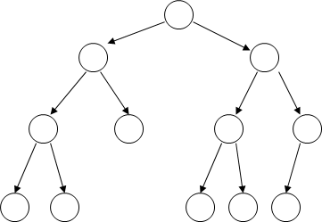
Example (1) - Proof by Induction
Theorem: A binary tree of height n has at most 2^{n} leaves.
Proof by induction:
let L(i) be the maximum number of leaves of any subtree at height i

Slide 6
Example (1) - cont.
We want to show: L(i) <= 2^{i}
Inductive basis: L(0) = 1 (the root node)
Inductive hypothesis: Let’s assume L(i) <= 2^{i} for all i = 0, 1, …, k
Induction step: we need to show that L(k + 1) <= 2^{k+1}

Slide 7
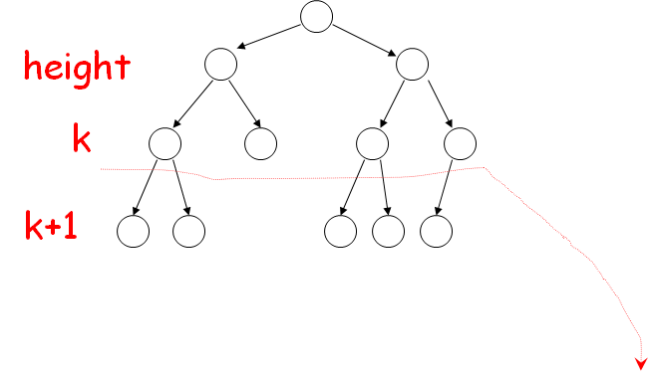
Example (1) - cont.
Inductive step
From Inductive hypothesis: L(k) <= 2^{k}

Slide 8
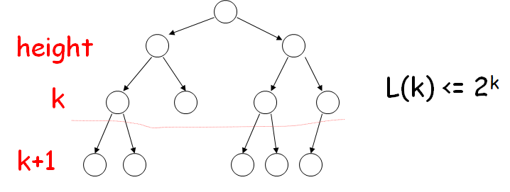
Example (1) - cont.
L(k+1) <= 2 * L(k) <= 2 * 2^{k} = 2^{k+1}
(we add at most two nodes for every leaf of level k)

Slide 9

Exercise
Use induction to prove

Slide 10
Proof by Contradiction
We want to prove that a statement P is true
we assume that P is false
then we arrive at an incorrect conclusion
therefore, statement P must be true

Slide 11

Example-2: Introduction by Contradiction
Theorem: is not rational
Proof:
Assume by contradiction that it is rational
= n/m
n and m have no common factors
We will show that this is impossible

Slide 12
Example-2: Cont.
= n/m ==> 2 m² = n²
Therefore, n² is even ==> n is even (n = 2k)
2 m² = 4k² m² = 2k² m is even (m = 2p)
Thus, m and n have common factor 2
Contradiction!

Slide 13
Exercise
In a triangle ABC, prove by contradiction that if the angle <CAB is equivalent to the angle <CBA, then the line AC is equivalent to the line CB.
C
A
B

