Slide 1
AGORA
Made by: Bédi Alexandra and Molnár Máté

Slide 2
Purpose of Software
Online marketplace for smallholders
Easy buying and selling
Good quality and environmentally friendly products
Sellers can have a larger customer base

Slide 3
Architecture of Software
Backend
Frontend
MySQL database

Slide 4
Backend
NodeJS
Express
API
Authentication
JSON
JWT
MySQL MariaDB

Slide 5
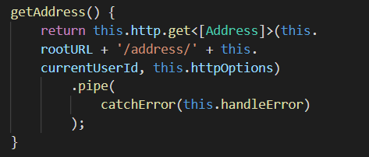
Frontend
Angular, TypeScript
Bootstrap scss directory
Mobile and computer view
Components
HttpClient service
Validation

Slide 6
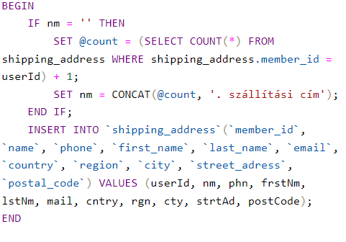
MySQL database
MariaDB
Stored procedures

Slide 7
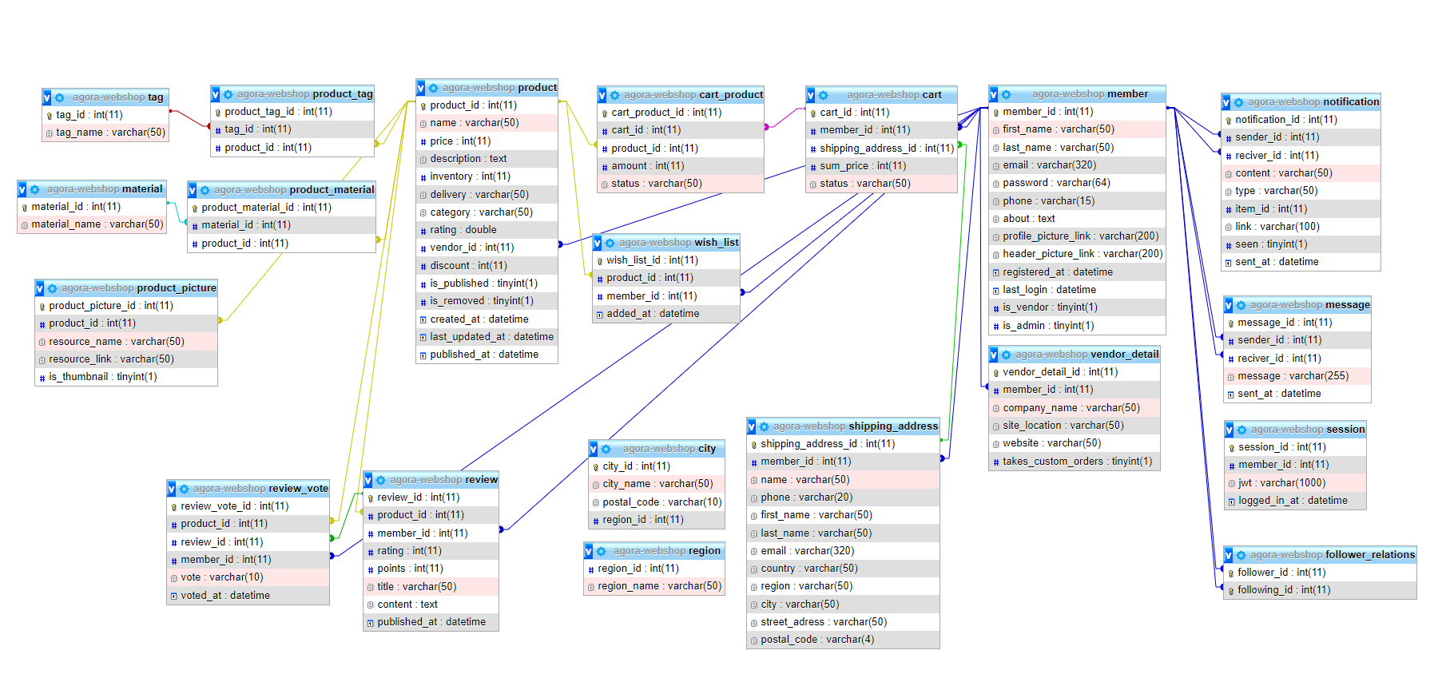
Data model tables

Slide 8
Thank you for your attention!

