Slide 1



Győri SZC Jedlik Ányos Gépipari és Informatikai Technikum és Kollégium
Made by:
Bédi Alexandra Molnár Máté

Slide 2
Purpose of Software
Online marketplace for small businesses, artists
Easy to use e-commerce platform
Good quality and environmentally friendly products
Growing a customer base, community

Slide 3

Features
Account management
Sell and buy
Review
Order tracking
Search
Wishlist

Slide 4
Components
Backend Node.js
Frontend Angular
Database MySQL

Slide 5
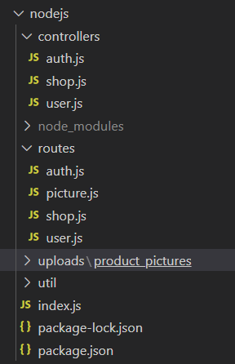
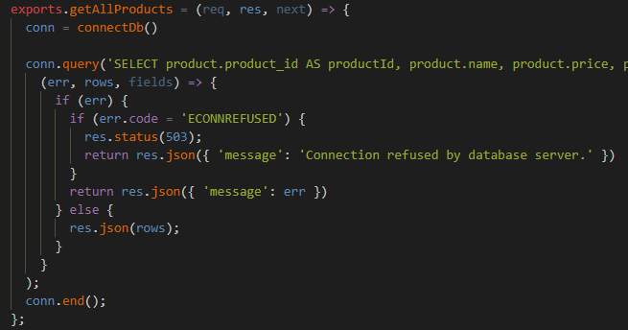
Backend
NodeJS
Express
Multer
Mysql
API (JSON)
Authentication
JWT

Slide 6
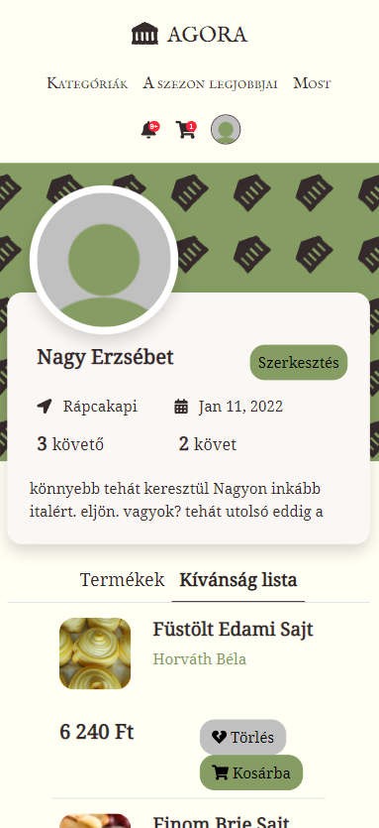
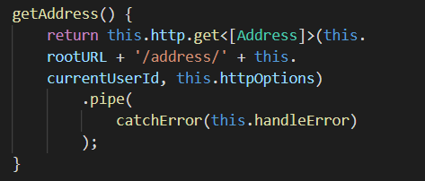
Frontend
Angular, TypeScript
Bootstrap SCSS directory
Mobile and computer view
Components
HttpClient service
Validation

Slide 7
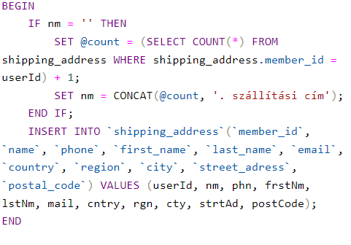
Database
MySQL (MariaDB)
Stored procedures

Slide 8
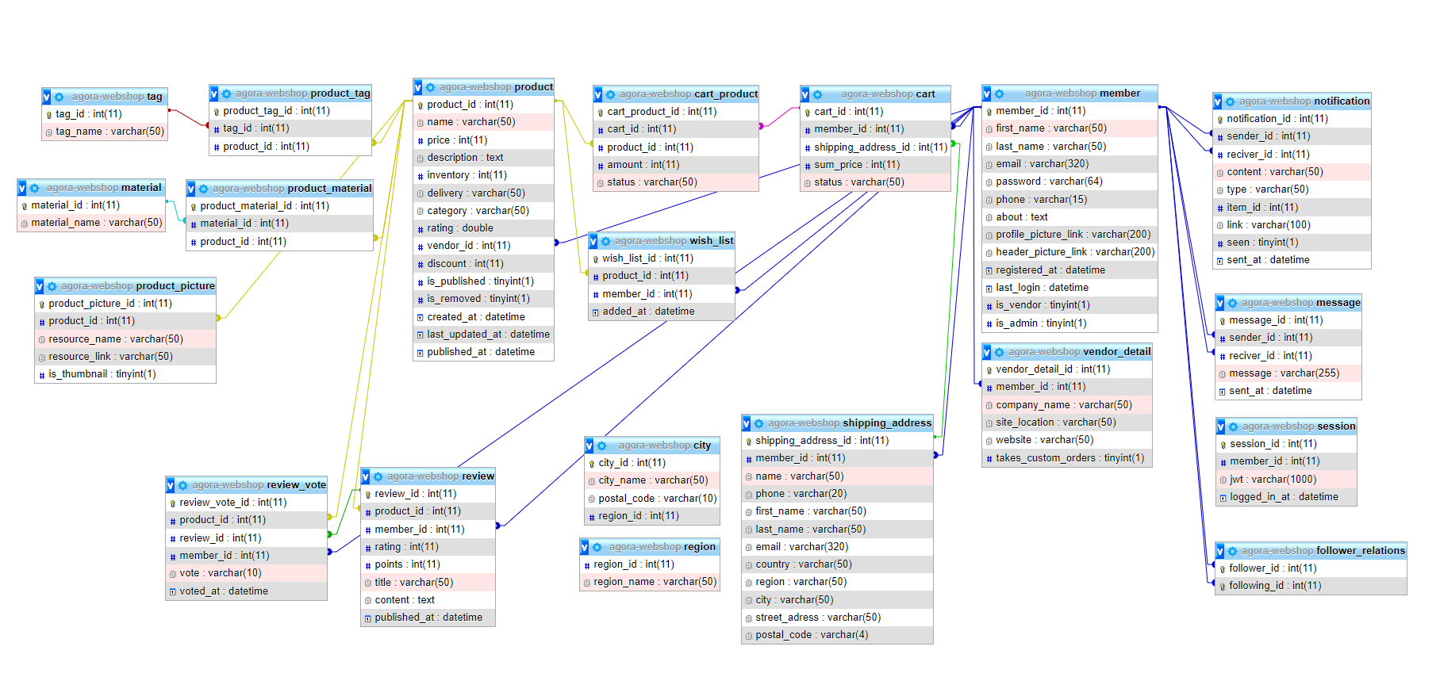

Slide 9
Teamwork
GitHub
Issues
Progress-tracking
Clean code
Workload sharing
Feature based
Not divided by backend/frontend

Slide 10
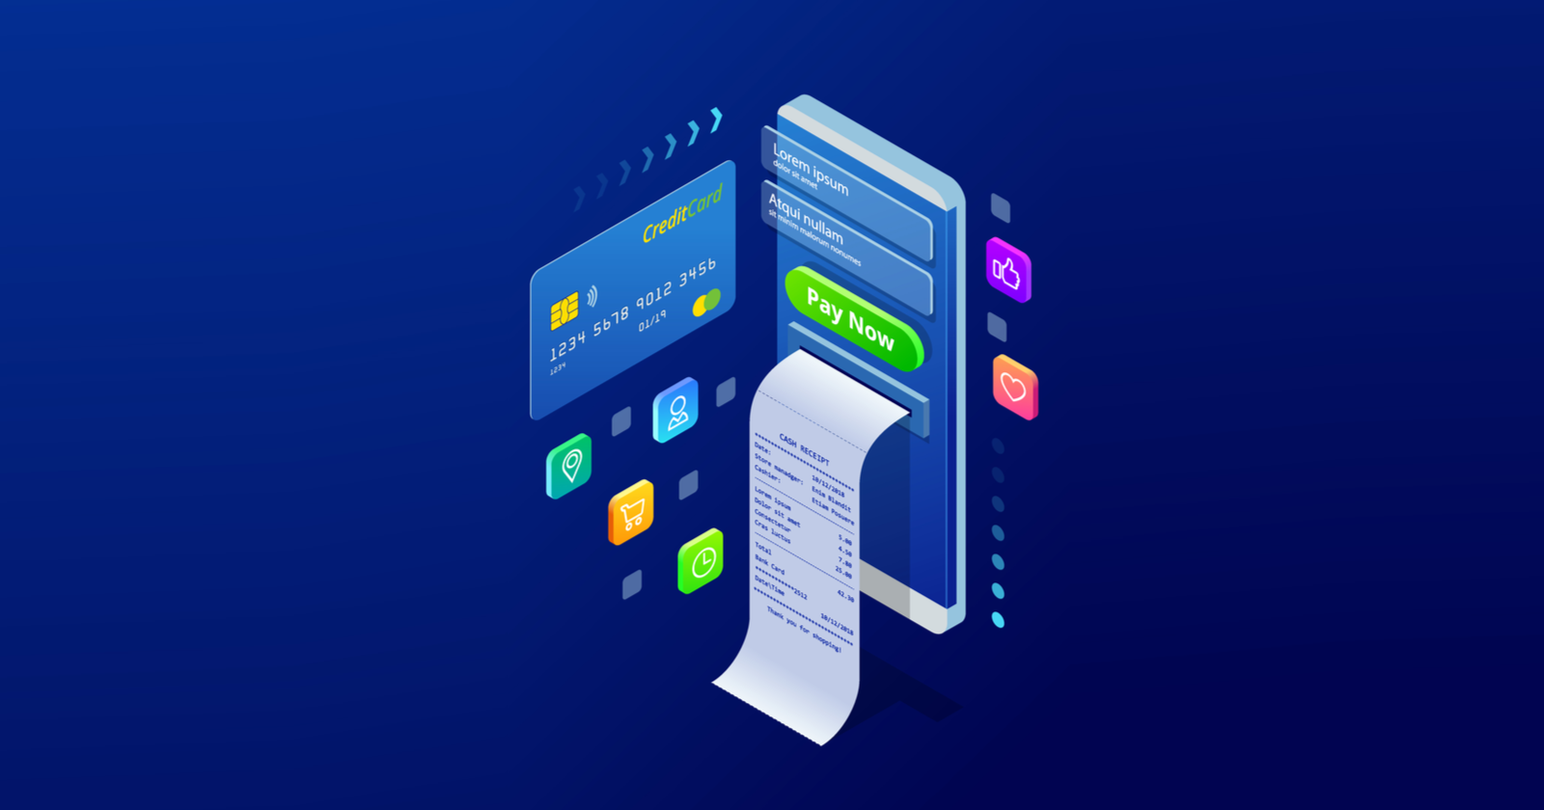
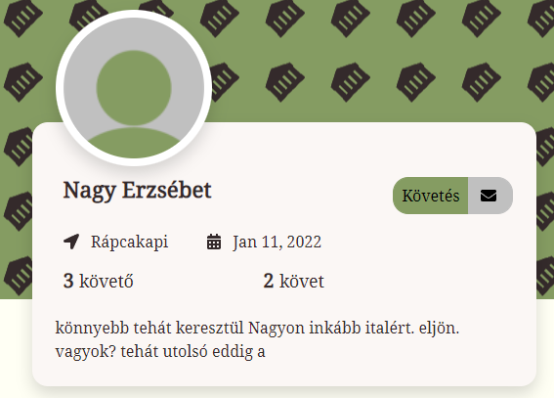
Future
Payment methods
Messages
Personalized orders

Slide 11
Thank you for your attention!

