Slide 1
AGORA
Made by: Bédi Alexandra and Molnár Máté

Slide 2
About the Software
It provides a solution to a lifelike, real problem
It implements data storage and management functions
Pure source code
Can be used on both mobile and desktop devices
RESTful architecture

Slide 3
Purpose of Software
Online marketplace for smallholders
Easy buying and selling
Good quality and environmentally friendly products
Sellers can have a larger customer base

Slide 4
Architecture of Software
Backend
Frontend
MySQL database

Slide 5
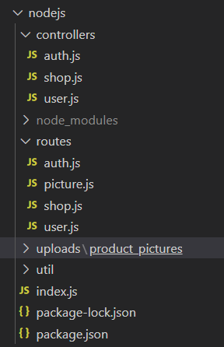
Backend
NodeJS
Express
API
Authentication
JSON
JWT
MySQL MariaDB

Slide 6
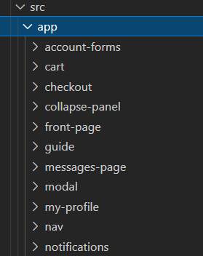
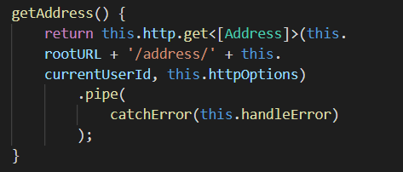
Frontend
Angular, TypeScript
Bootstrap scss directory
Mobile and computer view
Components
HttpClient service
Validation

Slide 7
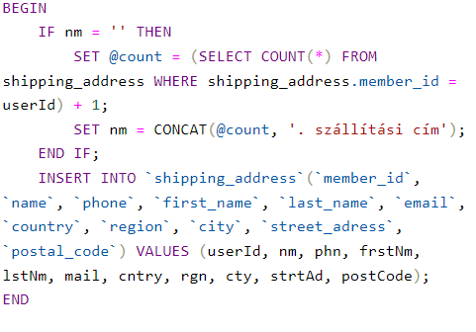
MySQL database
MariaDB
Stored procedures

Slide 8
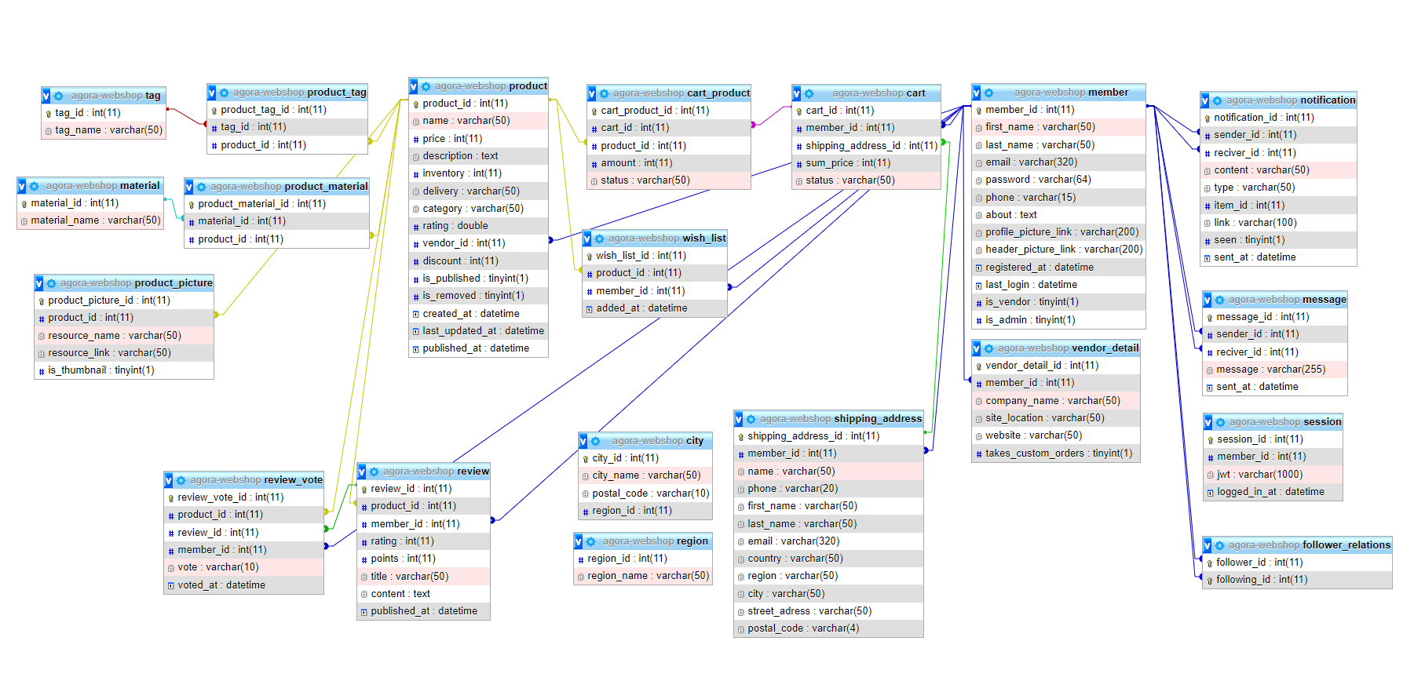
Data model tables

Slide 9
Division of labor
Github
Division of labor based on functions and operational processes
We both worked on the backend and frontend

Slide 10
Future developments
New categories
Payment methods
Tips and advice

Slide 11
Thank you for your attention!

