Slide 1



Győri SZC Jedlik Ányos Gépipari és Informatikai Technikum és Kollégium
Made by
Bédi Alexandra Molnár Máté

Slide 2
Purpose of Software
E-commerce made easy
For small independent businesses, artists
Quality and environmental consciousness
Growing customer base, community

Slide 3
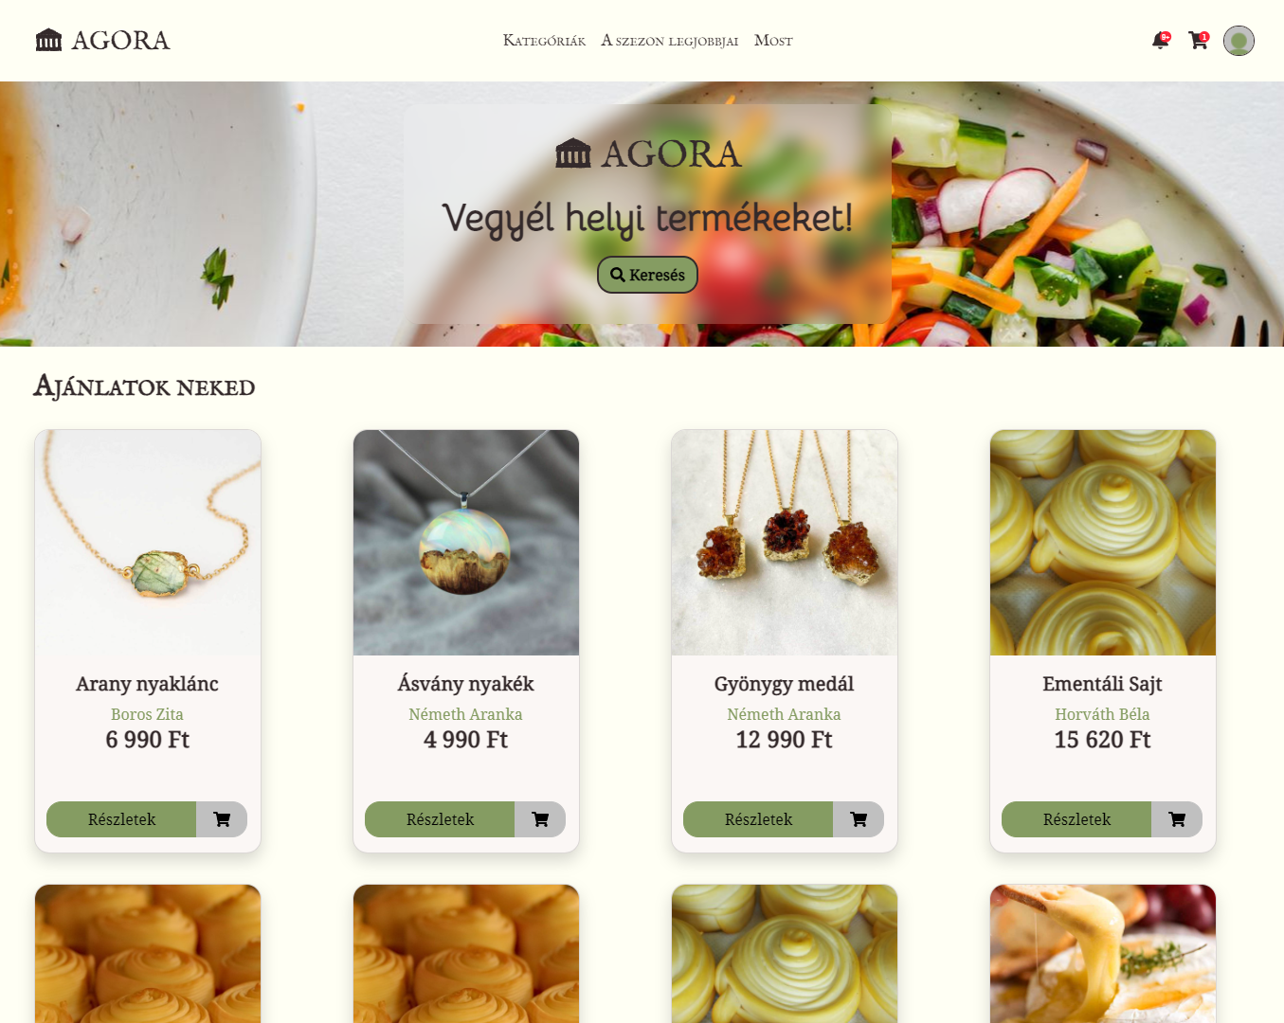
Features
Account management
Sell and buy
Review
Order tracking
Search
Wishlist

Slide 4



Components
Frontend
Backend
Database

Slide 5
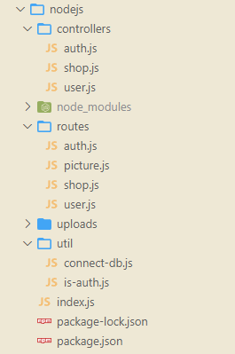
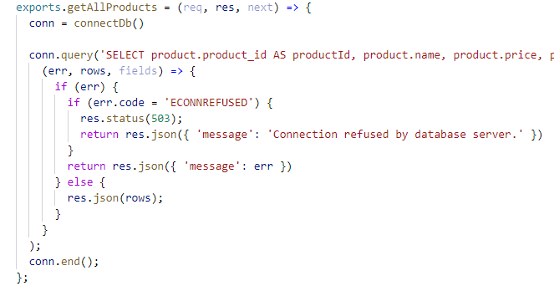
Backend
NodeJS
Express
Multer
Mysql
API (JSON)
Authentication
JWT

Slide 6
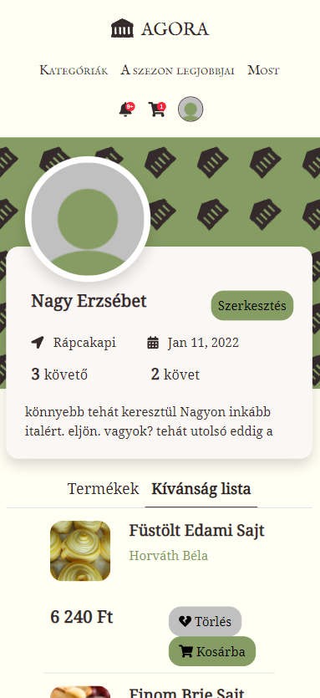
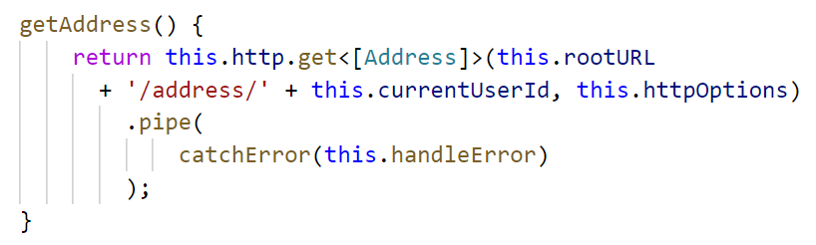
Frontend
Angular, TypeScript
Design
Responsive
Bootstrap SCSS directory
Font Awesome
Components
HttpClient service
Forms

Slide 7
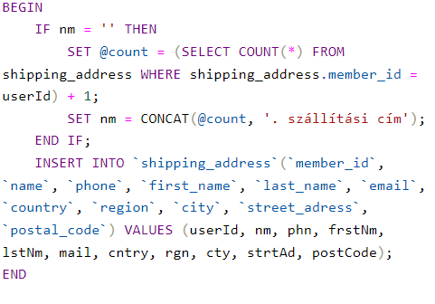
Database
MySQL (MariaDB)
Stored procedures

Slide 8
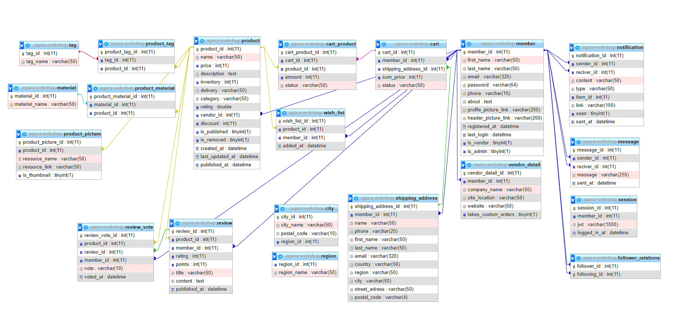

Slide 9


Teamwork
GitHub
Issues
Progress-tracking
Clean code
Workload sharing
Feature based
Not divided by backend/frontend

Slide 10


Future
Payment methods
Messages
Personalized orders

Slide 11
Thank you for your attention!

