Slide 1
ORIGIN MYTHS OF ARTIFICIAL INTELLIGENCE: HISTORIES OF TECHNOLOGY AND POWER Session 3: Common Histories: Probing AI's Interdisciplinary Roots
Andrew Hodges (Mathematical Institute, University of Oxford): “Alan Turing: Thinking and Doing”
Margaret Boden (University of Sussex): “AI and Other Disciplines: A Historical Sketch”
Andrew Pickering (University of Exeter): “The Cybernetic Brain: Psychiatry, Robotics and Future AI”
Pamela McCorduck (Machines Who Think): “Eye-Witness to 60 Years of Artificial Intelligence, from Fringe Science to Worldwide Existential Challenge”
Jon Agar (STS, UCL): “How to kill AI”

Slide 2
“Wishful mnemonics” (1976)

Slide 3
Trees as a data structure
Breadth First search
Depth First Search

Slide 4
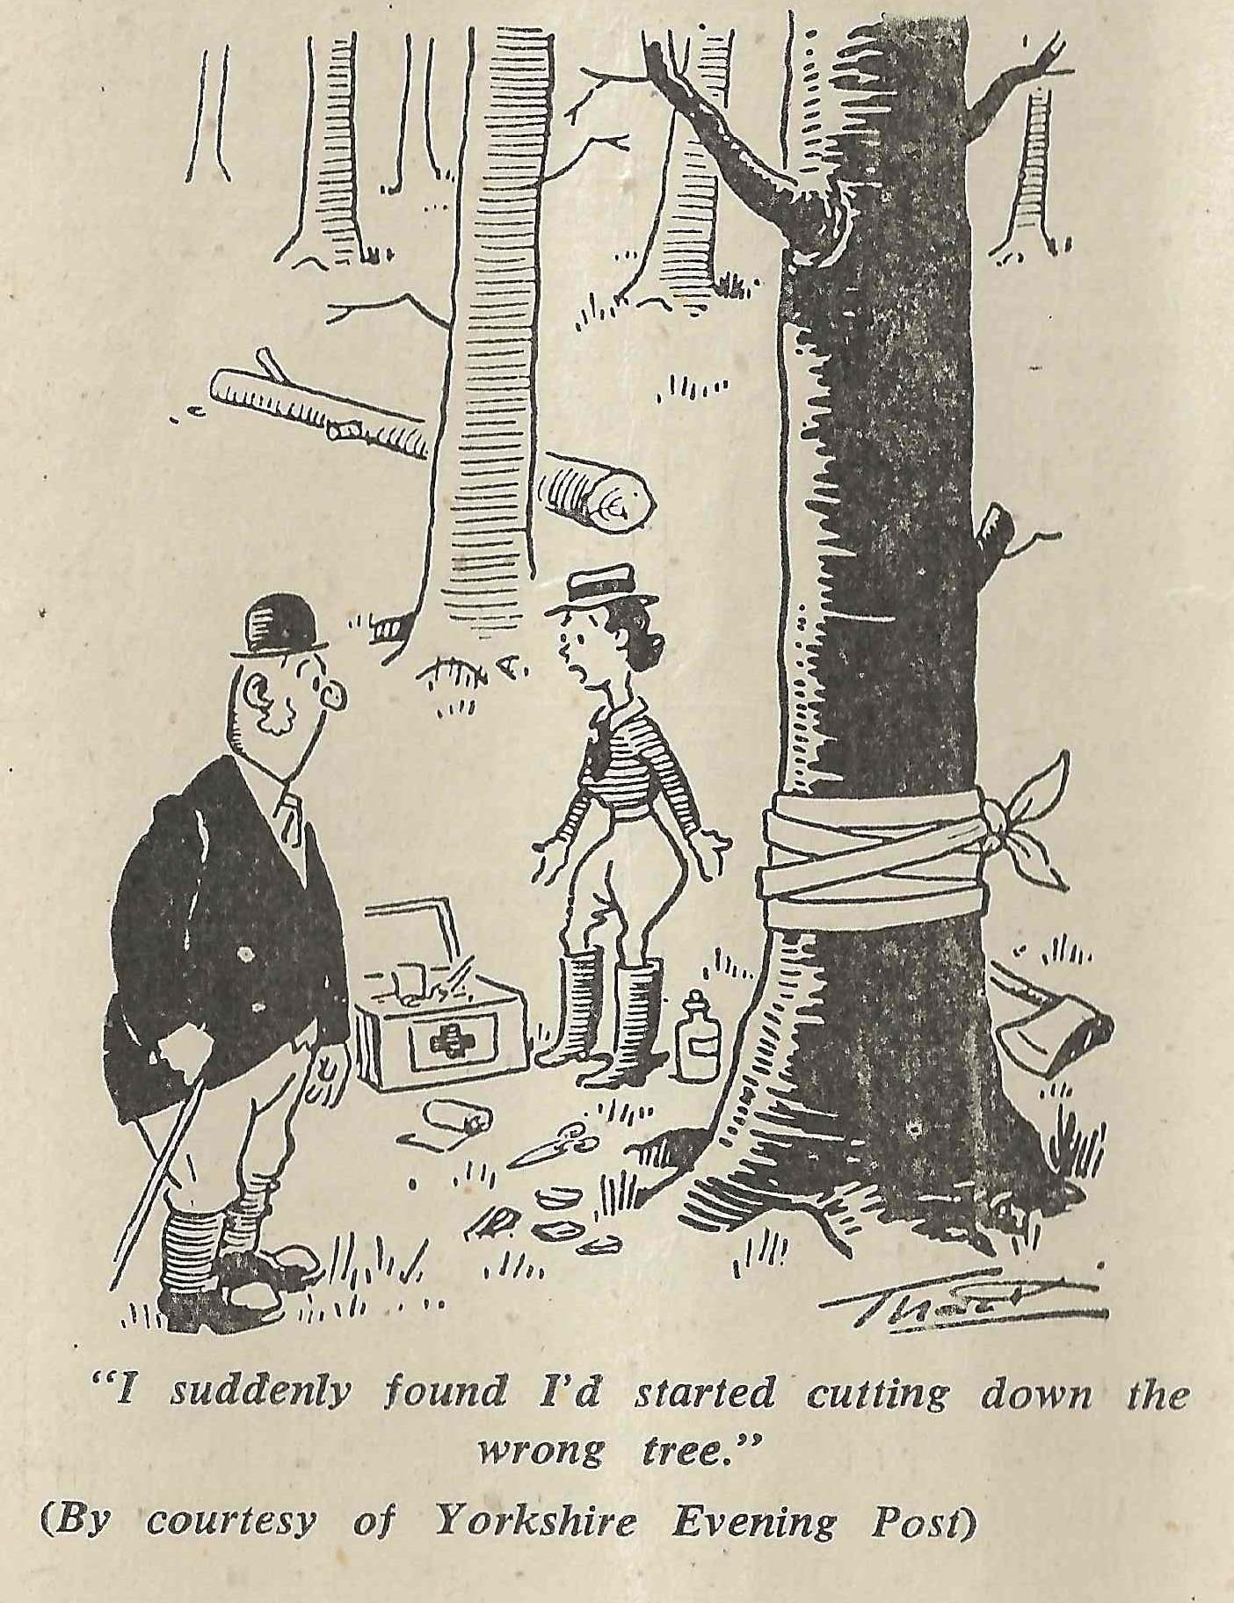

Slide 5
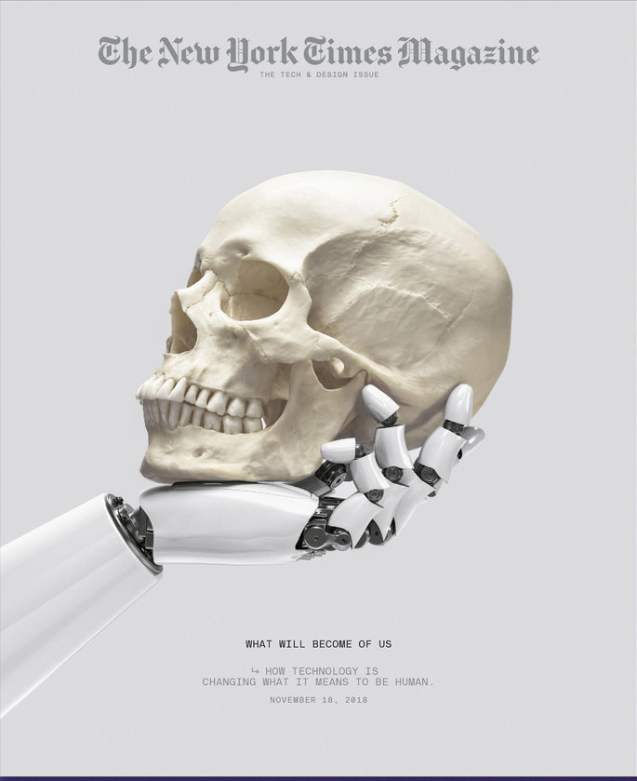
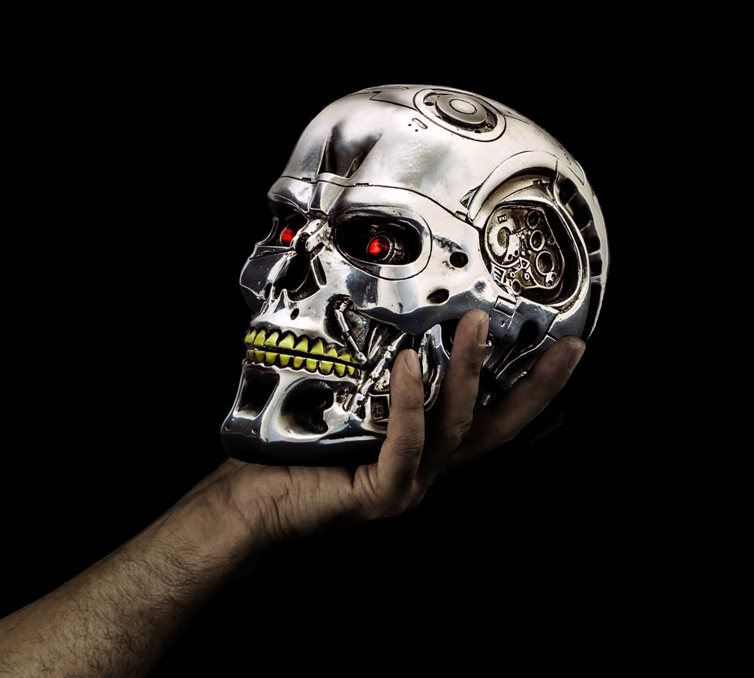
Sociotechnical imaginaries

