Slide 1
Ch#03 Un-Informed Searches
Artificial Intelligence Lab

Slide 2
BST or Binary Tree as CBT
R
G
m = maximum depth of tree maybe infinity
d = depth of the goal node

Slide 3
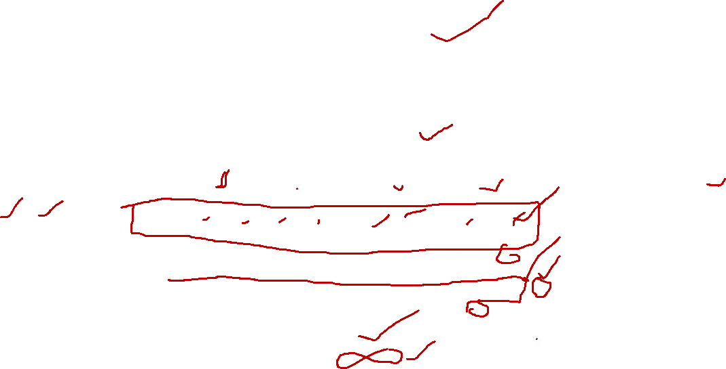
Breadth-First-Search
If branches are infinite => BFS is not complete!
Nodes on each level = 2^{n}
2⁰ = 1
R
2¹ = 2
Time = O (b^{d})
2² = 4
Space = O (b^{d})
2³ = 8 or 2^{d}
Bcz goal is on ‘d’
G
Complete = Yes
Optimal = Yes
2^{m} = ?
m = maximum depth of tree maybe infinity
d = depth of the goal node

Slide 4
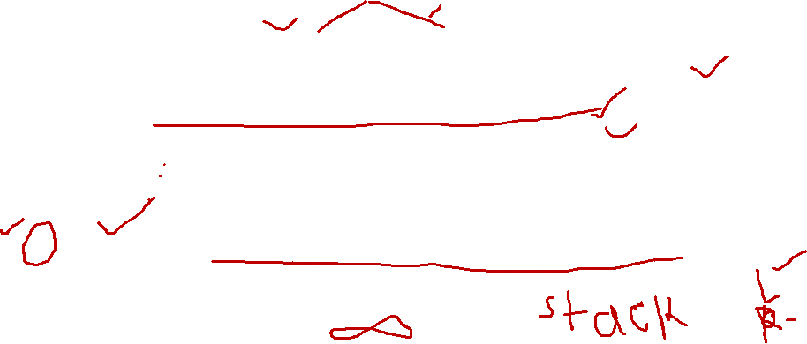
Depth-First-Search
If branches are infinite => BFS is not complete!
Nodes on each level = 2^{^n}
2⁰ = 1
R
2¹ = 2
Time = O (b^{m})
Space = O (bm)
2² = 4
2³ = 8
Complete = No
Optimal = No
G
Level m = b^{m}
m = maximum depth of tree maybe infinity
d = depth of the goal node

Slide 5
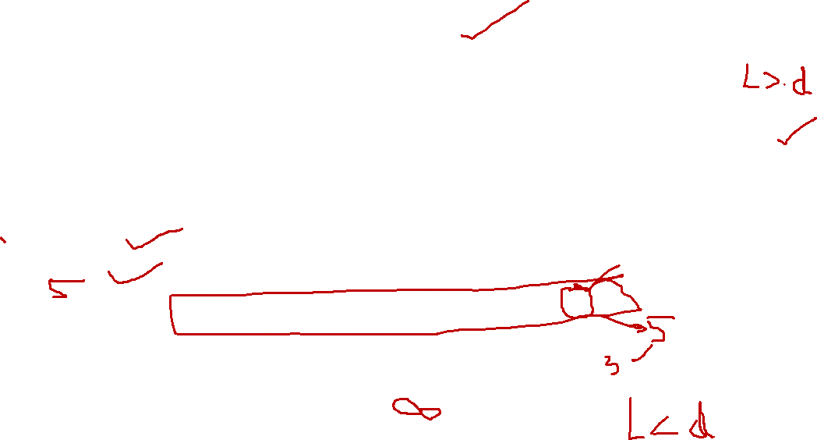
Depth-Limited-First-Search
if l = 3 => DLFS is incomplete!
Nodes on each level = 2^{^n}
2⁰ = 1
R
2¹ = 2
Time = O (b^{l})
Space = O (bl)
2² = 4
2³ = 8
Complete = No
Optimal = No
G
Level m = b^{m}
m = maximum depth of tree maybe infinity
d = depth of the goal node
l = limit

Slide 6
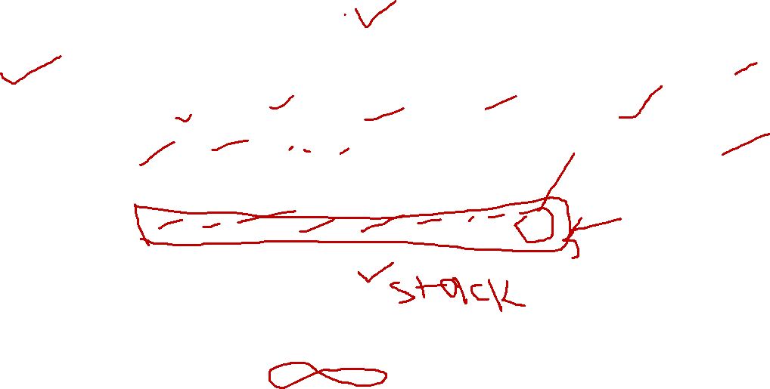
Iterative-Deepening-First-Search
IDFS expand nodes level-wise i.e. d=0,1,2,3…
2⁰ = 1
R
IDFS works same like BFS!
2¹ = 2
Time = O (b^{d})
Space = O (b^{d})
2² = 4
2³ = 8
Complete = Yes
Optimal = Yes
G
Level m = b^{m}
m = maximum depth of tree maybe infinity
d = depth of the goal node
l = limit

Slide 7
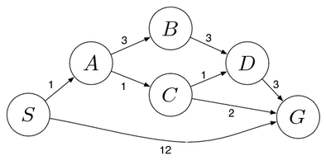
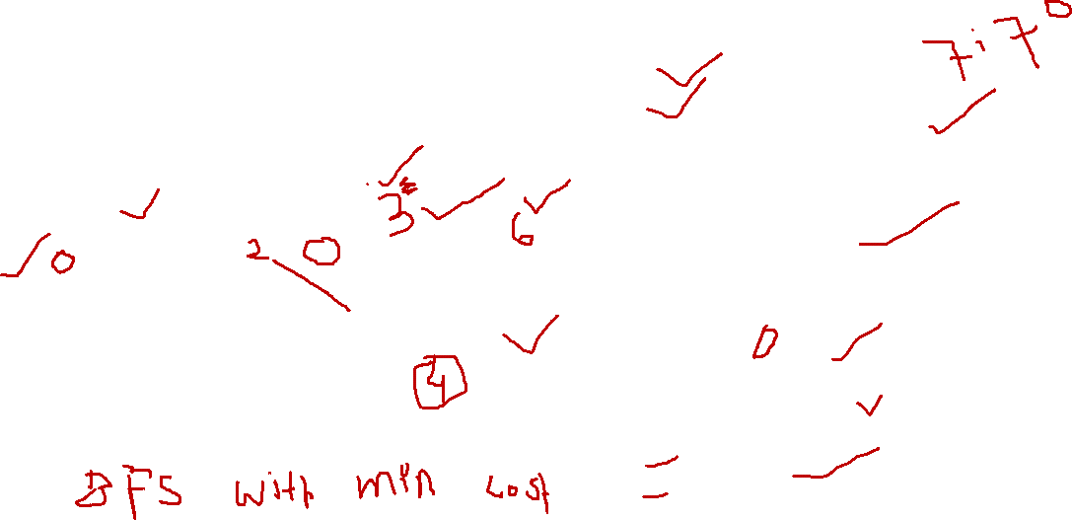
Uniform Cost Search
S = Start state
G = Goal state
Uniform Cost Search uses BFS and only selects the node with minimum path cost from S-->G!
Usually applied on Graphs!
Time = O (b^{C*/e})
OR = O (b^{d}) if all paths have equal cost!
Space = O (b^{C*/e}) O (b^{d})
Complete = Yes
Optimal = Yes

Slide 8
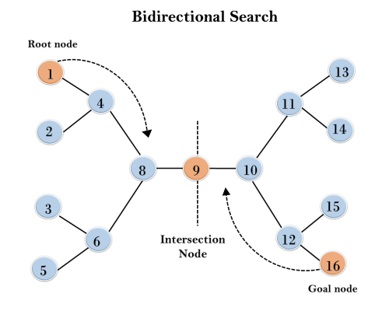
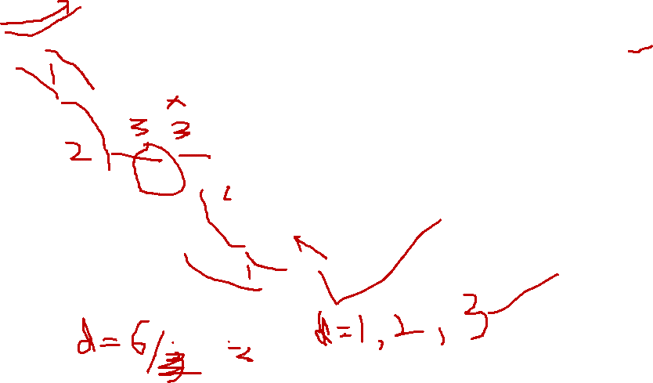
Bidirectional Search
Moves two steps simultaneously!
You have been given a Goal state.
Uses BFS on both sides!
Time = O (b^{d/2})
Space = O (b^{d/2})
Complete = Yes
Optimal = Yes

