Slide 1

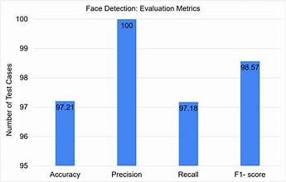
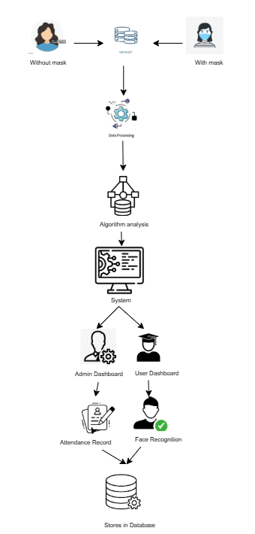
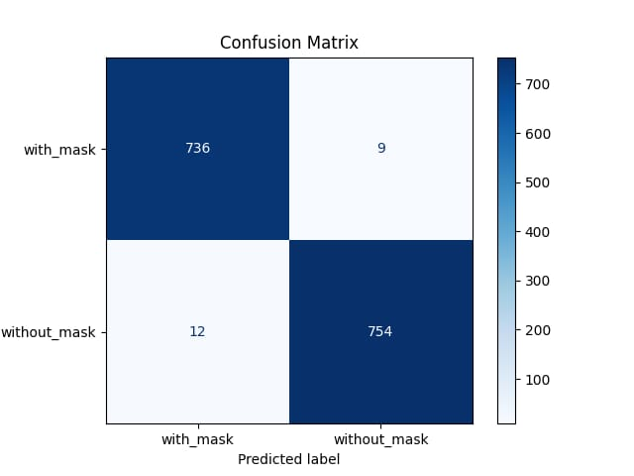
Face Recognition based Attendance Management System
Instructor: Sir Samyan Qayyum Wahla
University of Engineering and Technology, Lahore
Abstract
Dataset
Results and Analysis
This project presents an advanced Facial Recognition Attendance System designed to automate attendance management processes. Traditional methods, such as paper-based or biometric systems, are prone to inefficiencies and inaccuracies, under conditions like masks, glasses, or diverse facial orientations. Using OpenCV DNN for face detection with the ResNet-10SSD model and MobileNetV2-based CNN for mask detection, the system ensures high accuracy in diverse conditions. The backend is built with Flask and Tkinter, while the frontend uses HTML, CSS, and Bootstrap. Attendance data is securely stored in a MySQL database. This scalable, contactless solution is designed for educational and corporate settings, enhancing efficiency, reliability.
The dataset for this project is taken from Kaggle. Data set consists of 7553 RGB images in 2 folders as with_mask and without_mask. Images are named as label with_mask and without_mask. Images of faces with mask are 3725 and images of faces without mask are 3828.
The Face Recognition Attendance System demonstrates a significant improvement in attendance management by leveraging advanced facial recognition technology. It ensures high accuracy in identifying both bare and masked faces, reduces errors, and processes attendance swiftly compared to manual methods. The system eliminates issues like proxy attendance and manual recording errors, making it highly applicable in schools, universities, workplaces, and hygiene-sensitive environments. Its scalability and adaptability to post-pandemic requirements position it as a reliable, secure, and efficient solution for modern attendance tracking needs.
Algorithms and Technologies
OpenCV DNN, MobileNetV2-based CNN, ResNet-10SSD model, HTML, CSS, Bootstrap, Flask, Tkinter
Objectives
Proposed Methodology
This project leverages advanced AI and facial recognition technologies to automate attendance management, enhancing efficiency, accuracy, and reliability. The system replaces manual processes with real-time face detection, instantly identifying individuals and logging attendance seamlessly. Powered by deep learning algorithms, it ensures precise recognition under varying conditions, including mask usage and diverse lighting. A user-friendly interface facilitates effortless attendance tracking and access to detailed reports for administrators and users alike. With encrypted data storage and compliance with privacy regulations, the system ensures secure and responsible data management. This solution streamlines attendance processes, saving time and delivering a scalable, robust, and secure system for modern institutions.
Conclusions
The Face Recognition Attendance System offers a secure, efficient, and contactless solution for attendance management. By integrating OpenCV DNN, the face_recognition library, and MySQL, it enables accurate facial detection and authentication. Overcoming challenges such as lighting variations and masked faces, the system streamlines attendance tracking, showcasing scalability and reliability. Its seamless integration with biometric technology positions it as a future-ready solution for real-world applications.
Group Members
Hadia Moosa(2022-CS-119)
Momina Rashad(2022-CS-137)
Shahneela Iqbal(2022-CS-159)

