Slide 1
Face Recognition Based Attendance System
HADIA MOOSA (2022-CS-119)
MOMINA RASHAD (2022-CS-137)
SHAHNEELA IQBAL(2022-CS-159)

Slide 2
01
Introduction to Face Recognition
02
System Architecture
03
User Registration and Login
CONTENTS
04
Attendance Management
05
Challenges and Solutions
06
Future Directions

Slide 3
Introduction to Face Recognition
01

Slide 4
Overview of Face Recognition Technology
Definition of Face Recognition
Face recognition is a biometric technology that identifies or verifies a person by comparing and analyzing patterns based on the person's facial features. It utilizes computer vision and machine learning algorithms to map facial features and match them against a database.
Applications in Attendance Systems
In attendance systems, face recognition automates the process of tracking student attendance by allowing seamless identification during entry or classroom sessions. This leads to increased efficiency and accuracy, eliminating the need for manual roll calls.
Benefits of Using Face Recognition
The primary benefits include reduced time spent on attendance logging, enhanced accuracy as compared to manual methods, and increased security and accountability. It also allows for remote attendance management, making it versatile for various environments.

Slide 5
Importance of Attendance Systems
01
02
03
Traditional Attendance Methods
Limitations of Current Methods
Need for Automation
Traditional methods often involve manual roll calls, sign-in sheets, or biometric systems like fingerprint scanners. These methods can be time-consuming and prone to human error, leading to inaccuracies in attendance records.
Current methods can suffer from issues like buddy punching, where one student marks the attendance for another, as well as difficulties in tracking attendance in large groups. Manual processes also require significant administrative time and effort.
Automation in attendance systems reduces administrative burden, improves accuracy, and enhances student engagement by providing instant feedback on attendance status. This is increasingly crucial in today's digital learning environments.

Slide 6
System Architecture
02

Slide 7
Components of the System
03
Admin Role
02
Student Role
The admin plays a crucial role in managing the attendance system, overseeing student registrations, monitoring attendance records, and ensuring the overall integrity of the data within the system.
Students interact with the system primarily through the user dashboard where they can mark their attendance efficiently. Their registered facial data is crucial for the system to recognize and validate their identity.
01
Dashboard Features
The dashboard features user-friendly options for students to easily mark attendance and for admins to manage student data, view attendance reports, and handle operations like updates or deletions.

Slide 8
Technology Stack
01
02
03
Face Detection Model (Face Net)
Mask Detection Model (Mask Net)
MobileNetV2 Architecture
Face Net is a deep learning model designed for high accuracy in facial recognition. It uses convolutional neural networks to convert face images into a 128-dimensional embedding that can be efficiently compared for identification.
Mask Net is specifically trained to differentiate between faces with and without masks. It ensures compliance with health protocols by accurately recognizing masked faces, particularly vital in public health contexts.
MobileNetV2 is an architecture that emphasizes lightweight computation and speed, making it ideal for real-time facial recognition applications. Its efficiency is critical for mobile and embedded applications in attendance systems.

Slide 9
User Registration and Login
03

Slide 10
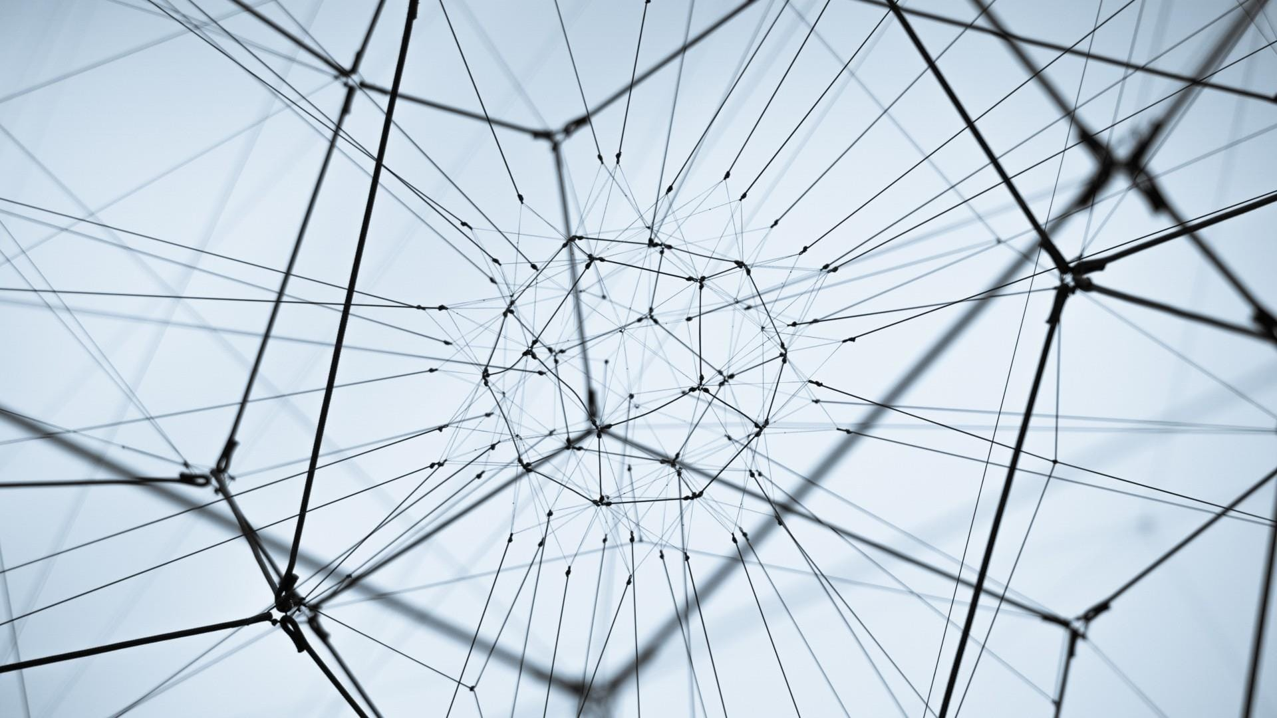

Admin Signup Process
Step-by-Step Signup
Role of the Admin
The admin signup process includes filling out a registration form with necessary credentials, followed by email verification. Once registered, the admin can log in to manage the system effectively.
The admin is responsible for system configuration, user management, and data oversight. They ensure that the system operates correctly and securely, maintaining the integrity of attendance records.

Slide 11
Student Registration
Conditions for Capture Validity
Images will only be considered valid if the student's face is clearly visible without obstructions, and for masked captures, the mask must be properly fitted over the nose and mouth. This ensures reliable data for the model.
Phase Two: Capturing Masked Face
Phase One: Capturing Bare Face
The second phase involves capturing the student's face with a mask. The system issues a prompt to ensure that students are wearing the mask correctly, capturing only valid images for attendance processing.
In the first phase, the admin captures the student's bare face image, ensuring the face is free from obstructions. This initial capture is crucial for subsequent identification and verification during attendance marking.

Slide 12
Attendance Management
04

Slide 13

User Dashboard Features
Marking Attendance
Viewing Attendance Records
Students can mark their attendance directly through the dashboard with a simple interface. The system uses facial recognition to validate their presence and logs their attendance automatically.
Users can view their attendance history on the dashboard, allowing them to track their attendance over time, which promotes accountability and engagement in their educational activities.

Slide 14
Admin Features
View Students List
Update and Delete Students
Download Attendance in CSV
Admins can access a comprehensive list of registered students, which includes their attendance status and capture timestamps, enabling effective monitoring and management of attendance data.
The system allows admins to update student information as necessary and to delete profiles for students who are no longer part of the institution, ensuring that the database remains current and accurate.
Attendance records can be easily exported in CSV format, allowing for offline analysis and reporting. This feature facilitates data sharing with other departments or for administrative review processes.

Slide 15
Challenges and Solutions
05

Slide 16
Challenges in Face and Mask Detection
Detection with Glasses
Detection at Angles (e.g., 45 degrees)
Detecting faces that are obscured by glasses can pose challenges due to reflections and distortions. This necessitates robust training data and algorithms capable of recognizing and accommodating various eyewear.
Identifying faces at angles, such as 45 degrees, can hinder recognition accuracy. The system must incorporate techniques to handle various orientations to ensure that attendance is recorded reliably.

Slide 17


Potential Solutions
Model Training Techniques
Enhancements in Data Collection
01
02
Implementing data augmentation and retraining the models with diverse datasets can improve detection accuracy. This can include simulating different facial expressions and accessories like glasses or masks.
Enhancing data collection methods, such as using controlled lighting conditions and diverse backgrounds, can also help improve facial recognition reliability and reduce false positives during attendance marking.

Slide 18
Future Directions
06

Slide 19


Improvements in Technology
Advanced Algorithm Development
Integration with Other Systems
Future developments may focus on creating more advanced algorithms that improve detection speed and accuracy, possibly utilizing artificial intelligence methods beyond current machine learning approaches.
There is potential for integrating the attendance system with other educational software and platforms, enhancing its utility and creating a comprehensive ecosystem for student management and engagement.

Slide 20
Expanding Applications
Implementation in Different Environments
Future Scope and Research Areas
The attendance system can find applications in varied contexts, such as corporate settings and public events, where attendance tracking is essential for operational efficiency.
Future research could explore areas such as emotion recognition in conjunction with attendance systems, as well as improvements in privacy measures and ethical considerations surrounding biometric data usage.

Slide 21
Thank you

