Slide 1
Name: Bilqees Momin
Role: Data Analyst Intern
Tool Used: Power BI
Dataset Used: Superstore Sales Dataset (Kaggle)Project Type: Sales & Profit Analysis Dashboard Date: 17/11/25

Slide 2
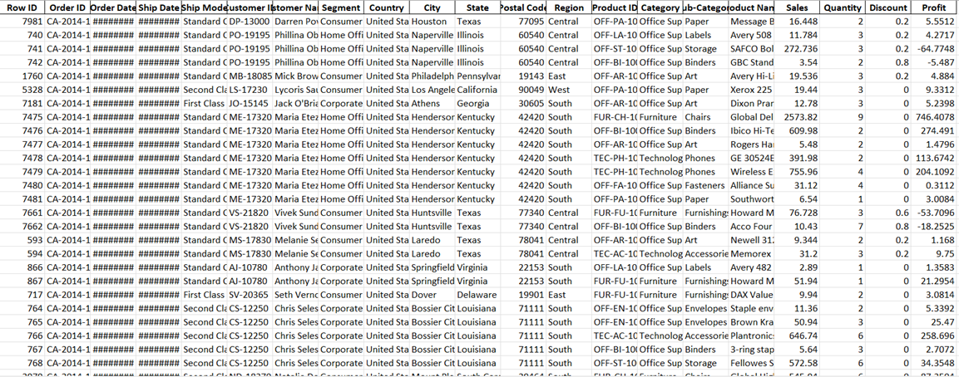

Slide 3
Slide 1 — Dashboard Project
Overview Title: Sales & Profit Analysis Dashboard Tool Used: Power BIDataset: Superstore Sales Dataset Objective:To design an interactive dashboard for business stakeholders showing key business insights using sales, profit, orders, and product performance.

Slide 4
Slide 2 — Dashboard KPIs
This dashboard highlights the following
KPIs:Total Sales: 887.92K
Total Profit: 108.80KTotal
Quantity Sold: 15K
Total Orders: 4042
These KPIs help understand overall business performance.

Slide 5
Slide 3 — Visuals Included
The dashboard contains the following visuals: Line Chart-Sum of Sales by Year and Month Shows sales trends over time. Map Visual Sum of Profit by Region Shows profit distribution across different geographic regions. Bar Chart-Sum of Sales by Product Name Highlights top-selling products. Donut Chart Sum of Sales by Ship Mode Shows contribution of different shipping modes (Standard, Second Class, First Class, Same Day).

Slide 6
Slide 4 — Filters (Slicers)
Used The dashboard is fully interactive using slicers:Category: Furniture, Office Supplies, TechnologyRegion: Central, East, South, West Segment: Consumer, Corporate, Home Office These slicers help stakeholders explore data easily.

Slide 7
Slide 5 — Key Insights From the dashboard:
Sales and profit increased significantly during 2016–2017.The highest profit is generated by the Central & East regions.The top-selling products include.Standard Class shipping contributes the highest sales share (57.5%).

Slide 8
Slide 6 — Conclusion
The dashboard provides clear insights into:Sales trendsRegional performanceProduct profitabilityShipping mode contributionThese insights help management make informed business decisions regarding marketing, inventory planning, and customer segments.

Slide 9
