Slide 1
Chapter 14
Software Testing Techniques
Slide Set to accompany Software Engineering: A Practitioner’s Approach, 6/e
by Roger S. Pressman
Slides copyright © 1996, 2001, 2005 by Roger S. Pressman
For non-profit educational use only
May be reproduced ONLY for student use at the university level when used in conjunction with Software Engineering: A Practitioner's Approach, 6/e. Any other reproduction or use is prohibited without the express written permission of the author.
All copyright information MUST appear if these slides are posted on a website for student use.

Slide 2
Basic Terminology
Testing:
Verification:
Validation:
Debugging:

Slide 3
Testing Definitions
Module/Unit Test:
Integration Test :
Function Test :
System Test :
Acceptance Test:
Installation Test:

Slide 4
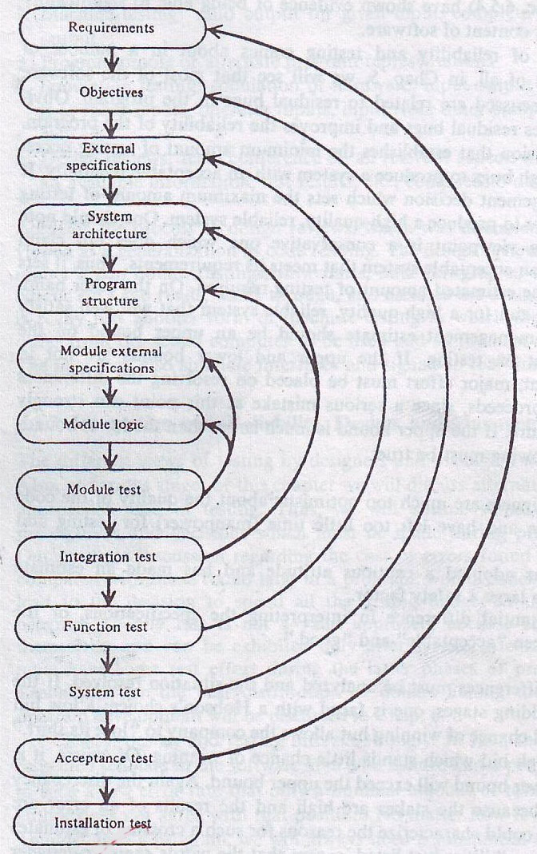
Relationships of Testing Processes with Design Processes

Slide 5
Testability
Operability—it operates cleanly
Observability—the results of each test case are readily observed
Controllability—the degree to which testing can be automated and optimized
Decomposability—testing can be targeted
Simplicity—reduce complex architecture and logic to simplify tests
Stability—few changes are requested during testing
Understandability—of the design

Slide 6
What is a “Good” Test?
A good test has a high probability of finding an error
A good test is not redundant.
A good test should be “best of breed”
A good test should be neither too simple nor too complex

Slide 7
Internal and External Views
Any engineered product (and most other things) can be tested in one of two ways:
Knowing the specified function that a product has been designed to perform, tests can be conducted that demonstrate each function is fully operational while at the same time searching for errors in each function;
Knowing the internal workings of a product, tests can be conducted to ensure that "all gears mesh," that is, internal operations are performed according to specifications and all internal components have been adequately exercised.

Slide 8
Test Case Design
"Bugs lurk in corners
and congregate at
boundaries ..."
Boris Beizer
OBJECTIVE
to uncover errors
CRITERIA
in a complete manner
CONSTRAINT
with a minimum of effort and time

Slide 9
Exhaustive Testing
loop < 20 X
14
There are 10 possible paths! If we execute one
test per millisecond, it would take 3,170 years to
test this program!!

Slide 10
Selective Testing
Selected path
loop < 20 X

Slide 11
Software Testing
white-box
methods
black-box
methods
Methods
Strategies

Slide 12
Testing Strategy
unit test
integration
test
system
test
validation
test

Slide 13
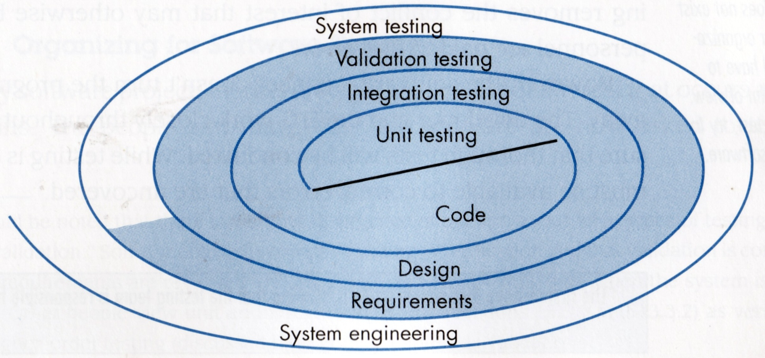
Testing Strategy

Slide 14
White-box Testing
Uses the control structure part of component-level design to derive the test cases
These test cases
Guarantee that all independent paths within a module have been exercised at least once
Exercise all logical decisions on their true and false sides
Execute all loops at their boundaries and within their operational bounds
Exercise internal data structures to ensure their validity
“Bugs lurk in corners and congregate at boundaries”

Slide 15
White-Box Testing
... our goal is to ensure that all
statements and conditions have
been executed at least once ...

Slide 16
Why Cover?
logic errors and incorrect assumptions
are inversely proportional to a path's
execution probability
we often
believe
that a path is not
likely to be executed; in fact, reality is
often counter intuitive
typographical errors are random; it's
likely that untested paths will contain
some

Slide 17
BPT: Flow Graph Notation
A circle in a graph represents a node, which stands for a sequence of one or more procedural statements
A node containing a simple conditional expression is referred to as a predicate node
Each compound condition in a conditional expression containing one or more Boolean operators (e.g., and, or) is represented by a separate predicate node
A predicate node has two edges leading out from it (True and False)
An edge, or a link, is a an arrow representing flow of control in a specific direction
An edge must start and terminate at a node
An edge does not intersect or cross over another edge
Areas bounded by a set of edges and nodes are called regions
When counting regions, include the area outside the graph as a region, too

Slide 18
BPT: Flow Graph Example
FLOW CHART
FLOW GRAPH
0
0
1
1
R4
2
2
3
R3
3
6
4
6
4
R2
7
8
5
R1
7
8
5
9
9
11
10
11
10

Slide 19
Basis Path Testing
First, we compute the cyclomatic
complexity:
number of simple decisions + 1
or
number of enclosed areas + 1
or
The number of regions
or
V(G) = E – N + 2
In this case, V(G) = 4

Slide 20
Cyclomatic Complexity
A number of industry studies have indicated
that the higher V(G), the higher the probability
or errors.
modules
V(G)
modules in this range are
more error prone

Slide 21
Basis Path Testing
1
Next, we derive the
independent paths:
2
Since V(G) = 4,
there are four paths
3
Path 1: 1,2,3,6,7,8
4
Path 2: 1,2,3,5,7,8
5
6
Path 3: 1,2,4,7,8
Path 4: 1,2,4,7,2,4,...7,8
Finally, we derive test
7
cases to exercise these
paths.
8

Slide 22
A Second Flow Graph Example
3
1 int functionY(void)
2 {
3 int x = 0;
4 int y = 19;
5 A: x++;
6 if (x > 999)
7 goto D;
8 if (x % 11 == 0)
9 goto B;
10 else goto A;
11 B: if (x % y == 0)
12 goto C;
13 else goto A;
14 C: printf("%d\n", x);
15 goto A;
16 D: printf("End of list\n");
17 return 0;
18 }
4
5
6
8
7
10
9
16
11
17
13
12
14
15

Slide 23
A Sample Function to Diagram and Analyze
1 int functionZ(int y)
2 {
3 int x = 0;
4 while (x <= (y * y))
5 {
6 if ((x % 11 == 0) &&
7 (x % y == 0))
8 {
9 printf(“%d”, x);
10 x++;
11 } // End if
12 else if ((x % 7 == 0) ||
13 (x % y == 1))
14 {
15 printf(“%d”, y);
16 x = x + 2;
} // End else
18 printf(“\n”);
19 } // End while
20 printf("End of list\n");
21 return 0;
22 } // End functionZ

Slide 24
A Sample Function to Diagram and Analyze
1 int functionZ(int y)
2 {
3 int x = 0;
4 while (x <= (y * y))
5 {
6 if ((x % 11 == 0) &&
7 (x % y == 0))
8 {
9 printf(“%d”, x);
10 x++;
11 } // End if
12 else if ((x % 7 == 0) ||
13 (x % y == 1))
14 {
15 printf(“%d”, y);
16 x = x + 2;
} // End else
18 printf(“\n”);
19 } // End while
20 printf("End of list\n");
21 return 0;
22 } // End functionZ
3
4
6
7
9
12
13
10
15
16
18
20
21

Slide 25
Basis Path Testing Notes
you don't need a flow chart,
but the picture will help when
you trace program paths
count each simple logical test,
compound tests count as 2 or
more
basis path testing should be
applied to critical modules

Slide 26
Deriving Test Cases
Summarizing:
Using the design or code as a foundation, draw a corresponding flow graph.
Determine the cyclomatic complexity of the resultant flow graph.
Determine a basis set of linearly independent paths.
Prepare test cases that will force execution of each path in the basis set.

Slide 27
Graph Matrices
A graph matrix is a square matrix whose size (i.e., number of rows and columns) is equal to the number of nodes on a flow graph
Each row and column corresponds to an identified node, and matrix entries correspond to connections (an edge) between nodes.
By adding a link weight to each matrix entry, the graph matrix can become a powerful tool for evaluating program control structure during testing

Slide 28
Control Structure Testing
Condition testing — a test case design method that exercises the logical conditions contained in a program module
Data flow testing — selects test paths of a program according to the locations of definitions and uses of variables in the program

Slide 29
Loop Testing
Simple
loop
Nested
Loops
Concatenated
Loops
Unstructured
Loops

Slide 30
Loop Testing: Simple Loops
Minimum conditions—Simple Loops
1. skip the loop entirely
2. only one pass through the loop
3. two passes through the loop
4. m passes through the loop m < n
5. (n-1), n, and (n+1) passes through
the loop
where n is the maximum number
of allowable passes

Slide 31
Loop Testing: Nested Loops
Nested Loops
Start at the innermost loop. Set all outer loops to their
minimum iteration parameter values.
Test the min+1, typical, max-1 and max for the
innermost loop, while holding the outer loops at their
minimum values.
Move out one loop and set it up as in step 2, holding all
other loops at typical values. Continue this step until
the outermost loop has been tested.
Concatenated Loops
If the loops are independent of one another
then treat each as a simple loop
else* treat as nested loops
endif*
for example, the final loop counter value of loop 1 is
used to initialize loop 2.

Slide 32
Black-Box Testing
requirements
output
input
events

Slide 33
Black-box Testing Categories
Incorrect or missing functions
Interface errors
Errors in data structures or external data base access
Behavior or performance errors
Initialization and termination errors

Slide 34
Black-Box Testing
How is functional validity tested?
How is system behavior and performance tested?
What classes of input will make good test cases?
Is the system particularly sensitive to certain input values?
How are the boundaries of a data class isolated?
What data rates and data volume can the system tolerate?
What effect will specific combinations of data have on system operation?

Slide 35
Graph-Based Methods
To understand the objects that are modeled in software and the relationships that connect these objects
In this context, we consider the term “objects” in the broadest possible context. It encompasses data objects, traditional components (modules), and object-oriented elements of computer software.

Slide 36
Equivalence Partitioning
A black-box testing method that divides the input domain of a program into classes of data from which test cases are derived
An ideal test case single-handedly uncovers a complete class of errors, thereby reducing the total number of test cases that must be developed
Test case design is based on an evaluation of equivalence classes for an input condition
An equivalence class represents a set of valid or invalid states for input conditions
From each equivalence class, test cases are selected so that the largest number of attributes of an equivalence class are exercise at once

Slide 37
Equivalence Partitioning
user
queries
output
formats
FK
input
mouse
picks
data
prompts

Slide 38
Sample Equivalence Classes
Valid data
user supplied commands
responses to system prompts
file names
computational data
physical parameters
bounding values
initiation values
output data formatting
responses to error messages
graphical data (e.g., mouse picks)
Invalid data
data outside bounds of the program
physically impossible data
proper value supplied in wrong place

Slide 39
Guidelines for Defining Equivalence Classes
If an input condition specifies a range, one valid and two invalid equivalence classes are defined
Input range: 1 – 10 Eq classes: {1..10}, {x < 1}, {x > 10}
If an input condition requires a specific value, one valid and two invalid equivalence classes are defined
Input value: 250 Eq classes: {250}, {x < 250}, {x > 250}
If an input condition specifies a member of a set, one valid and one invalid equivalence class are defined
Input set: {-2.5, 7.3, 8.4} Eq classes: {-2.5, 7.3, 8.4}, {any other x}
If an input condition is a Boolean value, one valid and one invalid class are define
Input: {true condition} Eq classes: {true condition}, {false condition}

Slide 40
Boundary Value Analysis
A greater number of errors occur at the boundaries of the input domain rather than in the "center"
Boundary value analysis is a test case design method that complements equivalence partitioning
It selects test cases at the edges of a class
It derives test cases from both the input domain and output domain

Slide 41
Boundary Value Analysis
user
queries
output
formats
FK
input
mouse
picks
data
prompts
input domain
output
domain

Slide 42
Guidelines for Boundary Value Analysis
1. If an input condition specifies a range bounded by values a and b, test cases should be designed with values a and b as well as values just above and just below a and b
2. If an input condition specifies a number of values, test case should be developed that exercise the minimum and maximum numbers. Values just above and just below the minimum and maximum are also tested
3. Apply guidelines 1 and 2 to output conditions; produce output that reflects the minimum and the maximum values expected; also test the values just below and just above
4. If internal program data structures have prescribed boundaries (e.g., an array), design a test case to exercise the data structure at its minimum and maximum boundaries

Slide 43
Orthogonal Array Testing
Used when the number of input parameters is small and the values that each of the parameters may take are clearly bounded

Slide 44
Debugging
Once the error has been discovered, begin an investigation to localize the error,
i.e., to find out which module or interface is causing it.
Then, this section of code is studied to determine the cause of the problem.
This process is called debugging.
It generally involves further specialized testing and code reading to pinpoint the source of the error.

Slide 45
Debugging Strategies
Trial and Error
Backtracking
Forward Tracking

Slide 46
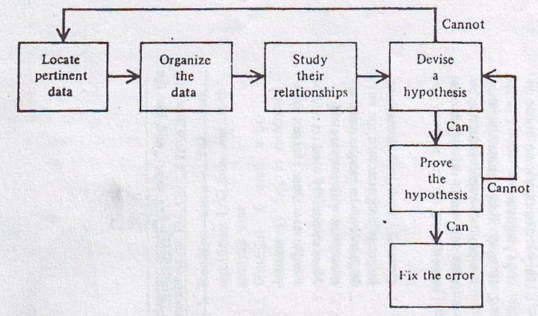
The Inductive Debugging Process
The inductive approach comes from the formulation of a single working hypothesis based on:
the data,
the analysis of existing data,
and on specially collected data to prove or disprove the working hypothesis.

Slide 47
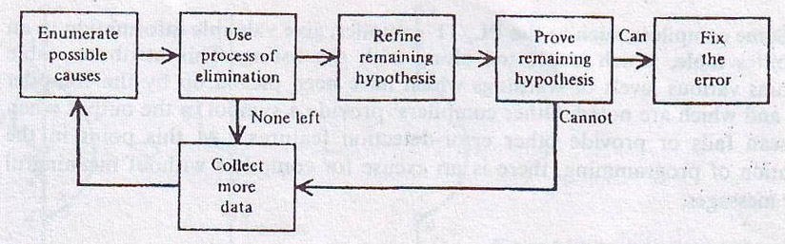
The Deductive Debugging Process
The process of deduction begins by enumerating all causes or hypotheses which seem possible.
Then, one by one, particular causes are ruled out until a single one remains for validation.

