Slide 1
WELCOME to our presentation

Slide 2
PRESENTED BY,
1. Robiul Alam
ID:16172103061
2. Rasel Hossain
ID:16172103107
3. Imran hossain
ID:16172103103
4. Fateha israt
ID:16172103066

Slide 3
Cricket Scoreboard Management System
Supervised By,
SHAMIM AHMED
ASSISTANT PROFESSOR
DEPT. OF CSE
BUBT

Slide 4
OVERVIEW
INTRODUCTION
MOTIVATION
Objective
Features
System requirement
Desing and implementation
ER-D and discussion
Conclusion
Reference

Slide 5
Introduction
Display score
Live score of cricket match
know all information of a match

Slide 6
Motivation
To keep up entire data of a match
To Know all information of a match
Enjoy Live socre update ball-by-ball

Slide 7
objective
Store players,match and vanue details
Display score when match going
The score are constantly updated

Slide 8
How does this project work…?

Slide 9
Features of this project
Show live score
Display total run,over and wicket of a match
Show batsman run in ball by ball
Display single bowler’s over and wicket
After fall of wicket,new batsman in the ground
Display final score of a team

Slide 10
System requirment
Software requirment
Hardware requirment
Windows or Linux Operating System.
Codeblocks.
Turbo C++.
Processor: Pentium(R) Dual-core CPU to core i-3 Processor
Minimum 2 GB RAM
256 MB or more hard disk

Slide 11
Implementation
void getAllPlayersName(void);
void select_batsman(void);
void select_baller(void);
void clrscr(void);
void playCricket(void);

Slide 12
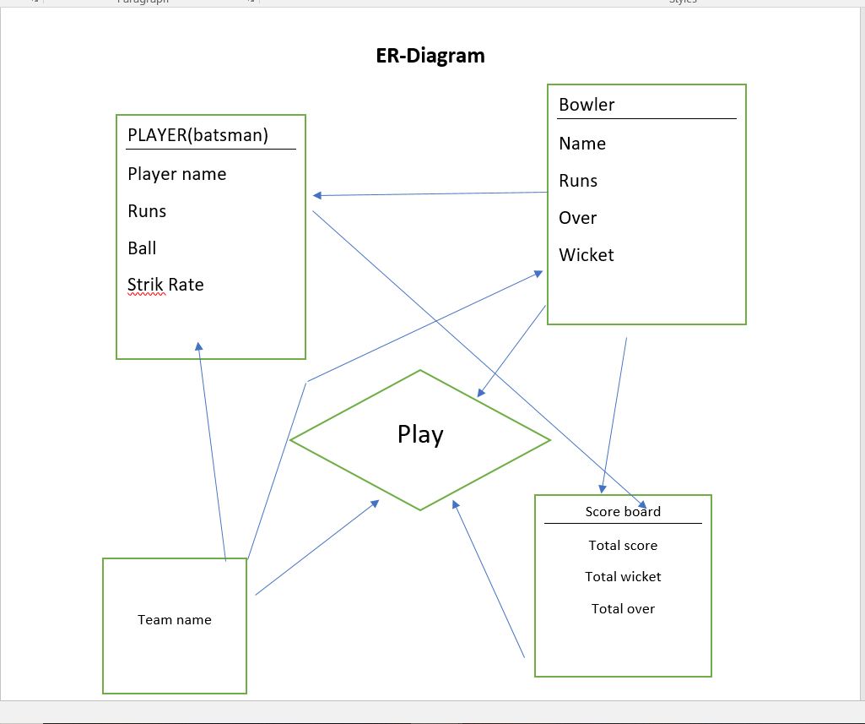
ER-diagram

Slide 13
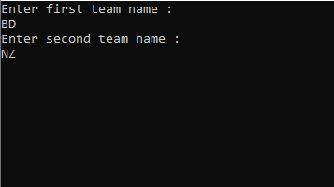
Interface(first page)

Slide 14
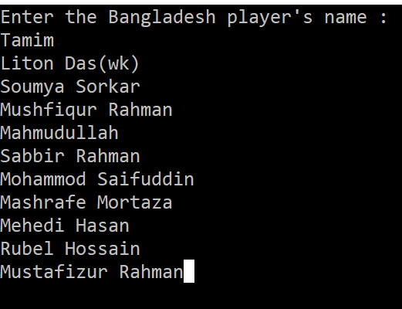
Players name

Slide 15
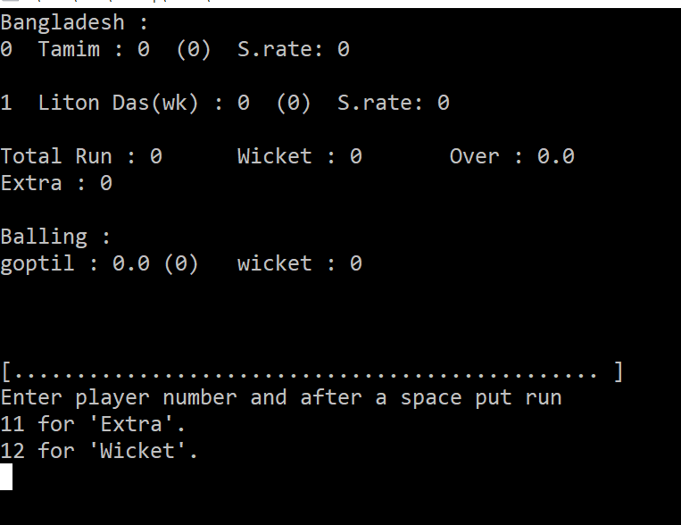
Display score-board

Slide 16
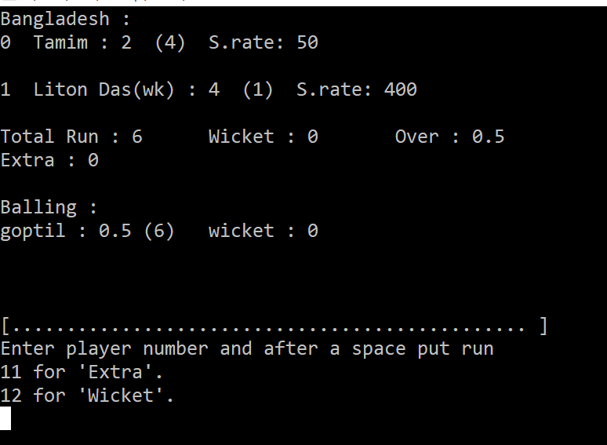
Update score

Slide 17
Conclusion
User can known all news of a match
Know the news of favourit team

Slide 18
reference
https://en.wikipedia.org/wiki/Scoring_(cricket)
https://projectsgeek.com
https://www.researchgate.net
https://pdf.wondershare.com/templates

Slide 19
Thank You

