Slide 1
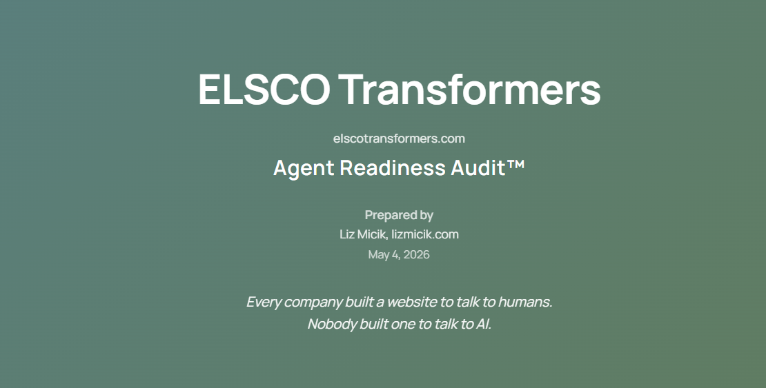

Slide 2
AGENT READINESS AUDIT · ELSCO TRANSFORMERS · HIGHLIGHT REEL
Disambiguation.
\ ˌdis-am-ˌbi-gyə-ˈwā-shən \ · noun
to clarify (something ambiguous) especially by providing or considering additional information.
It's what Elsco needs most.
lizmicik.com · Find / Understand / Trust

Slide 3
PROOF #2 · ENGINE VARIANCE
The gap is structural, not competitive
In two years even the least capable LLM may ascertain Elsco's organization, products, and services easily. Today the variance below tells us we have a long way to go to reach that level of understanding. While many will say “I’ll wait,” everything I learned doing this audit says you understand the opportunity cost of missing structured data.
Perplexity Sonar
75%
Gemini 3 Flash
64%
Google AI Overviews
6%
ChatGPT (GPT-5.4)
4%
Claude (Sonnet 4.6)
0%
Retrieval-grounded engines find Elsco. Training-data-weighted engines don't yet. The 75-point gap is disambiguation manifesting in measurable engine behavior.

Slide 4
PROOF #3 · STRUCTURAL DIAGNOSIS
What's causing the Claude blindspot
Two structural realities. Both are disambiguation problems. Both are fixable.
01
02
Bifurcated Entity Name
Schema Floor
ELSCO Transformers ↔ The Electric Service Company
Yoast WordPress minimums only.
Founded 1912. Indexed separately across BBB, ZoomInfo, Manta, Yellow Pages, NDT.org. The Organization schema’s alternateName, legalName, @id, sameAs fields don’t bridge the modern brand to the legacy mentions.
274 URLs. WebPage + BreadcrumbList + WebSite — that’s it on most pages. No Product / Offer on KVA-spec product pages. No Service on emergency-replacement pages. No LocalBusiness on Cincinnati location. No Article + author across 75 blog posts.
Training-data-weighted engines never reconcile.
AI engines can’t extract what isn’t structurally disclosed.
lizmicik.com · Find / Understand / Trust

Slide 5
HOW TO CLOSE THE GAP
Three principles – Three layers
AI agents need information that is clear, complete, and consistent. The audit covers the gaps in each — and so does the framework.
FIND
UNDERSTAND
TRUST
Clear
Complete
Consistent
Speak the agent’s language.
Give them every detail.
Repeat the facts everywhere.
Schema is precise machine-readable language. Humans find clarity and specificity dull; agents need it. The audit prescribes structured-data layers on the highest-leverage page templates.
A human knows that "M.D." means doctor; an agent needs knowsAbout schema to know it’s a pediatrician. The audit names the schema fields, the entity types, and the templates where they belong.
Agents declare a fact when they see it repeated across surfaces. Without consistency they infer — and present half-truths as fact. The audit maps where Elsco’s entity story breaks across off-site surfaces.
lizmicik.com · Find / Understand / Trust

Slide 6
WHY THIS WORK PAYS OFF
16%
→
54%
Accuracy triples when AI is given structured data.
GPT-4 question-answering accuracy when content is queried over a knowledge graph (54%) vs. raw SQL (16%).
data.world Benchmark · Sequeda / Allemang / Jacob · Nov 2023 · ACM GRADES/NDA · arXiv 2311.07509
“If you can even come close to tripling an agent’s accuracy using structured data, why wouldn’t you do it?
If you want them to get you right, write it right.”
— Liz Micik
lizmicik.com · Find / Understand / Trust

Slide 7
WHAT TO DO NEXT
Three quick wins. Two critical issues.
Quick wins are dashboard-only or single-file edits. Critical issues take more work but unlock the biggest visibility lift.
QUICK WIN
Add named AI-crawler directives to robots.txt
Wildcard already permits all AI crawlers. Adding explicit named-bot Allow rules signals intentional AI-readability. Single-file edit.
QUICK WIN
Audit Cloudflare bot management for AI-crawler verification
Confirm GPTBot, ClaudeBot, PerplexityBot, Google-Extended, Bytespider, Amazonbot, CCBot pass as Verified Bots. Dashboard verification only.
QUICK WIN
301 redirect the orphan URLs to their parent directories
Four URLs sit at the site root that should nest under their parent. Each has a clear canonical home in the existing IA.
CRITICAL ISSUE
Bridge the two entity names in Organization schema onsite
Expand alternateName beyond the acronym; add legalName and @id. Four fields together establish the bridge.
CRITICAL ISSUE
Claim and update the two entity names in offsite directory listings
Reconcile the listings on every directory so both names surface together. Standalone Directory Alignment Guide ships with this audit.
lizmicik.com · Find / Understand / Trust

Slide 8
PROOF #1 · BENCHMARK SCORES
How AI-readiness tools score Elsco.
Two independent third-party assessments. Gumshoe looks at content; Wordlift looks at technical structure. Both converged on the same diagnosis.
GUMSHOE SCORE
WORDLIFT SCORE
35%
47%
Content perspective
Technical structure perspective
Elsco shows up 35% of the time in AI answer conversations about transformers, beating every named competitor.
Elsco's website structure is hard for AI and search engines to fully understand without more schema.
lizmicik.com · Find / Understand / Trust

Slide 9
WHAT'S NEXT
From audit to implementation.
The audit names the gaps. The Roadmap names the fixes — page-template inventory, schema field-and-value specs, semantic-HTML blueprints, sample schema with real Elsco content. Two ways to bring it in.
ROADMAP TO ELSCO
ROADMAP WITH WEB FX
Roadmap to Elsco.
Roadmap with Web FX.
A separate engagement, delivered to your team. Web FX implements directly from the blueprint — clean handoff, build to spec. Best when Web FX has the bandwidth to execute on a clear plan.
A separate engagement, delivered alongside Web FX. I sit beside their build team as the agentic-web strategy partner. Implementation stays with them. Best when Web FX wants a strategy co-pilot on a layer that’s evolving fast.
Clean handoff.
Strategy alongside.
lizmicik.com/#contact
lizmicik.com/#contact
Disambiguation is the destination. The Roadmap is the route.

Slide 10
LET’S TALK
Disambiguation is fixable.
Web FX is a strong partner. If they want a strategy co-pilot for this layer, you know where to find me.
info@lizmicik.com · lizmicik.com/contact

