Slide 1
JAXFluids with NVIDIA Warp
WARP
Phase 1 · 1-D Compressible Euler
Scheme: WENO3 reconstruction + HLLC Riemann solver + SSP-RK2
Validated against exact Riemann solution · 4-backend V&V
Benchmark: JAX CPU / JAX CUDA / Warp CPU / Warp CUDA
Result: Warp CUDA 2.4 – 1.6× faster than JAX CUDA (fused kernels)
RTX 5000 Ada · Warp 1.12.1 · JAX 0.6.2 · WSL2 Ubuntu 22.04
NVIDIA · Warp · Confidential
warplabs-fluids | Phase 1

Slide 2
Strategy & Approach
METHODOLOGY
Why Warp?
Numerical Scheme
Kernel Architecture
• Python-first GPU kernels — no CUDA C required
• @wp.func inlines to registers; @wp.kernel marks global-memory boundaries
• Kernel fusion collapses 6 launches → 2 per timestep
• Memory pool (cudaMallocAsync) — O(1) allocs inside loops
• Targets production physics workloads at NVIDIA
Equations
1-D compressible Euler [ρ, ρu, E]
Reconstruction
WENO3 on primitive variables (Jiang-Shu 1996)
Riemann solver
HLLC (Toro 2009, Einfeldt wave speeds)
Time integration
SSP-RK2 (2 stages, CFL=0.4)
Ghost cells
ng=2 embedded in state array
Precision
float32 (matches JAX default)
Fused kernel (current)
1 launch per RK stage → 2 / step
Thread i computes both interface
fluxes in registers (5-cell stencil):
F_left = WENO3+HLLC(i-2..i+1)
F_right = WENO3+HLLC(i-1..i+2)
No global flux array allocated.
BC handled inline (clamp / modulo).
Unfused baseline: 6 launches / step
bc + flux + update × 2 stages
NVIDIA · Warp · Confidential
warplabs-fluids | Phase 1

Slide 3
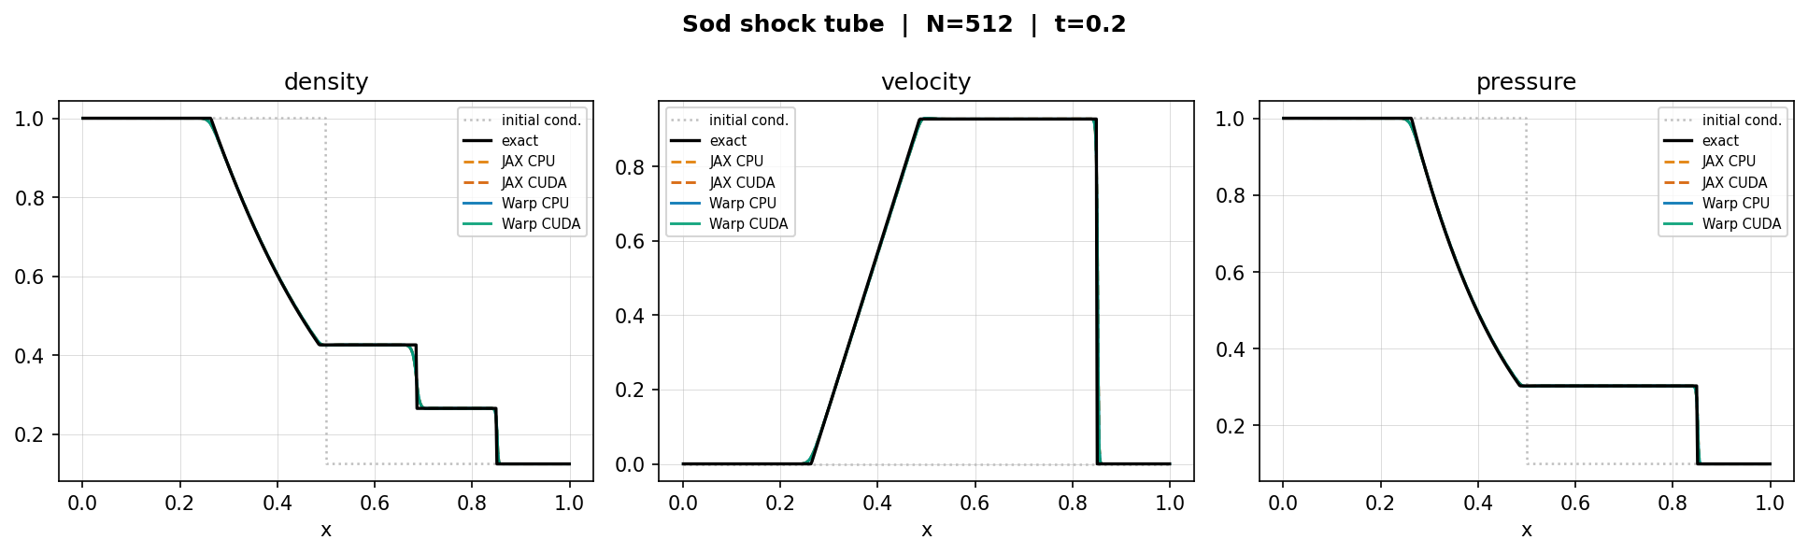
Correctness · Sod Shock Tube V&V
EXACT RIEMANN SOLUTION
What is Sod?
Membrane at x=0.5 bursts at t=0.
Three waves emerge:
← rarefaction fan
→ contact discontinuity
→ shock wave
Exact Riemann solution available
(Toro 2009) — ideal for V&V.
L1 errors (N=512, t=0.2)
Backend
L1(ρ)
L1(u)
L1(p)
JAX CPU
1.73e-3
3.19e-3
1.18e-3
JAX CUDA
1.73e-3
3.19e-3
1.18e-3
Warp CPU
1.73e-3
3.19e-3
1.18e-3
Warp CUDA
1.73e-3
3.19e-3
1.18e-3
All four backends produce identical results.
NVIDIA · Warp · Confidential
warplabs-fluids | Phase 1

Slide 4
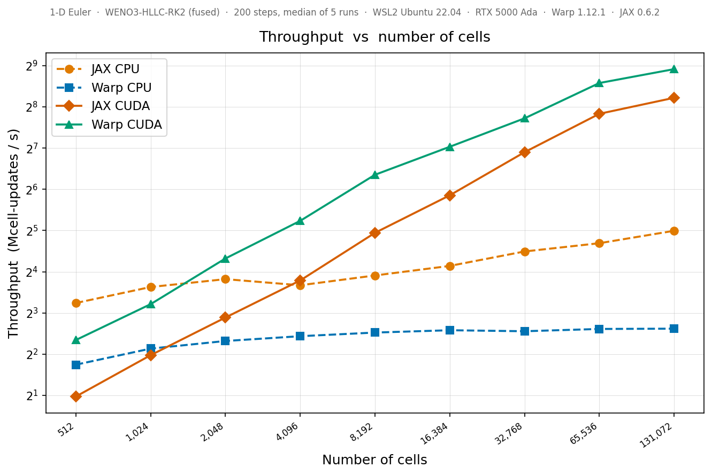
Performance · Throughput Scaling
GPU THROUGHPUT
Key Results
Warp CUDA vs JAX CUDA
482 vs 298 Mcell/s at 131K cells
→ 1.62× faster
Kernel fusion impact
6 launches/step → 2/step
~3× speedup on Warp CUDA
GPU crossover vs CPU
Warp CUDA > JAX CPU at N~2K
Warp CUDA > JAX CUDA at N~2K
Both GPUs still scaling
at 131K cells — not yet
bandwidth-limited
CPU backends flat
Warp: single-threaded LLVM
JAX: saturates ~30 Mcell/s
NVIDIA · Warp · Confidential
warplabs-fluids | Phase 1

Slide 5
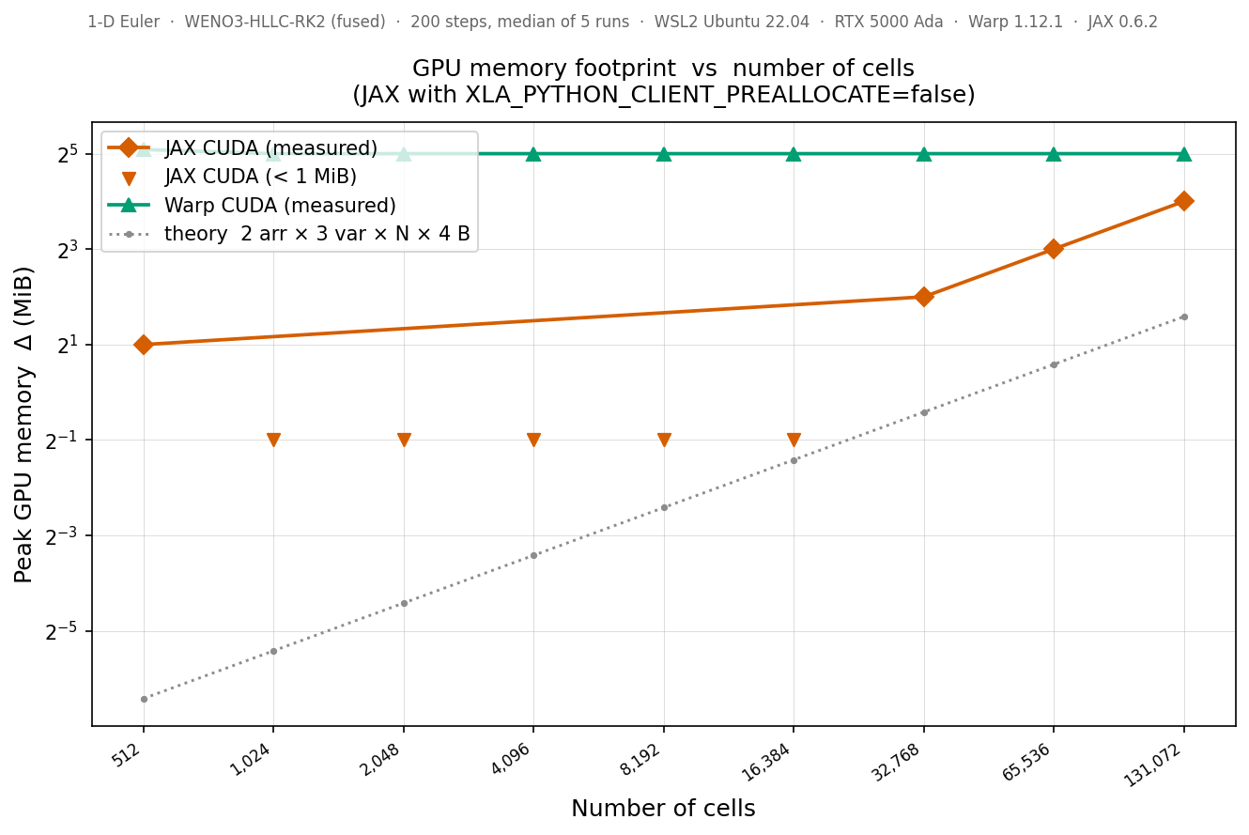
Memory Footprint · Roadmap
MEMORY + NEXT STEPS
Memory
Warp: 32 MiB flat
cudaMallocAsync pool —
pre-allocated once,
O(1) reuse.
JAX: grows linearly
Matches theoretical min.
(with PREALLOCATE=false)
Crossover ~3M cells.
Roadmap
✓
Phase 1 COMPLETE
1-D Euler · WENO3-HLLC-RK2 · float32 Kernel fusion · 4-backend V&V · scaling benchmarks
2
Phase 2 NEXT
2-D Euler · Strang dimensional splitting Kelvin-Helmholtz V&V · 2-D N-scaling
3
Phase 3 PLANNED
3-D compressible Navier-Stokes Taylor-Green vortex V&V · full turbulence benchmark
Phase 3 target: 3-D turbulence at GPU scale
NVIDIA · Warp · Confidential
warplabs-fluids | Phase 1

